Slide 1


SMART INDIA HACKATHON 2024
TITLE PAGE
Problem Statement ID – 1651
Problem Statement Title- Microphone array-based direction of arrival for gunshot
Theme- Miscellaneous
PS Category- Software
Team ID-
Team Name- Hack Hawks

Slide 2

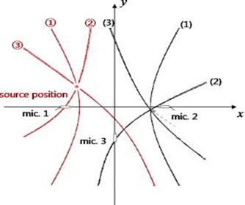
Hybrid Approach for Gunshot Localization
Hack
Hawks
Proposed Solution
Develop software for real-time gunshot detection and localization using Machine Learning and Hyperbolic Localization.
Real time accurate location to guide the soldiers.
Adaptable to different environment and location changes.
Takes input from 6 microphones arranged in the form of a regular hexagon.
Time Difference of Arrival (TDoA) is used to compute Hyperbolic Localization.
Machine Learning algorithms are used to identify gunshots and then classify them to various weapon types.
Provides two modes :-
Quick Locate: Provides an approximate location and direction, optimized for longer missions.
High Precision : Uses additional Microphones, Temperature and Humidity sensors to adjust for changes in sound speed, calculate elevation and provide pin point accuracy.

Slide 3
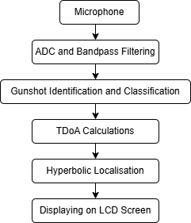
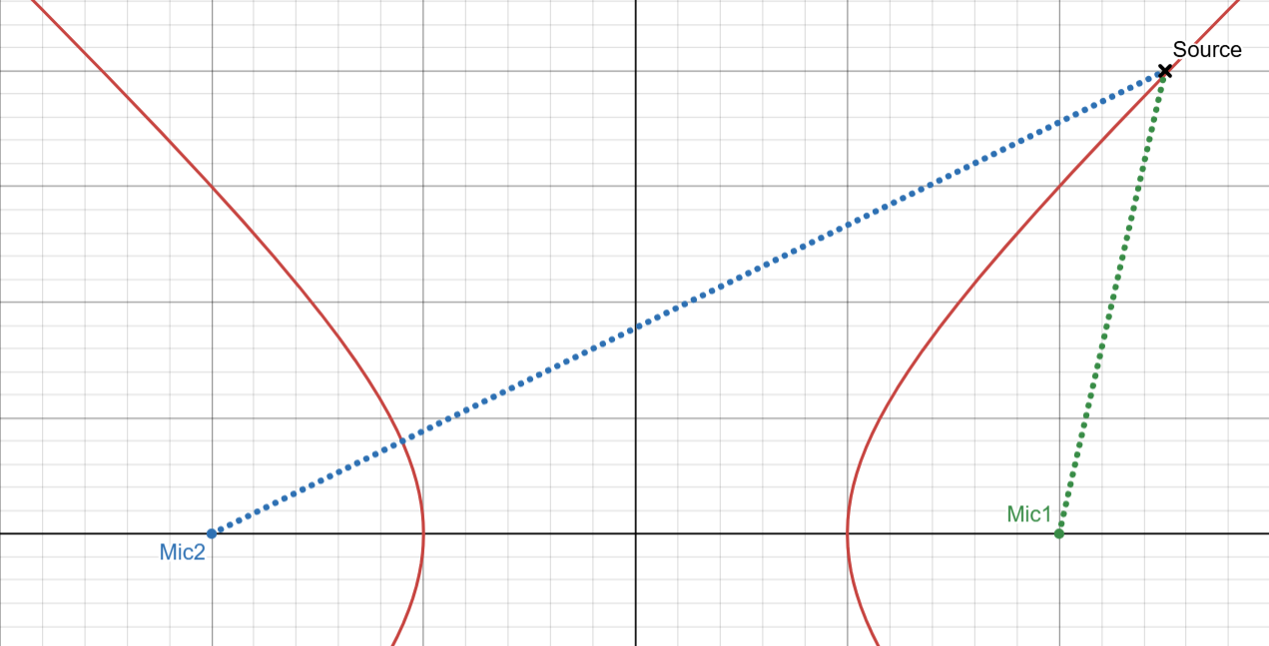

TECHNICAL APPROACH
Hack Hawks
Implementation Process:-
Capture sound and timestamps through microphones.
Convert signals via ADC and apply bandpass filtering (1KHz – 5KHz).
Use ML algorithms to identify gunshot and classify gunshots by weapon type.
Calculate TDoA and perform Hyperbolic Localization.
Display the results on a LCD Screen.
d1
d2
Hyperbolic Localisation :-
Calculate the TDoA for a pair of microphones.
Using this time difference, calculate the distance difference.
The constant distance
difference gives a locus of
points which form a hyperbola.
Use other pair of microphones to form hyperbolas, and the source lies at the intersection of these hyperbolas.
$d1 −d2= ∆$t . v_{s}
Languages : Verilog (for FPGA), C/C++ and Python (for ML models and Signal Processing)
Sensors : Microphone, Temperature Sensor, Humidity Sensor

Slide 4
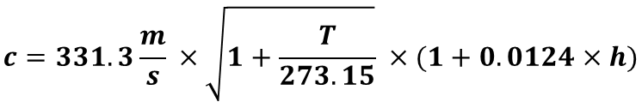
FEASIBILITY AND CHALLENGES
Hack Hawks
Equations for Localization: Adaptable to various locations and weather conditions through mathematical precision.
Challenges | Solutions
Differentiating gunshots from other noise. | Robust ML algorithm to handle noise, echo, multiple gunshots.
Gunshots fired simultaneously from various directions using weapons of the same type, causing overlapping sound waves. | Use signal processing techniques to separate overlapping sound waves. Amplitude analysis helps distinguish gunshots based on their distance and the microphone's relative position, isolating each source. After separation, apply TDoA and Hyperbolic Localization to pinpoint the precise location of each gunshot.
Variation in sound speed due to Temperature and Humidity. | Use additional sensors for measuring temperature and humidity and give precise location.
$$c=331.3\frac{m}{s} ×\sqrt{1+\frac{T}{273.15}} ×(1+0.0124×h)$$
Speed of sound at 0 °C is 313.3 m/s
For every 1 °C increase in temperature, Sound speed increases by 0.6 m/s
For every 1% rise in relative humidity, speed increases by 0.1 to 0.2 m/s
c : Speed of Sound

Slide 5
IMPACT AND BENEFITS
Hack Hawks
IMPACT ON TARGET AUDIENCE
Enhanced Soldier Safety : The system provides real-time, accurate gunshot detection and localization, allowing soldiers to respond quickly and effectively, minimizing casualties.
Improved Tactical Decision-Making : Troops can better plan offensive and defensive actions based on precise data, giving them a strategic advantage in complex situations.
Increased Operational Efficiency : Reduces the need for manual detection and reporting of gunfire, allowing soldiers to focus on other critical tasks.
BENEFITS
SOCIAL : Enhanced security and increased soldier safety, particularly in conflict zones or high-risk environments.
ECONOMIC : A cost-effective solution that utilizes existing hardware and sensors, reducing the need for expensive new equipment.
FLEXIBILITY : System offers two modes:
Quick Locate Mode : Provides a rapid, approximate location for immediate situational awareness during extended missions, optimizing performance for longer durations.
High Precision Mode : Incorporates temperature and humidity sensors to account for environmental variations, ensuring pinpoint accuracy. Additionally, two centrally placed microphones—facing upwards and downwards—provide 3D localization, enabling precise performance even in complex terrains or multi-level environments

Slide 6
RESEARCH AND REFERENCES
Hack Hawks
Suman, P., Karan, S., Singh, V., & Maringanti, R. (2014). “Algorithm for gunshot detection using Mel-frequency cepstrum coefficients (MFCC)”. In R. Maringanti, M. Tiwari, & A. Arora (Eds.), Proceedings of Ninth International Conference on Wireless Communication and Sensor Networks (Vol. 299, pp. 299-306). Springer
Ahmed, T., Uppal, M., & Muhammad, A. (2013). “Improving efficiency and reliability of gunshot detection systems”. In 2013 IEEE International Conference on Acoustics, Speech and Signal Processing (pp. 513-517). IEEE.
Damarla, T. (2015). “Detection of gunshots using microphone array mounted on a moving platform”. In 2015 IEEE SENSORS (pp. 1-4). IEEE
Chacon-Rodriguez, A., Julian, P., Castro, L., Alvarado, P., & Hernandez, N. (2011). “Evaluation of gunshot detection algorithms”. IEEE Transactions on Circuits and Systems I: Regular Papers, 58(2), 363-373.
Park, C.-S., Jeon, J.-H., & Kim, Y.-H. (2014). “Localization of a sound source in a noisy environment by hyperbolic curves in quefrency domain”. Journal of Sound and Vibration, 333(21), 5630-5640.
Wang, X., & Xu, S. (2015). “Sound-localization system”. Applied Mechanics and Materials, 734, 18-21.

