Slide 1


DEPARTEMENT OF ELECTRONICS AND COMMUNICATION ENGINEERING
FIRE ALARM SYSTEM
ANALOG DESIGN EXPO’2023

Slide 2
INTRODUCTION TO FIRE ALARM SYSTEMS
Project Goal: Create a reliable, low-cost, standalone fire alarm system using only basic components and breadboard connections, suitable for environments like homes, small offices, or crowd gatherings.
Fire alarm systems are designed to detect signs of fire—such as smoke, heat, or flames—and alert occupants. These systems provide early warnings, reducing potential risks to life and property by allowing time for safe evacuation.
Types:
Fire alarms can be automatic or manual, often using a combination of sensors to monitor for temperature or gas emissions.

Slide 3
PROBLEM STATEMENT ADDRESSED
Fire Hazards: Fires pose severe risks to safety and property, making early detection critical to avoid damage.
Need for Low-Cost Solutions: Many fire alarm systems are either expensive or complex. Our objective is to design a simple, effective, and affordable fire alarm.
Solution Requirements: The fire alarm should be easy to set up and operate, have adjustable sensitivity, and function reliably without complex wiring or programming.

Slide 4
SYSTEM DESIGN OVERVIEW
Core Components: Our design uses a thermistor (temperature sensor), LM358 OP AMP (signal amplifier), buzzer (alert system), power supply, and potentiometer (sensitivity adjustment).
Breadboard-Only Setup: The circuit is built solely on a breadboard, with no microcontroller or software involved. Connections are straightforward, enabling ease of setup and portability.
System Flowchart:
1. The thermistor senses temperature increases.
2. Signal is processed through the LM358 OP AMP, which amplifies it if it surpasses a preset threshold.
3. Amplified signal triggers the buzzer, alerting nearby individuals.
Design Goal: Provide an easy-to-deploy, hardware-based fire alarm that uses minimal components but delivers essential functionality.

Slide 5
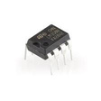
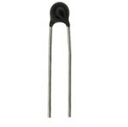
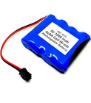


lm358 OP AAMP
THERMISTOR
COMPONENTS
5V POWER SUPPLY
3V BUZZER
POTENTIOMETER

Slide 6
PROPOSED SOLUTION
The Fire Alarm System operates by detecting a change in the resistance value of a thermistor.
This thermistor is designed to sense temperature changes and is part of a circuit that measures its resistance.
When a fire breaks out in the environment, the heat generated by the fire causes a rapid increase in temperature, which in turn causes a significant change in the resistance value of the thermistor.
This change in resistance value is detected by the circuit, which triggers the alarm, alerting people in the vicinity of the fire to evacuate immediately.
In this way, the fire alarm system helps to prevent potential injuries or loss of life due to fires by providing an early warning system.

Slide 7
WORKING PRINCIPLE
Thermistor detects heat, causing resistance to drop. This change in resistance is recognized by the LM358 OP AMP.
If resistance is low enough (indicating high heat), the OP AMP sends an amplified signal. Amplified signal activates the buzzer, producing a loud alert.
Technical Insight: The OP AMP essentially serves as a threshold detector, allowing only significant changes (like fire-induced heat) to activate the buzzer, while minor fluctuations are ignored.
Potentiometer’s Role: Acts as a variable resistor to fine-tune the temperature sensitivity, ensuring that the alarm activates only at meaningful heat levels.
Turning the potentiometer adjusts resistance, setting a higher or lower temperature threshold.
Higher Sensitivity: More likely to detect small temperature changes (useful in sensitive environments).
Lower Sensitivity: Reduces false alarms in areas with variable temperatures.

Slide 8
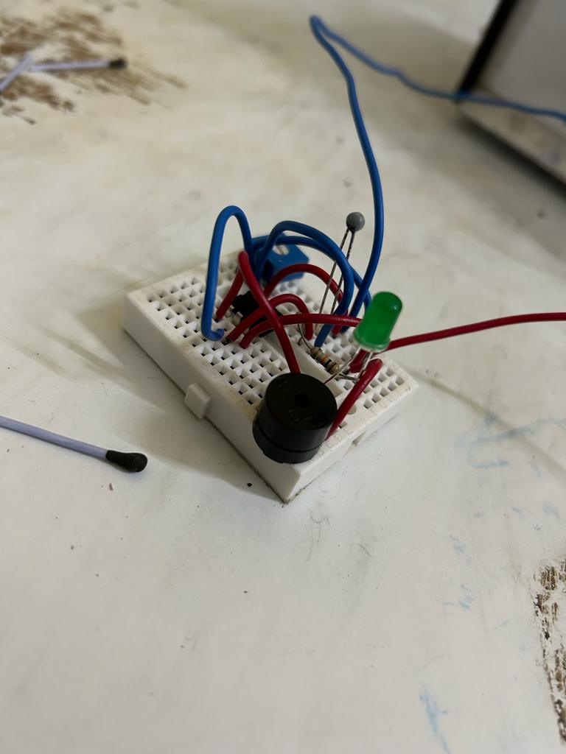

PROJECT IMPLEMENTATION
Shreerecvidya@4

Slide 9
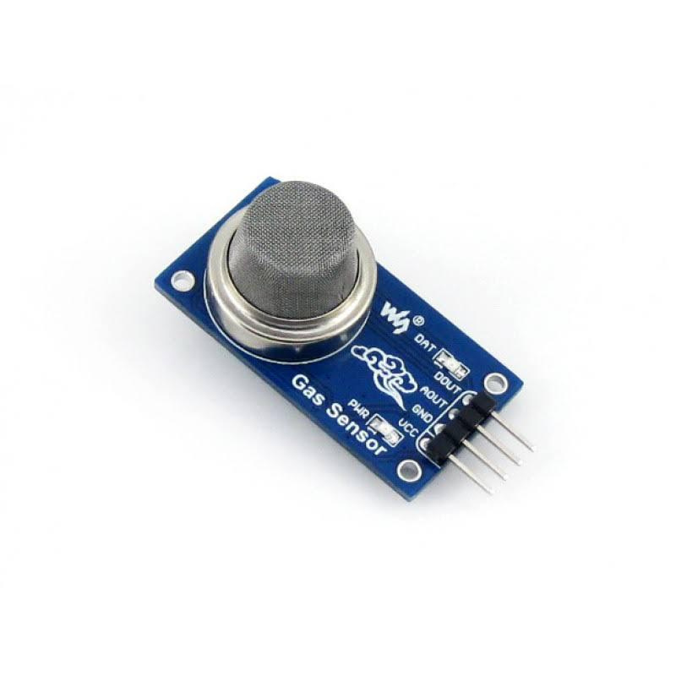
FUTURE UPGRADATION
In future work we can replace the thermistor by
Gas Sensor Addition: Introduce an MQ2 gas sensor to detect specific gases (e.g., CO, CO2), allowing differentiation based on the level of CO2 present it differentiates between actual fire and Inscense Stick
Wireless Integration: Add Bluetooth or Wi-Fi modules to connect to smartphones for remote alerts, allowing the alarm to notify users of fire risk even when they are not nearby.
Power Efficiency: Explore battery-based versions for portable or off-grid applications, expanding potential use cases.

Slide 10
THANK YOU

