Slide 1
DESIGN-A-THON 2022
Designers Consortium and Department of ECE
presents
04 . 11 . 2022
HOSPITAL MANAGEMENT SYSTEM

Slide 2
PROBLEM STATEMENT
Hospital Management System
Features which can be added are as follows:
1. register Patient
2. record his complains and preliminary diagnostics.
3. attach lab reports
4. Complete treatment
5. If the patient comes again, View the previous treatment history with their files accordingly.
Roles Can be Implemented
Only admins can create a Patient and assign it to a Doctor
Only doctor can include patient compliance and diagnostics
Oly doctor can allocate Scan info
Only Doctors and lab Technicians Can upload scan reports.
Hospital management system enables to manage information and data related to all aspects of healthcare ensuring the process and database are completely effective. The above mentioned Features are incorporated with the Roles to turn the system efficient for immediate requirement of details, data modification, diagnostics and solution for the health problems.

Slide 3
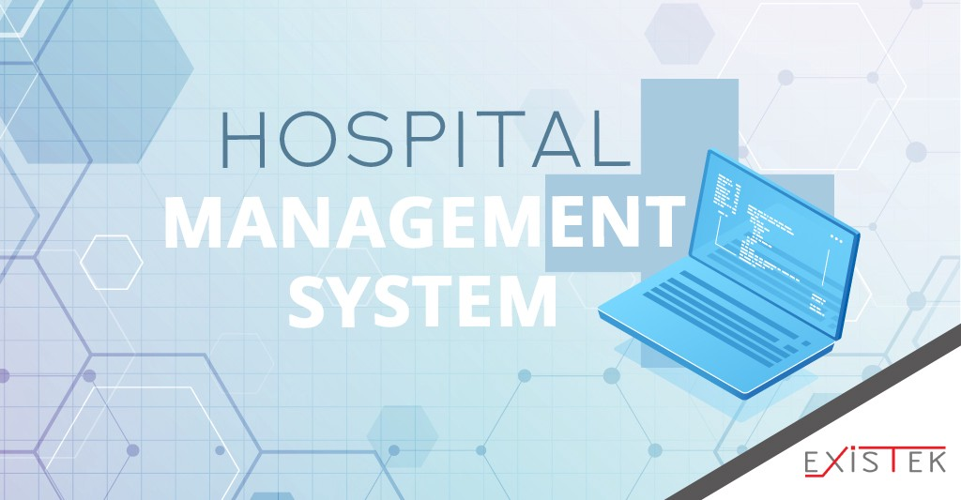
PROPOSED SOLUTION
In the recent times, we all are aware of the fast spreading diseases and need for the consult of a doctor in a regular basis and also good intake of food. For example, the pandemic COVID-19 devastated many people life and we all are aware of its adverse impact. So medical field played a role saving our life and we see this project as the need of the hour to present you all the database of Hospital Management System that helps the society largely.
We have made a database for the hospital management system which deals the patient’s personal details their medical history. Also we give the treatment for the disorder faced by the patient by proper advice of tablets and diet schedules to overcome the problem .Also lab reports is facilitated for better analysis of patient health through this database.

Slide 4
TECHNOLOGY USED
Hospital Management System is made with the help of PYTHON programming language which is the wide spread latest and time consuming in the aspect of code run is the new.
PYTHON is an interpreted, object oriented, high level programming language with dynamic semantics
Python 3.11.0 is used as it is newest major release of the python programming language and it contains many new features and optimizations.

Slide 5
NOVELTY
The Hospital Management System is made in such a way that is secure from any one use i.e., highly secured by giving a password and username for the login credentials.
System is made to access by the administrative officer and doctor to input patient’s details and doctor can only access lap reports. In absence of doctor, administrative officer can do it.
Getting treatment and ambulance service 24/7
Uploading lab reports and patient’s health analysis online
Maintaining patient’s medical history for past 30 years
Patient will be assigned unique registration identity along with personal details of g-mail, phone number, date of birth, address, etc.,.
Suggesting relevant medicines and diet system
Facilitating patient to pay by any cards or google pay.
Accepting any medical insurance policies and providing attender on chargeable basis for immediate treatments.
Providing nursing assistance post discharge.
Providing life insurance for patient's coming to hospital more than 15 years.

Slide 6
SOCIAL RELEVANCE
Suggesting fitness programs for patients
Suggesting yoga classes
Providing dietician assistance at free of cost
Reducing suffering of patients
Creating disease-free India

Slide 7
REFERENCES
https://en.wikipedia.org/
https://dir.indiamart.com/impcat/pharmaceutical-tablets.html
https://medlineplus.gov/
https://lifemedambulance.in/

Slide 8
THANK YOU

