Slide 1

ENHANCED SOLAR PANEL POWER PREDICTION THROUGH ARTIFICIAL NEURAL NETWORK
DEPARTMENT OF ELECTRONICS AND COMMUNICATION ENGINEERING

Slide 2
OUTLINE
Results and Discussion
Conclusion
Future Developments
References
Abstract
Objective
Literature Survey
Summary of Literature Survey
Proposed System
Novelty in Proposed System
Block Diagram
Hardware/Software requirements
Data Collection
Preliminary process of model
Implementation of ML Algorithms
ANN Model
Model Training
Prediction comparison based on performance
Prediction and Cost Estimation
Long term Predictions and Energy Conservation

Slide 3
ABSTRACT
The Solar Panel Power Prediction addresses the increasing demand for renewable energy by leveraging Machine Learning for precise solar panel power prediction. It develops an artificial neural network (ANN) model to predict photovoltaic (PV) output.
The dataset contains environmental variables and corresponding photovoltaic (PV) output measurements which undergoes preprocessing, including feature standardization, and is then split into distinct sets for optimal Performance and accuracy.
The ultimate goal is to deploy the trained ANN model for practical applications, such as forecasting PV output in renewable energy systems.
It also contributes to the advancement of renewable energy technology by providing a reliable and efficient method for predicting PV output.

Slide 4
OBJECTIVE
Develop an artificial neural network (ANN) model to predict photovoltaic (PV) output based on environmental factors.
Train the ANN model using a dataset containing environmental features such as daily yield AC power, DC power , temperature, and solar irradiance.
Evaluate the performance of the ANN model using appropriate metrics such as mean squared error (MSE).
Split the dataset into training, validation, and testing sets to ensure robust model evaluation.
Preprocess the dataset by standardizing the features to improve model convergence and performance.
Visualize the training and validation losses to assess the model's training progress and identify over-fitting or under-fitting.
Deploy the trained ANN model for real-world applications, such as forecasting PV output for renewable energy systems.

Slide 5
LITERATURE SURVEY
TITLE | YEAR | AUTHOR | TECHNIQUE
Machine Learning Based Solar Photovoltaic Power Forecasting: A Review and Comparison | 2023 | J. Gaboitaolelwe, A. M. Zungeru, A. Yahya, C. K. Lebekwe, D. N. Vinod and A. O. Salau | Support Vector Machines (SVM), Multilayer Feedforward Neural Network (MLFFNN),Recurrent Neural Network (RNN) with large data set
Solar PV Power Estimation and Upscaling Forecast Using Different Artificial Neural Networks Types: Assessment, Validation, and Comparison | 2023 | Abdel Nasser Sharkawy Mustafa M. Ali, Hossam H. H. Mousa, Ahmed S. Ali | ANNs, Nonlinear Autoregressive Exogenous model neural network (NARXNN), Levenberg Marquardt(LM)
Classification and Summarization of Solar Irradiance and Power Forecasting Methods: A Thorough Review | 2023 | B. Yang et al, ianjiao Zhu, Pulin Cao, Zhengxun Guo | ANNs, Multilayer Feedforward Neural Networks (MLFFNN), Nonlinear Autoregressive Network with Exogenous Inputs (NARXNN) using two months of data

Slide 6
SUMMARY OF LITERATURE SURVEY
[1] The paper examines Support Vector Machines (SVM) for solar PV power forecasting, noting their adeptness in capturing non-linear relationships. Challenges include selecting optimal hyper-parameters and addressing scalability issues with large datasets due to SVM's computational complexity.
[2] The paper examines solar PV power estimation with artificial neural networks, highlighting their effectiveness in reducing errors by incorporating weather variables. While addressing challenges like model complexity and data preprocessing, it contributes significantly to enhancing renewable energy integration for more reliable grid management.
[3] The paper conducts a comprehensive review of 128 solar irradiance and power forecasting methods, aiding researchers and practitioners in making informed decisions. While the vast number of methods may be overwhelming, its meticulous classification and summarization offer a valuable resource for advancing solar forecasting research, promoting more accurate prediction models in renewable energy.
With reference to all these, we have updated to the idea with latest technology aiming to give accuracy in optimum level overcoming the existing difficulty.

Slide 7
PROPOSED SYSTEM
The different stages by which ANN is applied on the dataset are
1. First, the required packages are imported.
2. Then the folder where the dataset is stored is imported.
Data Collection: Gather historical data on solar irradiance, temperature, humidity, and other relevant factors from weather stations and solar monitoring systems.
Data Preprocessing: Clean and preprocess the data, handling missing values, outliers, and ensuring consistency in the dataset.
Feature Engineering: Extract meaningful features from the data, identifying key predictors influencing solar panel performance.
Dataset Splitting: Divide the dataset into training and testing sets to evaluate the model's performance accurately.
ANN Architecture Design: Define the architecture of the artificial neural network, specifying the number of layers, nodes, and activation functions.
Input-Output Mapping: Set environmental and meteorological parameters (e.g., solar irradiance, temperature, humidity) as inputs and power generation as the output.

Slide 8
PROPOSED SYSTEM
ANN Training: Train the ANN using the training dataset, utilizing backpropagation and optimization algorithms.
Model Interpretation: Interpret the results of the trained model, including the significance of different features in predicting solar panel power output. This involve examining feature importance scores or visualizing model predictions compared to actual values.
Prediction and Energy Conservation:Predicts solar power generation on daily, monthly, and yearly basis using ANN.Displays predicted DC power output, AC power saved, and cost savings.Provides insights into solar energy production potential and efficiency gains.
Estimation of Electricity Cost:Utilizes tiered pricing structure to calculate electricity costs based on consumption.Offers a user-friendly interface for inputting consumption data and viewing cost estimates.
The method utilizes historical data and ANN training for precise solar panel power prediction, demonstrating superior performance for sustainable energy management. Thorough documentation ensures transparency and reproducibility for future advancements in renewable energy forecasting.

Slide 9
NOVELTY IN PROPOSED SYSTEM
Predictive Power Analysis Model: Under this subheading, the focus is on the predictive power analysis model developed in the project. It explores how this model provides precise insights into the expected daily, monthly, and yearly energy generation from solar panels, empowering users to optimize energy usage effectively.
Cost Estimation Integration: This project introduces the innovative aspect of incorporating cost estimation into solar panel power prediction. It discusses how this integration enables users to accurately forecast electricity expenses, aiding in budgeting and financial planning.
Contribution to Grid Stability: Uniqueness to this project is the enhancement of energy resources by utilisation of power for the purpose of improving the grid Stability. Equilibrium between production and consumption is maintained in balance state for promoting the conservation of energy.
Strategic Focus on Sustainable Energy Management: The project goes beyond predictive accuracy, emphasizing the broader goal of sustainable energy management. By leveraging advanced machine learning techniques, the model contributes to optimizing the utilization of renewable energy resources, paving the way for more efficient and environmentally friendly energy solutions.

Slide 10
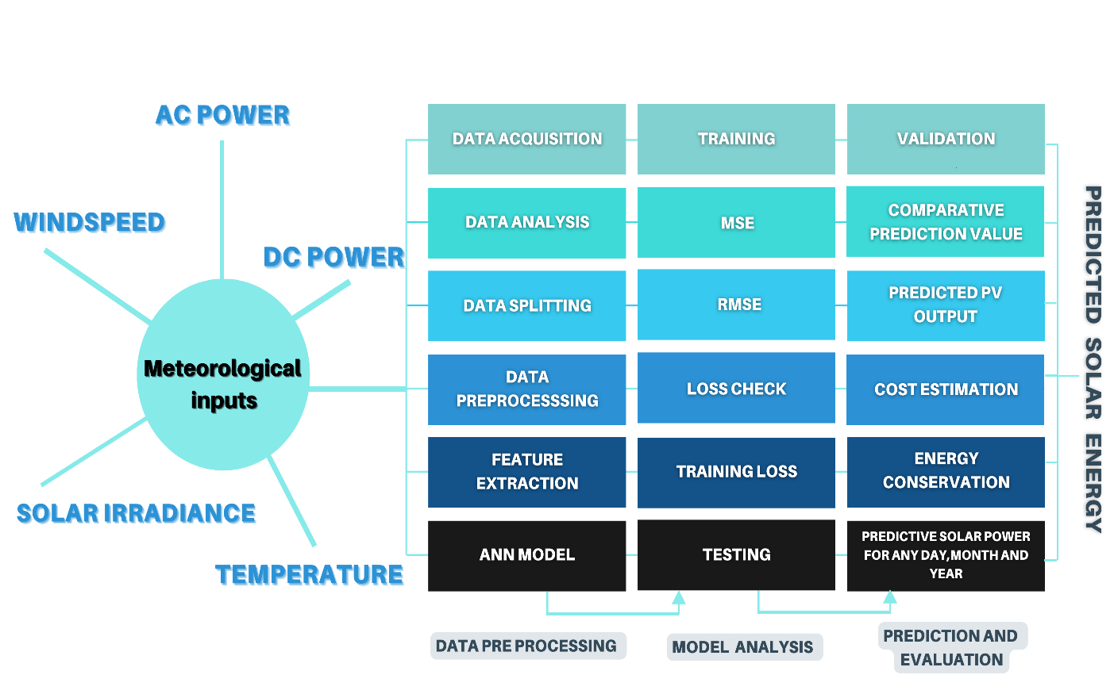
BLOCK DIAGRAM
shreerecvidyam@4
shreerecvidyam@4
shreerecvidyam@4
shreerecvidyam@4

Slide 11
HARDWARE/SOFTWARE REQUIREMENTS
Hardware Requirement
System : Intel CORE i3 10th Gen
RAM : 8 GB
GPU
Software Requirement
Google Colab
Python version 3.10 and above
Machine Learning Framework
Machine Learning Libraries
Neural Network Library

Slide 12
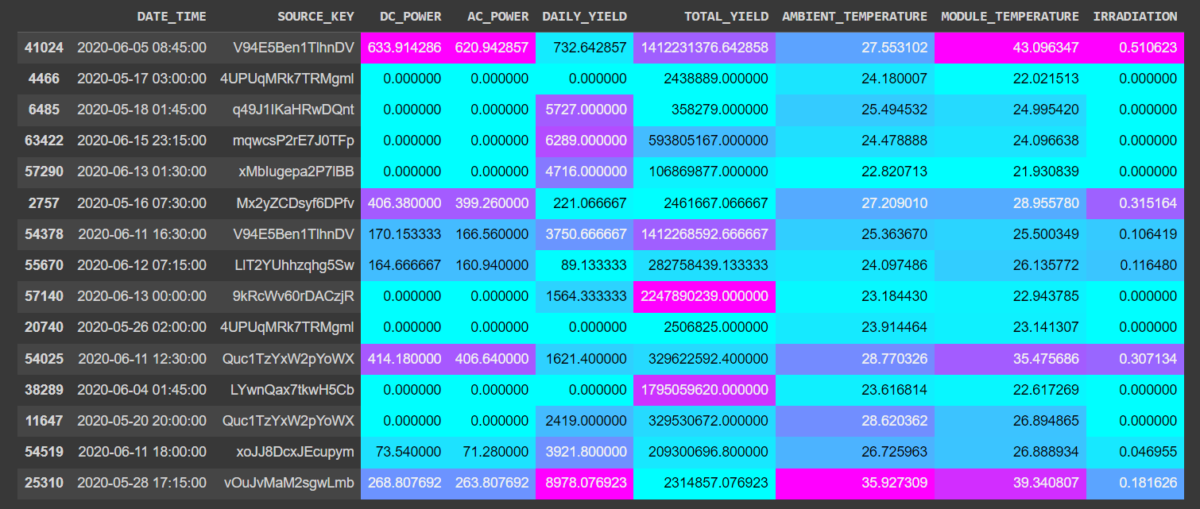
DATA COLLECTION
The Dataset has been gathered at two solar power plants in India.
Dataset has two pairs of files - each pair has one power generation dataset and one sensor readings dataset.
Irradiation, Temperature, DC Power are few of the attributes that are considered.
Total of records 67698 are present in the dataset which helps us in improving the efficiency of our analysis.

Slide 13
PRELIMINARY PROCESS OF MODEL
DATA PREPROCESSING:
Data Cleaning: Removal of duplicates, irrelevant columns, or rows with missing values.
Feature Selection: Identifying and selecting relevant features that have the most impact on the prediction model.
Data Transformation: Scaling numerical features to a similar range to prevent dominance of certain features.
Handling Missing Values: Imputing missing values using methods like mean, median, or mode imputation.
Normalization/Standardization: Scaling the features to ensure they have similar ranges, preventing some features from dominating others.
DATA SPLITTTING:
The Data Splitting allows for fine-tuning the model's hyper parameters on validation set while preserving the testing set for unbiased evaluation of the final model.
Tabulation of Data Split Percentage and Count
 | DATA SPLIT
TRAINING SET | 47388 | 70
TESTING SET | 10155 | 15
VALIDATION SET | 10155 | 15

Slide 14
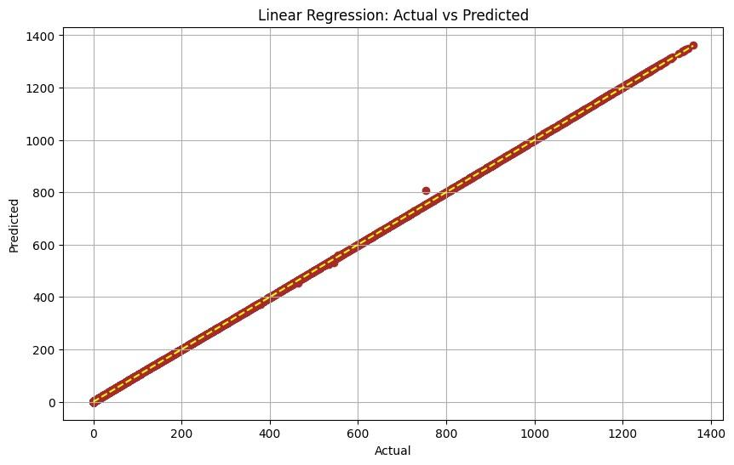
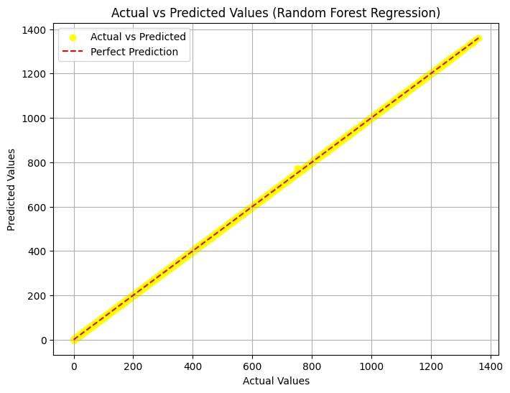
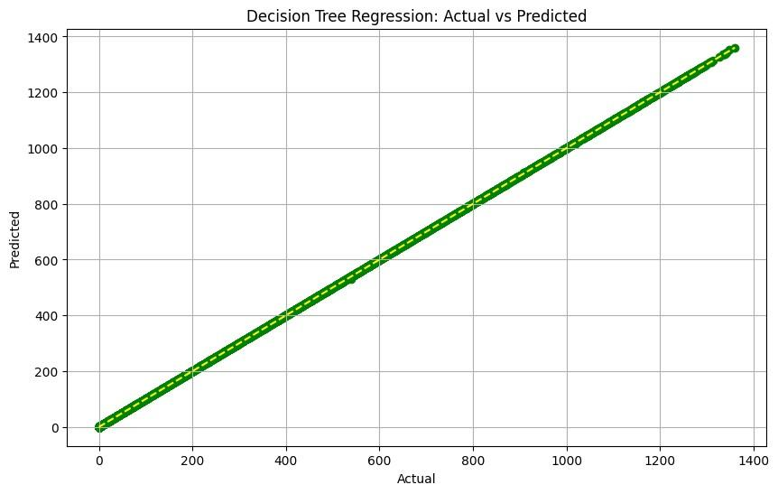
IMPLEMENTATION OF ML ALGORITHMS
Linear Regression
Linear Regression forecasts solar panel power by fitting a linear equation to variables like solar irradiance and temperature, offering simplicity and interpretability but struggling with nonlinear relationships of data.
Random Forest Regression
Random Forest Regression improves solar power prediction through ensemble learning, combining multiple decision trees to capture complex relationships and handle high-dimensional data, enhancing accuracy and robustness.
Decision Tree Regression
Decision Tree Regression uses a tree structure to split data based on features, providing high interpretability and robustness to outliers, making it effective for accurate solar power prediction in varied conditions.

Slide 15
PURPOSE OF ARTIFICIAL NEURAL NETWORK (ANN)
Artificial Neural Networks (ANNs) hold a critical role in solar panel power prediction within the realm of Artificial Intelligence (AI) and Machine Learning (ML). They are invaluable due to their capacity to decipher intricate nonlinear relationships between meteorological variables and solar panel power output. Unlike conventional linear models, ANNs excel at capturing complex dependencies, enabling more precise predictions without the need for manual feature engineering. Significance of ANN are as follows
Scalability and Data Handling: ANNs handle large datasets and high-dimensional feature spaces, making them well-suited for the vast data generated by weather stations and sensors.
Robust Generalization: They provide accurate predictions even with unseen data, crucial for adapting to diverse environmental conditions and ensuring reliability.
Adaptive Learning: ANNs continuously refine their parameters with new data, adapting to evolving scenarios and improving over time.
Enhanced Interpretability: Techniques like interpretability algorithms demystify the black-box nature of ANNs, boosting stakeholder understanding and confidence in their predictions.

Slide 16
ANN MODEL
ANNs empower AI and ML practitioners to develop accurate and adaptable models, contributing to optimized energy management and seamless integration of renewable energy sources into existing grids. The model used outlines the architecture and parameters of two neural network models, named "sequential_1" and "sequential_2".
The first model consists of three dense layers with output shapes of 32, 64, and 1, respectively. It has a total of 2401 trainable parameters, with each layer contributing to the overall parameter combination
The second model is more complex, comprising five dense layers with output shapes of 8, 16, 32, 64, and 1, respectively. Additionally, it includes a dropout layer, which helps prevent over-fitting by randomly dropping a fraction of input units during training.This model has a total of 2921 trainable parameters.
Both models follow a sequential architecture, where layers are stacked sequentially, with each layer feeding into the next. These model are designed for regression tasks, aiming to predict a continuous output value based on input features. The model provides insights into the structure, including the number of layers, their output shapes, and the total number of trainable parameters, essential for understanding the model's complexity and capacity to learn from the data .

Slide 17
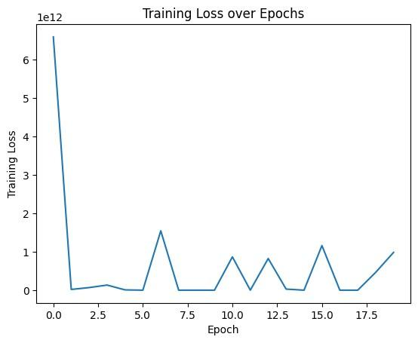
MODEL TRAINING
Loss Function Selection: Explanation of the choice of loss function, such as Mean Squared Error (MSE) or Root Mean Squared Error (MAE), depending on the nature of the problem and the desired model behavior. Discussing the advantages and limitations of different loss functions in regression tasks.
Loss Monitoring During Training: Monitoring the training process by observing how the loss function evolves over epochs or iterations. Plotting loss curves to visualize the training progress and identify any trends or anomalies.
Interpreting Loss Values: Explaining the interpretation of loss values in the context of the problem domain. Understanding how changes in loss values reflect improvements or deteriorations in model performance.

Slide 18
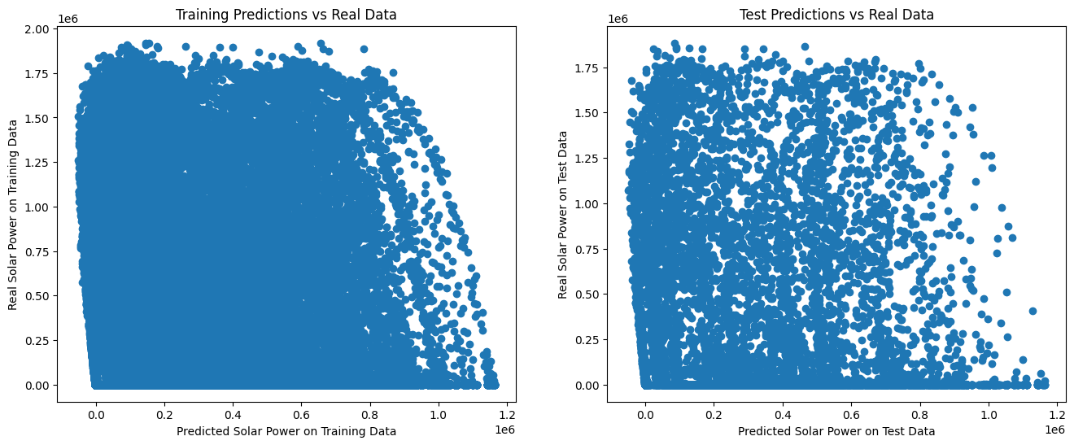
PREDICTION COMPARISON BASED ON PERFORMANCE
The scatter plots in Figure illustrate the relationship between predicted and actual solar power values for both the training and test datasets. In the plot for training data, each point represents a pair of predicted and actual solar power values from the training dataset. Similarly, in the plot for test data, each point represents a pair of predicted and actual solar power values from the test dataset. By comparing the distribution of points to the diagonal line, we can assess the model's performance. If the points cluster closely around the diagonal line, it indicates accurate predictions, while deviations from the line suggest discrepancies between predicted and actual values. This visual representation allows us to evaluate how well the model generalizes to unseen data (test data) compared to the data it was trained on (training data).

Slide 19
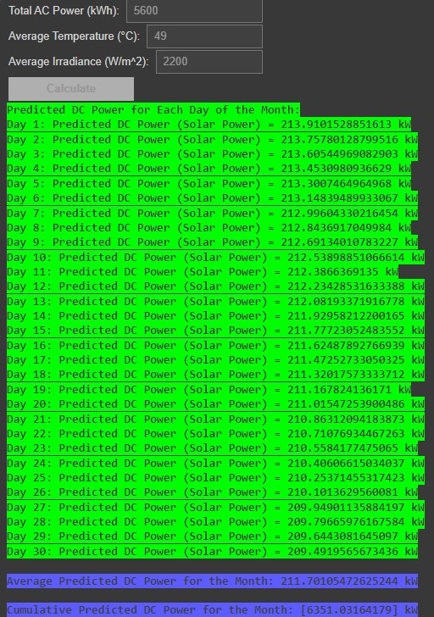
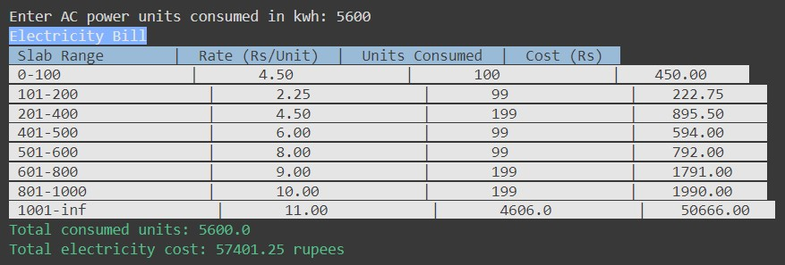
PREDICTION AND COST ESTIMATION
The project calculates the expected DC power output for each day of the month in kilowatts (kW). , considering factors like sunlight intensity and temperature variations. Additionally, it estimates the cumulative DC power for the entire month, providing insights into the overall solar energy generation potential. Additionally, the average predicted DC power for the month and the cumulative predicted DC power are provided, offering insights into the overall solar energy production potential over the specified timeframe. Furthermore, the code calculates and displays the amount of AC power saved for each day compared to the total AC power consumption, highlighting the efficiency gains achieved through solar power generation. Finally, it presents the total AC power saved for the month in kilowatt-hours (kWh), emphasizing the environmental and economic benefits of utilizing solar energy. Below figure estimates the cost for the consumed AC power according the TNEB bill slab rates so that consumer pays only for the amount of AC power left by solar power as his consumption of electricity.

Slide 20
LONG TERM PREDICTIONS AND ENERGY CONSERVATION
Predicting solar power generation on a daily, monthly, and yearly basis is vital for effective energy management and planning. By utilizing advanced computational techniques and machine learning algorithms and ANN, this code predicts the solar power output based on input variables such as total AC power consumption, average temperature, and average irradiance. The below three tabulation are predictive analysis of a day, two months and year consisting of Average Predicted DC Power, Cumulative predicted DC Power and Total AC power saved.
Average Predicted DC Power for a Month: 211.70105472625244 Kw
Cumulative Predicted DC Power for a Month: 6551.0316417 Kw
Total AC Power Saved for a Month: 731.0316417873737
Average Predicted DC Power for the Two Months: 187.19409026575255 kW
Cumulative Predicted DC Power for the Two Months: 11231.645415945153 kW
Total AC Power Saved for the Two Months: 5831.645415945153 kWh
Average Predicted DC Power for the Year: 226.41721607243517 kW
Cumulative Predicted DC Power for the Year: 81510.19778607668 kW
Total AC Power Saved for the Year: 60510.19778607667 kWh

Slide 21
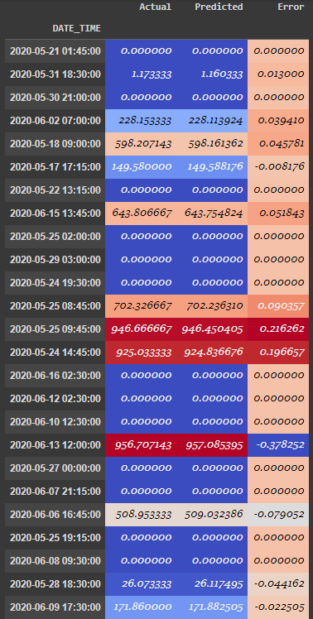
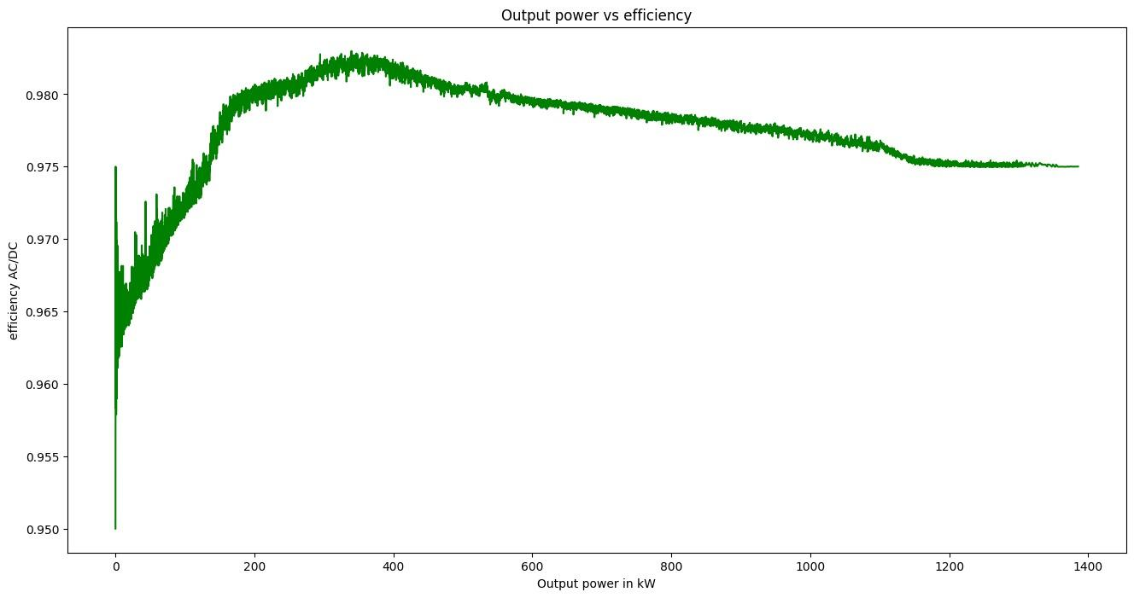
RESULTS AND DISCUSSION
The efficiency ratio between AC and DC power varies with output, important for optimizing energy conversion processes. Tabulated results show mostly accurate predictions, with minor discrepancies highlighting areas for improvement. In the first rows, both the actual and predicted values are 0.000, indicating that the model accurately predicted zero solar power output for the instances, resulting in an error of 0.000. However, in the fifth row, while the actual solar power output was 598.207143, the predicted value was 598.161362, resulting in a small error of 0.045781. This discrepancy suggests a slight underestimation in the predicted value compared to the actual observation.

Slide 22
CONCLUSION
The utilization of Artificial Intelligence (AI) and Machine Learning (ML) techniques, particularly employing Artificial Neural Networks (ANNs), in solar panel power prediction has yielded significant results and sparked insightful discussions within the renewable energy community. . The developed ANN model demonstrated exceptional predictive accuracy, as evidenced by various performance metrics This approach demonstrated minimal errors, effectively capturing temporal and seasonal variations. The model's ability to predict power output facilitated accurate cost estimation, aiding financial planning and budgeting. Additionally, the analysis of efficiency ratios between AC and DC components provided insights for optimizing energy conversion processes. The project's outcomes contribute to better energy management, resource allocation, and grid integration, ultimately promoting energy conservation and sustainability. Further research can address challenges such as data scarcity and model interpretability to refine and enhance the system's capabilities.

Slide 23
FUTURE DEVELOPMENTS
Scheme
Pradhan Mantri Suryodaya Yojana is a scheme that will involve installing solar power systems at rooftops for residential consumers. The main aim of scheme is not only to reduce electricity bills of the “poor and middle class”, but also push India’s goal of becoming self-reliant in the energy sector.
Impact
India is expected to witness the largest energy demand growth of any country or region in the world over the next 30 years, according to the latest World Energy Outlook by the International Energy Agency (IEA).To meet this demand, the country would need a reliable source of energy.
This project advances renewable energy technology through an predictive approach of power before hand thereby it aligns with India's goals for energy self-reliance and sustainability, promising significant impact. The applications given below are few of the future scope ahead in the upcoming decades.
Utilization of advanced AI-driven algorithms.
Integration of IoT technology for real-time monitoring.
Application of big data analytics and machine learning techniques.
Exploration of methods for smart grid integration.
Guidance for energy production scheduling in utility-scale solar farms.
Optimization of energy utilization in remote off-grid installations.

Slide 24
REFERENCES
[1] J. Gaboitaolelwe, A. M. Zungeru, A. Yahya, C. K. Lebekwe, D. N. Vinod and A. O. Salau, "Machine Learning Based Solar Photovoltaic Power Forecasting: A Review and Comparison," in IEEE Access, vol. 11, pp. 40820-40845, 2023, doi: 10.1109/ACCESS.2023.3270041.
[2] A. -N. Sharkawy et al., "Solar PV Power Estimation and Upscaling Forecast Using Different Artificial Neural Networks Types: Assessment, Validation, and Comparison," in IEEE Access, vol. 11, pp. 19279-19300, 2023, doi: 10.1109/ACCESS.2023.3249108.
[3] B. Yang et al., "Classification and Summarization of Solar Irradiance and Power Forecasting Methods: A Thorough Review," in CSEE Journal of Power and Energy Systems, vol. 9, no. 3, pp. 978-995, May 2023, doi: 10.17775/CSEEJPES.2020.04930.
[4] N. M. Haegel and S. R. Kurtz, "Global Progress Toward Renewable Electricity: Tracking the Role of Solar (Version 3)," in IEEE Journal of Photovoltaics, vol. 13, no. 6, pp. 768-776, Nov. 2023, doi: 10.1109/JPHOTOV.2023.3309922.
[5] H. Ding, L. Fan, Z. Miao, and D. Ramasubramanian , "Operational Challenges of Solar PV Plus Storage Power Plants and Modeling Recommendations," in IEEE Open Access Journal of Power and Energy, vol. 10, pp. 477-489, 2023, doi: 10.1109/OAJPE.2023.3284375.
[6] M. Badoni, R. Kumar,H. Saxena, A. K. Singh, and A. Singh, "Grid Tied Solar PV System with Power Quality Enhancement Using Adaptive Generalized Maximum Versoria Criterion," in CSEE Journal of Power and Energy Systems, vol. 9, no. 2, pp. 722-732, March 2023, doi: 10.17775/CSEEJPES.2020.04820.
[7] D. J. Ault, M. Bello, W. B. Hobbs, A. Tuohy, and Q. Wang, "Evaluating Potential Benefits of Flexible Solar Power Generation in the Southern Company System," in IEEE Journal of Photovoltaics, vol. 12, no. 1, pp. 152-160, Jan. 2022, doi: 10.1109/JPHOTOV.2021.3126118.

Slide 25
REFERENCES
[8] G.Bull, T. Cooke, J. Johns,G. Singh, A. Valdez and L. Vega, "Telephone Interference From Solar PV Switching," in IEEE Open Access Journal of Power and Energy, vol. 10, pp. 373-384, 2023, doi: 10.1109/OAJPE.2023.3239854.
[9] C. V. Chandrakant and S. Mikkili, "A Typical Review on Static Reconfiguration Strategies in Photovoltaic Array Under Non-Uniform Shading Conditions," in CSEE Journal of Power and Energy Systems, vol. 9, no. 6, pp. 2018-2039, November 2023, doi: 10.17775/CSEEJPES.2020.02520.
[10] F. Cheng, H. Gong , , M. Li, C. Liu, Y. Yu and Z. Wu,"A Review of Multitemporal and Multispatial Scales Photovoltaic Forecasting Methods," in IEEE Access, vol. 10, pp. 35073-35093, 2022, doi: 10.1109/ACCESS.2022.3162206.
[11] K. Davies, D. Matthews, C. Qin, A. Y. Saber, and A. K. Srivastava, "Geometric Deep-Learning-Based Spatiotemporal Forecasting for Inverter-Based Solar Power," in IEEE Systems Journal, vol. 17, no. 3, pp. 3425-3435, Sept. 2023, doi: 10.1109/JSYST.2023.3250403
[12] F. V. De Almeida, P. L. P. Corrêa, A. L. F. Marques, and M. J. Teixeira "Neural Networks Forecast Models Comparison for the Solar Energy Generation in Amazon Basin," in IEEE Access, vol. 12, pp. 17915-17925, 2024, doi: 10.1109/ACCESS.2024.3358339
[13] A. Dimitrovski, H. Liu, S. Mahdavi, H. Panamtash, G. -J. Qi, and Q. Z. Sun, "Very Short-Term Solar Power Forecasting Using a Frequency Incorporated Deep Learning Model," in IEEE Open Access Journal of Power and Energy, vol. 10, pp. 517-527, 2023, doi: 10.1109/OAJPE.2023.3294457.
[14] N. Zanib, M. Batool, S. Riaz and F. Nawaz, "Performance Analysis of Renewable Energy Based Distributed Generation System Using ANN Tuned UPQC," in IEEE Access, vol. 10, pp. 110034-110049, 2022, doi: 10.1109/ACCESS.2022.3213948.
[15] H. Kim,S. Kim, H. -J. Park, S. Park, H. -G. Son , "Solar Radiation Forecasting Based on the Hybrid CNN-CatBoost Model," in IEEE Access, vol. 11, pp. 13492-13500, 2023, doi: 10.1109/ACCESS.2023.3243252.

Slide 26

CERTIFICATE OF PRESENTATION
Shortlisted as Top 3 Project in “DESIGN THINKING CONTEST 2024”

Slide 27

Participated in “PROJECT DESIGN AND PRESENTATION CONTEST”

Slide 28
THANK YOU

