Slide 1
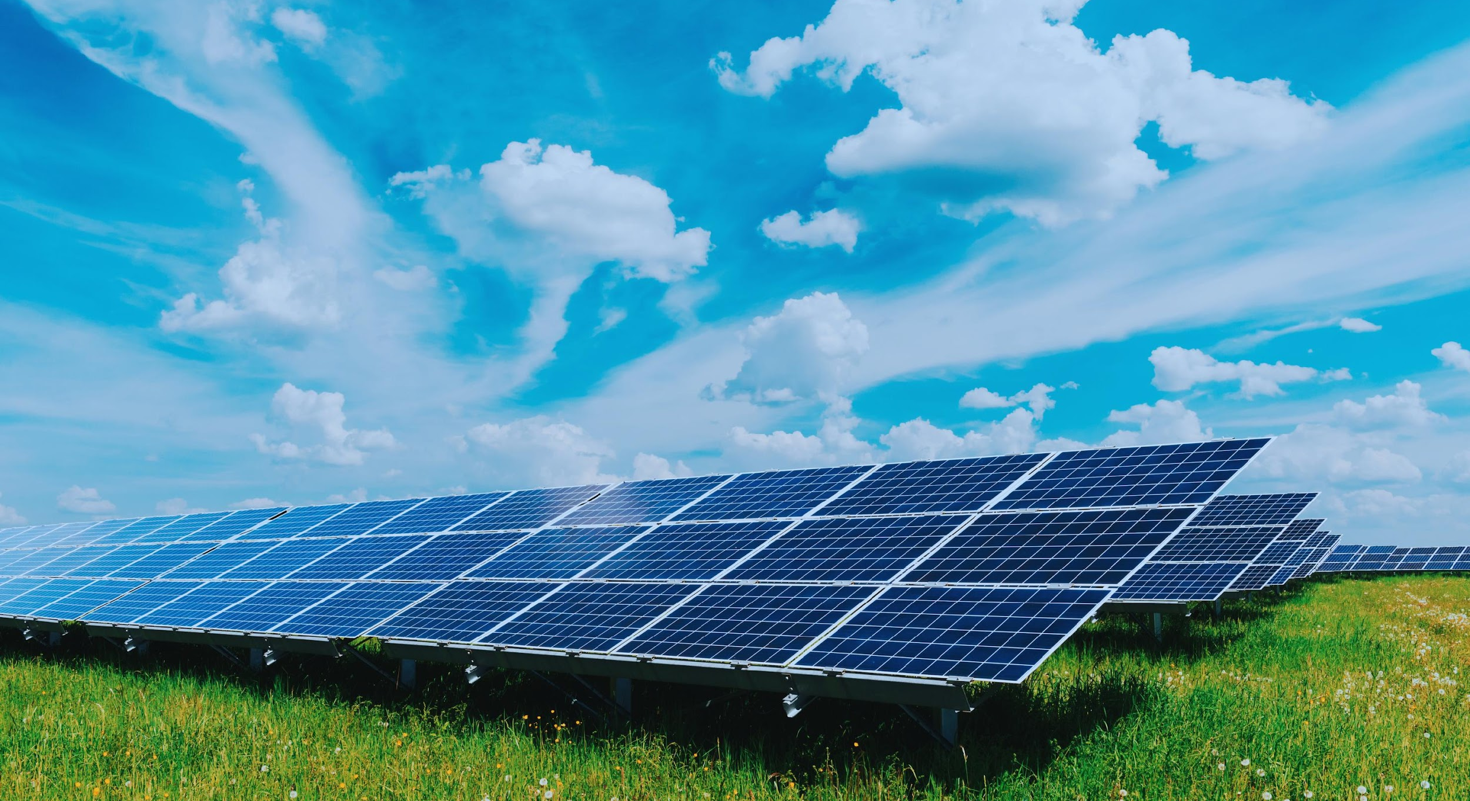
ARDUINO POWERED SOLAR TRACKING SYSTEM FOR ENERGY ENHANCEMENT OF PV SOLAR PANEL USING ADVANCED COATING TECHNOLOGY

Slide 2
ABSTRACT
Our Idea aims to revolutionize solar panel efficiency by addressing the challenges of dust and atmospheric moisture accumulation. By applying hydrophobic coatings to the surface of solar panels, idea seek to repel foreign particles effectively, ensuring optimal performance over time. Through rigorous experimentation and analysis, we explore the impact of these coatings on mitigating detrimental effects, ultimately improving solar panel efficiency. This research not only delves into various coating materials and application techniques but also develops sophisticated monitoring systems to evaluate long-term effectiveness. By offering a cost-effective and scalable solution, our project significantly contributes to advancing sustainable energy solutions and promoting environmental sustainability.
Problem Addressed
Challenges of dust and atmospheric moisture accumulation on solar panels.
How might we develop a solution to enhance solar panel efficiency by addressing the challenges of dust and atmospheric moisture accumulation, which currently diminish their performance below intended levels?
Solution Proposed
Application of hydrophobic coatings to repel foreign particles and maintain optimal performance.
Research Focus
Rigorous experimentation and analysis to explore the impact of hydrophobic coatings.
Investigation into various coating materials and application techniques.
shreerecvidyam@4

Slide 3
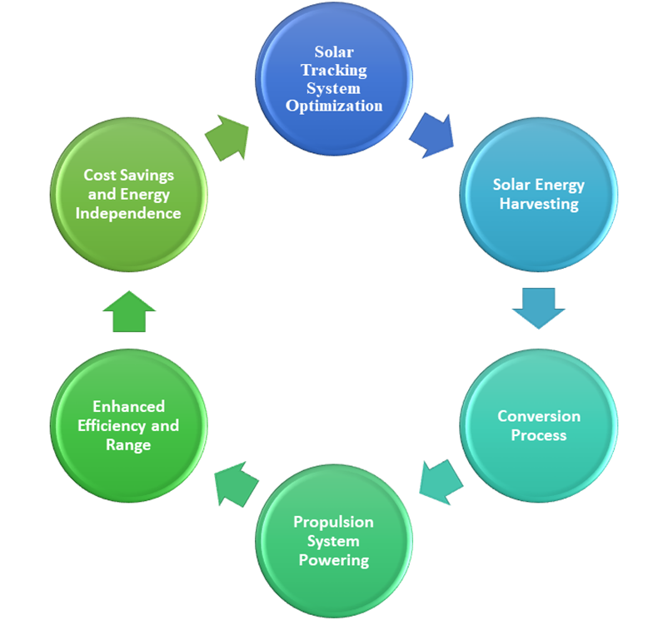
OBJECTIVE
Enhance Solar Panel Efficiency
Revolutionize solar panel efficiency by integrating advanced cleaning mechanisms and protective coatings.
Optimize Sunlight Exposure
Ensure optimal alignment with the sun using advanced sun tracking mechanisms to maximize energy capture.
Increase Durability and Longevity
Protect solar panels from corrosion and material degradation, extending their lifespan and maintaining performance.
Promote Sustainability
Provide a cost-effective, scalable solution that contributes to broader adoption of renewable energy technologies and reduces reliance on fossil fuels.
shreerecvidyam@4

Slide 4
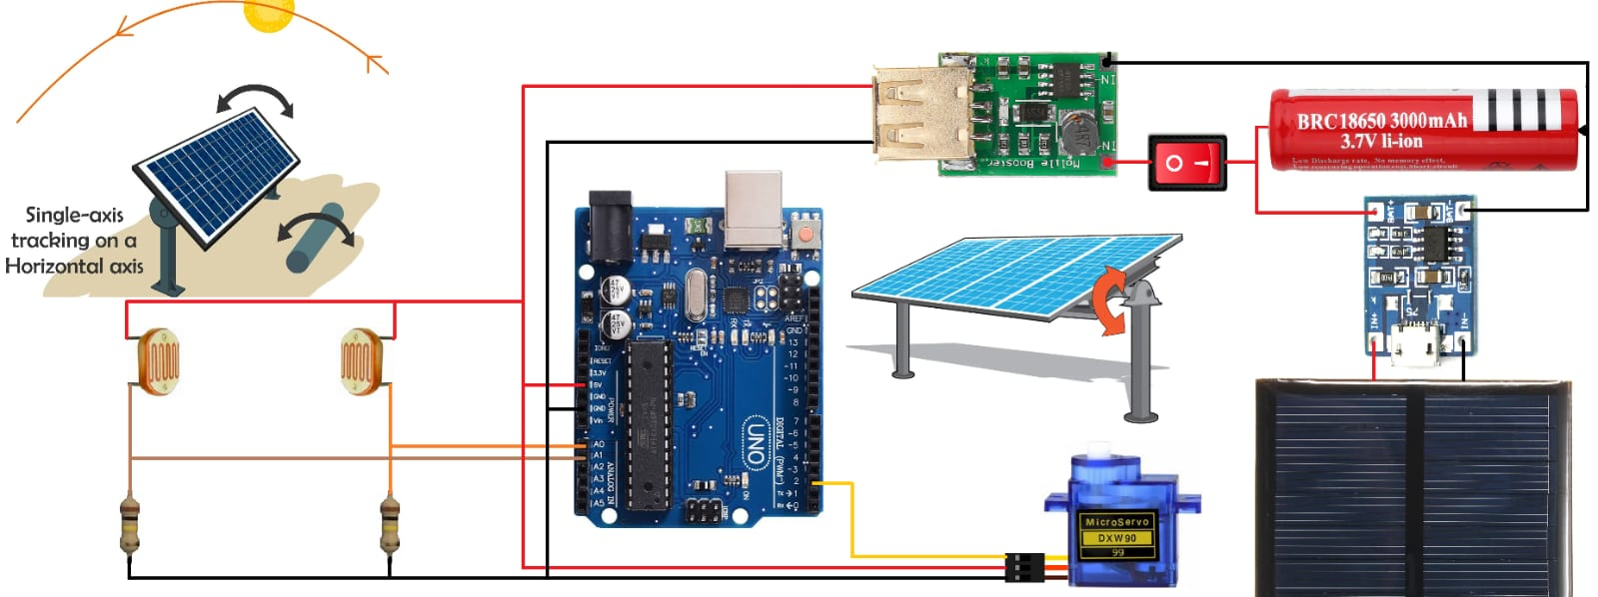
PROPOSED SOLUTION
shreerecvidyam@4
Components Overview and Setup:
The Arduino UNO serves as the central control unit, while the LDRs detect sunlight intensity changes.
The servo motor adjusts the solar panel's tilt angle, and the BO motor provides mobility to the system.
Solar Tracking and Mechanism:
LDRs detect sunlight changes, Arduino calculates optimal panel angle, and servo motor adjusts accordingly.
Dynamic adjustment maintains panel alignment with the sun for maximum energy capture.
Energy Flow and Conversion:
Sunlight captured by the solar panel is converted into electrical energy, powering both the servo motor for panel adjustment and the Arduino controller for system control.

Slide 5
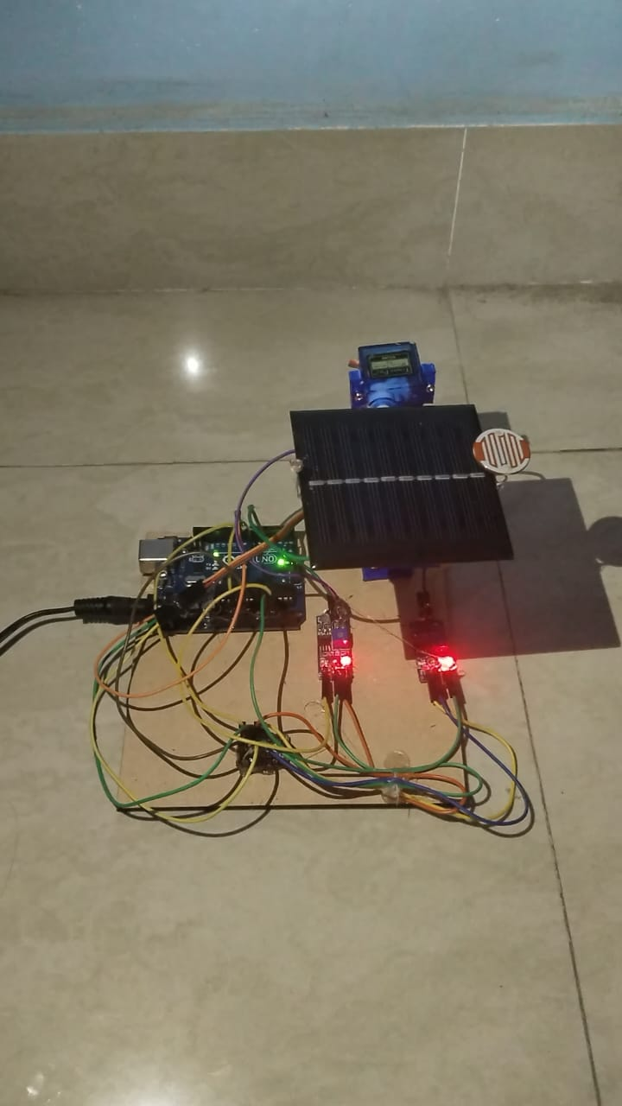
PROPOSED SOLUTION
Orientation Adjustment:
The microcontroller sends control signals to actuators, typically servo motors, attached to the solar panel mounts. These actuators adjust the orientation of the solar panels, tilting them to align with the calculated optimal angle.
Coating Application:
The selected hydrophobic coating is applied uniformly on the solar panels following manufacturer instructions.
Observation:
Angle of Rotation of solar panel and sun light intensity is calculated using Arduino code. By comparing the readings from both LDRs, the Arduino can determine the direction of the sunlight and calculate the optimal orientation for solar panels. The controller calculates every tilt angle for the panels to maximize solar energy absorption.Calibrate the sensitivity of LDRs and servo motor range for optimal performance. The effectiveness of the advanced coating is verified in repelling dust and moisture.
shreerecvidyam@4

Slide 6
TECHNICAL IMPLEMENTATION
Coating Application: Hydrophobic coatings are applied to the panel surface to repel water and prevent moisture build up, protecting against corrosion and maintaining optical properties for maximum sunlight absorption.
Automated Cleaning Mechanisms Integration: Automated cleaning brushes or air jets are strategically positioned to cover the panel surface, periodically removing dust and debris to ensure thorough cleaning and optimal performance.
Solar Panel Installation: Solar panels are installed strategically to optimize sunlight exposure, serving as the foundation for energy capture and conversion.
Sun Tracking Mechanism Integration: The system integrates sun tracking mechanisms, driven by single or dual-axis tracking systems, to dynamically adjust panel orientation throughout the day, ensuring optimal alignment with the sun's trajectory.
Soldering and Wiring: Meticulous soldering and wiring are undertaken to establish reliable connections between components, enhancing durability and minimizing signal interference.
Arduino Microcontroller Utilization: The Arduino microcontroller plays a pivotal role, enabling precise control of panel orientation based on input from light-dependent resistors (LDRs).
shreerecvidyam@4

Slide 7
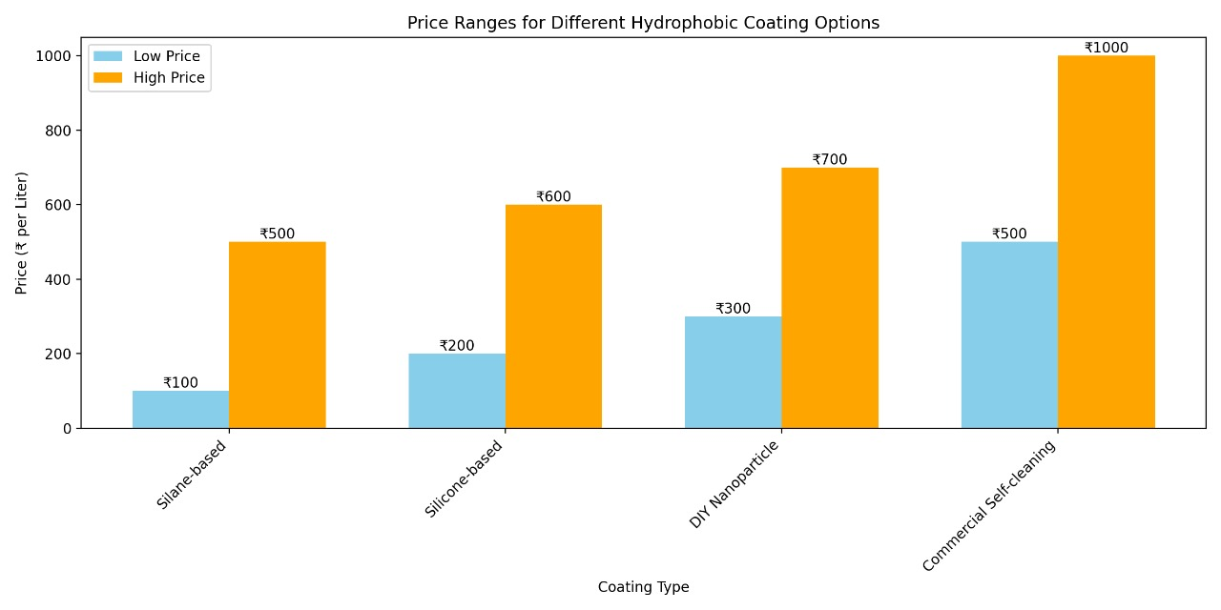
COST EFFECTIVENESS AND BUDGET
When budgeting for a solar tracking system, it’s crucial to factor in the costs of hydrophobic coatings along with other components such as solar panels, inverters, and mounting systems. For a mid-sized solar system, the total budget may range from ₹1,00,000 to ₹1,50,000, which includes approximately ₹10,000 to ₹15,000 allocated for the hydrophobic coating.
BUDGET – small scale purpose
Solar cell=150
Ldr*2=60
Servo motor=100
Arduino UNO+USB cable=700
Jumper wires=100(Male to male)as required can vary
Hydrophobic Silane based coating=1000
Total 2200 (approx)
shreerecvidyam@4
For a cost-effective hydrophobic coating for solar tracking systems in India, consider silane-based (₹100-₹500/litre), silicone-based (₹200-₹600/liter), DIY nanoparticle (₹300-₹700/litre), or commercial self-cleaning sprays (₹500-₹1000/litre).

Slide 8
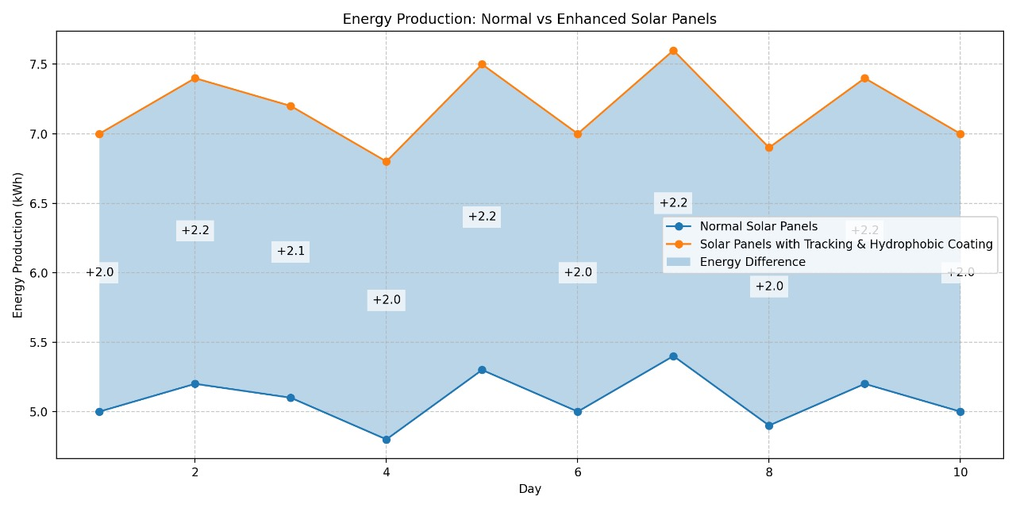
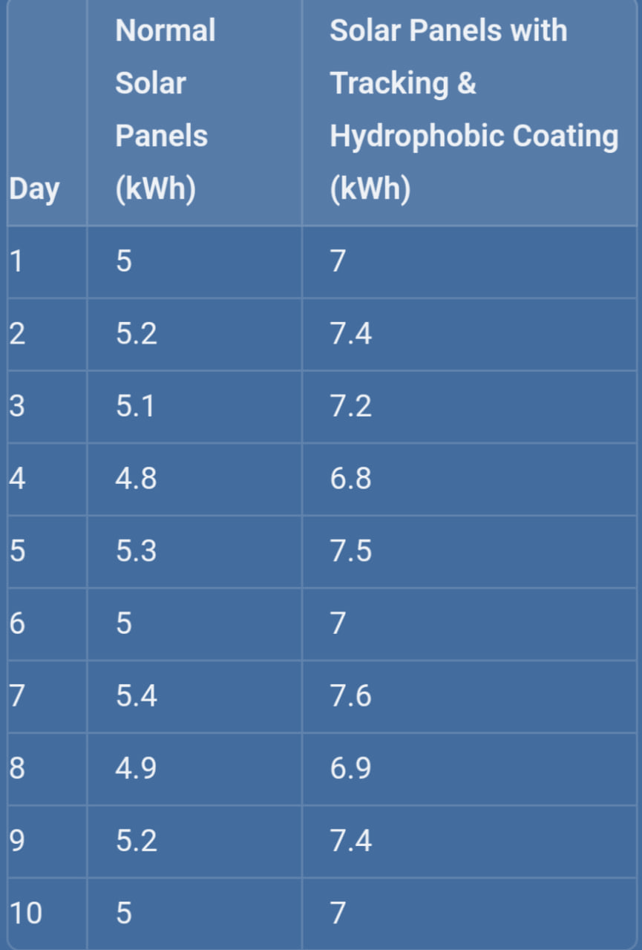
NORMAL VS ENHANCED SOLAR PANEL
Here is a graph showing energy savings for solar panels in both normal conditions and with solar tracking plus hydrophobic coatings. The values are in kilowatt-hours (kWh).

Slide 9
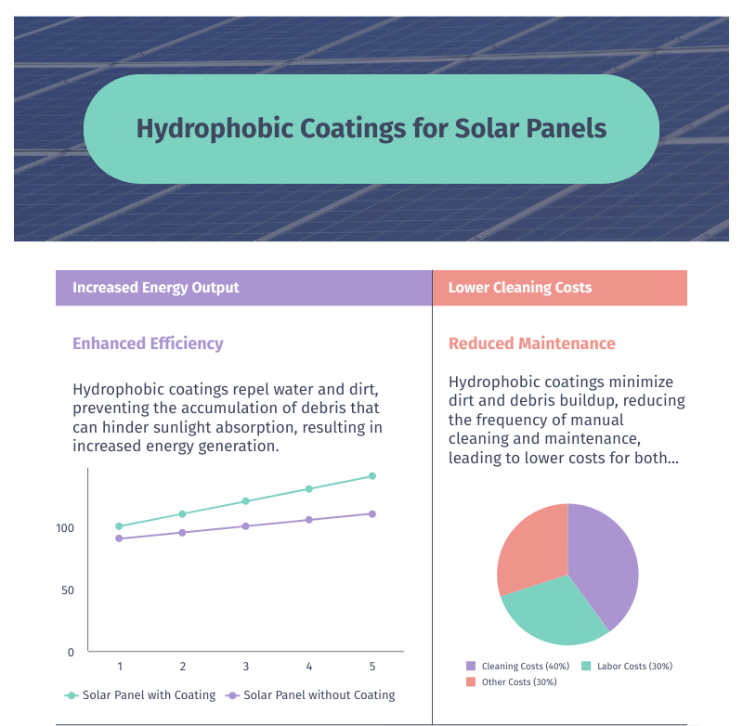
TAM, SAM, and SOM
The Total Addressable Market (TAM) for hydrophobic coatings in solar energy includes the global market for solar panels, where enhanced efficiency and reduced maintenance are key benefits. This vast market is driven by the global push towards renewable energy adoption. The Serviceable Available Market (SAM) focuses on India’s solar sector, particularly households and small businesses under initiatives like the PM Surya Ghar Muft Bijli Yojana, where government incentives make solar installations more attractive. The Serviceable Obtainable Market (SOM) targets early adopters in urban and semi-urban areas of India, where solar panel installations are growing rapidly. This niche market can be captured by leveraging government support and existing distribution channels to promote cost-effective hydrophobic solutions.

Slide 10
LEAN CANVAS
Problem:How can solar panels be optimized to significantly increase energy output and efficiency, especially in regions with variable weather conditions,By doing so What are the most cost-effective materials and technologies for hydrophobic coatings on solar panels that can maintain long-term performance and durability while minimizing maintenance costs.
Customer Segment:
B2B (Business-to-Business):
The B2B customer segment includes large-scale solar farms, commercial and industrial businesses, and the agricultural sector, all seeking to reduce energy costs and enhance sustainability. Government and public sector entities also invest in solar solutions for renewable energy infrastructure development.
B2C (Business-to-Consumer):
Homeowners looking for advanced solar solutions for personal use, aiming to increase energy efficiency and reduce electricity bills.
User Roles Interacting with the Customer:
Installers and Technicians are the professionals will interact with the panels during installation and maintenance. First,They need to understand the specifics of the tracking system and the application of hydrophobic coatings.
Energy Consultants,Advisors who help businesses and homeowners will choose the best solar solutions for their needs.
Facility Managers for B2B customers, facility managers or operations managers can oversee the integration and operation of these solar panels.
shreerecvidyam@4

Slide 11
LEAN CANVAS
Unique Value Proposition:The ability to maximize energy output and efficiency, even in challenging weather conditions, while reducing maintenance costs and enhancing long-term durability.
Solution:The top three features of solar panels with tracking and hydrophobic coatings are:
1.Solar Tracking System: Enhances energy capture by automatically adjusting the panel orientation to follow the sun's movement throughout the day.
2.Hydrophobic Coating: Provides a self-cleaning surface that repels water and dirt, maintaining optimal panel efficiency with minimal maintenance.
3.Increased Energy Efficiency: Combines advanced technology to deliver significantly higher energy output compared to traditional fixed solar panels.
Channel Path:The channel path to customers involves direct sales through specialized solar technology providers and partnerships with renewable energy consultants, supported by online platforms for broader market reach and customer education. Additionally, collaboration with government and industrial bodies can help access large-scale projects.
Key Metrics:Key metrics include energy output per panel (measuring efficiency gains from tracking and coatings), customer acquisition cost (CAC), return on investment (ROI) for clients, and maintenance frequency (indicating the effectiveness of hydrophobic coatings in reducing upkeep). These metrics helps in assessing the system's performance, customer value, and overall profitability.
shreerecvidyam@4

Slide 12
LEAN CANVAS
Revenue Stream:
- Revenue Model:
-Direct Sales of solar panel systems to B2B and B2C customers.
- Installation Services offered as an additional revenue stream.
- Maintenance Contracts for ongoing support and upkeep.
- Licensing/Partnerships with other solar companies for technology integration.
-Lifetime Value:
- High Lifetime Value due to long-term energy savings, reduced maintenance costs, and potential for system upgrades or expansions over the years.
- Revenue:
- One-Time Revenue from the initial sale and installation of solar systems.
- Recurring Revenue from maintenance contracts and potential system upgrades.
- Gross Margin:
- High Gross Margin on the sale of solar panels and tracking systems, particularly if proprietary technology is involved.
- Moderate Gross Margin on installation and maintenance services, depending on the competitive landscape and operational efficiency.
shreerecvidyam@4

Slide 13
NOVELTY
Combination of Advanced Coating Technology and Solar Tracking: Integrates advanced coating technology with an Arduino-powered solar tracking system to address multiple performance challenges simultaneously. Enhanced Efficiency: Coatings reduce dust and moisture accumulation while the tracking system ensures optimal sun exposure, resulting in significantly higher energy output.
Improved Energy Conversion Efficiency: Advanced coating technology maintains optimal panel cleanliness, enhancing energy conversion efficiency. Dust and moisture repellent coatings maximize sunlight absorption, resulting in higher energy yields.
Enhanced Panel Durability: Hydrophobic coatings resist moisture accumulation, preventing corrosion and degradation of panel materials. Increased panel lifespan ensures long-term efficiency and reliability in energy production.
Cost-Effective and Customizable: The Arduino-based systems offer a low-cost, flexible solution that can be easily customized and scaled for different applications and environments
Scalability: The system can be easily scaled and adapted for various sizes of solar installations, from small residential setups to large commercial arrays.
shreerecvidyam@4

Slide 14
SOCIAL RELEVANCE
Promoting Renewable Energy Adoption
Increased Efficiency: By enhancing solar panel efficiency, the system increases the appeal of solar energy for homes and businesses. This boosts renewable energy adoption, reducing fossil fuel use and emissions.
Reduced Carbon Footprint: By improving solar panel efficiency and durability, the system contributes to a reduction in the overall carbon footprint associated with energy production. This aligns with global efforts to combat climate change and promote environmental sustainability.
Affordable Clean Energy: The use of cost-effective Arduino technology and sustainable coatings makes the system more affordable, potentially lowering the barriers to entry for households and businesses considering solar energy investments.
Educational and Awareness Opportunities
STEM Education: The integration of Arduino and advanced coating technologies presents opportunities for educational programs in science, technology, engineering, and mathematics (STEM). Schools and universities can use this system as a practical example to teach students about renewable energy, electronics, and material science.
Public Awareness: Demonstrating the benefits of advanced solar technologies can raise public awareness about renewable energy solutions and their importance in addressing environmental and energy challenges.
shreerecvidyam@4

Slide 15
FUTURE DEVELOPMENT
Enhancement of Coating Technologies
Advanced Nanomaterials: Further research into nanomaterials can lead to coatings with even higher efficiency in repelling dust and moisture. Development of multi-functional nano-coatings that combine self-cleaning, anti-reflective, and anti-corrosive properties.
Smart Coatings: Developing smart coatings that can change their properties based on environmental conditions, such as becoming more hydrophobic during rainy seasons and more dust-repellent during dry seasons.
Improvement of Solar Tracking Algorithms
Machine Learning: Implementing machine learning algorithms to improve the accuracy and efficiency of solar tracking.
Adaptive Control Systems: Developing adaptive control systems that adjust tracking parameters in real-time based on environmental feedback, ensuring maximum energy capture even under rapidly changing conditions.
Global Deployment and Adaptation
Region-Specific Solutions: Developing solutions tailored to the specific environmental challenges of different regions, such as areas with high dust levels, high humidity, or extreme temperatures.
Collaboration and Partnerships: Partnering with local governments, organizations, and businesses to facilitate the deployment and adaptation of the technology in various regions, ensuring it meets local needs and regulations.
shreerecvidyam@4

Slide 16
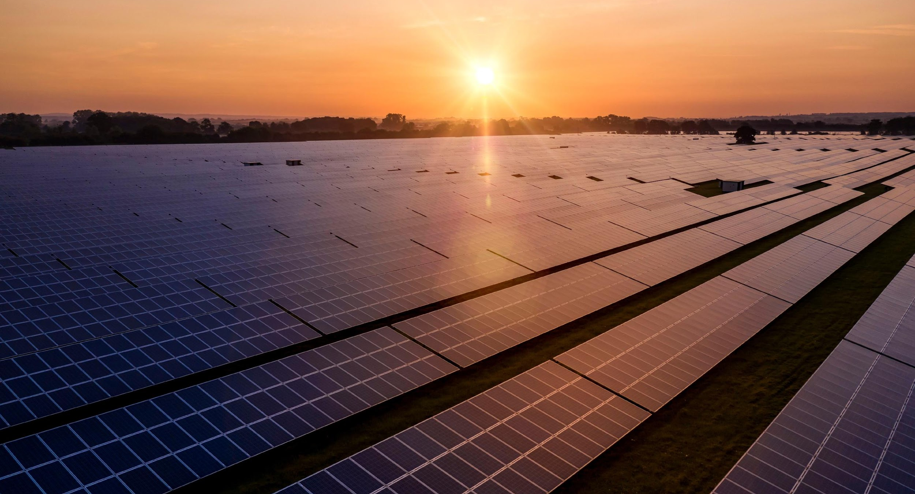
THANK YOU

