Slide 1

INTEGRATED SOLAR TRACKING AND CONVERSION SYSTEM
DEPARTMENT OF ELECTRONICS AND COMMUNICATION ENGINEERING

Slide 2
OUTLINE
Abstract
Objective
Literature Survey
Summary of Literature
Requirement Specification
System Architecture
Working of integrated solar tracking and conversion system
Proposed System
Significance of System
Novelty of Proposed System
Simulated output of Solar Tracking System
Angle of Rotation of Solar Panel
Observation of Sunlight Intensity
Results and Discussion
Conclusion
Future Scope
References

Slide 3
ABSTRACT
The Integration of a solar tracking system with a solar-powered car enhances energy efficiency and mobility.
The system utilizes Light-Dependent Resistors (LDRs) and a servo motor to track the sun's position and adjust the azimuth location of the solar panels accordingly.
By incorporating Arduino technology, the system offers flexibility for customization and integration with other systems.
The integration of a solar car adds mobility to the tracking mechanism, creating a sustainable mode of transportation powered by renewable energy.
The project involves hardware integration, testing, and optimization to ensure efficiency.
This innovative solution contributes to improving solar energy harvesting efficiency, making it suitable for small-scale solar power applications while offering opportunities for learning and innovation in renewable energy and vehicle design.

Slide 4
OBJECTIVE
The Solar Tracking System and Conversion System using Arduino aims to enhance solar panel efficiency through automated tracking. Key objectives include:
Dynamic Panel Alignment: Develop a system for real-time azimuth adjustments, optimizing solar panel alignment with the sun.
LDR Integration: Utilize two LDRs to measure sunlight intensity, enabling the Arduino to calculate the optimal azimuth angle.
Mobility Tracking Algorithm: Create an algorithm for continuous monitoring and adjustment by mobility of Solar Car, adapting to changing sunlight conditions throughout the day.
Effective Sunlight Detection: Ensure the system detects direct sunlight by monitoring sufficient light intensity on both LDRs.
Sustainable Transportation: Solar cars offer a renewable energy-powered alternative to traditional fossil fuel vehicles, significantly reducing carbon emissions and contributing to environmental conservation.
Cost Efficiency: Operating a solar car reduces fuel costs and maintenance expenses over time, as solar energy is freely available and solar panels have a long lifespan.

Slide 5
LITERATURE SURVEY
TITLE | YEAR | AUTHOR | TECHNIQUE
Increasing the Solar Reliability Factor of a Dual-Axis Solar Tracker Using an Improved Online Built-In Self-Test Architecture | 2024 | S. L. Jurj R. Rotar | Built-in online self-test, Circuit fault detection, Power system reliability, Dual-axis solar tracker, Bit-flip mechanism, Extended Hamming codes, Stuck-at faults, Solar tracking, Real-time fault detection.
Optimal Selection of the Control Strategy for Dual-Axis Solar Tracking Systems | 2023 | S. I. Palomino-Resendiz, F. A. Ortiz-Martínez, I. V. Paramo-Ortega, J. M. González-Lira and D. A. Flores-Hernández | Heuristic methodology for the optimal selection of control strategies in dual-axis solar tracking systems, controller pre-selection, heuristic selection, and comparative analysis stages.
A Novel Method for Maximum Power Point Tracking of the Grid-Connected Three-Phase Solar Systems Based on the PV Current Prediction | 2023 | S. Bairami, M. Salimi , D. Mirabbasi, | Maximum power point tracking (MPPT), Current predictive control, Grid-connected solar systems, Static converter, Power electronics.

Slide 6
SUMMARY OF LITERATURE SURVEY
[1] The paper introduces advanced self-test architecture for dual-axis solar trackers and a novel predictive MPPT method for grid-connected three-phase solar systems, enhancing reliability and stability but posing challenges in complexity and practical implementation.
[2] The paper presents a novel predictive MPPT method for grid-connected three-phase solar systems, aiming to minimize voltage and current ripple for enhanced stability, yet facing challenges in complexity and practical implementation.
[3] The AGMVC control technique enhances power quality in grid-tied solar PV systems by mitigating harmonics and other issues, boasting superior performance metrics but facing obstacles like the requirement for sophisticated hardware and higher implementation costs.
With reference to all these, we have updated to the idea with latest technology aiming to give optimum utilization of sun intensity and conversion to a mobility driven solar powered car overcoming the existing difficulty.

Slide 7
REQUIREMENT SPECIFICATION
COMPONENTS | QUANTITY | SPECIFICATION
Arduino | 1 | UNO
Solar Panels | 1 | 70mm x 70mm 6V 100 mAh
LDR | 2 | 5 mm
Resistors | 2 | 10K O (Ω) 1/2w (0.50 watt) ±5% Tolerance
BO Motors | 2 | 150RPM Dual Shaft BO Motor
Bread board | 1 | 840 pin
Jumper Wires | Atleast 20 pcs | Male to Male
shreerecvidyam@4

Slide 8
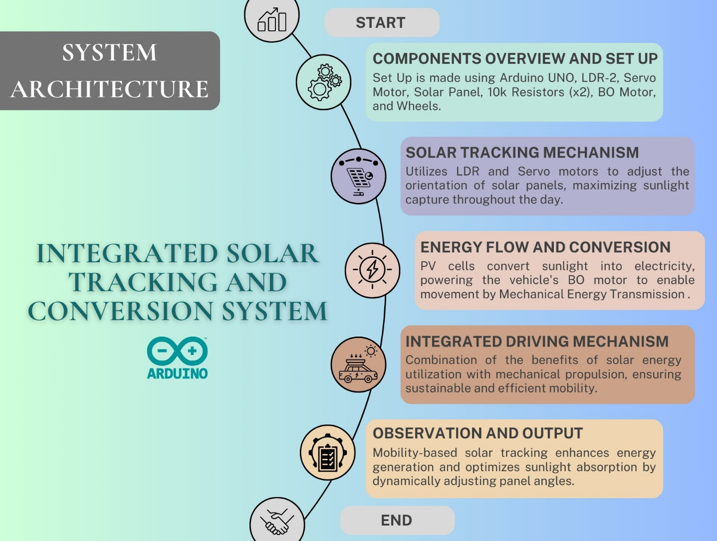
shreerecvidyam@4
shreerecvidyam@4

Slide 9
WORKING OF INTEGRATED SOLAR TRACKING AND CONVERSION SYSTEM
COMPONENTS OVERVIEW AND SETUP:
The Arduino UNO serves as the central control unit, while the LDRs detect sunlight intensity changes.
The servo motor adjusts the solar panel's tilt angle, and the BO motor provides mobility to the system.
SOLAR TRACKING MECHANISM:
LDRs detect sunlight changes, Arduino calculates optimal panel angle, and servo motor adjusts accordingly.
Dynamic adjustment maintains panel alignment with the sun for maximum energy capture.
ENERGY FLOW AND CONVERSION:
Sunlight captured by the solar panel is converted into electrical energy, powering both the servo motor for panel adjustment and the Arduino controller for system control.
Additionally, surplus energy generated by the solar panel can be stored in batteries for later use, ensuring continuous operation even during periods of low sunlight intensity system maximizes energy utilization by directly harnessing sunlight intensity.

Slide 10
WORKING OF INTEGRATED SOLAR TRACKING AND CONVERSION SYSTEM
INTEGRATED DRIVING MECHANISM:
PV cells convert sunlight into electricity, powering the vehicle's BO motor to enable movement by Mechanical Energy Transmission. This motor drives the wheels of the vehicle, propelling it forward.
Mechanical transmission ensures smooth movement, reducing reliance on fossil fuels.
Combination of the benefits of solar energy utilization with mechanical propulsion, ensuring sustainable and efficient mobility.
OBSERVATION AND OUTPUT:
Real-time monitoring optimizes panel orientation for increased energy capture.
Performance analysis enhances solar energy utilization, contributing to sustainable solutions.
This setup showcases the practical application of mobility-based solar tracking for enhanced solar energy utilization, contributing to sustainable energy solutions.

Slide 11
PROPOSED SYSTEM
THE SOLAR TRACKING SYSTEM
The Proposed System integrates solar tracking technology with a solar-powered car to enhance energy efficiency and extend its range. The system converts the captured sunlight into electricity, stores excess energy in batteries, and powers the vehicle's propulsion. The proposed system is first proceeded with Solar Tracking System and then integrated to convert the energy for the application of Solar powered Car
1. Solar Panel:
The heart of the system is solar panels which capture sunlight and convert it into electrical energy.
2. Sun Tracking Mechanism:
This mechanism is responsible for orienting the solar panels towards the sun throughout the day. One of the primary type of sun tracking systems used in the project work is Single Axis Tracking.
Single Axis Tracking: Tracks the sun's movement from east to west by rotating around a single axis.
3. Solar Energy Harvesting:
Solar panels capture sunlight and convert it into direct current (DC) electricity .The Solar Tracking System ensures panels are positioned optimally for maximum energy capture.
4. Sunlight Detection:
Light sensors, such as Light Dependent Resistors (LDRs) or photovoltaic cells, measure the intensity of sunlight.
5. Microcontroller Unit (MCU):
Arduino UNO Controls the operation of the sun tracking mechanism based on input from the sensors.

Slide 12
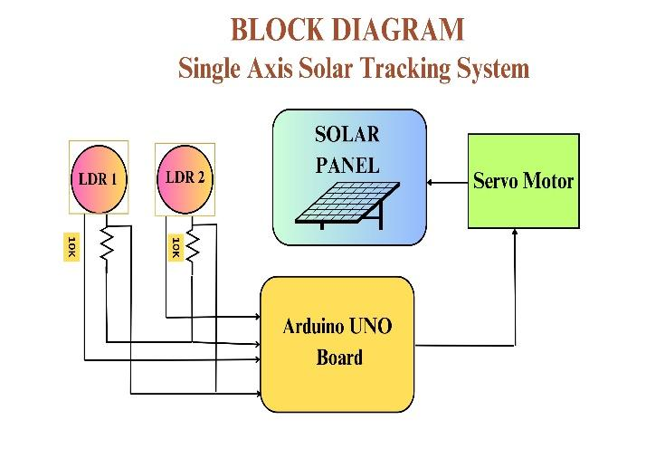
PROPOSED SYSTEM
shreerecvidyam@4
6. Orientation Adjustment: The microcontroller sends control signals to actuators, typically servo motors, attached to the solar panel mounts. These actuators adjust the orientation of the solar panels, tilting them to align with the calculated optimal angle.
7. Continuous Monitoring: Throughout the day, the microcontroller continues to monitor sunlight intensity and adjust the orientation of the solar panels in real-time to track the sun's movement across the sky.
8. Observation: Angle of Rotation of solar panel and sun light intensity is calculated using arduino code. By comparing the readings from both LDRs, the Arduino can determine the direction of the sunlight and calculate the optimal orientation for solar panels. The controller calculates every tilt angle for the panels to maximize solar energy absorption.

Slide 13
SIGNIFICANCE OF LDR
The Light-Dependent Resistor (LDR), also known as a photo resistor, is a crucial component in various electronic systems, and its significance lies in its ability to respond to changes in light intensity. Here are some key aspects highlighting the significance of LDRs:
Light Sensing: LDRs are specifically designed to change their resistance based on the ambient light level. This property makes them invaluable for sensing and responding to variations in light intensity.
Automatic Lighting Control: LDRs are widely used in applications like street lighting and outdoor security lighting. By incorporating LDRs, these systems can automatically adjust the intensity of illumination based on the surrounding ambient light, contributing to energy efficiency.
Solar Tracking Systems: In solar tracking systems, LDRs play a pivotal role in detecting sunlight intensity. This information is then used to adjust the orientation of solar panels, optimizing their exposure to sunlight throughout the day for maximum energy harvesting.
It is also used in various applications such as Weather Monitoring Systems, Educational experimentation and Artistic Installations.

Slide 14
PROPOSED SYSTEM
INTEGRATED SOLAR TRACKING AND CONVERSION SYSTEM
The concept of solar-powered cars embodies the innovative transformation of solar energy into a practical and eco-friendly transportation solution. By harnessing sunlight through advanced photovoltaic technology, these vehicles offer a sustainable alternative to traditional gasoline-powered cars. By integrating this system into a solar-powered car, the vehicle can harness solar energy more efficiently, extending its range and reducing its reliance on conventional energy sources. The conversion aspect of the system involves transforming solar energy into usable electrical power to drive the vehicle's propulsion system.
WORKING OF A SOLAR-POWERED CAR
1. Energy Capture
Solar Panels: Integrated into the car's roof, solar panels capture sunlight and convert it into electrical energy.
Maximized Exposure: The design ensures maximum exposure to sunlight, optimizing energy capture throughout the day.
2. Energy Conversion
Photovoltaic Cells: The solar panels use photovoltaic cells to generate direct current (DC) electricity from the captured sunlight.
Microcontroller: A microcontroller processes the electrical energy and manages the car’s systems.
Sensors: Light-dependent resistors (LDRs) help optimize the orientation of the solar panels for maximum sunlight exposure.
Solar-Powered Car:
Design and build a solar-powered car equipped with photovoltaic panels to harness solar energy for propulsion. Utilize lightweight and energy-efficient components, including high-efficiency motors, batteries, and power electronics, to maximize energy efficiency and range.

Slide 15
PROPOSED SYSTEM
3. Motor Control and Propulsion
Controlling the speed and direction of the vehicle, the Arduino UNO regulates the BO Motor based on the inputs from the LDRs.
The motor converts electrical energy into mechanical energy, propelling the car forward or backward, depending on the desired direction.
4. Energy Storage and Utilization
Continuous Monitoring and Adjustment Throughout its operation, the system continuously monitors sunlight intensity using the LDRs. By adjusting the orientation of the Solar Panel, the car ensures maximum energy capture, enabling it to operate efficiently under varying sunlight conditions.
Battery Storage: The generated electricity is stored in batteries, ensuring a stable energy supply for the car's operations.
Control and Wiring: Breadboards and jumper wires facilitate connections and control the distribution of electricity to various components, including resistors to manage current flow and protect the circuits.

Slide 16
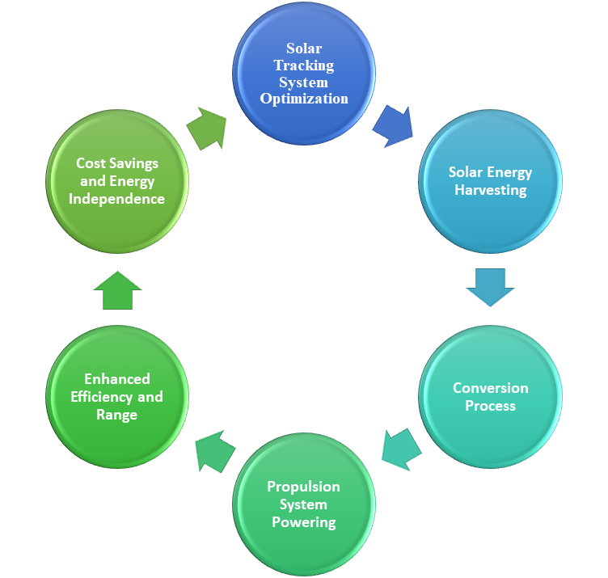
SIGNIFICANCE OF SYSTEM
The diagram outlines the workflow for optimizing a solar-powered vehicle system, starting with solar tracking system optimization to ensure panels capture maximum sunlight. This leads to efficient solar energy harvesting and a regulated conversion process where DC electricity charges the batteries. The stored energy powers the vehicle's propulsion system, enhancing efficiency and range. This continuous optimization results in significant cost savings and energy independence, promoting sustainable transportation.
shreerecvidyam@4
Work Flow of System

Slide 17
NOVELTY IN PROPOSED SYSTEM
Solar-Powered Smart Mobility: The project goes beyond conventional solar energy applications by integrating solar power into a smart mobility solution—a solar-powered car. By harnessing solar energy for propulsion, the project showcases an innovative approach to sustainable transportation that reduces dependence on fossil fuels and mitigates greenhouse gas emissions.
Enhanced Efficiency and Range: The integrated Solar Tracking and Conversion System uniquely combines solar energy harvesting with vehicle propulsion to maximize efficiency and extend range. By utilizing Light-Dependent Resistors (LDRs) and a servo motor, the system continuously optimizes solar panel orientation, ensuring maximum energy capture throughout the day.
Sustainable and Eco-Friendly Solution: This innovative approach converts sunlight into electricity, storing excess energy in batteries for continuous power supply. The system reduces environmental impact by relying on clean, renewable solar energy, promoting sustainability, and minimizing carbon emissions during operation.
Energy Independence and Practicality: By providing energy independence, particularly in remote or off-grid areas, this system lowers dependence on fossil fuels and grid-based electricity. It ensures reliable mobility and resilience, making it a significant advancement in renewable energy and sustainable transportation technologies.

Slide 18
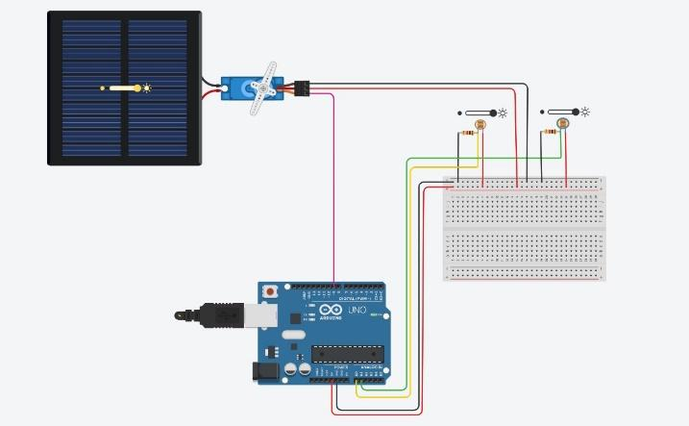
SIMULATED OUTPUT OF SOLAR TRACKING SYSTEM
shreerecvidyam@4
The simulated output of a solar tracking system as shown in Figure, typically involves visualizing the movement of solar panels in response to changing sunlight conditions throughout the day. Using simulation like Tinkercad, the system can demonstrate how the solar panels adjust their orientation to maximize sunlight exposure and energy capture. In the integrated solar car, the output of the solar tracking system is visualized through the dynamic movement of the solar panels mounted on the vehicle. As the car moves, the solar panels adjust their orientation in real-time to optimize sunlight capture. This functionality ensures that the car maximizes its energy efficiency and extends its range by continuously tracking the sun's position.

Slide 19
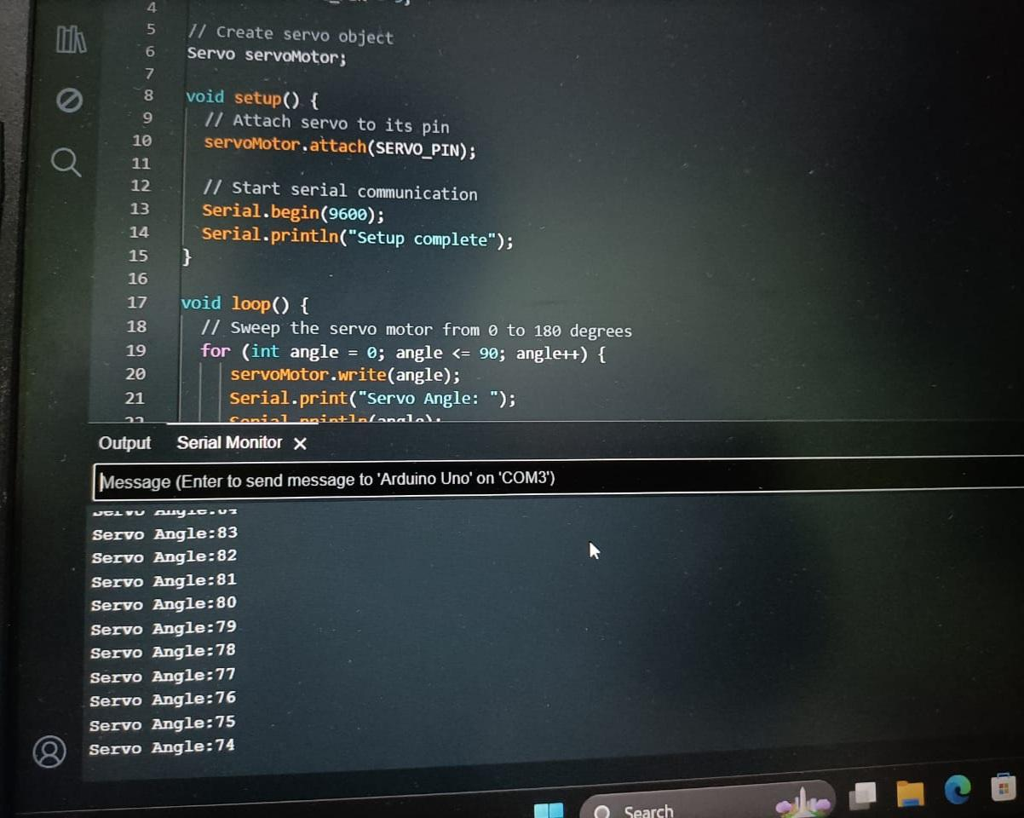
Azimuth Angle of Solar Panel Positioning
ANGLE OF ROTATION OF SOLAR PANEL
In a single-axis solar tracking system, solar panels pivot around an east-west axis to track the sun's trajectory across the sky. Light sensors, such as Light Dependent Resistors (LDRs), detect sunlight intensity changes and relay data to a controller, like an Arduino. Using this information, the controller calculates the optimal tilt angle for the panels to maximize solar energy absorption. Servo motors or linear actuators adjust panel orientation accordingly. This process is facilitated by coding in Arduino IDE as shown in Figure, where algorithms interpret sensor data, compute optimal angles, and control servo motors to adjust panel orientation in real-time, ensuring efficient solar tracking throughout the day.
shreerecvidyam@4

Slide 20
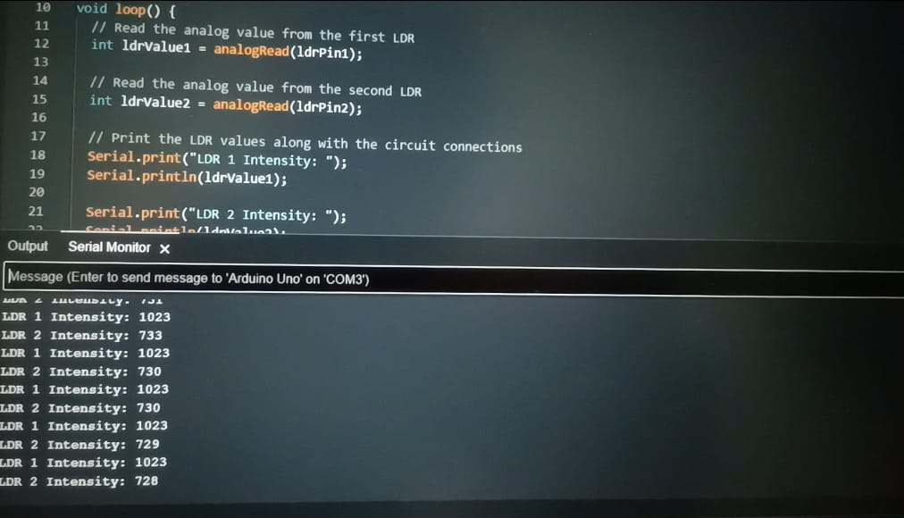
Sunlight Intensity observed by Solar Panel
OBSERVATION OF SUNLIGHT INTENSITY
In the observation of sunlight intensity, two Light Dependent Resistors (LDRs) are strategically placed to capture variations in light intensity. These LDRs serve as sensors to detect changes in sunlight levels throughout the day. Connected to an Arduino microcontroller, the LDRs provide input data that reflects the intensity of sunlight falling on them. By comparing the readings from both LDRs, the Arduino can determine the direction of the sunlight and calculate the optimal orientation for solar panels. This information is crucial for ensuring accurate solar tracking and maximizing energy absorption. In the Arduino code, the output from the LDRs is processed and displayed as shown in Figure 4.6, allowing users to monitor sunlight intensity levels in real-time and verify the system's performance.
shreerecvidyam@4

Slide 21
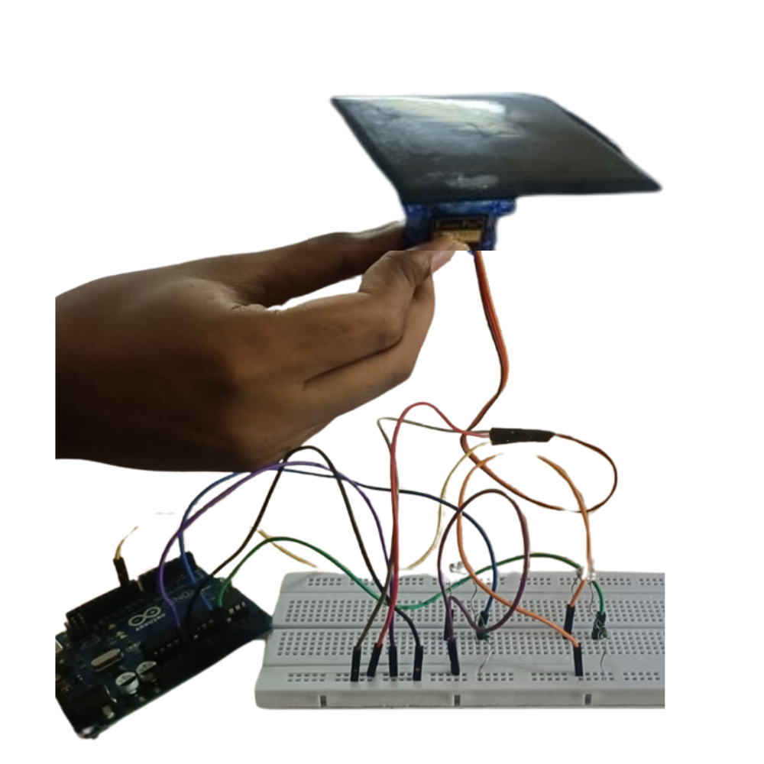
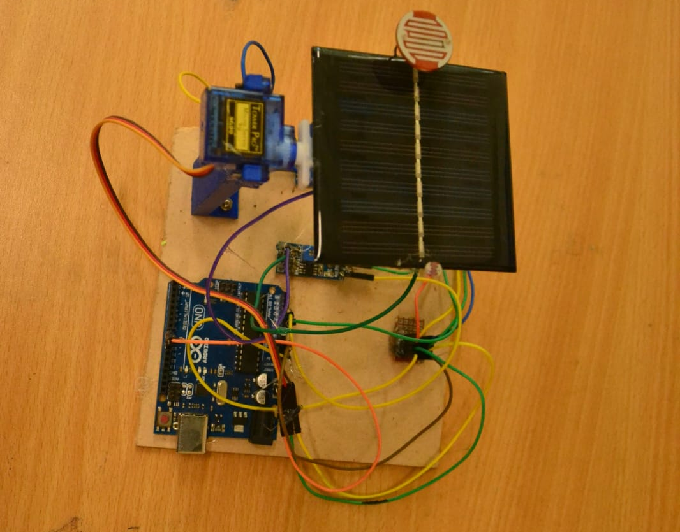
RESULTS AND DISCUSSION
SOLAR TRACKING SYSTEM
Arduino cable is connected to the laptop to run code and it makes the servo motor to work. Thus the Solar Panel rotates by single axis according to the detection of light intensity. The working principle of a solar tracking system involves orienting solar panels or collectors towards the sun to maximize their exposure and energy generation throughout the day.
shreerecvidyam@4

Slide 22
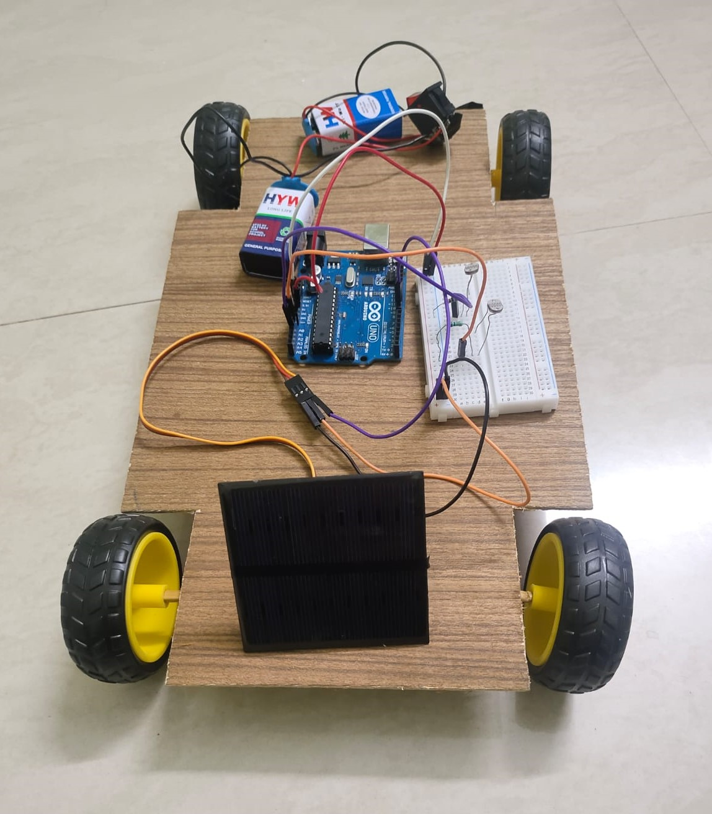
OUTPUT OF INTEGRATED SOLAR TRACKING AND CONVERSION SYSTEM TO A SOLAR POWERED CAR
The results of integrating a solar tracking and conversion system into a solar-powered car demonstrate enhanced energy efficiency, extended range, and reduced environmental impact. By seamlessly merging solar tracking technology with the propulsion system of the vehicle, the car as shown in Figure, becomes self-sufficient in harnessing renewable solar energy for its operation.
shreerecvidyam@4

Slide 23
CONCLUSION
The integration of solar tracking technology with solar-powered cars significantly enhances energy capture and utilization, ensuring maximum efficiency throughout the day.
This dynamic orientation adjustment, facilitated by sophisticated light-sensing technology, ensures maximal utilization of available solar irradiance throughout the day.
By relying on renewable solar energy, the project reduces greenhouse gas emissions, contributing to a cleaner and more sustainable environment.
The solar-powered car serves as a tangible example of sustainable transportation, showcasing how solar energy can be harnessed for propulsion while reducing dependence on fossil fuels and mitigating greenhouse gas emissions. By integrating renewable energy into mobility solutions, the project contributes to a cleaner and more sustainable transportation ecosystem.

Slide 24
FUTURE SCOPE
Future developments could focus on refining the system's tracking accuracy, optimizing energy storage capabilities, exploring alternative propulsion methods, enhancing user interface and control systems, and integrating with smart grid technologies for grid interaction and energy management. These advancements aim to further improve the sustainability, reliability, and practicality of solar-powered transportation solutions, paving the way for widespread adoption and a greener automotive industry.
Scheme
Pradhan Mantri Suryodaya Yojana is a scheme that will involve installing solar power systems at rooftops for residential consumers. The main aim of scheme is not only to reduce electricity bills of the “poor and middle class”, but also push India’s goal of becoming self-reliant in the energy sector.
Impact
India is expected to witness the largest energy demand growth of any country or region in the world over the next 30 years, according to the latest World Energy Outlook by the International Energy Agency (IEA).To meet this demand, the country would need a reliable source of energy.
This project advances renewable energy technology through an Arduino-powered solar tracking system, enhancing solar panel efficiency. It aligns with India's goals for energy self-reliance and sustainability, promising significant impact.

Slide 25
REFERENCES
[1] S. L. Jurj and R. Rotar, "Increasing the Solar Reliability Factor of a Dual-Axis Solar Tracker Using an Improved Online Built-In Self-Test Architecture," in IEEE Access, vol. 12, pp. 37715-37730, 2024, doi: 10.1109/ACCESS.2024.3375333.
[2] S. Bairami, D. Mirabbasi, and M. Salimi , "A Novel Method for Maximum Power Point Tracking of the Grid-Connected Three-Phase Solar Systems Based on the PV Current Prediction," in Chinese Journal of Electronics, vol. 32, no. 2, pp. 353-364, March 2023, doi: 10.23919/cje.2021.00.218.
[3] S. I. Palomino-Resendiz, F. A. Ortiz-Martínez, I. V. Paramo-Ortega, J. M. González-Lira and D. A. Flores-Hernández, "Optimal Selection of the Control Strategy for Dual-Axis Solar Tracking Systems," in IEEE Access, vol. 11, pp. 56561-56573, 2023, doi: 10.1109/ACCESS.2023.3283336.
[4] M. Badoni, R. Kumar, H. Saxena, A. K. Singh, and A. Singh, "Grid Tied Solar PV System with Power Quality Enhancement Using Adaptive Generalized Maximum Versoria Criterion," in CSEE Journal of Power and Energy Systems, vol. 9, no. 2, pp. 722-732, March 2023, doi: 10.17775/CSEEJPES.2020.04820.
[5] F. S. Bagci, K. A. Kim, Y. -C. Liu and Y. -H. Liu, "Evaluation of Power Maximization and Curtailment Control Methods for Converters in Wearable Photovoltaic Energy Harvesting Applications," in IEEE Open Journal of Power Electronics, vol. 3, pp. 508-520, 2022, doi: 10.1109/OJPEL.2022.3194185.
[6] H. Choi et al., "Optimal Inclination and Azimuth Angles of a Photovoltaic Module With Load Patterns for Improved Power System Stability," in IEEE Journal of Photovoltaics, vol. 14, no. 3, pp. 525-537, May 2024, doi: 10.1109/JPHOTOV.2024.3380459.
[7] K. V. Konneh et al., "Optimal Design and Performance Analysis of a Hybrid Off-Grid Renewable Power System Considering Different Component Scheduling, PV Modules, and Solar Tracking Systems," in IEEE Access, vol. 9, pp. 64393-64413, 2021, doi: 10.1109/ACCESS.2021.3075732.
[8] Z N. M. Haegel and S. R. Kurtz, "Global Progress Toward Renewable Electricity: Tracking the Role of Solar," in IEEE Journal of Photovoltaics, vol. 11, no. 6, pp. 1335-1342, Nov. 2021, doi: 10.1109/JPHOTOV.2021.3104149.
[9] W. M. Hamanah, A. Salem, M. A. Abido, A. M. Qwbaiban and T. G. Habetler, "Solar Power Tower Drives: A Comprehensive Survey," in IEEE Access, vol. 11, pp. 83964-83982, 2023, doi: 10.1109/ACCESS.2021.3066799.
shreerecvidyam@4

Slide 26
REFERENCES
[10] W. M. Hamanah, A. Salem, M. A. Abido, A. M. Qwbaiban and T. G. Habetler, "Solar Power Tower Drives: A Comprehensive Survey," in IEEE Access, vol. 11, pp. 83964-83982, 2023, doi: 10.1109/ACCESS.2021.3066799.
[11] N. Kumar, R. Niwareeba and H. K. Singh, "Adaptive Control Technique for Portable Solar Powered EV Charging Adapter to Operate in Remote Location," in IEEE Open Journal of Circuits and Systems, vol. 4, pp. 115-125, 2023, doi: 10.1109/OJCAS.2023.3247573.
[12] A. Arif, S. S. Khan, S. Larkin, M. Omar, and M. Usman, "Self-cleaning solution for solar panels," in SAIEE Africa Research Journal, vol. 114, no. 2, pp. 58-66, June 2023, doi: 10.23919/SAIEE.2023.10071978.
[13] K. Perry and C. Campos, "Panel Segmentation: A Python Package for Automated Solar Array Metadata Extraction Using Satellite Imagery," in IEEE Journal of Photovoltaics, vol. 13, no. 2, pp. 208-212, March 2023, doi: 10.1109/JPHOTOV.2022.3230565.
[14] I. Poonahela, S. Bayhan, H. Abu-Rub, M. M. Begovic and M. B. Shadmand, "An Effective Finite Control Set-Model Predictive Control Method for Grid Integrated Solar PV," in IEEE Access, vol. 9, pp. 144481-144492, 2021, doi: 10.1109/ACCESS.2021.3122325.
[15] V. Rajagopal, D. Sharath, G. Vishwas, J. Bangarraju, S. R. Arya and C. Venkatesh, "Optimized Controller Gains Using Grey Wolf Algorithm for Grid Tied Solar Power Generation with Improved Dynamics and Power Quality," in Chinese Journal of Electrical Engineering, vol. 8, no. 2, pp. 75-85, June 2022, doi: 10.23919/CJEE.2022.000016.
[16] I. Rahul and R. Hariharan, "Enhancement of Solar PV Panel Efficiency Using Double Integral Sliding Mode MPPT Control," in IEEE Journal of Tsinghua Science and Technology, vol. 29, no. 1, pp. 271-283, February 2024, doi: 10.26599/TST.2023.9010030.
[17] S. Roy, J. -J. Tiang, M. B. Roslee, M. T. Ahmed and M. A. P. Mahmud, "A Quad-Band Stacked Hybrid Ambient RF-Solar Energy Harvester With Higher RF-to-DC Rectification Efficiency," in IEEE Access, vol. 9, pp. 39303-39321, 2021, doi: 10.1109/ACCESS.2021.3064348.
[18] S. Thangavel, D. Mohanraj, T. Girijaprasanna, S. Raju, C. Dhanamjayulu and S. M. Muyeen, "A Comprehensive Review on Electric Vehicle: Battery Management System, Charging Station, Traction Motors," in IEEE Access, vol. 11, pp. 20994-21019, 2023, doi: 10.1109/ACCESS.2023.3250221.

Slide 27
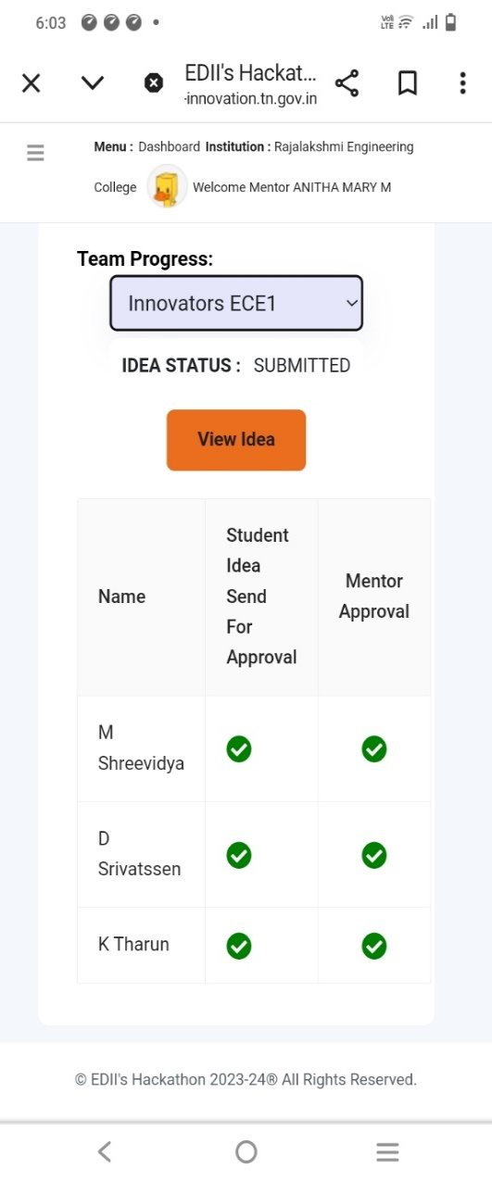
EDII-TN’s HACKATHON
Idea Submission
shreerecvidyam@4

Slide 28
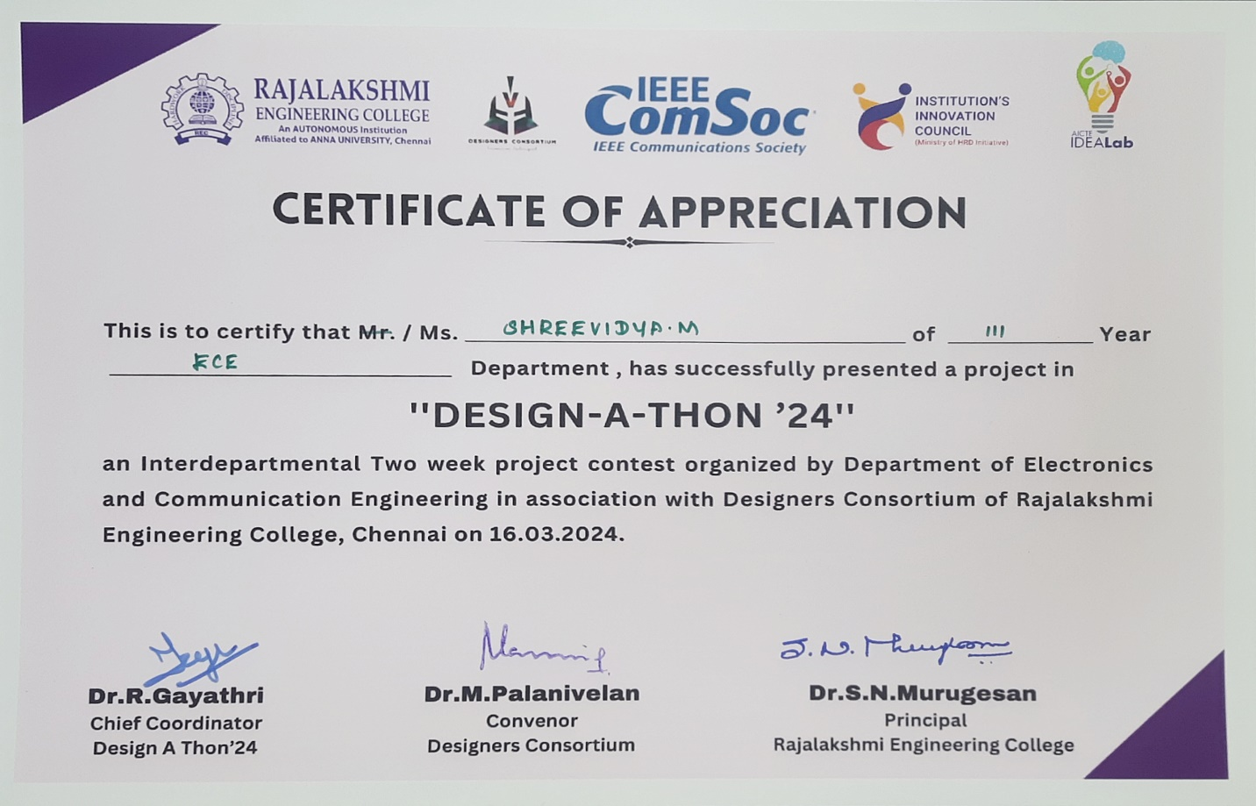
CERTIFICATE FOR PRESENTATION
Presented our project in “Design-A-Thon ’24” Competition organized by Rajalakshmi Engineering College.

Slide 29
THANK YOU

