Slide 1
Decision Tree

Slide 2
Table Of Contents
Introduction
Types
How it works
Recent Upgrades
Analysis and Usage
Overfitting
Example

Slide 3
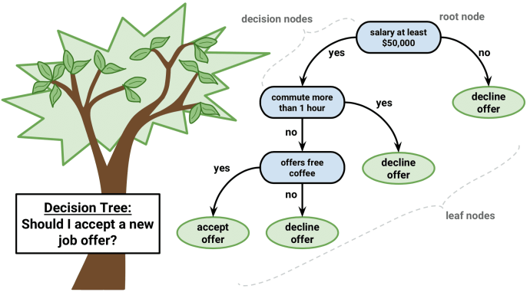
Introduction
Tree structure representing decision paths and it’s outcome .

Slide 4
Introduction ...contd
Tree is in Disjunctive Normal Form(Disjunction of conjunction)
In Propositonal Logic:
  Goal ( Path1 V Path2 V …. )
  Path = ( (salary>= $50000) = YES ^ (commute >= 1hr) = DeclineOffer )

Slide 5
Types
CART
Classification
Trees
Regression
Trees
-Categorical output
- Numeric output

Slide 6
X2
60
40
0
5
10
X1

Slide 7
X2
60
40
0
5
10
X1

Slide 8
How are splits done ?
Information entropy(uncertainty / disorder) :
- what questions to ask and in what order to obtain information to predict by the tree .
Less entropy is better .
Complex to calculate the entropy .
Greedy algorithm is used to pick the decision that reduce the entropy . It may not be optimal but it works !

Slide 9
Upgrades
Traditional decision trees not so popular .
Algorithms using decision trees :
  Random Forest
    - Avoid overfitting
    - Build multiple decision trees and average them (Ensemble Learning)
  Gradient Boosting

Slide 10
Analysis
Advantages
  Easy to understand and interpret .
  Transparent tracing .
  Easy handling of numeric and categorical data .
Disadvantages
  Hard to find optimal tree .
  Risk of overfitting or generalization is high .

Slide 11
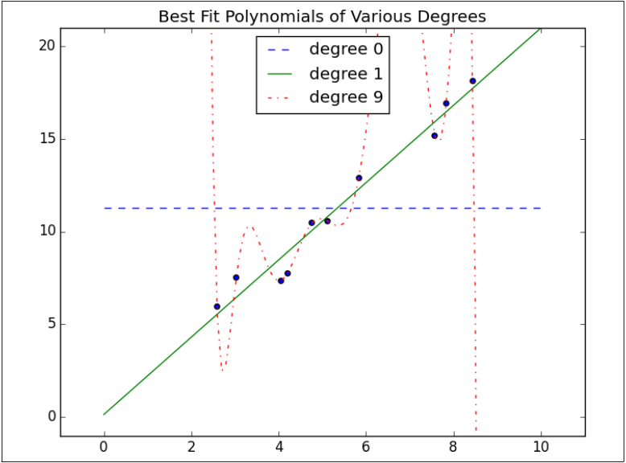
Overfitting vs Underfitting

Slide 12
Usages
Fraud Detection System
Spam filtering
Plagiarism
Recommendation Systems
Image Recognition
Customer Classification
Prediction Modelling

