Slide 1
Hamming Network
- Amrit Shrestha
- Saurav K.C
- Shreewatsa Timalsena
-Suprim Regmi

Slide 2
Neural network overview
Information processing paradigm inspired by biological nervous system
Why popular ?
Derive meaning from complicated data
Extract patterns , detect trends
Self-organization
Fault tolerance
Model non-linear and complex relationships

Slide 3
Neural Network Architechtures
Feed Forward Network
Perceptron
Competitive/Recurrent Network
Hamming Network
Recurrent Associative Memory Network
Hopfield Network

Slide 4
Hamming Network : Overview
Solves binary pattern recognition problems eg recognizing apples and oranges
Uses both feedforward and feedback/recurrent neural layers
Objective : To decide which prototype vector is closest to the input vector
Working principle : Calculating hamming distances between input vector and weight vector of output neurons

Slide 5
Hamming Distance
The distance between two vectors is equal to the number of elements that are different .
Greater the match between patterns , smaller the hamming distance .
Node with minimum hamming distance to input vector is the winner .
Hamming distance = number of different bits

Slide 6
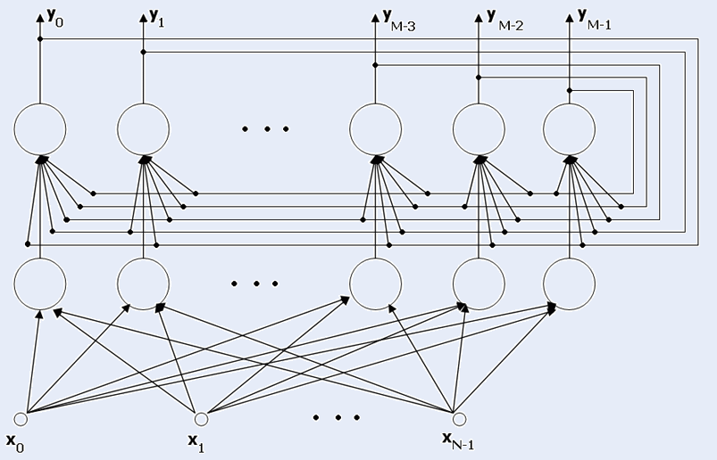
Hamming Network Architechture

Slide 7
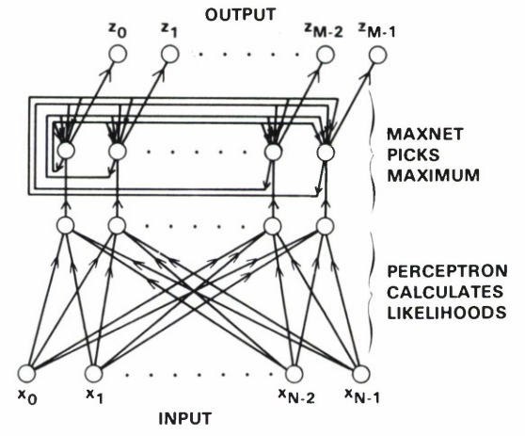
Architechture contd...(I)

Slide 8
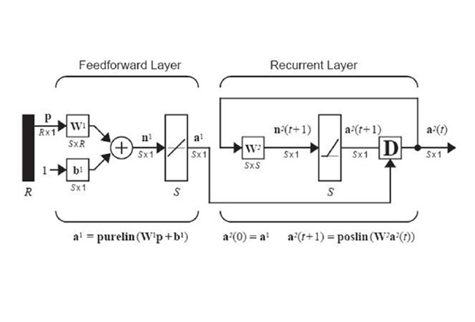
Architechture contd...(II)

Slide 9
Feed Forward Layer
Performs correlation , or inner product , between each of the prototype patterns and the input pattern .
Uses linear transfer function .
Inner Product :
Largest when the vectors point in same direction
Smallest if they point in opposite direction

Slide 10
Recurrent Layer
Initialized with the output of the feedforward layer .
Deciding learning rate , number of neurons is important .
Competitive Layer : neurons compete with each other to determine a winner .
After competition only one neuron will have a nonzero output .

Slide 11
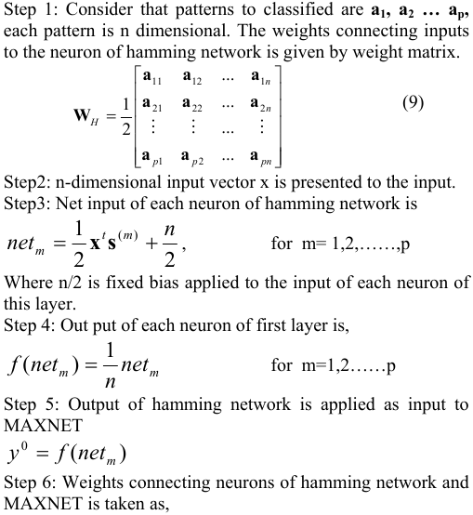
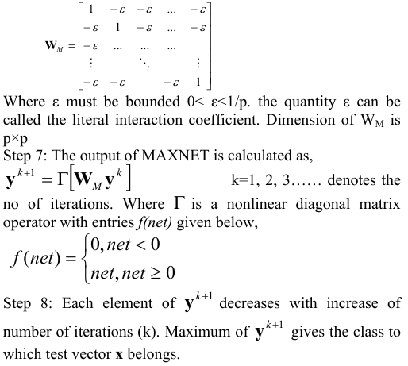
Hamming Algorithm

Slide 12


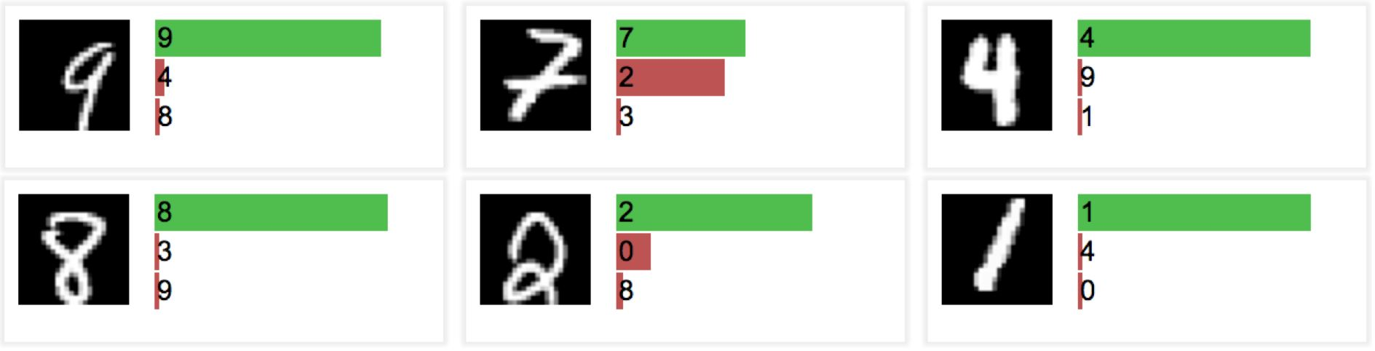
Hamming Network Example

Slide 13
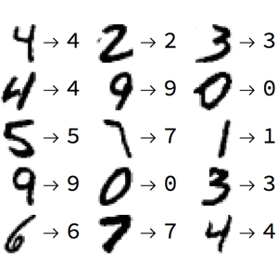
Example contd ...

Slide 14
Advantages over Hopfield Network
Requires fewer connections than hopfield network .
Number of connections grows linearly .

Slide 15
Hamming Network Usage
Digit Recognition
Image Classification
Voice Recognition
Spam Filtering
Noise Filtering
And many other classification problems

Slide 16
References
By Dr. Richard W. Hamming
https://youtu.be/aq_PLEQ9YzI
Hamming classifier by Stanisław Kamiński
http://home.agh.edu.pl/~vlsi/AI/hamming_en/

