Slide 1

Institutional asset issue and return management system
S.No. | Name | Roll No | USN
1. | Madhuram Garg | 349 | 01fe24bcs225
2. | Shreeya Mahale | 352 | 01fe24bcs228
3. | B.S Shanvi | 302 | 01fe24bcs0
4. | Rutu Kubasad | 362 | 01fe24bcs238
Under the guidance of : Manjula Pawar
Team no.: 9
Theme no.: 4

Slide 2
Integrated courses
Sl. No. | Course | Core Concepts
1. | Database Management System | ACID Properties, Concurrency Control & Row Locking, Relational Schema & Constraints, Triggers & Audit Logging.
2. | Web Technology | RESTful API Design, State Management, Asynchronous Programming, Form Validation & UI/UX.
3. | Software Engineering | State Machine Pattern, Role-Based Access Control (RBAC), Architectural Patterns.
4. | Operating Systems | Synchronization Primitives, Scheduling Algorithms.
5. | Computer Networks | RESTful API Design & Server-Side Validation, Authentication & Session Management.
6. | Data Structures and Algorithms | Queues for FIFO reservation management, searching and sorting for efficient book retrieval and transaction processing

Slide 3
Problem statement
The library lacks a bounded, reliable process for maintaining consistent book availability, reservation order, issue/return records and transaction history, which can result in inaccurate or difficult-to-trace asset status.

Slide 4
Project objectives
1. Maintain a unique record and current availability status for each library book.
2. Record book issue and return transactions with borrower and timestamp details.
3. Handle unavailable-book reservations in FIFO order.
4. Prevent an unavailable book from being issued through conflicting concurrent transactions.
5. Maintain an auditable transaction history for issue, return and reservation activities.

Slide 5
Functional requirements
The system shall authenticate user credentials and manage active sessions based on assigned roles (Borrower, Librarian, Administrator).
The system shall enforce role-based access control to restrict available features and data views for each user role.
The system shall register book metadata and assign unique copy identifiers for inventory tracking.
The system shall maintain real-time status for each book copy as Available, Issued, Reserved, or Maintenance.
The system shall verify book availability and borrower eligibility before authorizing any issue transaction.
The system shall record checkout transactions containing copy ID, borrower ID, issue timestamp, and calculated due date.

Slide 6
Functional requirements
The system shall record book returns with timestamps and update copy availability accordingly.
The system shall calculate overdue fines automatically based on days past the due date and institutional fine rates.
The system shall place borrowers into a First-In-First-Out (FIFO) reservation queue when no copies are available.
The system shall assign a returned reserved book to the top user in the FIFO queue and apply a temporary hold window.
The system shall maintain an immutable, append-only audit trail logging all issue, return, and reservation events.
The system shall generate searchable and filterable views for book availability, active issues, overdue, and transaction history.

Slide 7
Non functional requirements
The system shall enforce ACID compliance and row-level locking during issue and return transactions to prevent race conditions and duplicate checkouts.
The system shall complete availability lookups and transaction commitments within 500 ms under a typical load of up to 50 concurrent requests.
The system shall hash user passwords using standard salting algorithms and validate all incoming inputs server-side to prevent injection vulnerabilities.
The system shall maintain an append-only audit log with restricted write-only permissions that prevent modification or deletion by operational users.

Slide 8
Non functional requirements
The system shall allow circulation desk checkout and check-in workflows to be completed in three user interactions or fewer to minimize counter wait times.
The system shall decouple the user interface from business logic and database persistence using a modular RESTful API architecture.
The system shall automatically roll back incomplete or interrupted transactions to prevent orphan records and retain data consistency.
The system shall support catalog datasets of at least 10,000 book records and 2,000 user profiles without noticeable latency degradation.

Slide 9
Mapping FRs to engines
FR1. Computer Networks, Web Technology
FR2. Software Engineering, Web Technology
FR3. Database Management System, Web Technology
FR4. Software Engineering, Database Management System
FR5. Operating Systems, Computer Networks
FR6. Database Management System, Operating Systems
FR7. Database Management System, Software Engineering
FR8. Data Structures and Algorithms, Web Technology
FR9. Data Structures and Algorithms, Operating Systems
FR10. Data Structures and Algorithms, Software Engineering
FR11. Database Management System
FR12. Data Structures and Algorithms, Web Technology

Slide 10
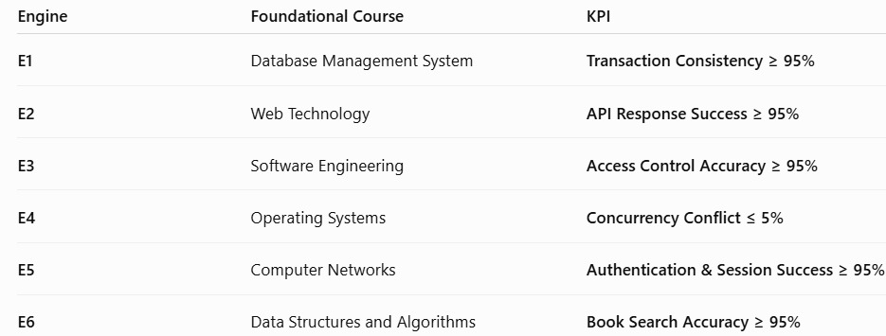
KPI

Slide 11
Stakeholders table
Stakeholder | Role / Description | Needs & Expectations | Current Pain Points | Influence (H/M/L)
Students | Main users borrowing books | Quick search, live book availability, automated due-date alerts | Long counter lines, untracked fines, surprise due dates | M
Librarians | Manage book issue, return, and member records | Easy record management, overdue tracking, automatic fine calculation | Manual entries, checking paper records, calculating fines takes time | H
Faculty members | Borrow books for teaching and research | Easy access to books and borrowing history | Delays in finding books and checking due dates | M
Library staff | Support daily library operations and maintain records | Simple system for managing books and transactions | Repetitive manual work and difficulty maintaining accurate records | M

Slide 12
In-scope
# | In-Scope Item
1 | Book registration and book master data.
2 | Borrower/student/faculty account records.
3 | Book availability/status management.
4 | Book issue and return transactions.
5 | Reservation queue using FIFO logic.
6 | Availability validation before issue.
7 | Transaction commit/rollback and basic concurrency protection.
8 | Audit trail for important issue, return and reservation actions.
9 | Basic reports such as available books, issued books, overdue/active transactions and transaction history.
10 | Role-based access for borrower, librarian and administrator.

Slide 13
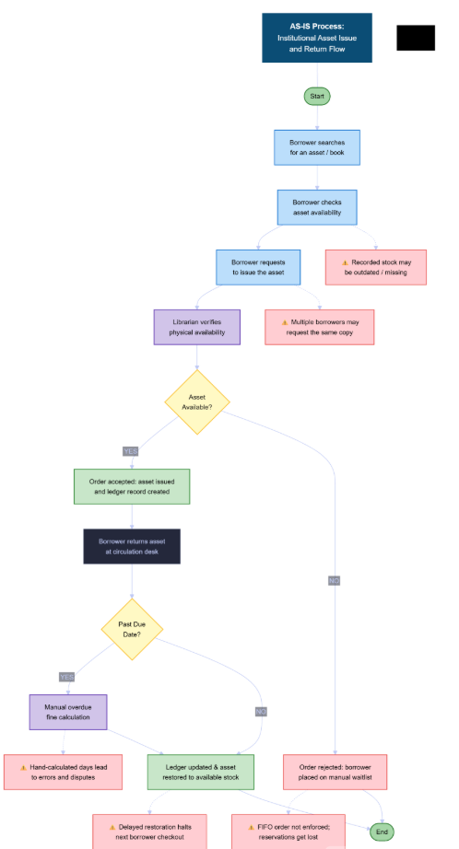
Workflow diagram

Slide 14
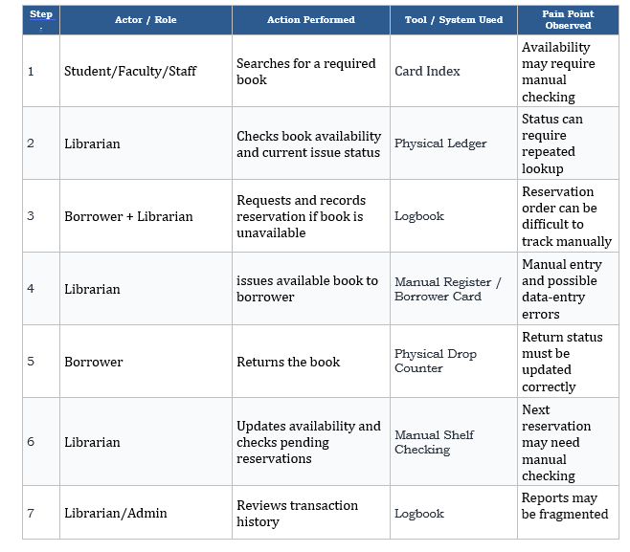
Workflow table

