Slide 1

AN AUTOMATED SYSTEM FOR LOCAL GP
Done BY: SHREEYA DINESH DESAI(sdd13)
Notes:
1

Slide 2
TOPICS TO BE COVERED
Aim.
Objective.
List Of Requirements.
Database.
Frontend.
Backend.
Azure Architecture.
Azure Services Used.
Demo.
Notes:
2

Slide 3
AIM
This project mainly aims to develop An Automated System For Local GPs, which would solve the problem faced by the GP’s, the healthcare staff and patients.
Problems such as:
No Clear communication between the GP and patient.
Patients need to go to the pharmacy to buy the prescription.
Patients must fill long appointment booking forms.
Minor injuries articles having lengthy information.

Slide 4

Objectives
The objective for this project would be to design a secure and user-friendly web application considering different demography of users, short appointment booking forms to patients with read through articles for minor injuries.
Conversely ,The General Practitioner will have a simplified dashboard which would help the doctors to set their availability, view the booked appointment, cancel their availability, view the patient previous medical history and prescribe the medicine.

Slide 5
List Of Requirements.
Essential:
Registration: The patient will be able to register to the webapp using secure login credentials. Registration of Doctors and Nurses will be performed by Admin.
Availability: The Doctor and Nurses will be allowed to set their availability prior to a month.
Book appointment: As per the need of patients they can book the appointment with the available Doctor/Nurse.
Provide prescription: The Doctor will be able to access medical history of patients and provide a digital prescription on the web app.
Admin Dashboard: The Admin Dashboard will allow administrators to add, remove healthcare staff and will also allow administrators to book appointments for aged patients.
Staff Dashboard: The Dashboard will help staff to set their availability, view booked appointments, provide prescriptions, view patients medical history and send prescription to pharmacy.
Patient Dashboard: The Dashboard will show the Doctor/Nurse Availability, book appointment, view prescriptions, upload the prior medical history, previous booked appointments records.
Notes:
5

Slide 6
List Of Requirements.
Desirable:
Deployment on the cloud
Articles for minor injuries & awareness: Inorder to tackle mild external injuries, Articles will be provided inorder to take safety measures at home which will reduce some staff workload.
View prescription: The patient will be able to view the prescription provided by the Doctor/Nurse online.
Buy and Pay prescriptions: For the prescribed medicine, the patient can buy and pay for the prescription either online or offline.
Notes:
6

Slide 7
List Of Requirements.
Optional:
One to one chat: Due shortage of Doctor/Nurse, if incase there's a follow-up required for a specific patient or a patient requires immediate attention the chat feature can be leverage.
Responsive Web Application.
Video Consultation.
Notes:
7

Slide 8
Database
ER- Diagrams
Database Connectivity
SQL Scripts
The database first approach was used.
Azure services used are Azure SQL and Azure Cosmos DB.
The application is developed considering N-tier / Multi –Tier architecture.
Frameworks used: React + bootstrap , Flask.

Slide 9
Frontend
Low Fidelity Prototype
High Fidelity Prototype
Components
Pages
Main(app.js)
The frontend was designed in React Bootstrap.
For each of the pages the component were designed and imported to the pages.
The app.js is the main root of the application.

Slide 10
Backend
The folder structure of the backend is scalable, maintainable and understandable.
The main.py file handled the logic of the application and the docker file was used to build the docker image.
The patient routes and staff routes handle the respective logic according to their names.
Additionally, the environment file contains the connecting string of the azure resources used.
Notes:
10

Slide 11
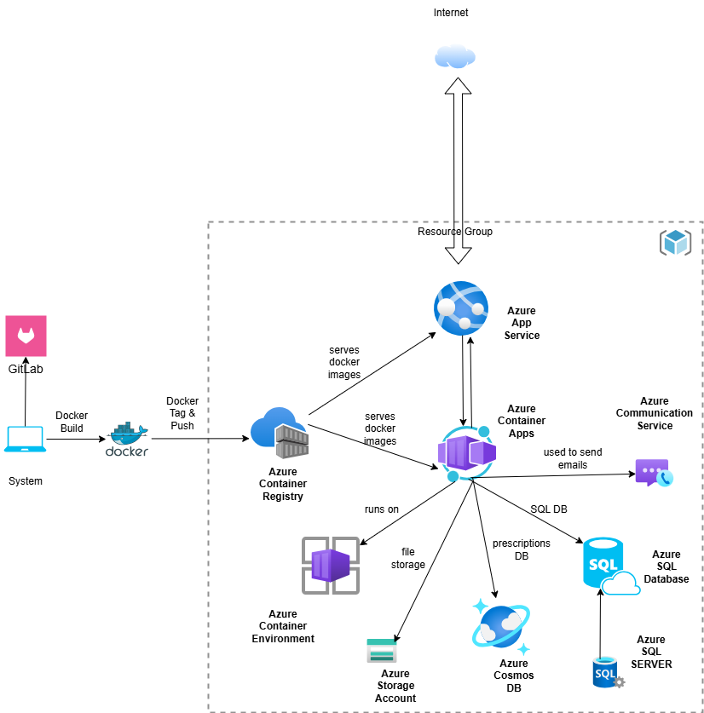
CLOUD ARCHITECTURE
Notes:
11

Slide 12
Azure Services used
Azure SQl.
Azure Cosmo DB.
Azure Container Apps.
Azure Service Apps.
Azure Communication service.
Azure Storage Accounts.

Slide 13
Demo

Slide 14
THANK YOU FOR YOUR TIME AND ATTENTION
Notes:
14

