Slide 1
Customer Churn Prediction
Using AI-ML and Deep Learning
By : Shreeya Dash
https://github.com/shreeya9094/Customer_Churn_Prediction_E2E_AI_ML_Project
https://www.kaggle.com/datasets/blastchar/telco-customer-churn

Slide 2
Presentation Overview
Objective
Problem Statement
Dataset & Methodology
Model Architecture
Results & Evaluation
Business Insights
Future Improvements
Conclusion

Slide 3
Objective
Develop a Machine Learning and Deep Learning based model to predict telecom customer churn accurately.
Analyze customer behavior and identify key factors influencing customer attrition.
Help businesses improve customer retention strategies and reduce revenue loss through data-driven insights.
Compare the performance of multiple Machine Learning and Deep Learning algorithms using evaluation metrics.
Enable organizations to take proactive actions for customer satisfaction and long-term business growth.

Slide 4
Problem Statement
Customer churn directly impacts telecom company revenue.
Acquiring new customers is more expensive than retaining existing customers.
Need an intelligent predictive system to identify high-risk customers early.

Slide 5
Dataset Information
IBM Telco Customer Churn Dataset from Kaggle.
Contains demographic, service usage, financial, and tenure information.
Target Variable: Churn (Yes / No).
Problem Type: Binary Classification.

Slide 6
Approach & Methodology
Performed data preprocessing and cleaning.
Converted Total Charges to numeric values.
Handled missing values using median imputation.
Applied One-Hot Encoding for categorical variables.
Scaled numerical features using Standard Scaler.
Split dataset into training and testing sets.

Slide 7
Models Implemented
Logistic Regression
Random Forest Classifier
XGBoost Classifier
Artificial Neural Network (ANN)

Slide 8
Deep Learning Architecture
Input layer with customer features.
Three hidden layers using ReLU activation.
Dropout layers used to prevent overfitting.
Sigmoid activation in output layer.
Binary Cross entropy loss function with Adam optimizer.

Slide 9
Results & Evaluation
Evaluation Metrics Used:
• Accuracy Score
• ROC-AUC Score
• Confusion Matrix
• Classification Report
ML and DL models successfully predicted churn patterns.

Slide 10
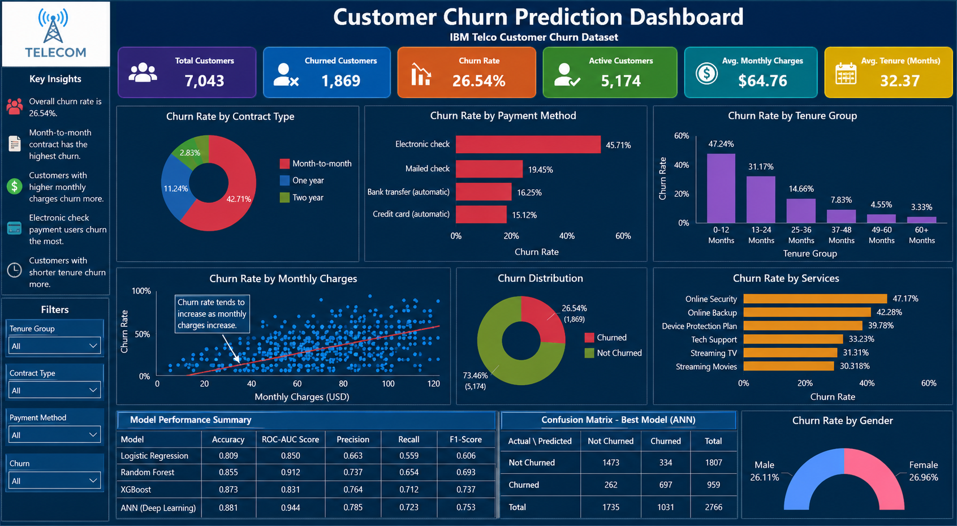
Customer Churn Prediction Dashboard

Slide 11
Key Business Insights
Month-to-month contract customers are more likely to churn.
Higher monthly charges increase churn probability.
Customers with longer tenure show lower churn risk.
Electronic payment users have higher churn tendencies.

Slide 12
Future Improvements
Hyperparameter tuning for better model performance.
Use SMOTE for class imbalance handling.
Deploy model using Streamlit or Flask.
Integrate explainability using SHAP values.

Slide 13
Conclusion
Machine Learning and Deep Learning can effectively predict telecom customer churn.
The project helps businesses improve customer retention strategies.
Predictive analytics can significantly reduce revenue loss.

Slide 14
References
IBM Telco Customer Churn Dataset – Kaggle
Scikit-learn Documentation
TensorFlow / Keras Documentation
XGBoost Documentation

