Slide 1
Cyber AI Hackathon 2026
Organized by University of Derby
Missing Stitch : An AI Auditor for Missed Surgical Bills
Team Number | : | 2265
Team Name | : | Missing Stitch
Problem Theme | : | AI in Healthcare & Life Sciences, Finance, Retail & Business (AI and its applied domain)
Institute Name | : | Indian Institute of Information Technology, Sri City
Team Members | : | Nitish Gorontala Badrinarayanan, Shreeya Sai Jetti
Contact | : | Mail - nitishgb52@gmail.com , Phone - +91 81978 43216
Date: 6 October 2026

Slide 2
1. Background
Tertiary care hospitals in India lose 1-5% of their surgical revenue due to manual billing omissions.
High-value consumables like implants, stents, and specialized medications are often used in the OT but fail to be documented in the final bill due to chaotic manual workflows.
Missing Stitch is an Agentic AI Auditor compares surgery notes with hospital bills to catch missing charges.
Who this is for
Billing teams, hospital admins and finance heads in large (tertiary care) hospitals.
1–5%
of a hospital's net revenue is lost to charges that never get captured
HFMA estimate
$7.5M
recovered in 15 months by one 14-hospital system after fixing its charge capture
Novant Health, reported by HFMA

Slide 3
2. Problem Statement
The notes recorded during the surgery is generally not matched with the final billing. Here's a real record from our test data:
What the OT note says
What the bill says
Patient P-002 · Cardiac stenting
“2x Onyx Stents (3.5mm) deployed in LAD. 1x Emerge Balloon used for pre-dilation.”
Billing invoice
Onyx Stent × 1
Missing from the bill: 1 stent and 1 balloon
Checking every bill against every note by hand takes hours, so it rarely happens. Simple keyword checks don't help much either as “Ti screw” and “Titanium Interference Screw” look like two different items, hence there is a need for an intelligent system that can map these two

Slide 4
3. Objectives
What we want Missing Stitch to do:
1
Read messy OT notes like a person would
Understand brand names, short forms and quantities written in free text.
2
Compare every note with its bill
Flag items that were used but not billed, or billed in a smaller quantity.
3
Report before the patient is discharged
Give admins a clear recovery table while the bill can still be corrected.
4
Keep patient records on the hospital's own machines
Raw files stay local. The AI model only sees what it needs to reason.

Slide 5
4. Proposed Solution
Missing Stitch is an AI assistant that admins can simply message on Telegram. Type “Audit this” and it replies with a table of everything that was used in theatre but not charged.
Read
Match
Flag
Report
Pulls in the OT notes and the bills for the day
Lines up each item in the notes with the bill, even when names differ
Marks items missing completely or billed short
Sends back a recovery table with patient, item and estimated value
Built on the hospital's own data
It works on top of the existing hospital managemetn software (HMS). No new system for staff to learn, just a chat.

Slide 6
5. Novelty and Show Stopper
 | Usual billing checks | Missing Stitch
Matching | Exact text only | Understands short forms and brand names
Hidden items | Only checks what's written | Knows a hip replacement normally needs bone cement
When | Monthly audit, after discharge | Same day, before discharge
How you ask | Reports on a desktop | Plain English, from your phone
Show stopper
An admin types “Show me leakage for today's ortho surgeries” on their phone and gets back a ranked list of missed items, while the bill can still be fixed.

Slide 7
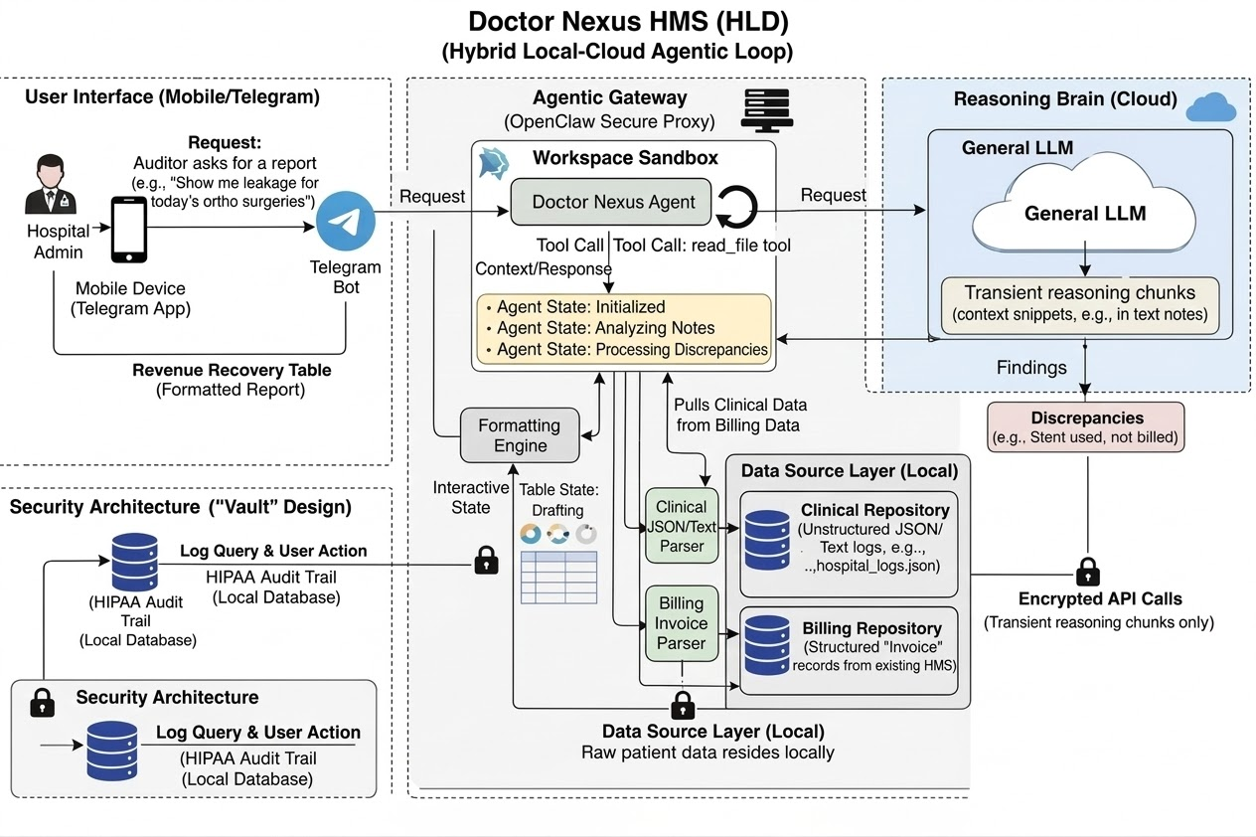
6. Methodology

Slide 8
7. Tech Stack used and Budget
Tech stack used
OpenClaw: For running agent locally and linking to telegram
Gemini 3.5 Flash: reads notes and finds gaps
Telegram Bot: Chatbot to interact with user
JSON files: sample OT notes and bills for 25 patients (Test data)
Python: For offline tests when Gemini API is not available
Estimated Budget
Prototype: Free
Everything runs on free tiers and a normal laptop.
For a hospital pilot we'd need:
A small on-site server or VM
Paid Gemini API usage (charged per request)
A link to the hospital's billing system (HMS)

Slide 9
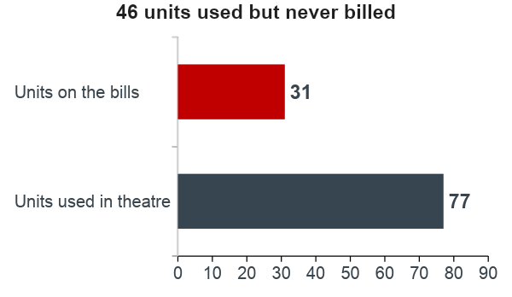
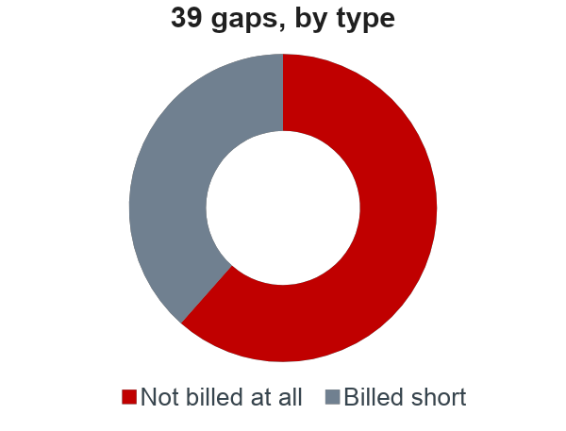
8. Deliverable / Expected Outcome
MVP : a Telegram chatbot backed by a local AI agent, plus a recovery table admins can act on.
We ran the audit on the 25 sample patients in the project:
Every one of the 25 patients had at least onediscrepancy. 29 of the 39 were implants or devices, which are the expensive ones.

Slide 10
9. Team Role
Role → Team ↓ | Research & problem | AI agent & prompt | Data & testing | Telegram & OpenClaw | Pitch & docs
Nitish GB | ✓ | ✓ |  | ✓ | ✓
Shreeya J |  | ✓ | ✓ | ✓ | ✓

Slide 11
10. Screenshot of the outcome-1
*Insert telegram runs here*

Slide 12
11. Screenshot of the outcome-2
*INSERT OFFLINE RUN HERE*

Slide 13
12. References
1. JTS Health Partners, “How Much Is Your Hospital Losing Through a Poor Charge Capture Process?” (cites HFMA: 1–5% of net revenue). jtshealthpartners.com/blog
2. Commure, “Charge Capture in Healthcare: What It Is, Why Revenue Leaks, and How AI Fixes It” (cites HFMA, Novant Health case). commure.com/blog
3. OpenClaw documentation. docs.openclaw.ai
4. Google, Gemini API documentation. ai.google.dev/gemini-api/docs
5. Telegram, Bot API documentation. core.telegram.org/bots/api

Slide 14
Thank You

