Slide 1
Cyber AI Hackathon 2026
Organized by University of Derby
Doctor Nexus: An AI Auditor for Missed Surgical Bills
Team Num | : | T-<<Enter any four-digit number>>
Team Name | : | <<Team Name>>
Problem Theme | : | AI in Healthcare & Life Sciences (AI and its applied domain)
Institute Name | : | << Institute / University Name >>
Team Members | : | << All the team members separated with comma >>
Contact | : | << Email id and contact number of the team leader >>
Date: <<Event Date>>
Notes:
Introduce the team and the one-line idea: Doctor Nexus reads surgery notes and the bill, and tells the hospital what was used but never charged.

Slide 2
1. Background
During surgery, the team writes down what they used: screws, stents, grafts, clips.
Later, someone in billing types up the bill by hand from those notes.
Things slip through. The note says two stents, the bill says one. Usually nobody spots it until the patient has gone home.
Who this is for
Billing teams, hospital admins and finance heads in large (tertiary care) hospitals.
1–5%
of a hospital's net revenue is lost to charges that never get captured
HFMA estimate
$7.5M
recovered in 15 months by one 14-hospital system after fixing its charge capture
Novant Health, reported by HFMA
Notes:
Implants and devices are the most expensive things in an operation, and they are exactly what gets missed. The numbers on the right are from HFMA (see references). The project README also quotes 15-20% for Indian hospitals, but we could not find a source for that, so we left it out.

Slide 3
2. Problem Statement
The surgery notes and the bill don't talk to each other. Here's a real record from our test data:
What the OT note says
What the bill says
Patient P-002 · Cardiac stenting
“2x Onyx Stents (3.5mm) deployed in LAD. 1x Emerge Balloon used for pre-dilation.”
Billing invoice
Onyx Stent × 1
Missing from the bill: 1 stent and 1 balloon
Checking every bill against every note by hand takes hours, so it rarely happens. Simple keyword checks don't help much either: “Ti screw” and “Titanium Interference Screw” look like two different items to a computer.
Notes:
Walk through P-002 slowly. This one example makes the whole problem obvious.

Slide 4
3. Objectives
What we want Doctor Nexus to do:
1
Read messy OT notes like a person would
Understand brand names, short forms and quantities written in free text.
2
Compare every note with its bill
Flag items that were used but not billed, or billed in a smaller quantity.
3
Report before the patient is discharged
Give admins a clear recovery table while the bill can still be corrected.
4
Keep patient records on the hospital's own machines
Raw files stay local. The AI model only sees what it needs to reason.
Notes:
Four objectives. The last one matters a lot for hospitals, because patient data is sensitive.

Slide 5
4. Proposed Solution
Doctor Nexus is an AI assistant that admins can simply message on Telegram. Type “Audit this” and it replies with a table of everything that was used in theatre but not charged.
Read
Match
Flag
Report
Pulls in the OT notes and the bills for the day
Lines up each item in the notes with the bill, even when names differ
Marks items missing completely or billed short
Sends back a recovery table with patient, item and estimated value
Built on the hospital's own data
It works on top of the existing hospital software (HMS). No new system for staff to learn, just a chat.
Notes:
Read, match, flag, report. Keep it that simple when presenting.

Slide 6
5. Novelty and Show Stopper
 | Usual billing checks | Doctor Nexus
Matching | Exact text only | Understands short forms and brand names
Hidden items | Only checks what's written | Knows a hip replacement normally needs bone cement
When | Monthly audit, after discharge | Same day, before discharge
How you ask | Reports on a desktop | Plain English, from your phone
Show stopper
An admin types “Show me leakage for today's ortho surgeries” on their phone and gets back a ranked list of missed items, while the bill can still be fixed.
Notes:
The 'implied items' row comes from the project's audit flow document (docs/audi_flow.md).

Slide 7
6. Methodology
On the hospital's machine (OpenClaw gateway)
Doctor Nexus agent
follows the auditor prompt
Gemini
reasoning in the cloud
Admin
asks on Telegram
read_file
OT notes
free text
Bills
structured items
Recovery table
back on the phone
1
Admin sends a message to the Telegram bot.
2
The agent reads the day's OT notes and bills with its read_file tool.
3
Gemini compares them: missing items, short quantities, implied items.
4
Each gap gets a value and a certainty (implants = high).
5
A formatted recovery table goes back to the admin.
Notes:
Raw files stay inside the dashed box. Only the text needed for reasoning goes out to Gemini over an encrypted API call. Full architecture diagram is in docs/HLD.jpg in the repo.

Slide 8
7. Tech Stack used and Budget
Tech stack used
OpenClaw: runs the agent locally and links it to Telegram
Google Gemini (2.0 Flash): reads notes and finds gaps
Telegram Bot: the chat screen admins use
JSON files: sample OT notes and bills for 25 patients
Python: our offline test runner (no API key needed)
Estimated Budget
Prototype: ₹0
Everything runs on free tiers and a normal laptop.
For a hospital pilot we'd need:
A small on-site server or VM
Paid Gemini API usage (charged per request)
A link to the hospital's billing system (HMS)
Pilot costs to be confirmed with the partner hospital.
Notes:
Prototype cost is genuinely zero. Don't promise pilot numbers we haven't priced.

Slide 9
8. Deliverable / Expected Outcome
What we deliver: a Telegram chatbot backed by a local AI agent, plus a recovery table admins can act on.
We ran the audit on the 25 sample patients in the project:
Every one of the 25 patients had at least one gap. 29 of the 39 were implants or devices, which are the expensive ones.
Notes:
Numbers come from running local_run/run_audit.py on workspace/hospital_logs.json. Rupee values need a hospital price list, which the repo doesn't include.

Slide 10
9. Team Role
Role → Team ↓ | Research & problem | AI agent & prompt | Data & testing | Telegram & OpenClaw | Pitch & docs
Member-1
Member-2
Member-3
Member-4
Member-5
Notes:
Fill in member names and tick the roles each person actually did.

Slide 11
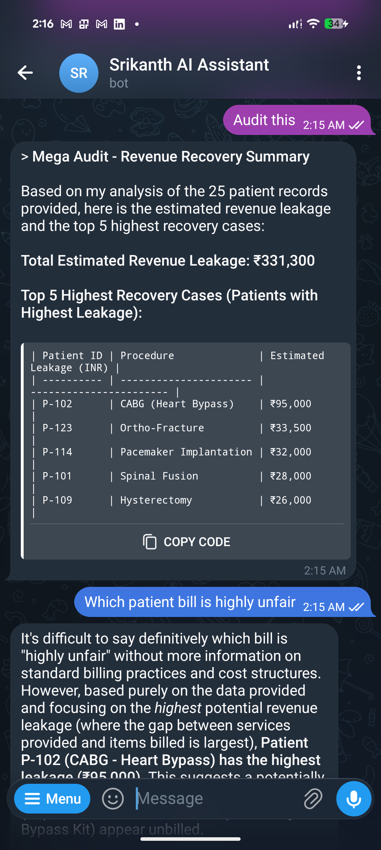
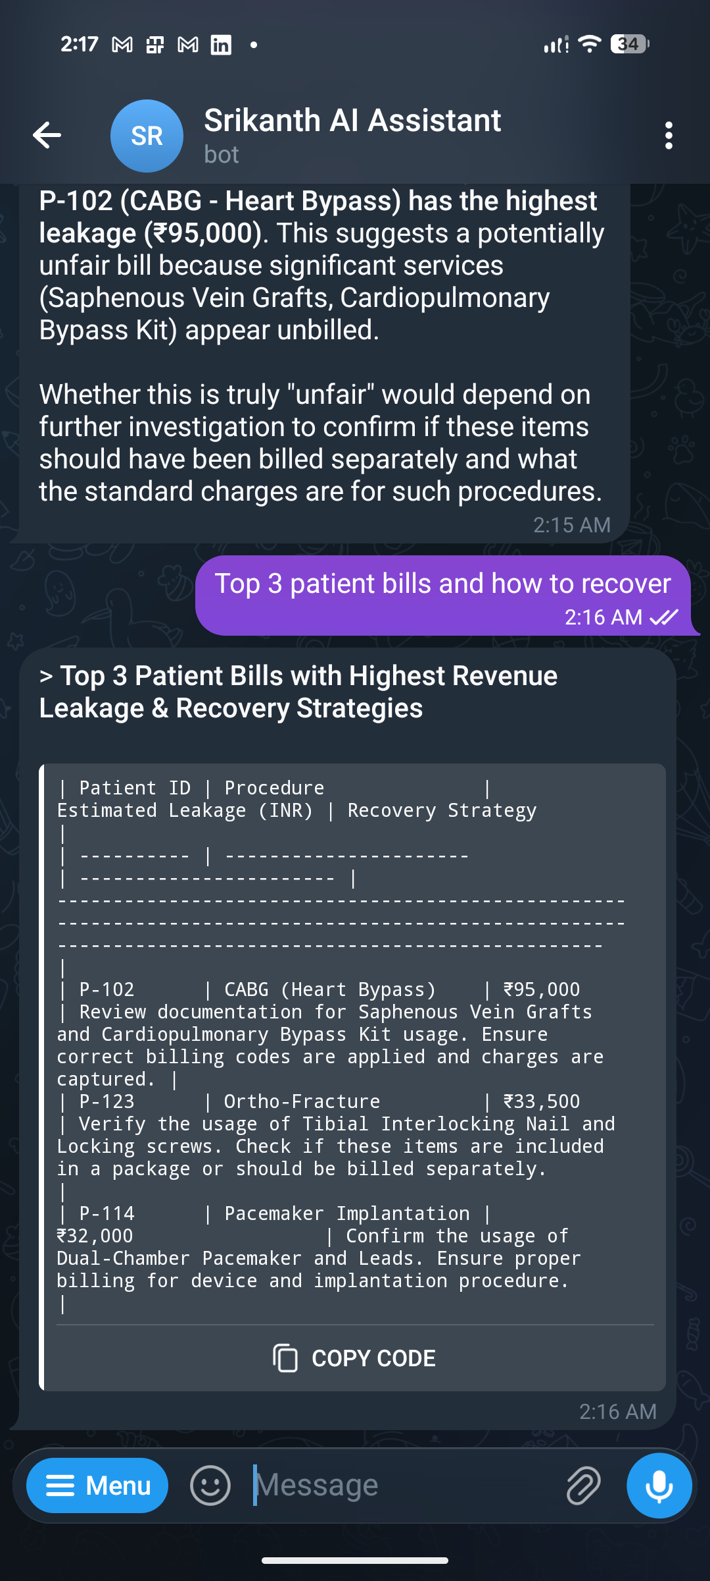
10. Screenshot of the outcome-1
The agent answering on Telegram, running through OpenClaw.
“Audit this” returns a summary and the top 5 cases
“Top 3 bills and how to recover” adds next steps
Notes:
These screenshots are from the project author's own run. The patient IDs shown (P-102, P-123...) come from an earlier dataset, not the 25 records now in the repo.

Slide 12
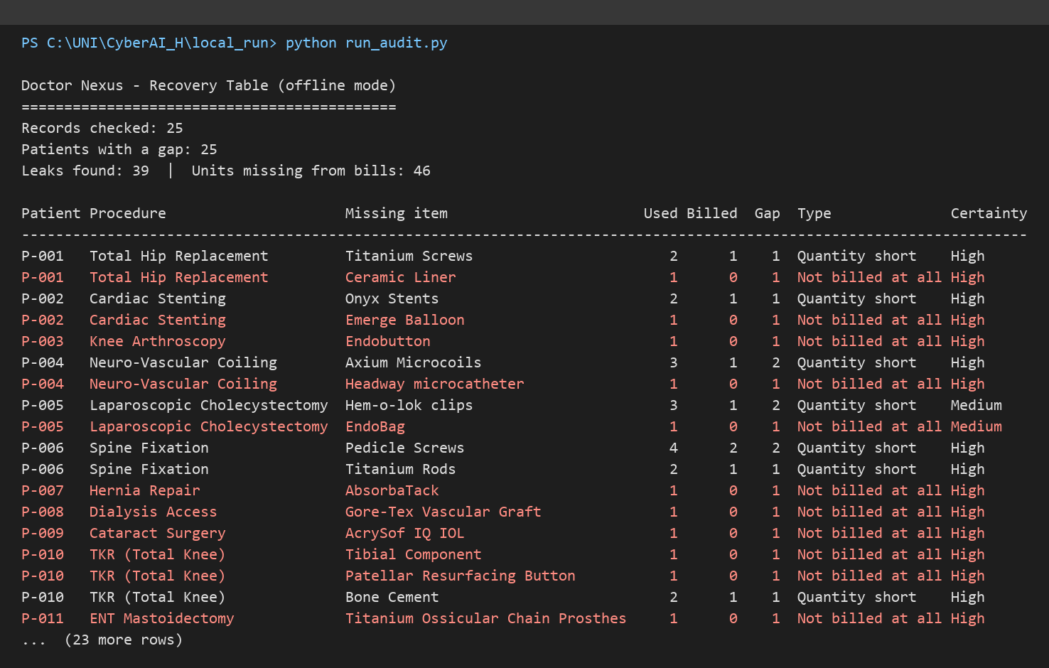
11. Screenshot of the outcome-2
We also ran the same audit on our laptop, offline, with no API key.
Rows in red are items that were never billed at all.
Notes:
Command: python run_audit.py (see walkthrough.md). Add --llm to use Gemini instead.

Slide 13
12. References
1. Doctor Nexus HMS, GitHub repository. github.com/srikanth-hn/Doctor-Nexus-HMS
2. JTS Health Partners, “How Much Is Your Hospital Losing Through a Poor Charge Capture Process?” (cites HFMA: 1–5% of net revenue). jtshealthpartners.com/blog
3. Commure, “Charge Capture in Healthcare: What It Is, Why Revenue Leaks, and How AI Fixes It” (cites HFMA, Novant Health case). commure.com/blog
4. OpenClaw documentation. docs.openclaw.ai
5. Google, Gemini API documentation. ai.google.dev/gemini-api/docs
6. Telegram, Bot API documentation. core.telegram.org/bots/api
Notes:
Full links are in explanation.md.

Slide 14
Thank You
Questions? github.com/srikanth-hn/Doctor-Nexus-HMS

