Slide 1

Coronavirus Tweet Categorization and Exploration
Group 2: Gabriel Cruz, Shreeya Kotasthane, Lisa Peterson, Md Main Uddin Rony

Slide 2

Research Questions
Can we predict the number of the retweet or favorite count based on the tweet text and other metadata?
Can we predict if the tweet is fake/rumor/hoax using a classification method?
Do the fear causing tweets get more attention during an epidemic like Coronavirus than fear relieving tweet?
Can we predict if a Twitter user is looking for any information about the Coronavirus? If so, what type of information are users looking for?

Slide 3
State of the Art
Pandemics in the Age of Twitter: Content Analysis of Tweets during the 2009 H1N1 Outbreak
It was the first time social media was used as the primary source of information by the public. Not only did it allow for dissemination of factual resources but became a source that allowed the public to engage their own fears and experiences but to spread fallacies as well.
Real time data mining is important for understanding public perception of outbreaks.
You Are What You Tweet: Analyzing Twitter for Public Health
Information analysis derived from Twitter provides an additional benefit of being less expensive and time consuming than traditional methods, but cons are the demographics of Twitter users are predominantly younger and may not be as commonly used in other countries.

Slide 4
State of the Art contd
Effects of misleading media coverage on public health crisis: a case of the 2019 novel coronavirus outbreak in China
A case study on the impact of misinformation on the spread of the outbreak, racial discrimination and public perception of geographical regions during a pandemic.
Forecasting the Future: Leveraging RNN based Feature Concatenation for Tweet Outbreak Prediction
A study on the ability for Recurrent Neural Networks to predict the popularity of a tweet demonstrates the practices to create the most effective model.

Slide 5
State of the Art contd
Monitoring Public Health Concerns Using Twitter Sentiment Classifications
Study performing a comparison of different machine learning methods to classify sentiment of tweets. This study demonstrates that there are ongoing studies on using classification methods to better understand how users feel about ongoing pandemics and global health concerns.

Slide 6
Data Collection
We took the initiative to collect the tweets through Twitter Streaming API.
Gathered streaming tweets using python
Package: tweepy
Dates: February 6, 2020 to February 10, 2020
Containing keyword: #coronavirus
As tweet searching is case insensitive, we didn’t have to consider the variations of these hashtags.
Filtered out tweets of other languages as well as tweets that were retweets.

Slide 7
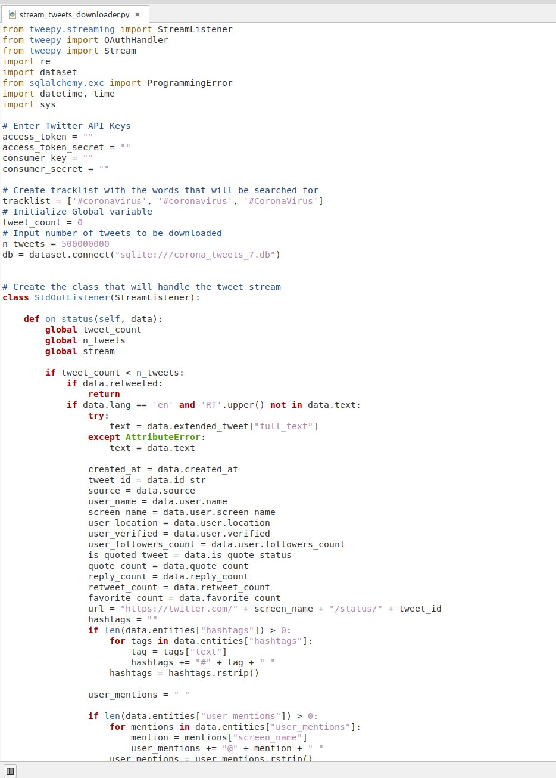
Data Collection

Slide 8
Dataset
We parsed 17 fields from the API response which we think might be interesting.
tweet text, tweet creation time, tweet id, tweet URL, tweet source, user’s name, screen name, user’s location, user’s verification information, user’s follower count, quote status, quote count, reply count, retweet count, favorite count, hashtags, and user mentions.
SQLite, to store the tweet data.
In total, we collected 1,75,251 tweets related to coronavirus.

Slide 9
Software Engineering Efforts
As the twitter streaming API does not give the URL of the tweets as a response field, a manual approach was taken to build the URL from the fields: tweet id and username.
Using the common pattern of the URL: https://twitter.com/user_name/status/tweet_id, we built the tweet URL.
Extra efforts might be needed to merge the data collected in two rounds.

Slide 10
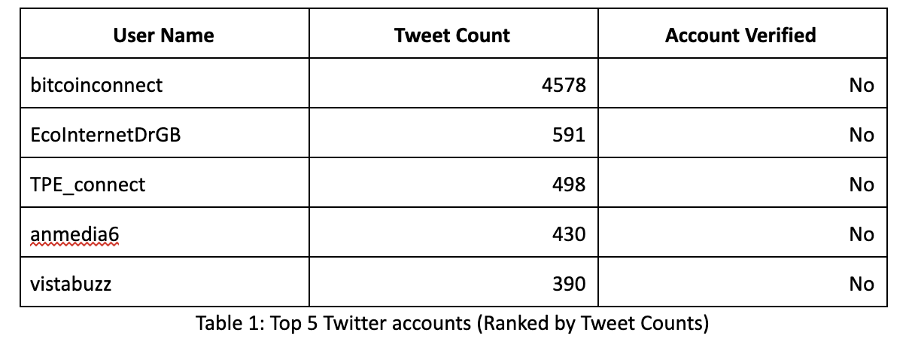
Data Analysis

Slide 11
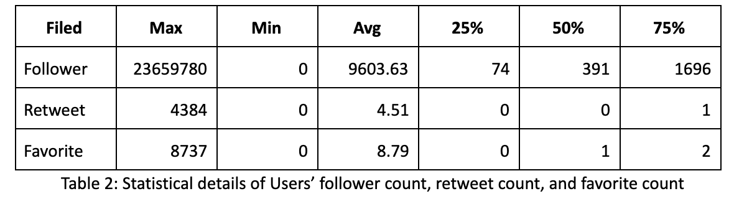
Data Analysis

Slide 12
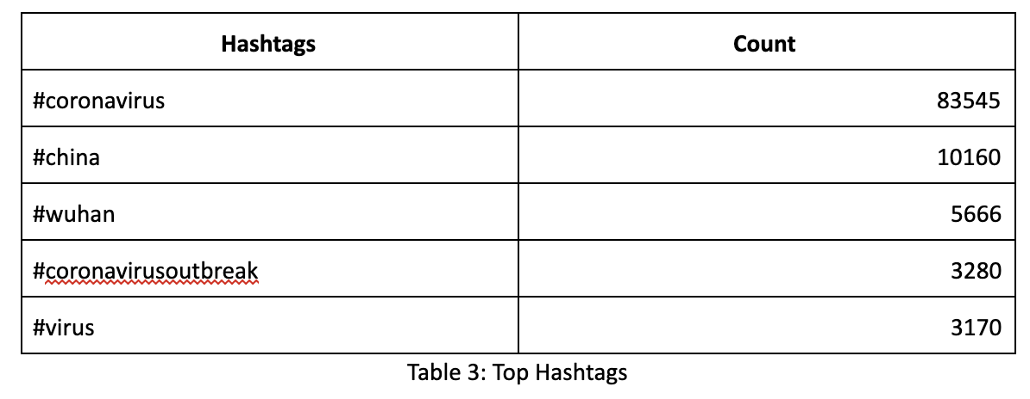
Data Analysis

Slide 13
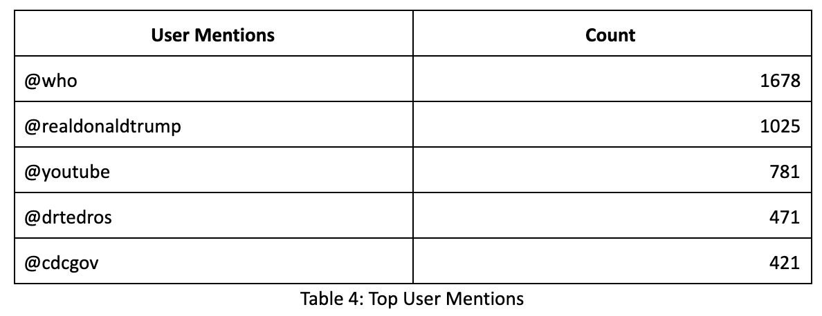
Data Analysis

Slide 14
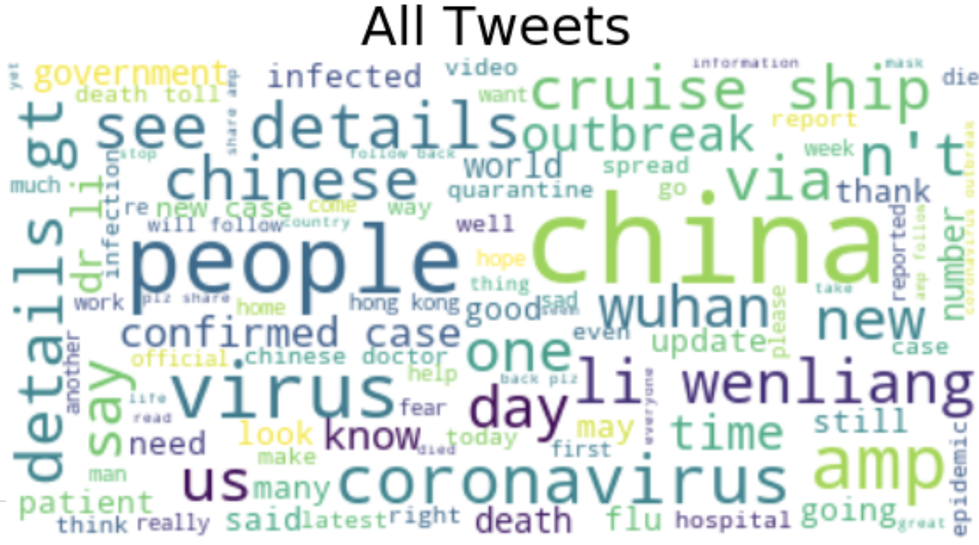
Data Analysis

