Slide 1

Forecasting U.S. Airline Passenger Traffic: A Data-Driven Approach
Presentation By:
Shreeya Sampat

Slide 2
Objective
Analyze historical passenger Traffic Data:
- Investigate trends, seasonality, and distributions (eg. Covid)
- Prepare data for time series modeling.
Develop and Evaluate Forecasting Models:
- Compare ARIMA and ETS models using statistical metrics (e.g., AIC, BIC, MAPE).
Combine Forecasts for Enhanced Accuracy:
- Explore equal-weighted, inverse MSE-weighted, and OLS-weighted combined forecasts.

Slide 3
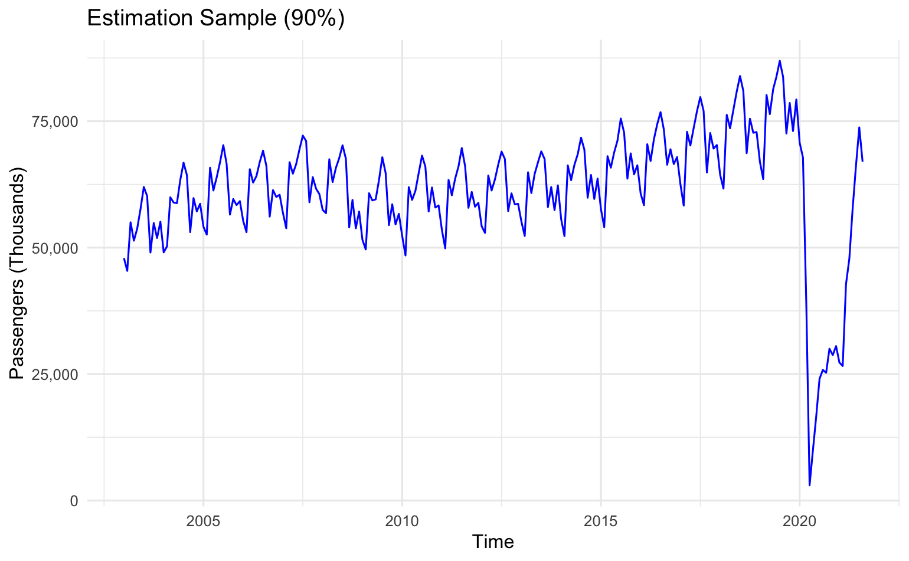
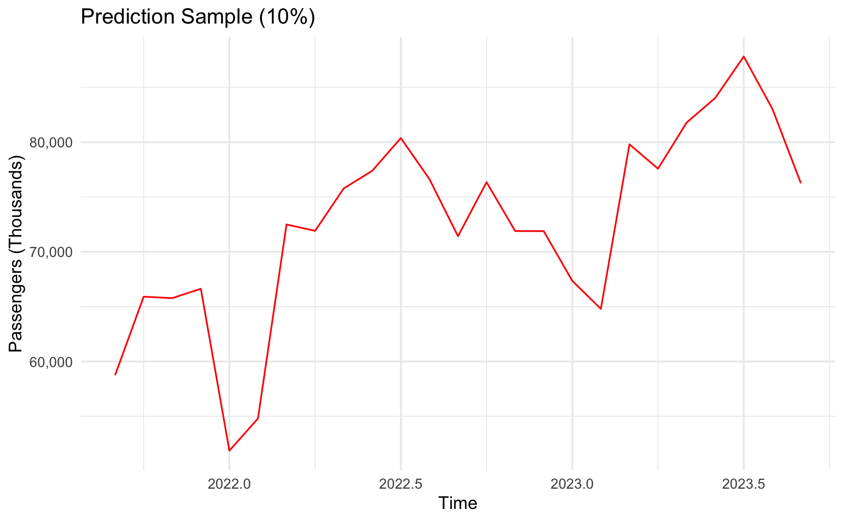
Why Are We Forecasting Air Traffic?
Importance of accurate forecasts for resource allocation, economic analysis, and planning.
Brief overview of U.S. airline passenger trends.
Dataset spans January 2003 to September 2023.

Slide 4

Model Selection & Fitting
Model Choices: We selected AR(1), MA(1), and ARMA(1,1) models for their simplicity and effectiveness in capturing time series patterns.
AR(1) and MA(1): These models focus on either autoregressive (AR) or moving average (MA) components individually, allowing us to assess their independent contributions to forecasting accuracy.
ARMA(1, 1): Combines both AR and MA components, making it suitable for capturing more complex dependencies in the time series data.
Fitting ARMA Model: We applied the ARMA(1, 1) model to the estimation sample, using it as the primary model to test different forecasting schemes.
Rationale for Model Choice: These models are commonly used in time series analysis for short-term forecasting, balancing interpretability and forecasting power.

Slide 5
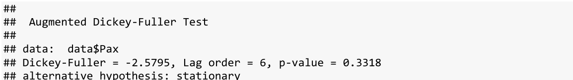
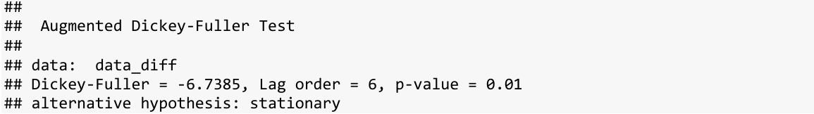
Stationarity Analysis
Why Stationarity?
ARIMA requires stationarity (constant mean and variance).
Methods Used:
Augmented Dickey-Fuller (ADF) Test.
Differencing to stabilize the data.
Results:
ADF p-value for original data: >0.05 (non-stationary).
ADF p-value for differenced data: <0.05 (stationary).

Slide 6

Forecasting Schemes Overview
Fixed Scheme: Forecasting with a static model for a fixed period.
Recursive Scheme: One-step forecasts that update the model each step.
Rolling Scheme: Continually updated model using a moving window.

Slide 7
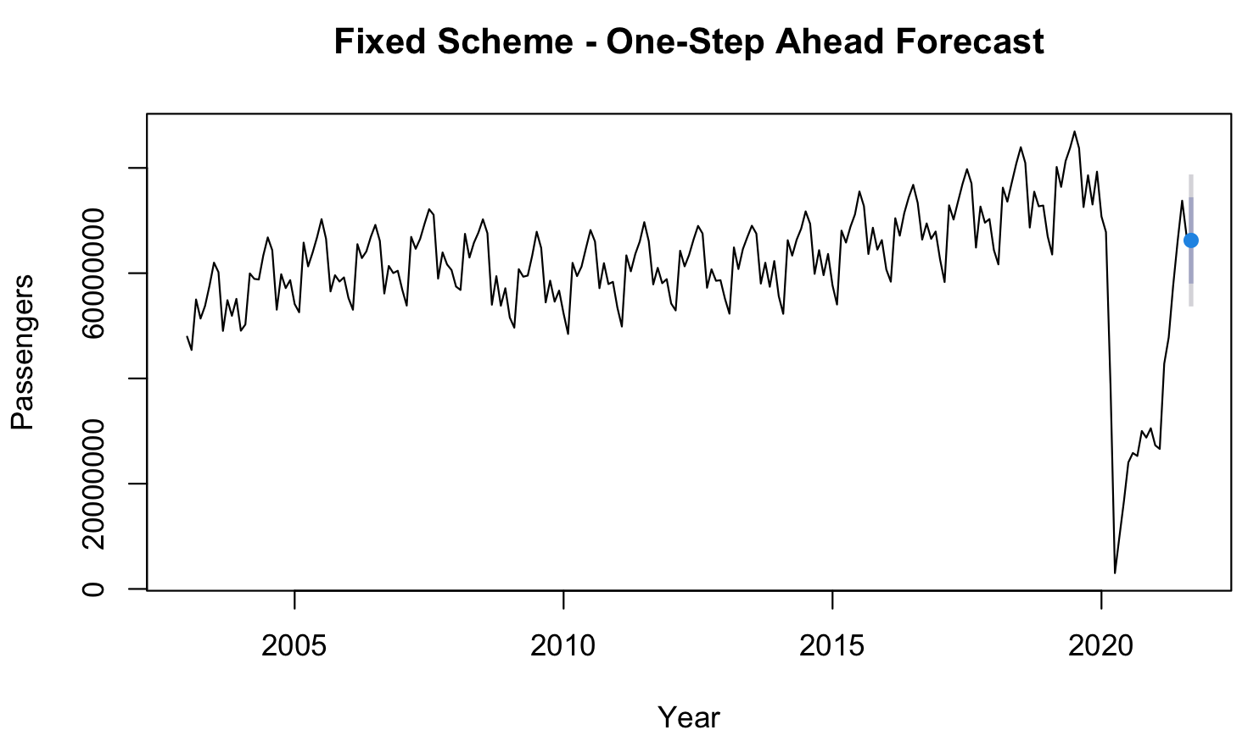
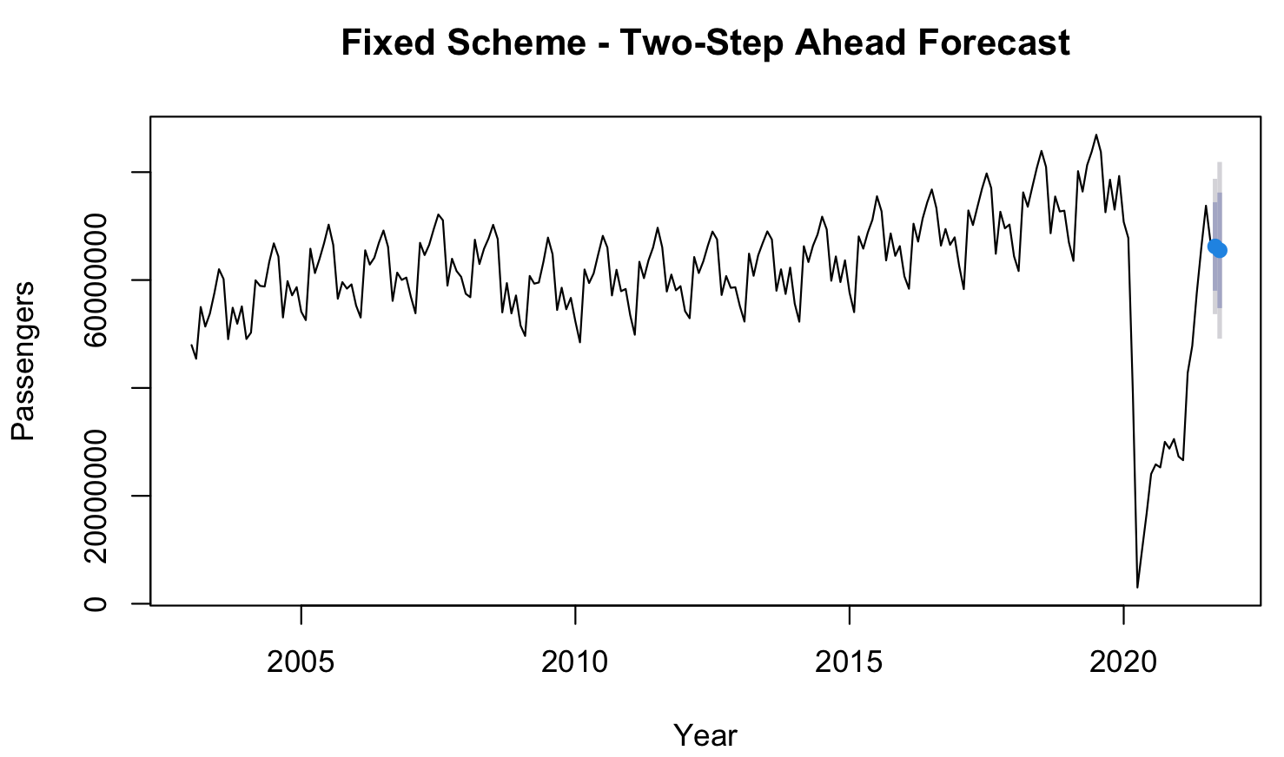
Fixed Scheme Results
This graph shows the forecasted value for one step ahead without updating the model.
This graph illustrates the forecasted values for two steps ahead, maintaining a fixed forecast approach.

Slide 8
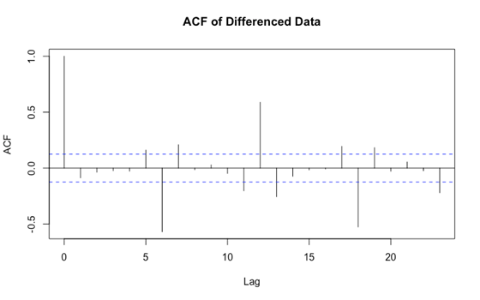
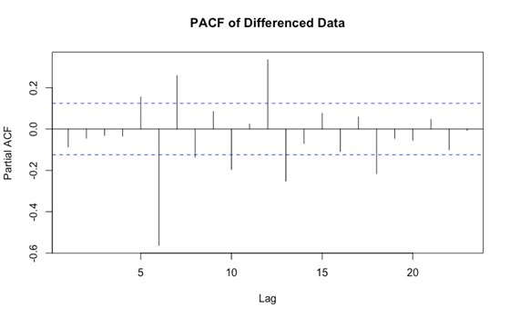
ACF/PACF Scheme Results
The Autocorrelation Function (ACF) measures the correlation between a time series and lagged values. It helps identify the patterns over different time lags.
The Partial Autocorrelation Function (PACF) measures the correlation between a time series and its lagged values, and it accounts for the correlations of the lagged values.

Slide 9
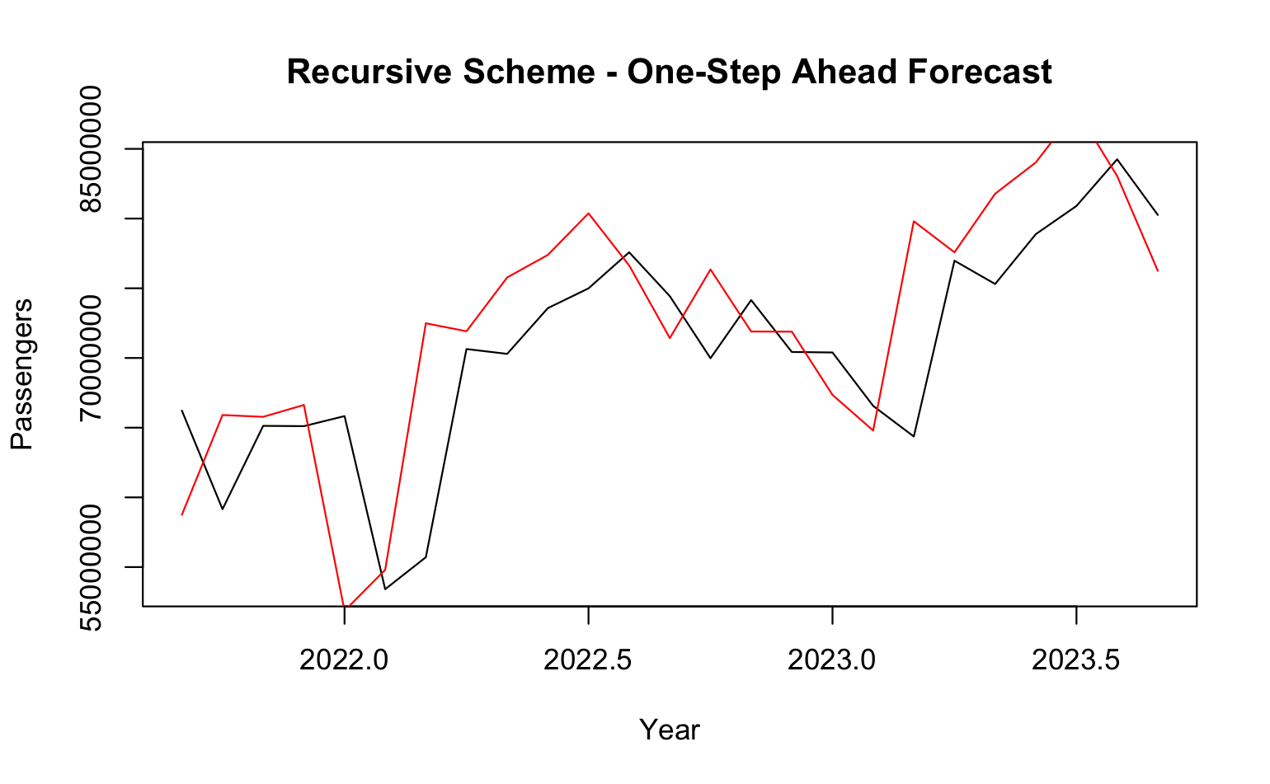
Recursive Scheme Results
In the Recursive Scheme, each forecasted value is fed back as input for the next prediction, allowing the model to adapt step-by-step and maintain continuity with recent data patterns.

Slide 10
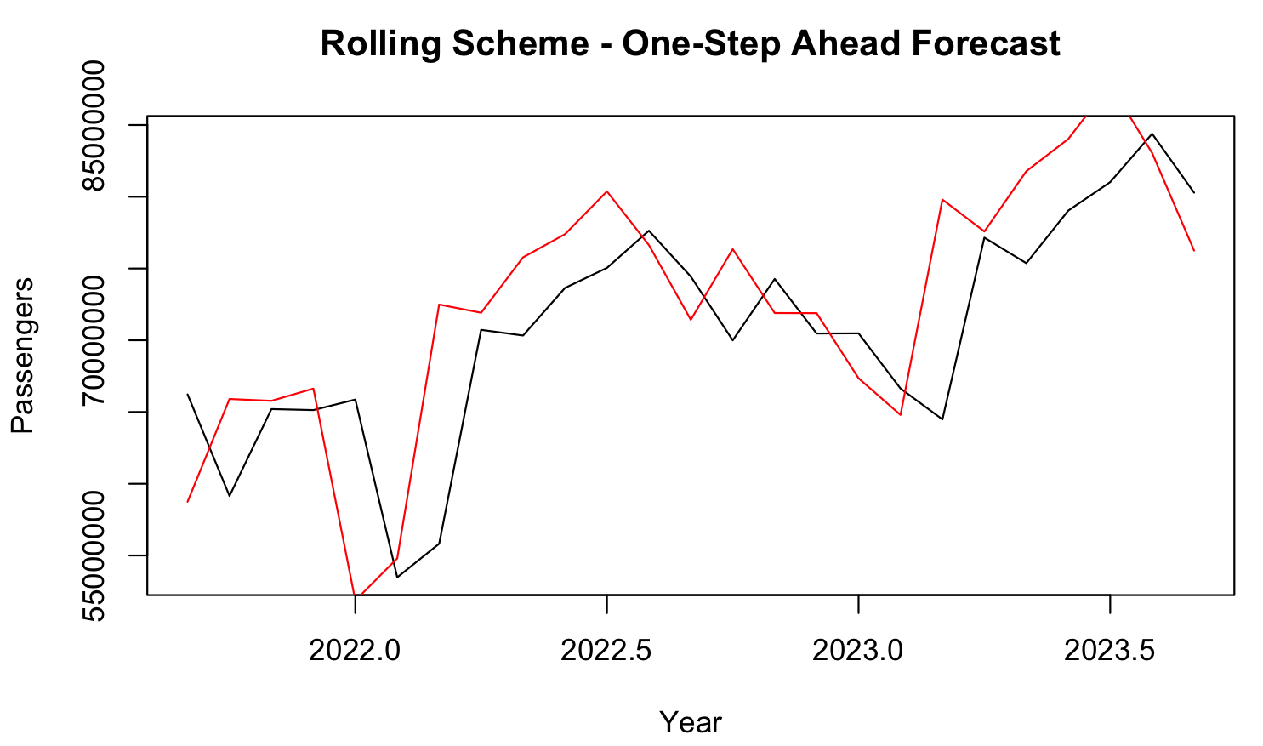
Rolling Scheme Results
Dynamic Adaptation:
The Rolling Scheme re-estimates the model at each step using a moving window, allowing it to adapt to recent data changes and potentially improve forecast accuracy over time.

Slide 11
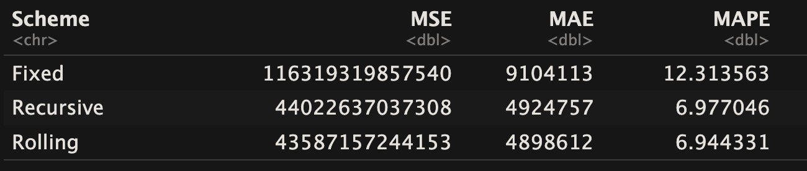
Error Metrics for Forecasting Schemes
Summary table of MSE, MAE, and MAPE for each scheme: Fixed, Recursive, Rolling.

Slide 12
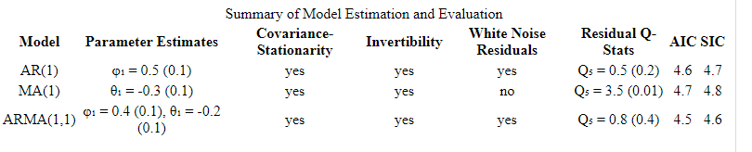
Summary of Model Estimation and Evaluation (8.2 Table)
Best Model: ARMA(1,1) is the most suitable model based on:
White noise residuals.
Lowest AIC and SIC values.
Q-statistic indicating no significant autocorrelation.
AR(1): Performs well but is slightly less optimal than ARMA(1,1).
MA(1): Fails to meet white noise assumptions and has the highest AIC and SIC, indicating a poorer fit.

Slide 13
Combining Forecasts for Enhanced Accuracy
Equal-Weighted: Averaging the top three models.
Inverse MSE-Weighted: Weighting based on inverse error.
OLS-Weighted: Using linear regression for optimized weights.

Slide 14
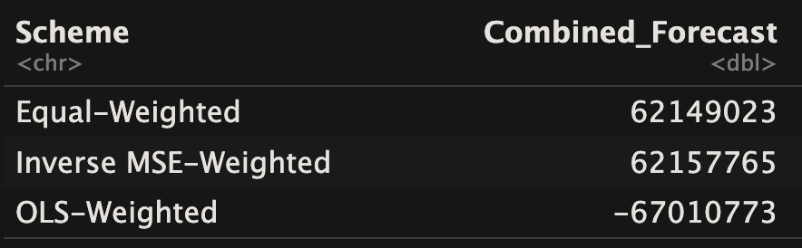
Combined Forecast Results
Table showing average combined forecast values for Equal-Weighted, Inverse MSE-Weighted, and OLS-Weighted methods.

Slide 15
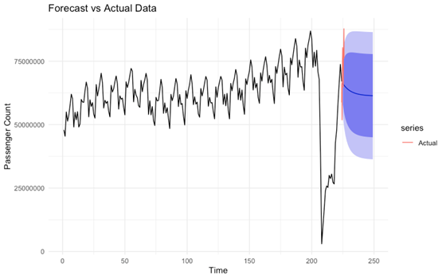
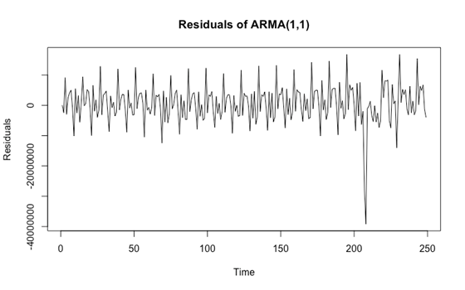
Multistep Forecasting
Models Used:
ARIMA and ETS.
Results:
ARIMA: Narrower confidence intervals but prone to overfitting.
ETS: Adapted better post-COVID but had wider confidence intervals.

Slide 16
Conclusion & Key Findings
Summary of findings:
ARMA(1,1) was the most effective model for short-term forecasts.
Potential for future forecasting projects:
Advanced Models: Future projects could use models like Seasonal ARIMA or machine learning to capture complex patterns.
External Variables: Including factors like economic indicators may enhance predictive accuracy.
Reccomendations
External Variables
Economic indicators
Weather
Machine learning models for long term forecasts
Real-time data for adaptive forecasting
Combined forecasts reduced overall error rates.
COVID-19 revealed the need for models that account for external shocks.

Slide 17
Individual Contributions
Shreeya Sampat – Model Comparisons, Report Data File, Powerpoint, Error Metrics, Data Analysis, Recommendations, Data cleaning, R Markdown.
Ryan Bolen - Data selection and problem statement, initial to final model selection and data analysis. Residual Analysis. Powerpoint.
Hunter Elliott - Table 8.2 and Table 9.8 for examples
Katie Yamabe – Forecast optimality Testing. Powerpoint
Kamran Badh – Multistep Forecasts + Interpretation and Calculating: One-Step Ahead, Forecast Errors, and the Loss + Powerpoint

Slide 18
THANK YOU!

