Slide 1








NIST CLOUD COMPUTING CLUB
Cloud Computing
(The Future of Digital Infrastructure)
NIST University
All CopyRights are Resereved At NIST Cloud Computing Club
NIST CLOUD COMPUTING CLUB

Slide 2
NIST CLOUD COMPUTING CLUB
Contents
What is the cloud computing?
Cloud Computing Components
Service Models
Deployment Models
Architecture
Cloud Engineering
Security and Privacy
Cloud Clients
Advanatges
NIST University
All CopyRights are Resereved At NIST Cloud Computing Club
NIST CLOUD COMPUTING CLUB

Slide 3
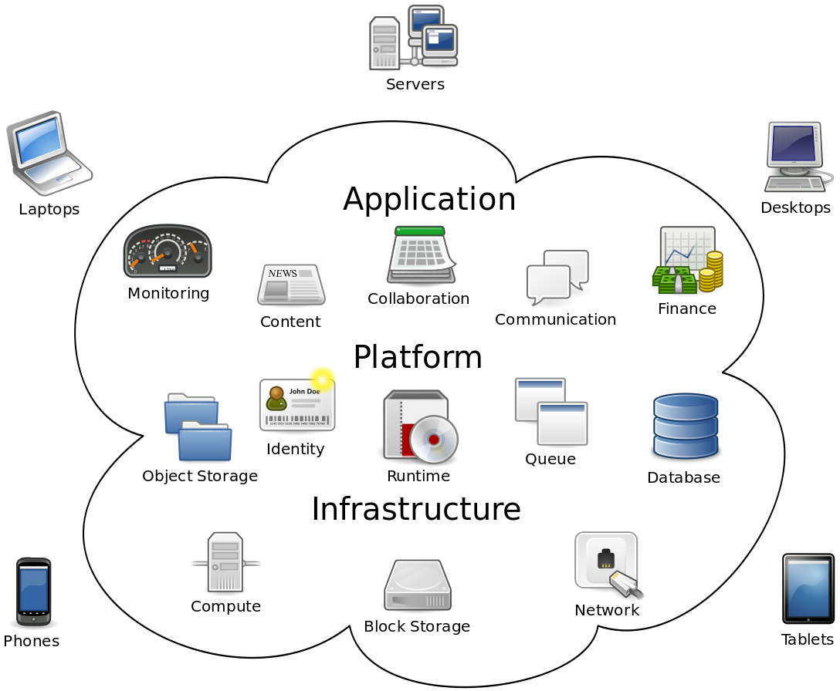
NIST CLOUD COMPUTING CLUB
What is Cloud Computing?
Cloud computing refers to the delivery of computing services—including servers, storage, databases, networking, software, analytics, and intelligence—over the internet from remote data centers, enabling on-demand access, scalability, and pay-as-you-go pricing without the need to manage physical hardware.
Cloud Computing Components
NIST University
All CopyRights are Resereved At NIST Cloud Computing Club
NIST CLOUD COMPUTING CLUB

Slide 4
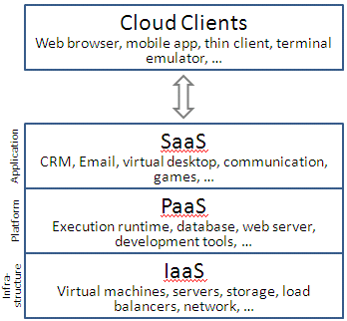
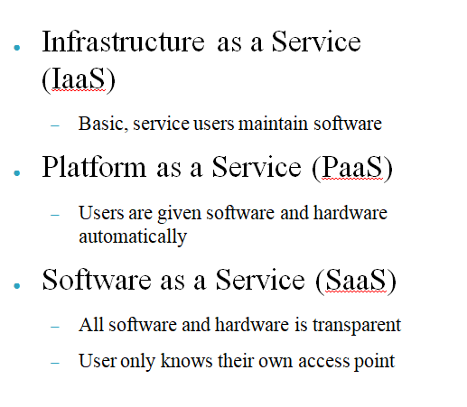
NIST CLOUD COMPUTING CLUB
Service Models
NIST University
All CopyRights are Resereved At NIST Cloud Computing Club
NIST CLOUD COMPUTING CLUB

Slide 5
NIST CLOUD COMPUTING CLUB
Deployment Models
Public cloud
  -Done by service providers
Community cloud
  -organizations from a specific community with common concerns
Private cloud
  -operated solely for a single organization
Hybrid cloud
  -composition of two or more clouds (private, community or public)
Private Cloud Rentals
  -option to consider when security is a concern
NIST University
All CopyRights are Resereved At NIST Cloud Computing Club
NIST CLOUD COMPUTING CLUB

Slide 6
NIST CLOUD COMPUTING CLUB
Security and privacy
Cloud Clients
Data protection
Physical Control
Identity management
Physical and personnel security
Availability
Application security
Privacy
Legal issues
Google Chrome book
Web browsers
Company specific applications
Advantages
NIST University
Cloud everyday use
To save huge amounts of data
Easier to maintain information
Makes security easy
Maintainability and sustainability are better
All CopyRights are Resereved At NIST Cloud Computing Club
NIST CLOUD COMPUTING CLUB

