Slide 1

iCardio
Heart Disease Prediction System
Name: nikita
Class: MCA 4th sem
(2024-2026)
Roll no: 240380010056
Guide name:
Prof. Dr. Jawahar Thakur

Slide 2
Table of content
Company Introduction
Introduction of the Project
How it Works (The "Process")
Technology Used (The "Tools")
Requirements
Conclusion

Slide 3

Company Introduction
  Novem Controls Pvt. Ltd. is an ISO 9001:2008 certified company established in 1999.
  The company is in Mohali, Punjab, India.
  Location : Plot No. 218, Industrial Area, Phase IX, Mohali, Punjab 160055

Slide 4

Introduction of the Project
The Goal: To help doctors and patients catch heart risks early.
The Problem: Heart disease is a
"silent killer."
Many people don't know they are at
risk until it's too late.
The Solution: An easy-to-use website where when enter health data (like age, smoking habits, etc), and an "AI Brain" tells you the likelihood of having heart issues.
The Result: Faster check-ups and early warnings that can save lives.

Slide 5
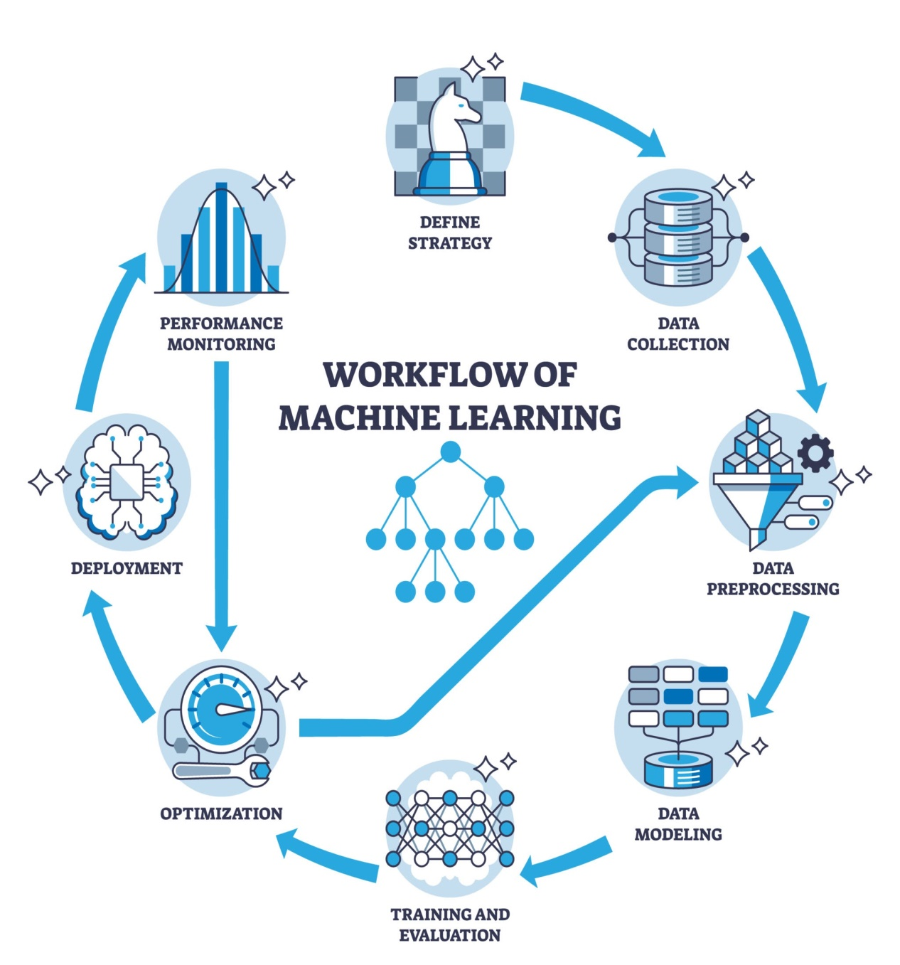
How it Works (The "Process")
Input: A person enters
their details into a simple
web form.
The Brain (Machine Learning):
The system looks at thousands
of past medical cases it
has "learned" from to find
patterns.
The Output:
The system gives a
percentage score (e.g.,
"85% Healthy" or "High
Risk") and
can even create a
downloadable PDF report.

Slide 6




Technology Used (The "Tools")
Think of these as the different parts of a car:
Python: The engine that runs everything.
FastAPI: The "hidden pipes" that move data from the user to the AI and back.
Streamlit: The "dashboard" and "steering wheel"—the part the user actually sees and clicks.
Scikit-Learn: The library used to train the AI to recognize heart disease.
Models (The Three Specialists): We used three different mathematical "experts" (Logistic Regression, SVM, and Random Forest) to ensure the most accurate answer.

Slide 7
Requirements
Software (The Programs):
A modern web browser (Chrome or Edge).
Python 3.11 installed on the computer.
The "Virtual Environment" (a private box for the project's tools so they don't get messy).
Hardware (The Machine):
Operating System: Windows , MacOS , Linux
Processor: Any available(AMD PRO A6-7350B R5 or AMD Ryzen Thread ripper PRO 7995WX
Computer: Any standard laptop or PC.
RAM: 4GB to 8GB (enough memory to think quickly).

Slide 8
Conclusion
While this system is not a replacement for a doctor, it serves as a powerful Early Warning System.
It proves that when we bridge the gap between Data Science and Software Engineering, we create tools that can truly save lives.
it’s a functional solution for a real-world problem.
Building a fast, accurate, and easy-to-use system that helps identify heart risks early.

Slide 9


Thankyou

