Slide 1

Note: The data and information in this document is reflective of a hypothetical situation and client. This document is to be used for KPMG Virtual Internship purposes only.
Sprocket Central Pty Ltd
Data analytics approach
[Division Name] - [Engagement Manager], [Senior Consultant], [Junior Consultant]

Slide 2
Note: The data and information in this document is reflective of a hypothetical situation and client. This document is to be used for KPMG Virtual Internship purposes only.
Agenda
Introduction
Data Exploration
Model Development
Interpretation

Slide 3
Note: The data and information in this document is reflective of a hypothetical situation and client. This document is to be used for KPMG Virtual Internship purposes only.
Introduction
CUSTOMER ANALYSIS:
Factor that should be taken into consideration for model development:
Age distribution
Past 3 years bike related purchases
Job industry Category
State wise distribution
Wealth Segment

Slide 4
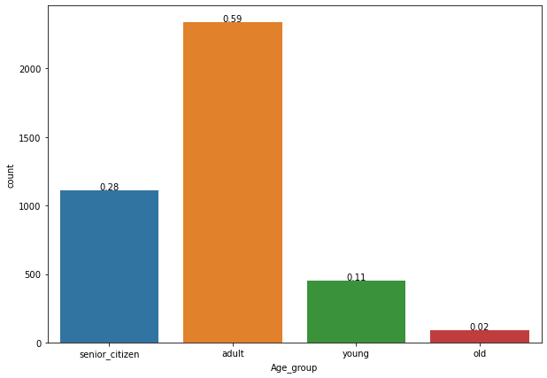
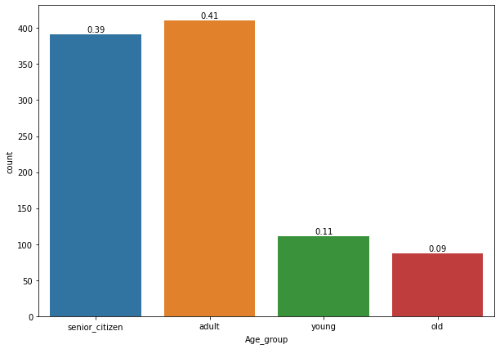
Data Exploration
Customer’s Age Categorization:
OLD
It is clear from the data that most of our customers are in age group of 25-50 years.
There is a increase of approx. 11% in the number of customers of senior citizen group.
The percentage count of young customers is not affected.
So, the most important age group comes out to be are adults and senior citizens.
NEW
Young : Age<=25
Adult : 25<Age<=50
Senior Citizen : 50<Age<=75
Old : Age>75

Slide 5
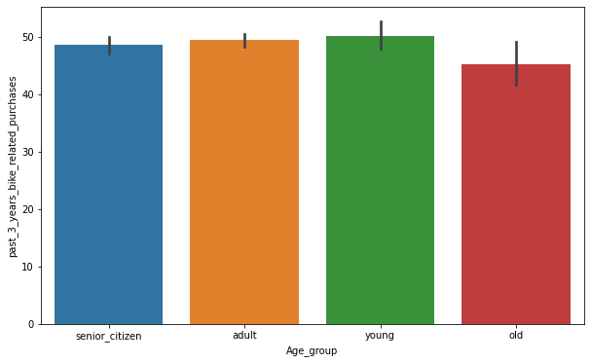
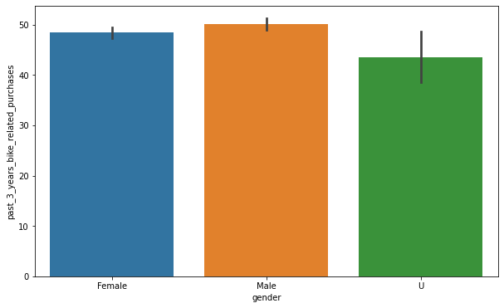
Note: The data and information in this document is reflective of a hypothetical situation and client. This document is to be used for KPMG Virtual Internship purposes only.
Data Exploration
PAST 3 YEARS BIKE RELATED PURCHASES:
The young and adult age group has more average bike related purchases than the other groups.
Males are most active in terms average bike related purchases in past 3 years
*The plots are plotted after combining both old and new customers’ data.

Slide 6
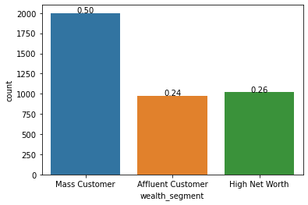
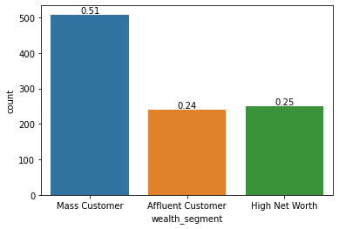
Note: The data and information in this document is reflective of a hypothetical situation and client. This document is to be used for KPMG Virtual Internship purposes only.
Data Exploration
Wealth Segment Analysis :
OLD
NEW
Both old and new data indicates that Mass Customer needs to be targeted for better sales strategies.
Other 2 class of wealth segment of customers have quiet similar effect and also they are lesser in numbers.

Slide 7
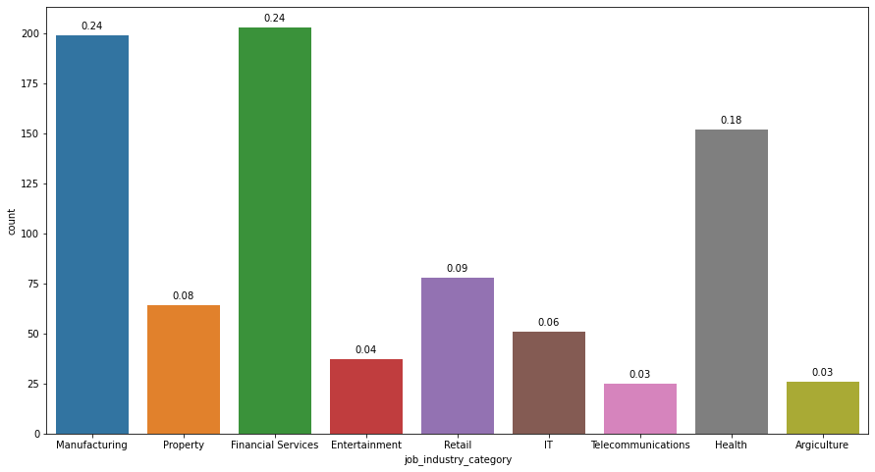
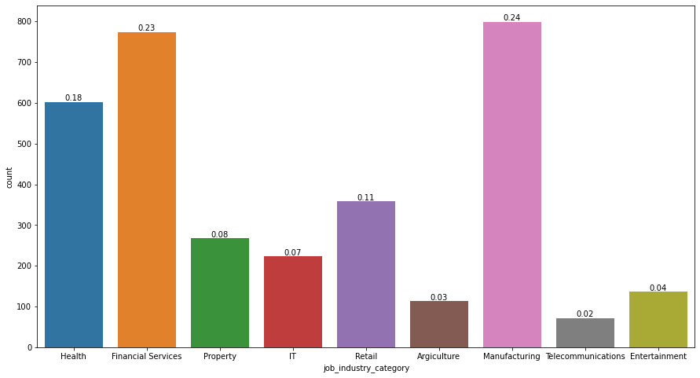
Note: The data and information in this document is reflective of a hypothetical situation and client. This document is to be used for KPMG Virtual Internship purposes only.
Data Exploration
JOB CATEGORY ANALYSIS:
NEW
OLD
In both new and old data Manufacturing, Financial Services, and Health sectors are found to be most suitable sectors for sales.
There is a slight drop in count of Retail sector sales while other remains same.

Slide 8
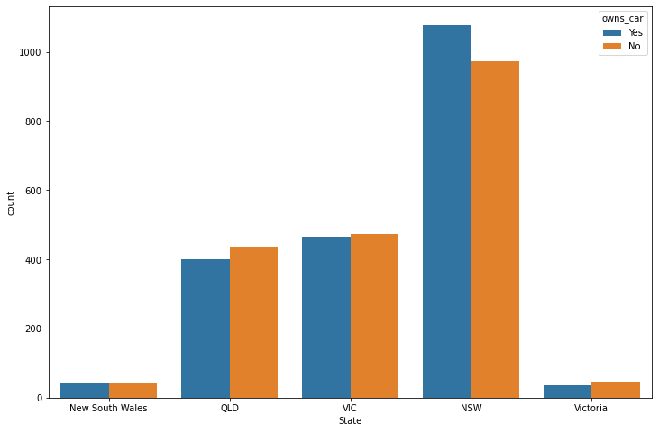
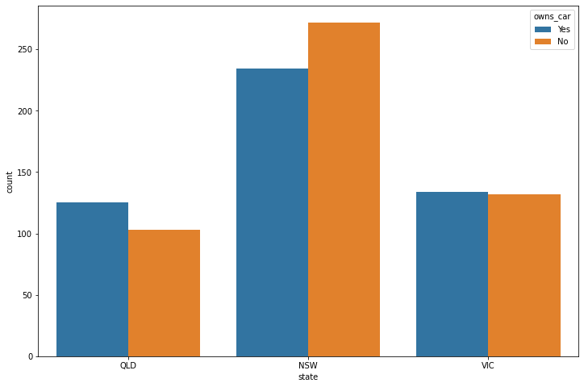
Note: The data and information in this document is reflective of a hypothetical situation and client. This document is to be used for KPMG Virtual Internship purposes only.
Data Exploration
CUSTOMER RESIDANCE ANALYSIS :
NEW
OLD
The two most prominent states are New South Wales and Victoria.
In old data, No. of customers in NSW who owns car are more likely to buy bike related items or bikes but the scenario changes in the new customer data.
In Victoria state, both type of customers that is car owner or not are almost same in number.

Slide 9
Note: The data and information in this document is reflective of a hypothetical situation and client. This document is to be used for KPMG Virtual Internship purposes only.
Model Development
CRITERIA:
The model for selecting top 1000 customers is prepared on the basis of some important features extracted after data exploration.
Customers are selected on the basis of their state, age group, past 3 year purchase, wealth segment and job industry category.
First of all the whole data set is divided into 2 categories of customers, one who belongs to NSW and other who belongs to VIC as these were the most prominent states.
After this we divided customers of each of the state according to their age groups and only filtering the one who belongs to adult and senior citizen’s category.
Then we classified our obtained subcategories according to job industry category and taking only manufacturing, financial services and health sector into considerations.
At last we filter the remaining customers according to wealth segments and picking only those who belongs to mass customer category.
After filter our dataset through this prominent features we are left with 930 top customers.

Slide 10
Note: The data and information in this document is reflective of a hypothetical situation and client. This document is to be used for KPMG Virtual Internship purposes only.
Interpretation
Nowadays, Those who do not owns car are more likely to purchase bikes and bike related purchases.
The most attention should be given to NSW state as it has maximum sales as compared to others.
In other states also some business strategies should be applied in order to boost sales.
The needs of financial services and manufacturing related customers should be taken into consideration

Slide 11
Note: The data and information in this document is reflective of a hypothetical situation and client. This document is to be used for KPMG Virtual Internship purposes only.
Appendix

