Slide 1
FMCG Customer & Sales
Analysis Using Python
PRESENTED BY
Shrejal Mishra

Slide 2
1
Dataset Overview
2,240 rows
Customer Information
Household Information
29 columns (before Total_Spend)
ID, Year of Birth, Education, Marital Status, Income
Kidhome, Teenhome
This dataset contains customer demographic information, income, product spending and purchasing behaviour. We will use Python to clean this data and identify useful patterns in customer spending.
Product Spending
Purchase Behaviour
Wine, Fruits, Meat, Fish, Sweets, Gold Products
Web, Catalog & Store Purchases, Deals, Web Visits
import pandas as pd
import matplotlib.pyplot as plt
import seaborn as sns
df = pd.read_csv('marketing_campaign.csv',
sep=';')
df.head()
Campaign Information
AcceptedCmp1–5, Response
2

Slide 3
2
Data Cleaning & Preparation
We cleaned the dataset before visualization so the analysis stays reliable.
1
Check missing values
2
Remove missing income rows
df.isna().sum()
df = df.dropna(
subset=["Income"]
).reset_index(drop=True)
24 missing values found in Income
2,240 → 2,216 rows remain
3
Remove income outlier
4
Remove junk marital-status
df = (df[df["Income"] < 200000]
.reset_index(drop=True))
junk = ["Alone","Absurd","YOLO"]
df = df[~df["Marital_Status"]
.isin(junk)].reset_index(drop=True)
666,666 income value dropped
7 junk rows removed (Alone/Absurd/YOLO)
3

Slide 4
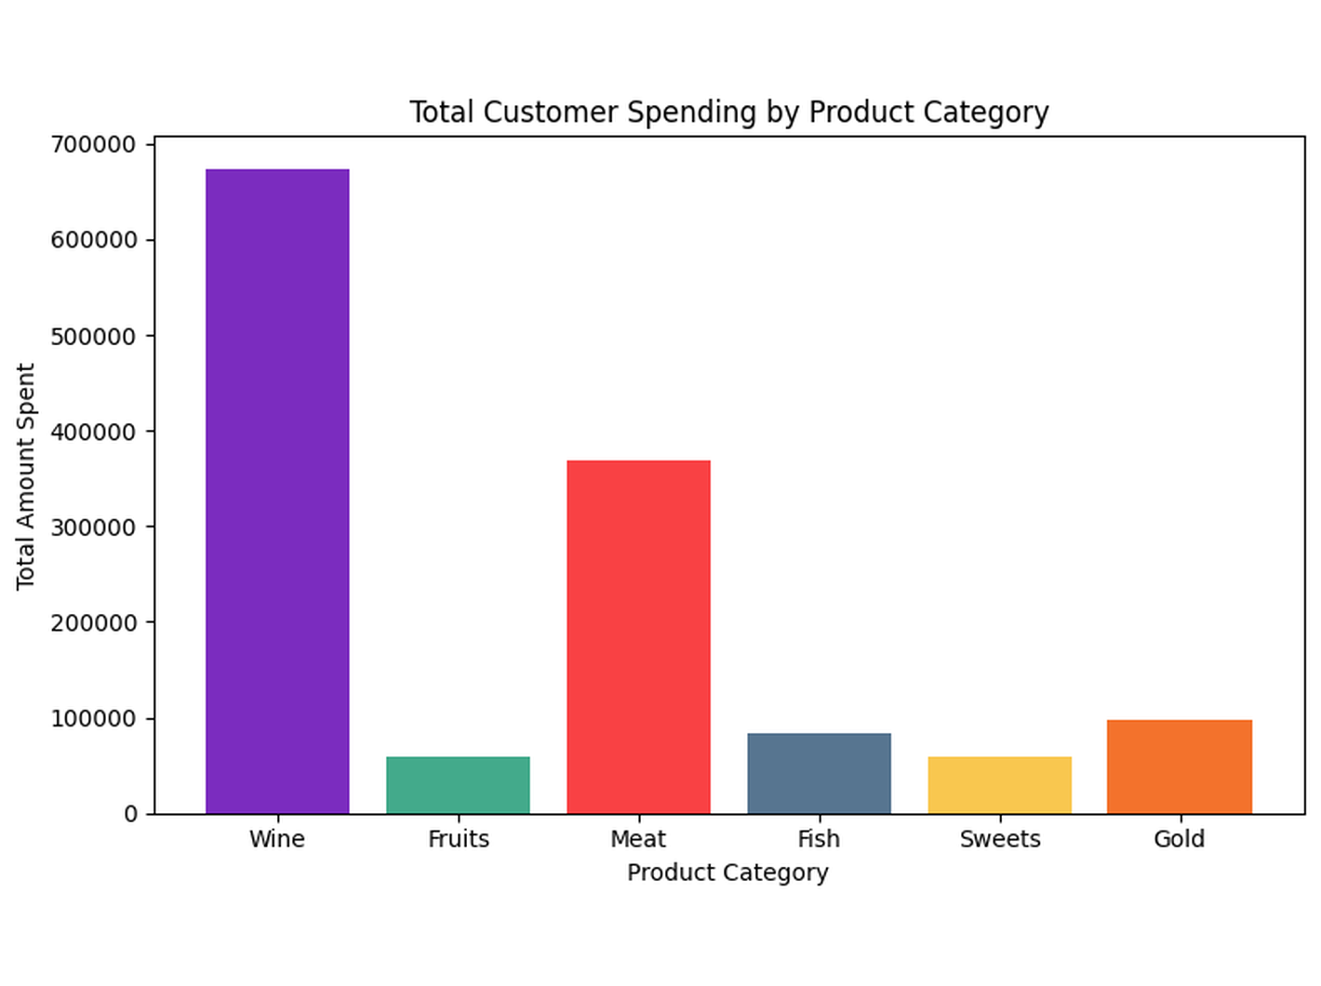
3
Total Spend & Graph 1 — Spending by Category
❓ Which product category brings in the most revenue?
df["Total_Spend"] = (
df["MntWines"] + df["MntFruits"] +
df["MntMeatProducts"] + df["MntFishProducts"] +
df["MntSweetProducts"] + df["MntGoldProds"])
category_spend = {
"Wine": df["MntWines"].sum(),
"Fruits": df["MntFruits"].sum(),
"Meat": df["MntMeatProducts"].sum(),
"Fish": df["MntFishProducts"].sum(),
"Sweets": df["MntSweetProducts"].sum(),
"Gold": df["MntGoldProds"].sum()
}
categories = list(category_spend.keys())
totals = list(category_spend.values())
plt.figure(figsize=(8, 5))
plt.bar(categories, totals, color=["#7B2CBF", "#43AA8B",
"#F94144", "#577590", "#F9C74F", "#F3722C"])
plt.xlabel("Product Category")
plt.ylabel("Total Amount Spent")
plt.title("Total Customer Spending by Product Category")
plt.tight_layout()
plt.show()
OBSERVATION
Wine leads with 50.3% of total spend; Meat follows at 27.5%. Fruits, Fish, Sweets and Gold are far smaller shares.
BUSINESS IMPLICATION
Prioritise Wine and Meat in inventory, promotions and marketing campaigns — together they drive ~78% of revenue.
4

Slide 5
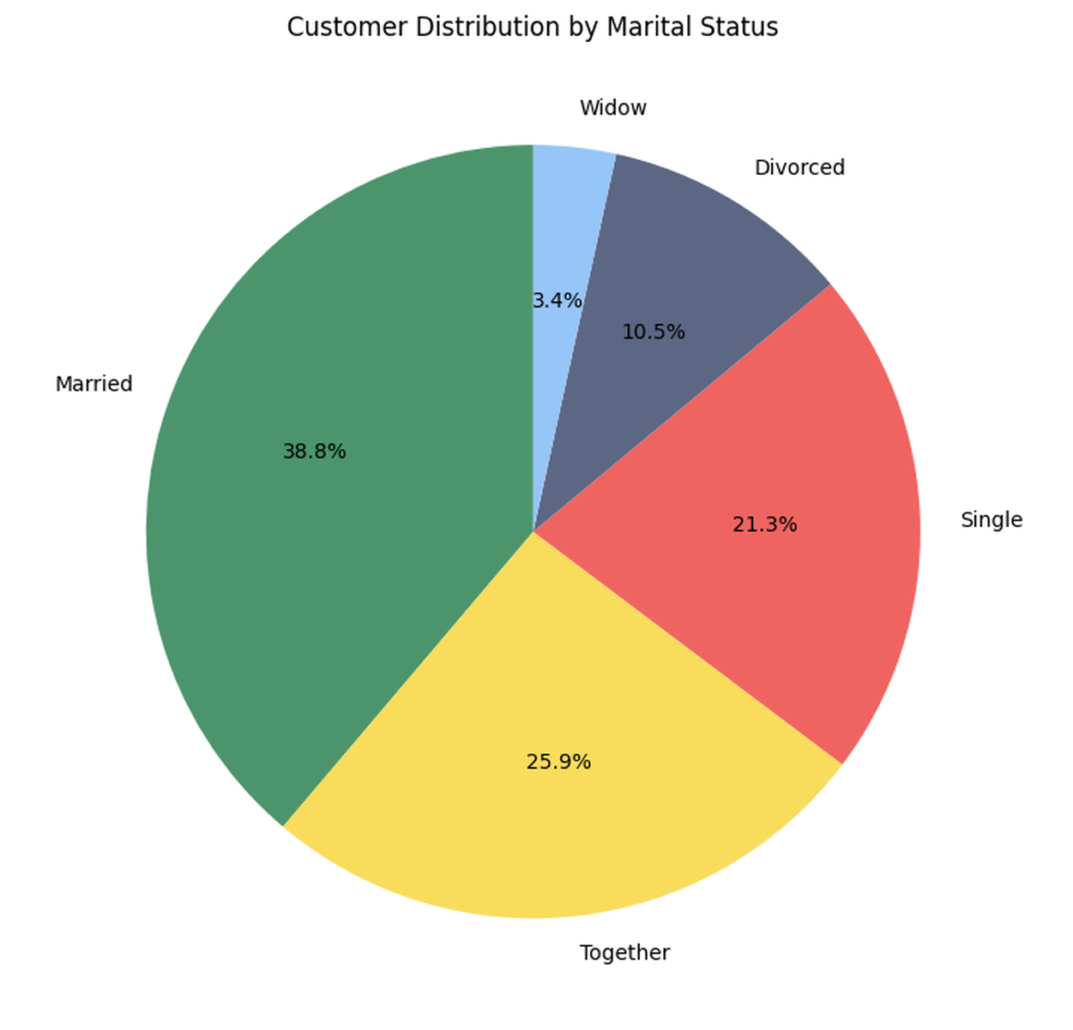
4
Graph 2 — Customer Distribution by Marital Status
❓ Who makes up the core customer base?
status_counts = (
df["Marital_Status"].value_counts())
plt.figure(figsize=(7, 7))
plt.pie(status_counts, labels=status_counts.index,
autopct="%1.1f%%", startangle=90,
colors=["#4C956C", "#F9DC5C", "#EF6461",
"#5C6784", "#96C5F7"])
plt.title("Customer Distribution by Marital Status")
plt.tight_layout()
plt.show()
OBSERVATION
Married (38.8%) and Together (25.9%) make up almost two-thirds of customers. Single adds 21.3%, while Divorced and Widow are smaller groups.
BUSINESS IMPLICATION
Customers in relationships/families dominate the base — design family-oriented offers and household-focused promotions.
5

Slide 6
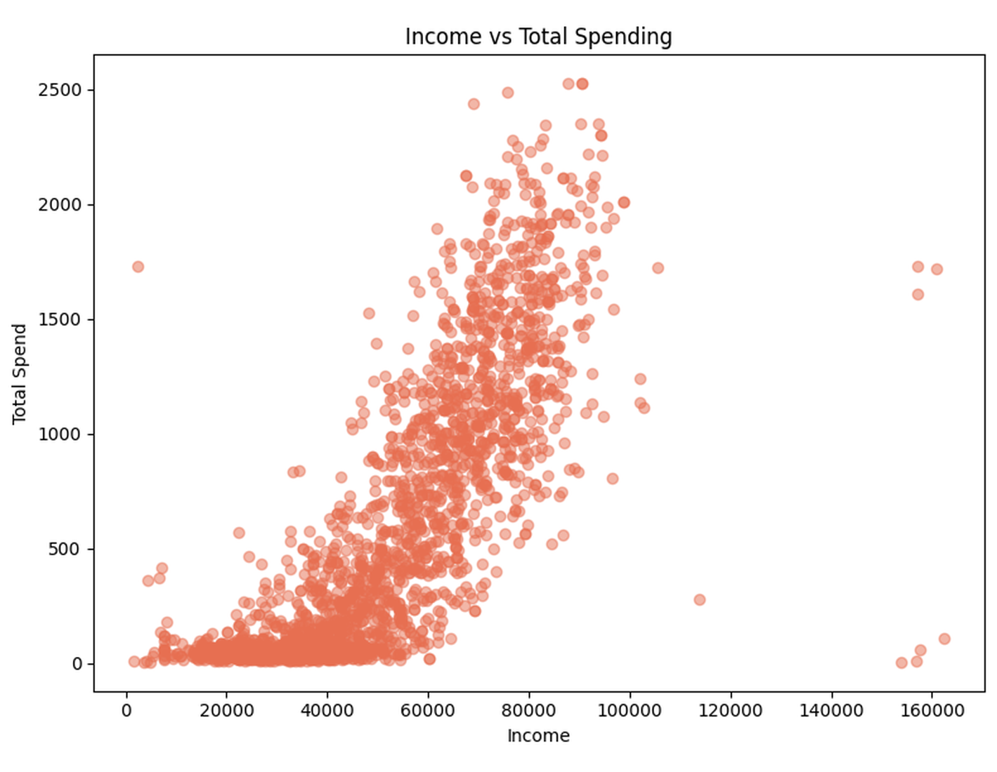
5
Graph 3 — Income vs Total Spending
❓ Does income actually affect customer spending?
plt.figure(figsize=(8, 6))
plt.scatter(df["Income"],
df["Total_Spend"], alpha=0.5,
color="#E76F51")
plt.xlabel("Income")
plt.ylabel("Total Spend")
plt.title("Income vs Total Spending")
plt.tight_layout()
plt.show()
OBSERVATION
A clear positive relationship: as income rises, spending rises. Lower-income customers (below ~30,000) mostly spend under 200 in total; higher-income customers (above ~60,000) show a much wider, higher spread, some crossing 2000.
BUSINESS IMPLICATION
Target higher-income customers with premium products; offer value packs and discounts to lower-income segments.
6

Slide 7
5
Bringing the Findings Together
Looking at spending, customer profile and income side by side (not one at a time) surfaces three patterns the individual graphs do not show alone.
1
2
3
Your Highest-Value Customers
Two Categories Carry the Business
A Large, Under-Served Budget Segment
PATTERN
PATTERN
PATTERN
Married/Together + income above ~60,000
Wine + Meat = ~78% of all revenue
Income below ~30,000 → total spend mostly under 200
EVIDENCE FROM THE DATA
EVIDENCE FROM THE DATA
EVIDENCE FROM THE DATA
65% of customers are Married or Together; total spend rises sharply once income passes ~60,000
Wine ₹674K and Meat ₹369K vs. Fruits, Fish, Sweets and Gold combined at ₹298K
This low-spend cluster is large and cuts across every marital-status group, not just one
This group should be the focus of premium bundles and loyalty offers.
Stock, shelf space and campaign budget should be weighted toward these two categories first.
Discount-led combo packs are more likely to unlock spend here than premium offers.
Together, these three patterns say the same thing: income and household type — more than product category alone — should drive how offers are targeted and priced.
7

Slide 8
CONCLUSION
Key Findings & Business Recommendations
Product Spending
Wine and Meat are the strongest spending categories (~78% of total).
1
Customer Profile
Married and Together customers form ~65% of the customer base.
2
Income & Spending
A clear positive relationship exists between income and total spending — as income rises, spending rises.
3
FUTURE PREDICTION PATH
Campaign Response
→
Customer Spending
→
Customer Segments
8

Slide 9
KHUSH RAHO 😊

