Slide 1

Retail Sales Forecasting
By
Shreya Mukerjee – SXM220064
Prescriptive Extra Credit Assignment

Slide 2
Index
Introduction
Data Collection and Usage
Exploratory Data Analysis
Result and Recommendation
Prediction Model - FbProphet
References

Slide 3

Introduction
In the retail industry, forecasting is essential for retailers to stay competitive and optimize their pricing strategies, inventory management, and other key business decisions.
Our model can be customized to meet the specific needs of individual retailers, taking into account factors such as store size, seasonality, weekly sales, pricing, promotions, and inventory.
The project develops a forecasting model for retail sales that addresses the unique challenges of the industry, such as limited historical data, seasonal fluctuations, and the impact of markdowns on sales

Slide 4
Data
The dataset was collected from Kaggle for 45 stores located in different regions - each store contains multiple departments. Here is the link:
https://www.kaggle.com/datasets/manjeetsingh/retaildataset?select=sales+data-set.csv
The dataset is divided into three parts where :
Stores- Anonymized information about the 45 stores, indicating the type and size of store
Features- This dataset has columns representing Store number, date, temperature (of that day) Markdown (amount of discount or price reduction offered on certain products)
Sales – Store, Date, Department, Weekly_sales, Is_holiday
On merging the datasets there were around 421570 rows ranging from 2010-02-05 to 2012-11-01.
Weekly_sales is our dependent variable whereas the rest of our variables are our independent variables

Slide 5
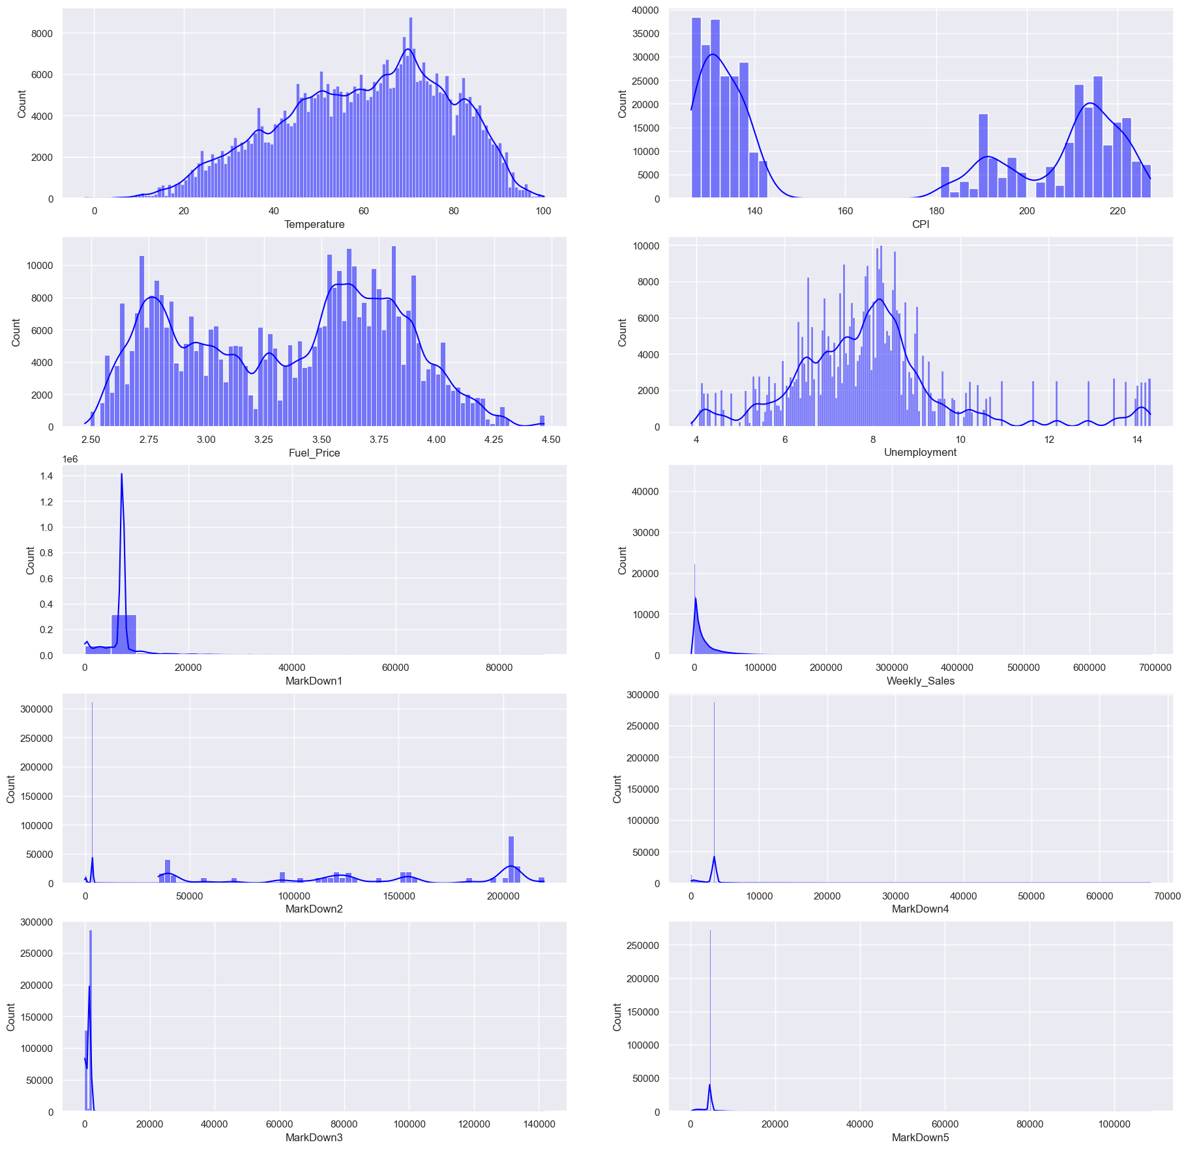
EDA- Univariate Analysis

Slide 6
Insights from univariate analysis
The Consumer Price Index (CPI) measures the monthly change in prices paid by U.S. consumers. We can see 3 peaks in its distribution which hints that there might be seasonality in the data.
We can again see peaks and troughs in fuel prices which depicts that prices go high at a certain ‘season’ than others.

Slide 7
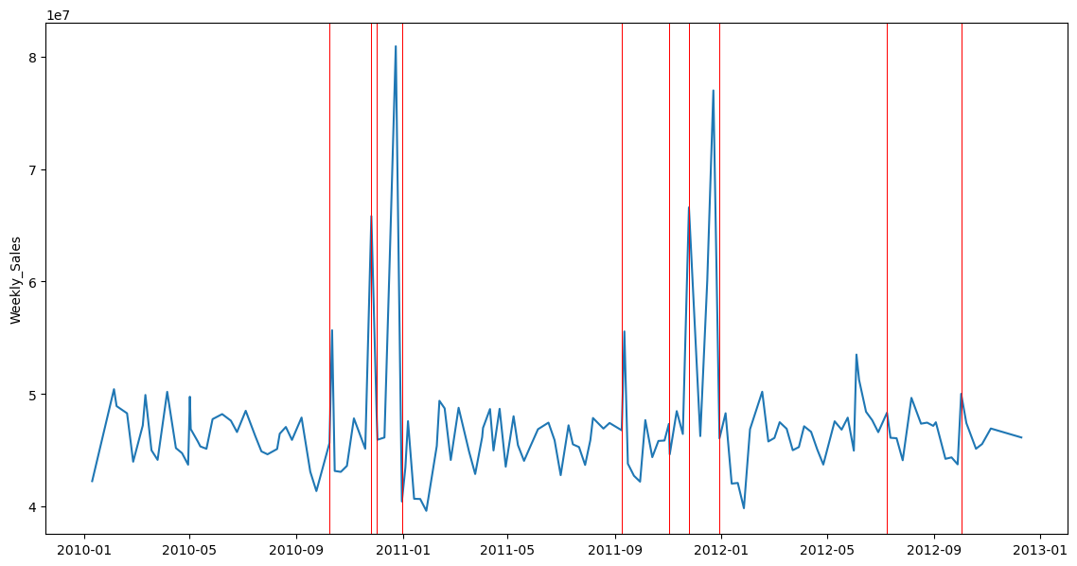
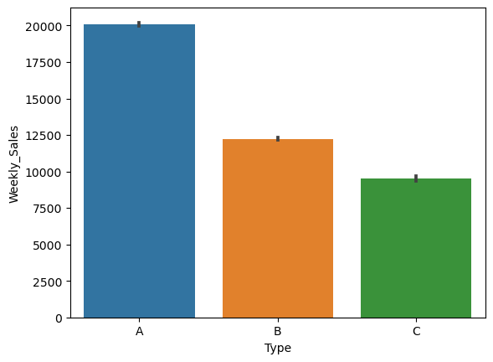
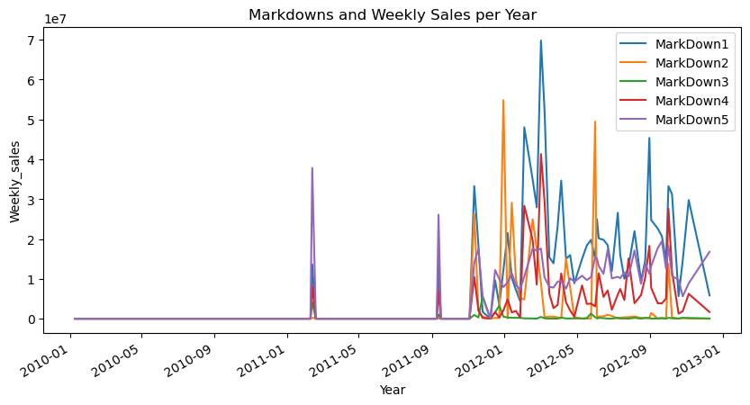
EDA – Bivariate Analysis

Slide 8
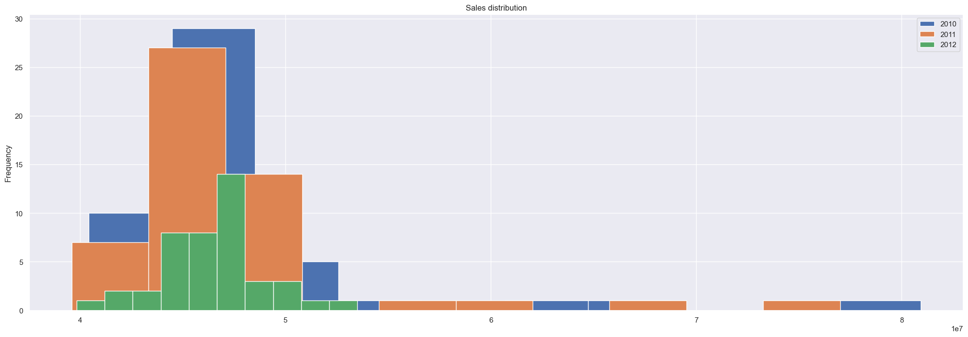
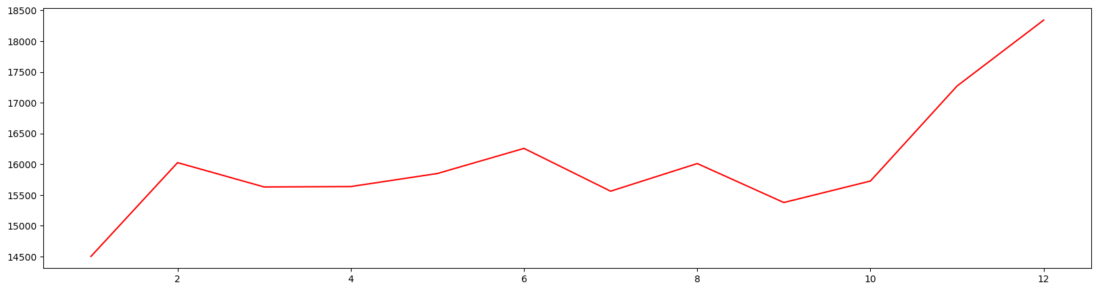

Slide 9
Insights from bivariate analysis
In the Year v/s weekly_sales diagram, Holidays are marked by red vertical lines. We can clearly see that store sales spike during Thanksgiving, Labor Day and Christmas. This is a clear indicator of seasonal component being present in our data.
Markdowns are nothing but discounts. These discounts are given during holiday seasons. We can clearly see a pattern of offering more discounts during festive seasons to boost up sales.
The line graph displays that monthly sales are highest during festive time
In the Sales distribution, 2012 doesn’t show much of a pattern because it doesn’t have enough data for holiday sales

Slide 10
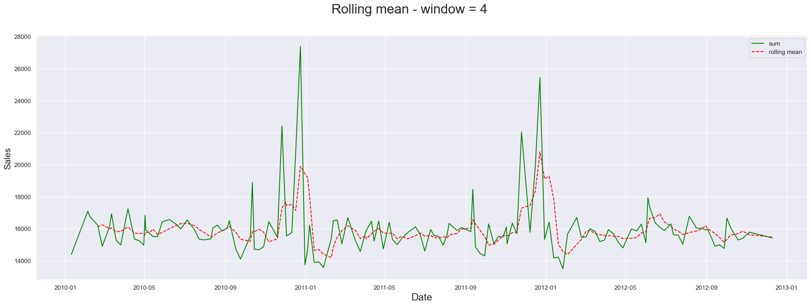
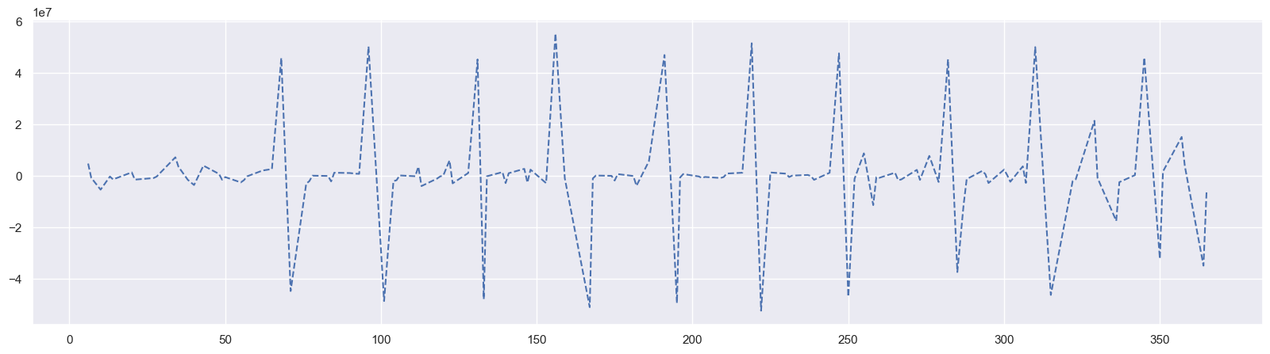
Time series Analysis
Insights
Rolling mean(or Moving Average) taken at k = 4 shows a much smoother graph for weekly sales.
Difference of Weekly Sales sum by day of year compared with a previous day of year

Slide 11
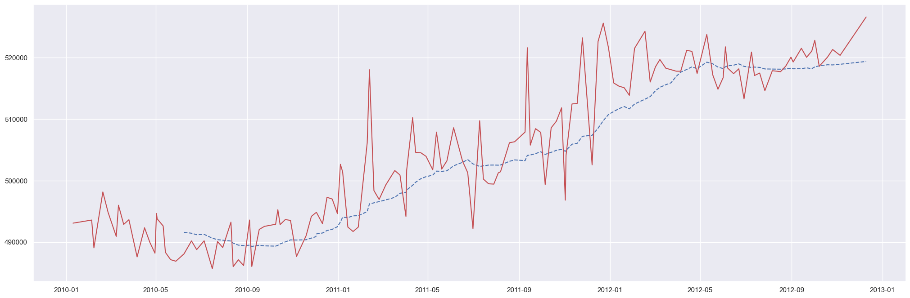
The above diagram shows the analysis of CPI over the tenure provided. We can observe that not only payment capability has increased over the years but also that there are visible spikes during festive seasons. The blue dotted line indicates moving average for k = 2.

Slide 12
Model
Chosen Fbprophet model to forecast weekly sales.
Prophet is a procedure for forecasting time series data based on an additive model where non-linear trends are fit with yearly, weekly, and daily seasonality, plus holiday effects. It works best with time series that have strong seasonal effects and several seasons of historical data. Prophet is robust to missing data and shifts in the trend, and typically handles outliers well.
Its fully automatic and accurate and fast.

Slide 13
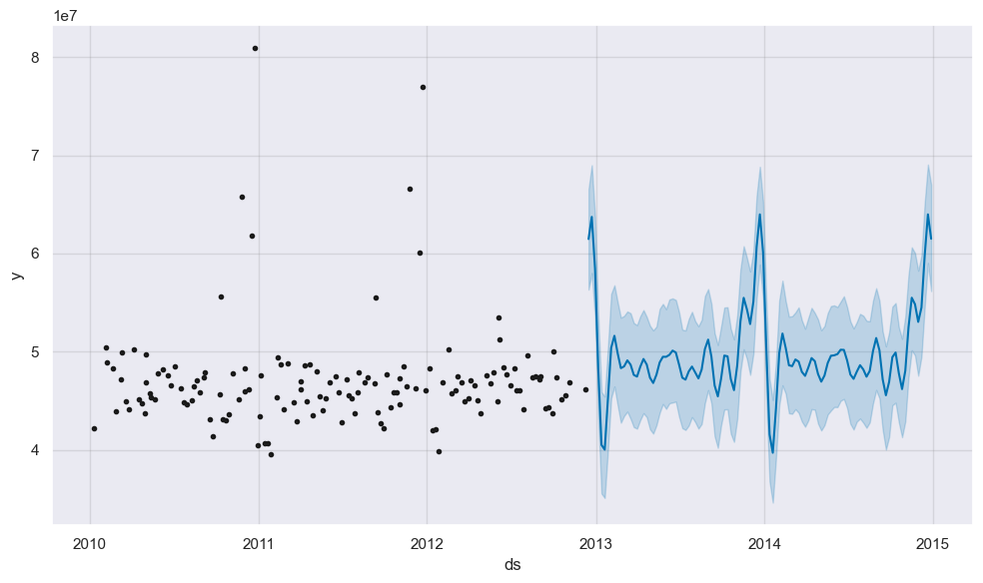
Forecast
Here, weekly sales have been forecasted for next three years(2013, 2014, 2015) alongwith the lower and upper boundaries using the FbProphet model.

Slide 14
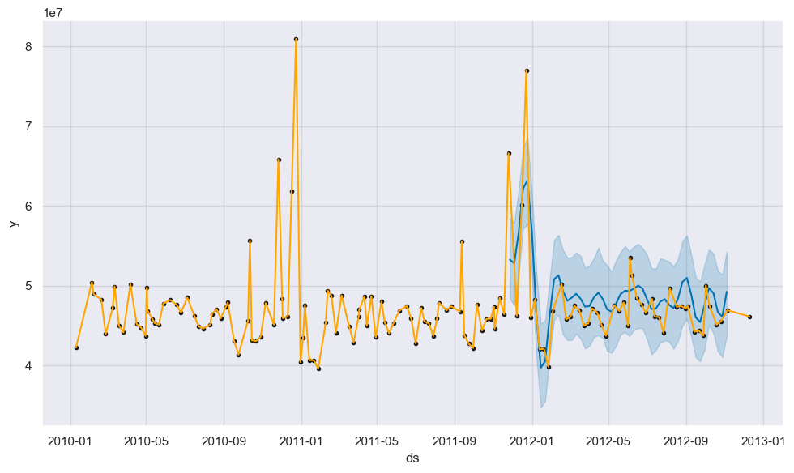
Forecast
Here, forecast has been done for next 3 months of 2012 using FbProphet model

Slide 15
Results
The following patterns were noticed during our analysis :
Sales is highest for months when there are festivals like Thanksgiving, Black Friday, Christmas
Larger the size of the store, more is the sales
When temperature is b/w 20 - 60, the companies have recorded highest sales
Weekly Sales increased noticeably when the stores started offering promotions
Recommendations for improving sales –
To improve sales in Type B and Type C, the stores can send out better promotional offers that should align with holiday season
Type B and Type C stores can increase the size of the store and their interiors to attract more customers

Slide 16
References
https://facebook.github.io/prophet/
Instructions to download Prophet can be found here
https://stackoverflow.com/questions/50808322/prophet-fbprophet-package-in-python
Data can be downloaded from here
https://www.kaggle.com/datasets/manjeetsingh/retaildataset?select=sales+data-set.csv

