Slide 1
DSA-3 · PBL FINAL REVIEW
INTELLIGENT RESOURCE SCHEDULING
FOR TEXT PROCESSING PIPELINES
PBL REVIEW 3
Team
2510030287 — Kollu Sree Lasya 2510030022 — Shrenika Reddy
2510030101 — Pasham Meghana 2510030130 — Rishikha Reddy
SYSTEM DATA FLOW
Documents
→
User Request
→
Tasks
→
Scheduler
→
Resources
→
Results
Notes:
Good [morning/afternoon]. We are presenting our DSA-3 PBL Review-3 project: Intelligent Resource Scheduling for Text Processing Pipelines. Over the last phase we moved from a literature-review concept to a fully working Java console system that takes a user request, breaks it into text-analytics tasks, schedules them intelligently across heterogeneous resources, and returns results — which is the flow you see at the bottom of this slide.

Slide 2
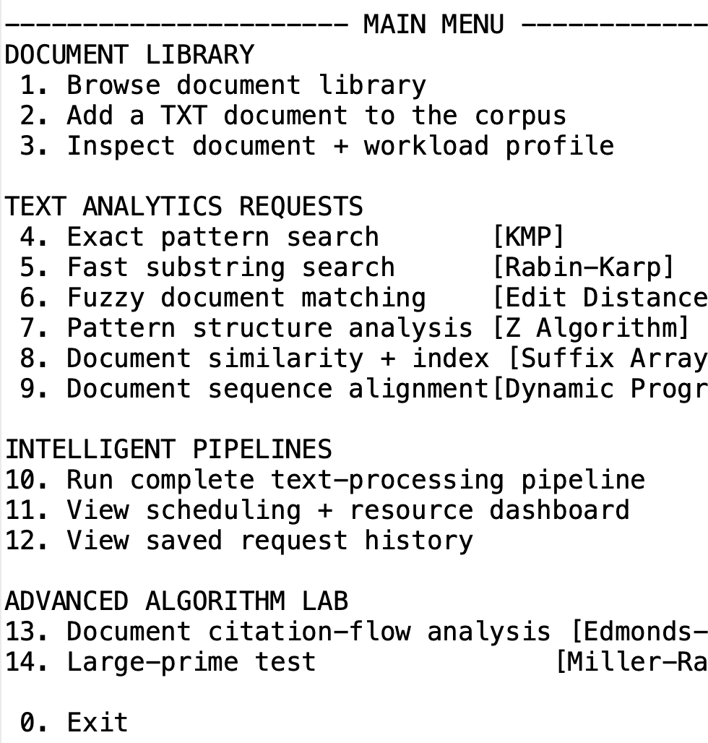
PROGRESS OVERVIEW
FROM PROPOSED CONCEPT TO WORKING SYSTEM
Review-2 planned an architecture. Review-3 demonstrates it running end to end.
REVIEW 2 — PROPOSED
REVIEW 3 — IMPLEMENTED
Literature review
10-document corpus
↓
↓
Working text-processing engine
[ INSERT SCREENSHOT ]
SYSTEM READY + MAIN MENU
Airflow / Spark / HEFT analysis
↓
↓
Runtime-aware scheduler
Identified scheduling gap
↓
↓
Parallel execution
Implemented Java console interface with 10-document corpus and integrated DSA-3 engine.
↓
Proposed architecture
Measured results
02 / 14
Notes:
Review-2 gave us a literature-backed plan: we studied Airflow, Spark and HEFT and identified a gap around integrating priority, dependencies, resource-awareness, parallelism, monitoring and recovery for text pipelines. Review-3 shows that plan converted into a working prototype — a 10-document corpus, a real text-processing engine, and a runtime-aware scheduler producing measured results, as shown in the console snapshot.

Slide 3
MOTIVATION
WHY TEXT-PROCESSING PIPELINES NEED INTELLIGENT SCHEDULING
Multiple tasks
+
Different CPU / RAM needs
+
Dependencies
+
Different execution times
+
Need for parallelism
↓
STATIC / SEQUENTIAL EXECUTION
↓
WAITING + RESOURCE UNDERUTILIZATION
↓
PROPOSED SOLUTION: TASK-AWARE INTELLIGENT SCHEDULING
03 / 14
Notes:
Text-processing pipelines are made of many tasks with different CPU and memory needs, dependencies between them, different execution times, and a real opportunity for parallelism. Running them statically and sequentially wastes time and underutilizes resources. Our solution is task-aware intelligent scheduling — deciding what runs, where, and when.

Slide 4
RUBRIC: NOVELTY OF DEVELOPED METHODOLOGY (10)
NOVELTY — TASK-AWARE TEXT PIPELINE SCHEDULING
User Request
WHAT'S NOVEL
↓
Text Analytics Tasks
Text algorithms unified under one scheduler
↓
Workload Profiling
Task dependency awareness across pipeline stages
↓
Dependency + Priority Analysis
Heterogeneous resource-aware assignment
↓
Runtime-Aware HEFT V3
Actual runtime feedback updates estimates
↓
Heterogeneous Resource Assignment
↓
Built-in failure / recovery architecture
Parallel Execution
↓
Novelty lies in the project-specific integration and adaptation of runtime-aware scheduling for text-processing pipelines — not in HEFT itself.
Runtime Feedback
04 / 14
Notes:
The novelty is not the HEFT heuristic itself — it's how we integrated it. A user request flows through text-analytics task generation, workload profiling, dependency and priority analysis, our runtime-aware HEFT V3 layer, heterogeneous resource assignment, parallel execution and runtime feedback — all specifically adapted for text-processing workloads, with recovery built in.

Slide 5
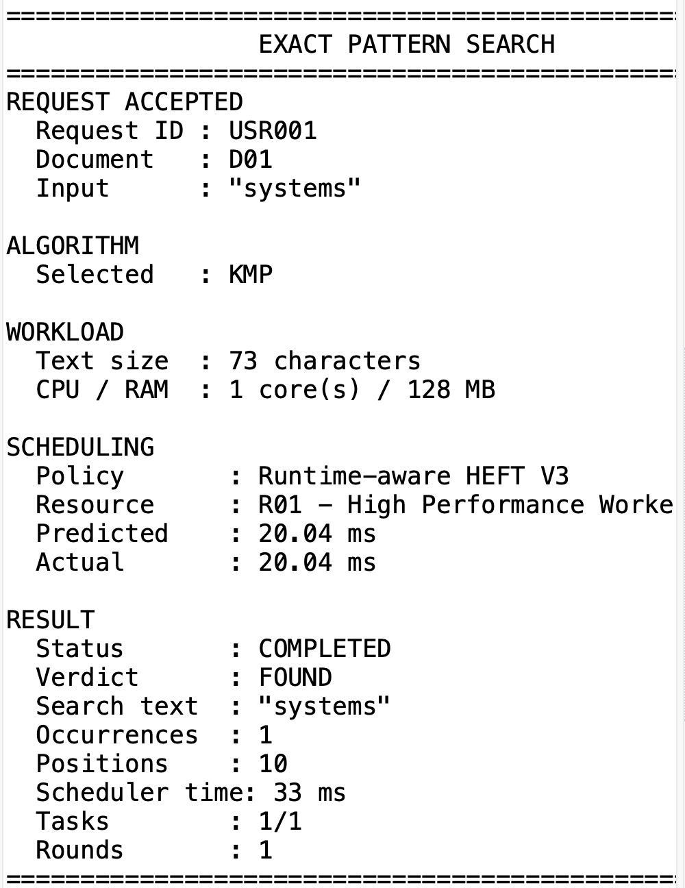
SYSTEM COMPONENTS
DSA-3 ALGORITHM ENGINE
STRING / TEXT
DYNAMIC PROGRAMMING
KMP
Edit Distance
Exact pattern search
Fuzzy document matching
Rabin-Karp
Sequence Alignment
Fast substring / keyword verification
Cross-document alignment score
Z Algorithm
Pattern structure analysis
Suffix Array + LCP
Text indexing & structural similarity
GRAPH / RANDOMIZED
Edmonds-Karp
Miller-Rabin
Console evidence of KMP execution on document D01, proving actual algorithm execution.
05 / 14
Notes:
Nine algorithms power the engine, grouped by category. String and text algorithms — KMP, Rabin-Karp, Z, Suffix Array with LCP — handle search, verification and indexing. Dynamic programming drives fuzzy matching and alignment. Graph and randomized algorithms — Edmonds-Karp and Miller-Rabin — add citation-flow and primality analysis. The console evidence at the bottom shows a real KMP run finding 'systems' at position 10.

Slide 6
RUBRIC: ADAPTABILITY OF METHODOLOGY (10)
ADAPTABILITY — ONE SCHEDULER, MULTIPLE TEXT WORKLOADS
Exact Search
Fast Keyword Search
Fuzzy Matching
Text Indexing
Alignment
Graph Analysis
KMP
Rabin-Karp
Edit Distance
Suffix Array
Dynamic Programming
Edmonds-Karp
Different workload
→
Different task profile
→
Different CPU / RAM requirement
→
Scheduler adapts resource assignment
10-document corpus spans Operating Systems, Networks, DSA, ISRO, Databases, AI, plus Indian & multilingual content — Telugu literature, Indian classical dance, the Constitution, Indian rivers & geography — proving the scheduler generalizes beyond a single domain.
06 / 14
Notes:
The same scheduler adapts to six very different text workloads — exact search, fast keyword verification, fuzzy matching, indexing, alignment and graph analysis. Each has a different task profile and CPU/RAM footprint, so the scheduler assigns resources differently each time. This is demonstrated across a 10-document corpus that deliberately includes Indian and multilingual content, not a narrow synthetic dataset.

Slide 7
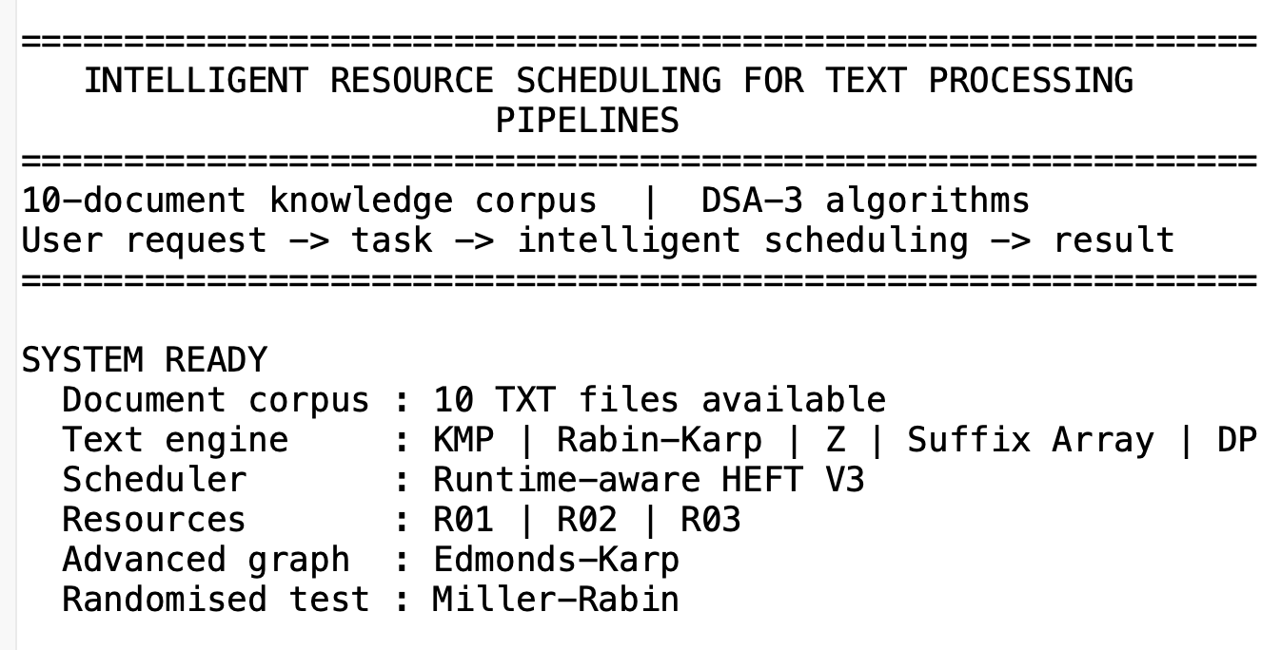
SCHEDULING LAYER
RUNTIME-AWARE HEFT V3 SCHEDULING
1
Generate tasks
6
Predict execution time
LOGICAL SCHEDULER RESOURCES
2
Detect dependencies
7
Assign heterogeneous resource
R01
High Performance Worker
4 CPU · 4096 MB
3
Compute upward rank
8
Execute in parallel
R02
Balanced Worker
4
Identify ready tasks
9
Measure actual runtime
2 CPU · 2048 MB
5
Check CPU / RAM compatibility
10
Update runtime estimate
R03
Lightweight Worker
1 CPU · 1024 MB
R01–R03 assignment vs. actual JVM host snapshot.
07 / 14
Notes:
Our runtime-aware HEFT V3 layer runs ten steps: generating tasks, detecting dependencies, computing upward rank, checking readiness and resource compatibility, predicting execution time, assigning a heterogeneous resource, executing in parallel, then measuring actual runtime and updating the estimate. These are logical scheduler resources — R01 through R03 — which we clearly separate from the real JVM host snapshot shown on the dashboard.

Slide 8
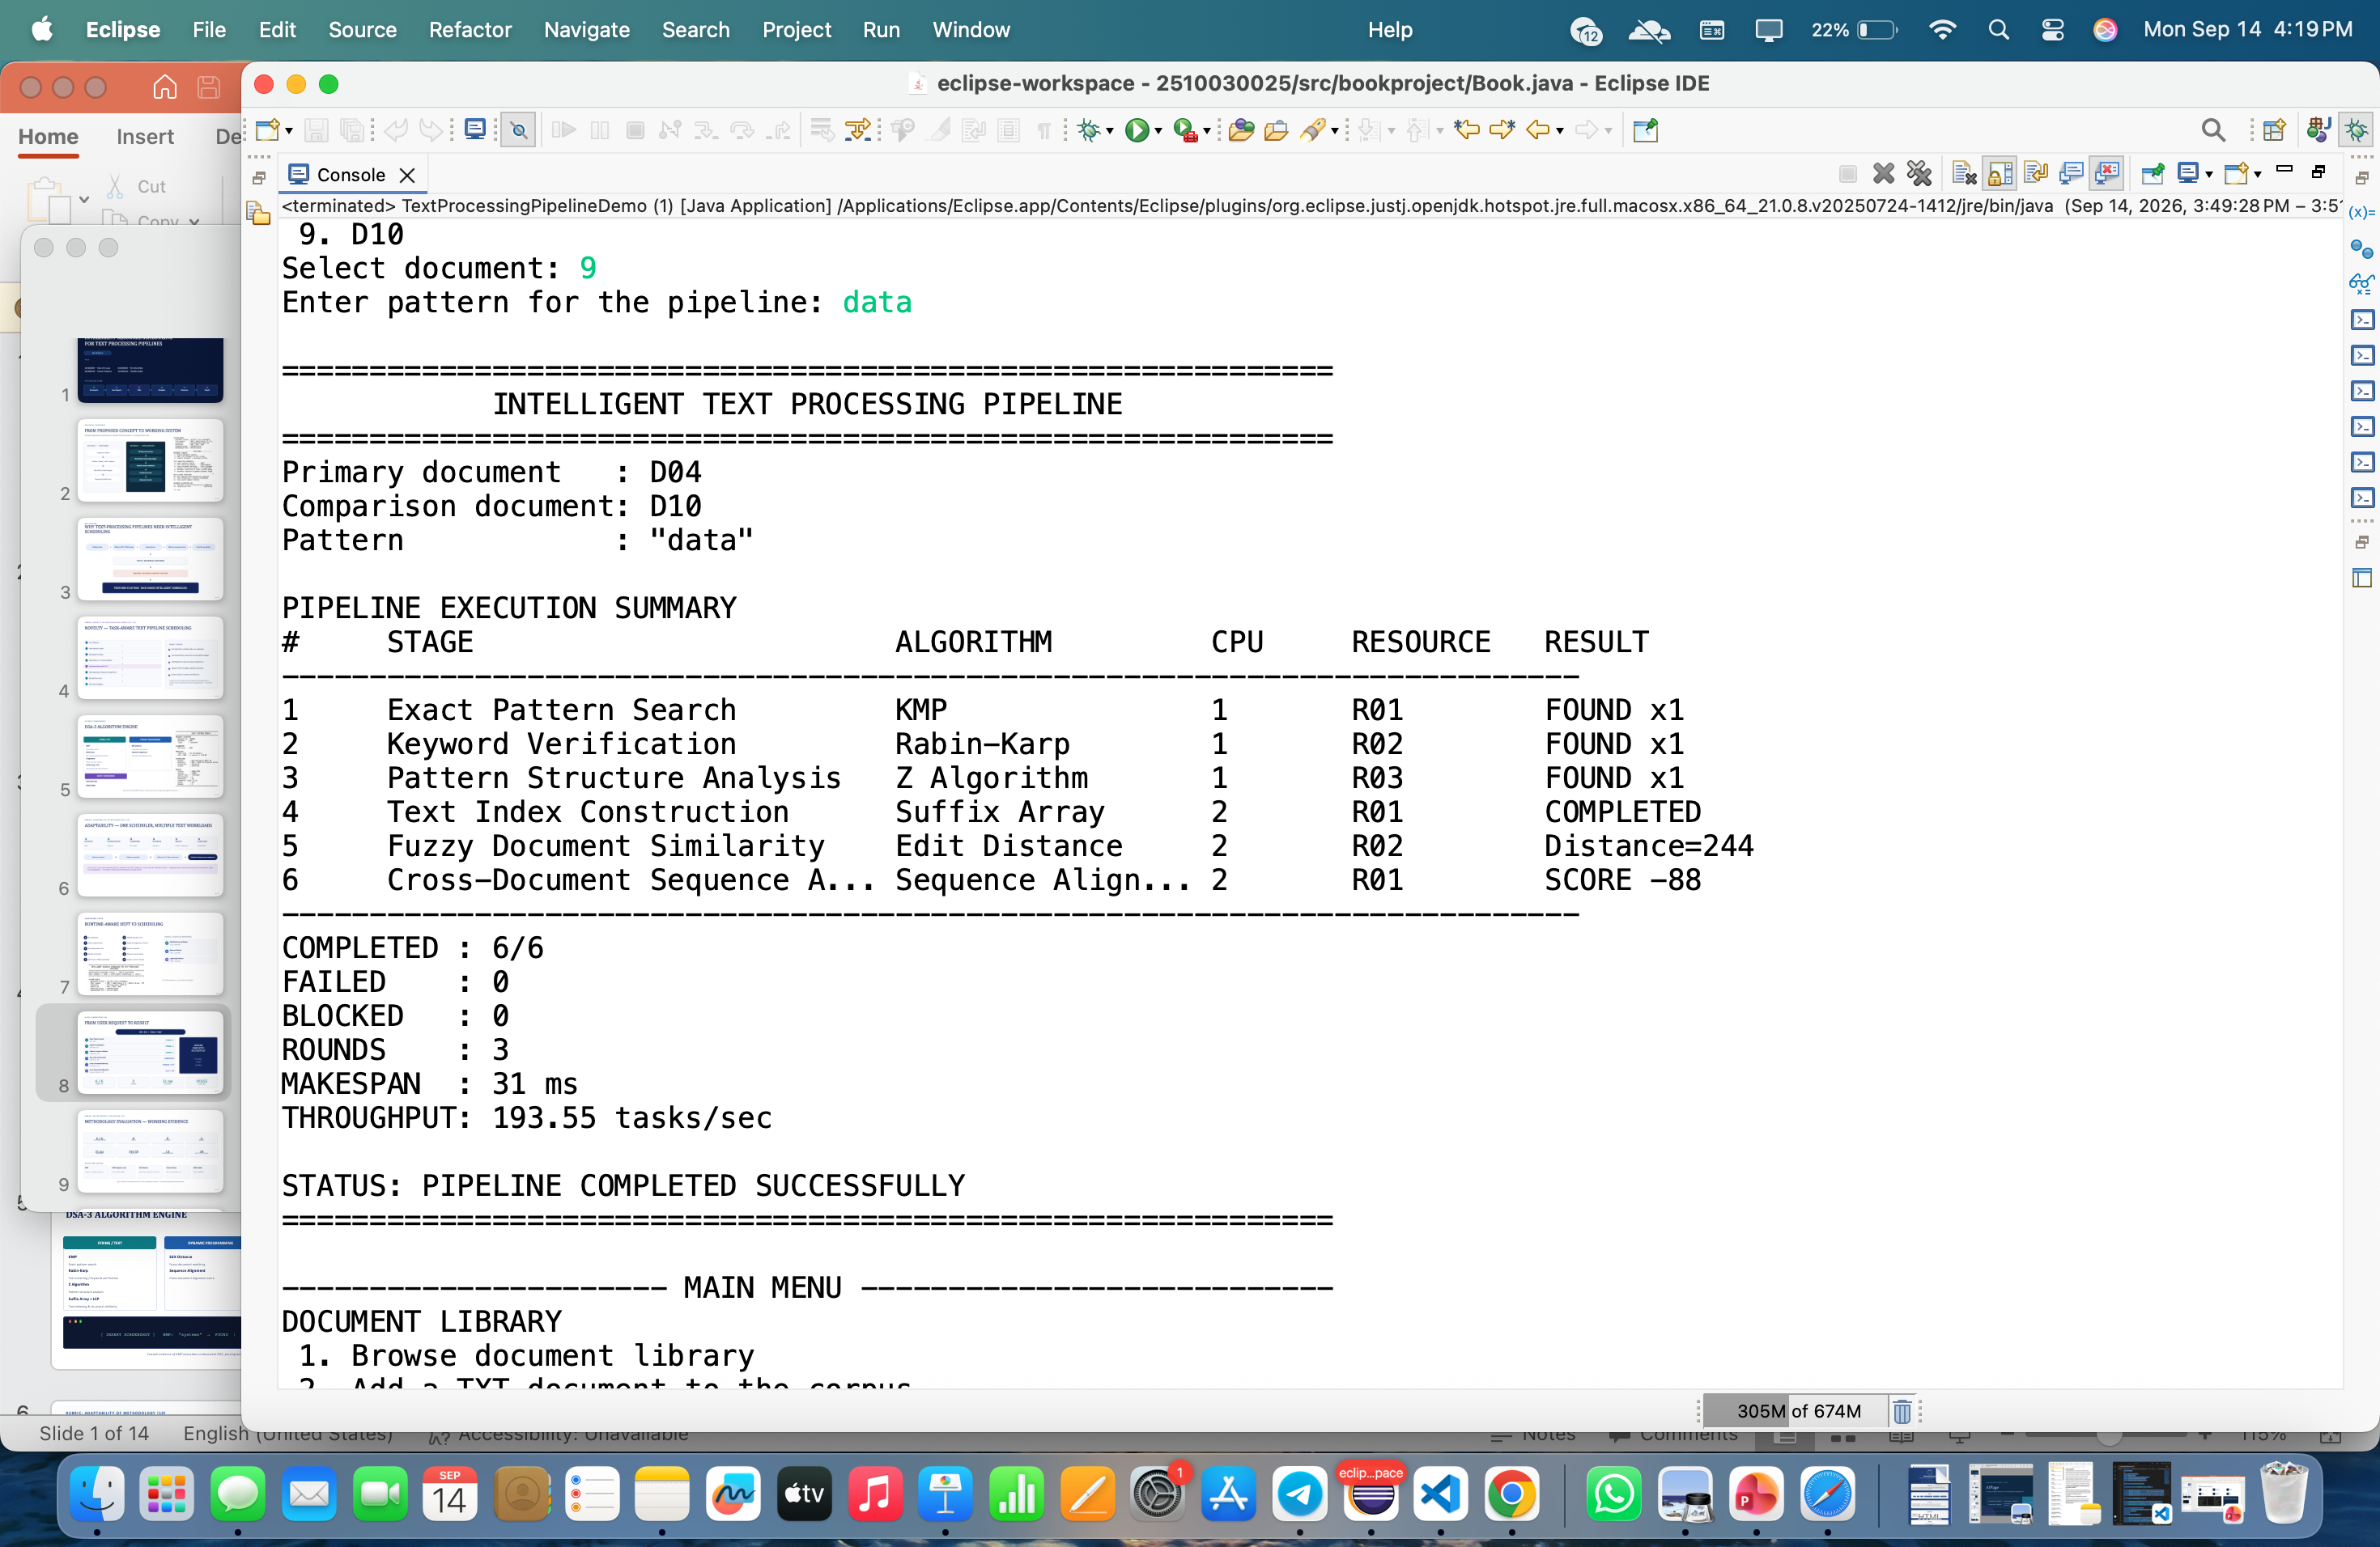
HERO DEMONSTRATION
FROM USER REQUEST TO RESULT
D04 + D10 • Pattern: "data"
1
Exact Pattern Search
FOUND × 1
KMP · R01
Keyword Verification
PIPELINE
COMPLETED
SUCCESSFULLY
2
Rabin-Karp · R02
FOUND × 1
3
Pattern Structure Analysis
FOUND × 1
Z Algorithm · R03
4
Text Index Construction
COMPLETED
Suffix Array · R01
5
Fuzzy Document Similarity
Distance = 244
Edit Distance · R02
6
Cross-Document Alignment
Score = -88
Sequence Alignment · R01
6 / 6
3
31 ms
193.55
COMPLETED
ROUNDS
MAKESPAN
TASKS / SEC
08 / 14
Notes:
This is the hero run of the system: documents D04 and D10, searching for the pattern 'data'. Six stages execute in dependency-aware, resource-assigned order — KMP, Rabin-Karp, Z, Suffix Array, Edit Distance and Sequence Alignment — all completing successfully. This particular run finished all six tasks in three scheduling rounds, a 31-millisecond makespan and a throughput of 193.55 tasks per second. Full console evidence for this run is on the implementation-evidence slide.

Slide 9
RUBRIC: METHODOLOGY EVALUATION (10)
METHODOLOGY EVALUATION — WORKING EVIDENCE
6 / 6
0
0
3
TASKS COMPLETED
FAILED
BLOCKED
ROUNDS
31 ms
193.55
13
10
MAKESPAN
TASKS / SEC
SAVED REQUESTS
HOST CPU THREADS
ALGORITHM EVIDENCE
KMP
KMP (negative case)
Edit Distance
Edmonds-Karp
Miller-Rabin
"systems" → FOUND, position 10
"data" → NOT FOUND
D01 vs D05 → 239 dist. / 17.87% sim.
D01 → D10, max flow = 10
400 → COMPOSITE
Figures reflect this demonstration run on the development machine — not universal performance guarantees.
09 / 14
Notes:
Evaluation is grounded in actual execution, not projections. The complete pipeline finished all six tasks with zero failures across three rounds, and the system logged thirteen saved requests during our demonstration. Individual algorithm runs confirm correctness — including a true negative case where KMP correctly reports 'data' as not found — alongside Edit Distance, Edmonds-Karp and Miller-Rabin results. These are demonstration-run figures, which we state explicitly.

Slide 10
VALIDATION
VALIDATION ACROSS MULTIPLE ALGORITHMS
Nine independent runs across the DSA-3 algorithm engine.
Algorithm | Input | Result
KMP | "systems" | FOUND — position 10
KMP | "data" | NOT FOUND
Rabin-Karp | "system" | FOUND — position 10
Edit Distance | D01 vs D05 | Distance 239 / 17.87% similarity
Z Algorithm | "abcd" | NOT FOUND
Suffix Array | D01 vs D04 | 13.70% structural similarity
Sequence Alignment | D05 vs D08 | Score −110
Edmonds-Karp | D01 → D10 | Max flow = 10
Miller-Rabin | 400 | COMPOSITE
10 / 14
Notes:
This table consolidates nine independent validation runs across every algorithm in the engine — both positive and negative search cases, similarity and alignment scores, max-flow analysis and primality testing — demonstrating breadth as well as correctness.

Slide 11
LIVE SYSTEM
IMPLEMENTATION EVIDENCE
"Working Java console prototype executing a six-stage text-processing pipeline with runtime-aware scheduling."
① Task generation
② Resource assignment
③ Parallel pipeline completion
11 / 14
Notes:
This is the live console output of our Java prototype completing the six-stage pipeline end to end. The three callouts trace exactly where task generation, resource assignment and parallel completion happen in the run — the same run summarized on the previous two slides.

Slide 12
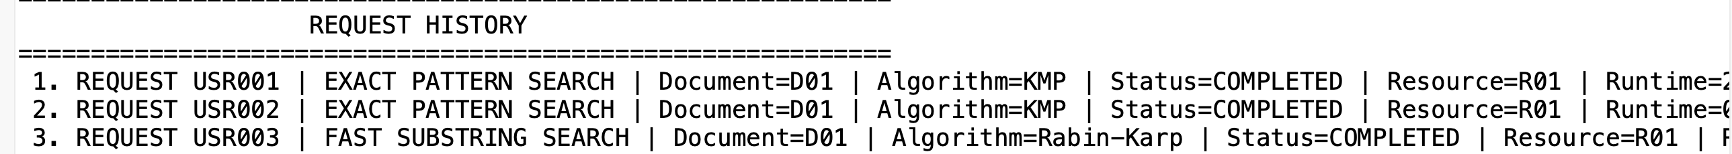
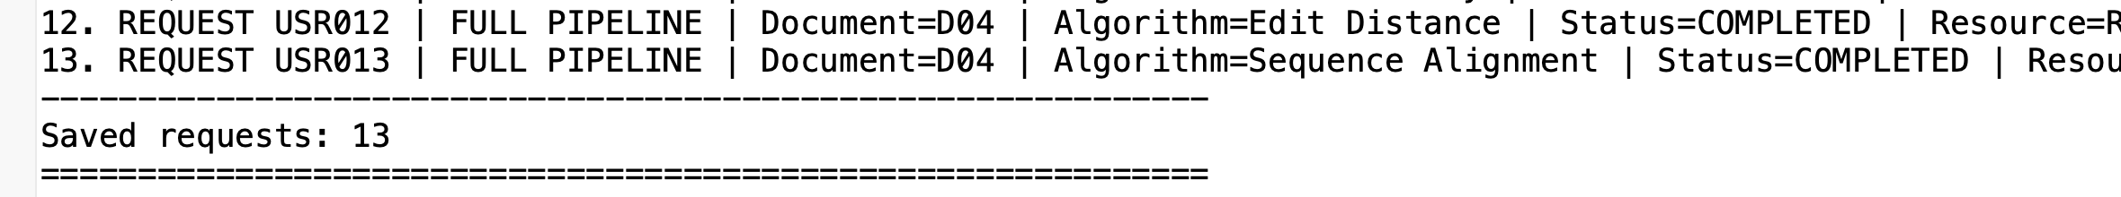
RUBRIC: DISSEMINATION AND ACCESSIBILITY (10)
DISSEMINATION & ACCESSIBILITY
Java console application
Input
TXT-based corpus — no proprietary dataset required
↓
Modular algorithm classes
Processing
Reproducible document inputs
↓
Clear request history
Scheduling
↓
Demonstrable outputs
Result
Suitable for academic demonstration
Structured as modular Java packages/classes; demonstrable via Eclipse
12 / 14
Notes:
The system is deliberately accessible: a self-contained Java console application over a plain TXT corpus, with no proprietary dataset. It's organized as modular algorithm classes, demonstrable directly through Eclipse, and every run is reproducible and traceable — the request history shown here logs thirteen distinct requests from our demonstration, USR001 through USR013.

Slide 13
ROADMAP
CURRENT LIMITATIONS → NEXT STEP
CURRENT
NEXT STEP
Logical resources are modeled scheduler resources
Larger, real-world corpus
More workload types
Current corpus is a controlled 10-document dataset
Stronger runtime prediction
Similarity metric is structural, not semantic
Adaptive resource discovery
Runtime results are workload / machine specific
Visualization dashboard
Larger benchmark study
Console interface rather than a web dashboard
Real distributed execution
13 / 14
Notes:
We're direct about scope: our resources are logical scheduler models, the corpus is a controlled 10-document set, and the similarity metric is structural rather than semantic. Runtime numbers are specific to this workload and machine. The clear next steps are a larger real-world corpus, more workload types, stronger runtime prediction, adaptive resource discovery, a visualization dashboard, a larger benchmark study, and eventually real distributed execution.

Slide 14
WRAP-UP
CONCLUSION
1
2
3
Converted the Review-2 scheduling concept into a working text-processing prototype.
Integrated DSA-3 algorithms with dependency-aware, resource-aware and runtime-aware scheduling.
Demonstrated successful multi-stage execution with measurable completion, scheduling and analytical results.
“Intelligent scheduling is not about running more tasks — it is about running the right task, at the right time, with the right resources.”
THANK YOU
14 / 14
Notes:
To conclude: we converted the Review-2 scheduling concept into a working text-processing prototype, integrated our DSA-3 algorithms with dependency-, resource- and runtime-aware scheduling, and demonstrated successful multi-stage execution with measurable results. As we noted at Review-2 — intelligent scheduling is not about running more tasks, it's about running the right task, at the right time, with the right resources. Thank you.

