Slide 1
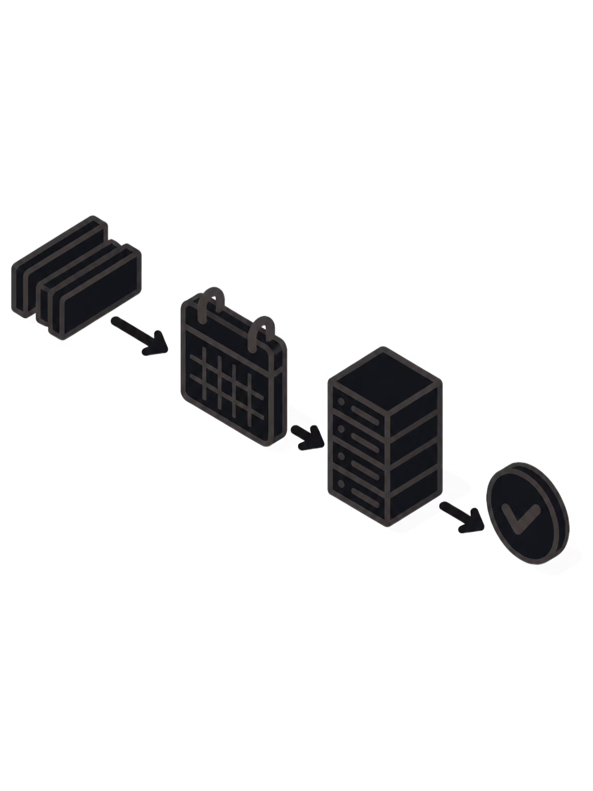
INTELLIGENT RESOURCE SCHEDULING FOR TEXT PROCESSING PIPELINES
PBL REVIEW – 2
Team:
2510030287 – Kollu Sree Lasya
2510030022 – Punreddy Shrenika Reddy
2510030130 – Pasham Rishikha Reddy
2510030101 – Pasham Meghana

Slide 2
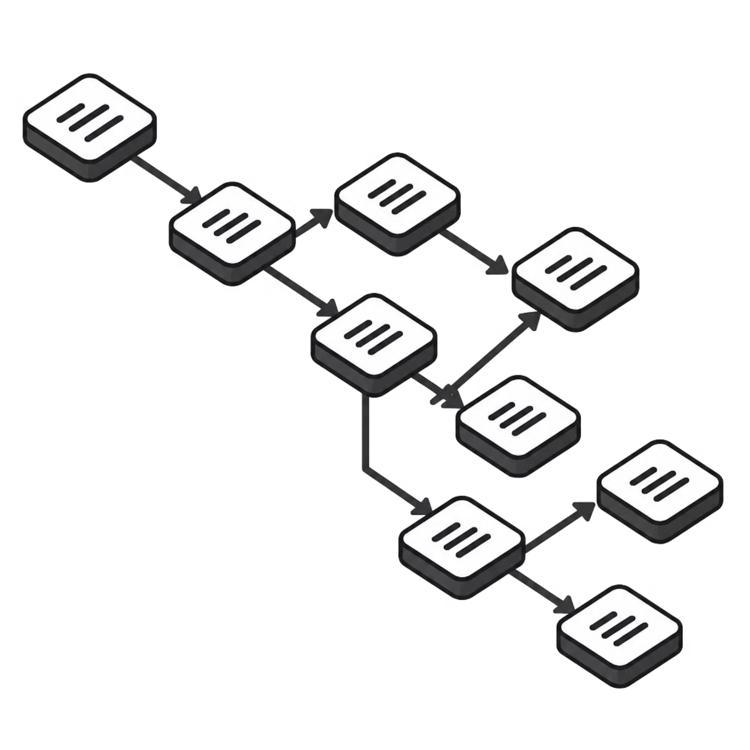
INTRODUCTION — THE SCHEDULING PROBLEM
Multiple Tasks
Text-processing pipelines contain multiple dependent and independent tasks (tokenize, parse, index, classify).
Different Requirements
Tasks differ in priority, CPU demand, memory footprint, and execution profiles.
Problem
Sequential execution often yields waiting, limited parallelism, and resource underutilization.
Proposed Solution
An intelligent scheduler that selects the next task and allocates resources to improve execution time, throughput, and utilization.

Slide 3
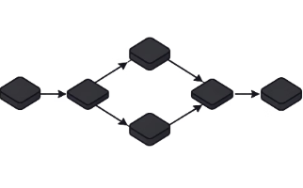
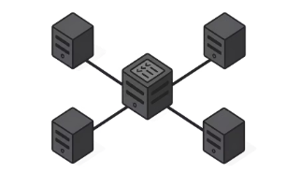
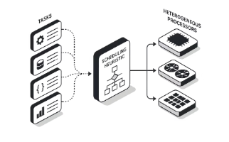
LITERATURE REVIEW — EXISTING APPROACHES
Three representative scheduling approaches were studied across dependency handling, prioritization, parallelism, resource awareness, monitoring, and recovery.
Apache Airflow
Apache Spark
HEFT
Dependency-aware orchestration using DAGs; readiness checks and concurrency controls.
Distributed execution with stage/task decomposition, FIFO/FAIR scheduling, and resource sharing.
Heuristic computing of priorities (upward rank) and resource selection to reduce makespan.
Compact comparison across core dimensions:
Dimension
Airflow
Spark
HEFT
Dependency Handling
✓
✓
✓
Prioritization
✓
Policy-based
✓
Parallelism
✓
✓
✓
Resource Awareness
✓
✓
✓
Each approach addresses important scheduling concerns from a different perspective.

Slide 4
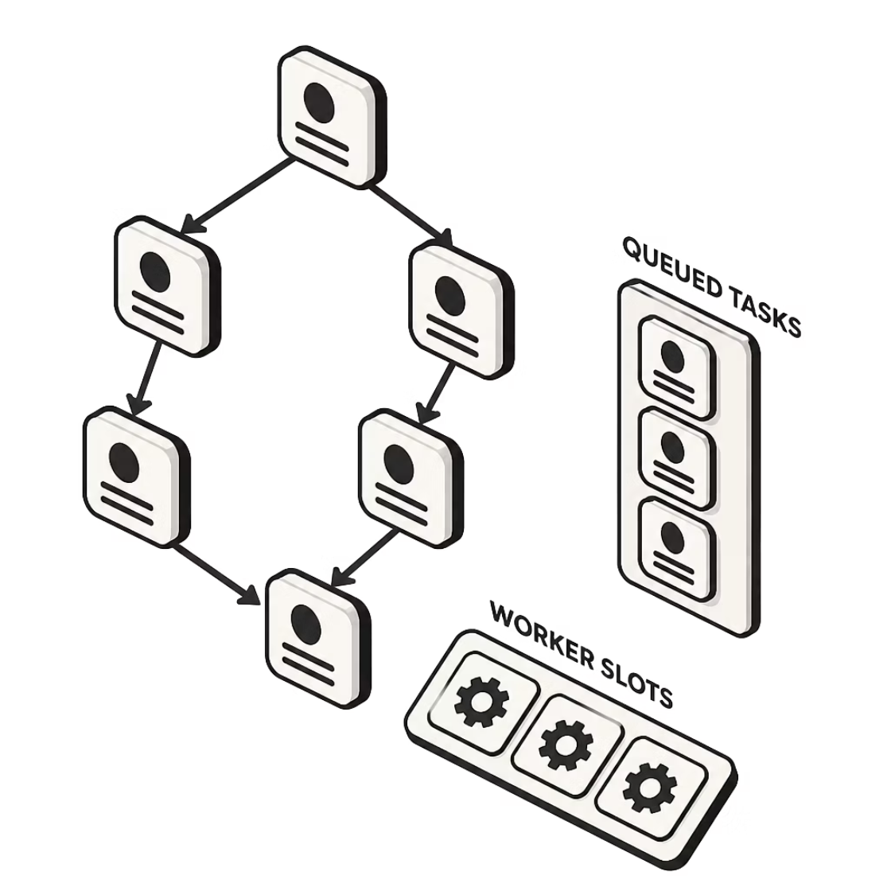
STUDY 1 — APACHE AIRFLOW
Problem Addressed
Orchestration of dependent tasks using DAGs; tasks scheduled when dependencies are satisfied.
Key Ideas
DAG-based readiness checks
Dependency enforcement
Pool slots and concurrency controls
Task prioritization
Strength
Strong dependency-aware workflow orchestration and readiness semantics.
Scope Difference
"Airflow is a general-purpose orchestration platform; our work focuses specifically on scheduling within text-processing pipelines."
Reference
Apache Airflow Documentation — Scheduler

Slide 5

STUDY 2 — APACHE SPARK
Problem Addressed
Scheduling and resource sharing for distributed data-processing workloads.
Key Ideas
FIFO and FAIR scheduling policies
Stage/task decomposition
Parallel execution across executors
Resource sharing mechanisms
Strength
Scalable distributed execution and high parallel throughput.
Scope Difference
Spark targets large-scale distributed computation; our project focuses on scheduling behavior within a dedicated text-processing pipeline.
Reference
Apache Spark Documentation — Scheduling

Slide 6
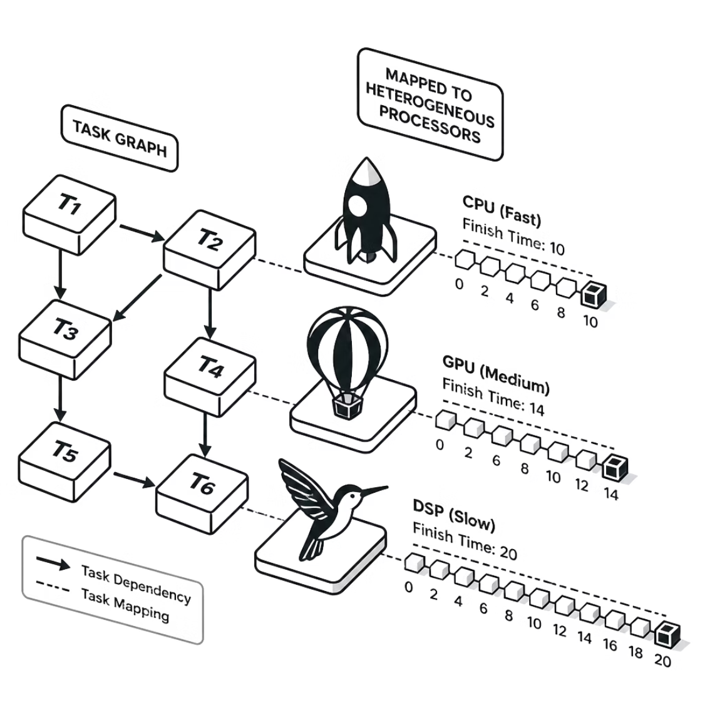
STUDY 3 — HEFT
Full Name
Heterogeneous Earliest Finish Time
Problem Addressed
Efficient scheduling of dependent tasks on heterogeneous resources to reduce makespan.
Key Idea
Compute task priorities using upward rank and select resources by estimated finish time.
Strengths
Dependency-aware prioritization
Heterogeneity-aware placement
Makespan-focused optimization
Scope Difference
"HEFT is an algorithmic scheduling heuristic for heterogeneous environments; our proposed system additionally focuses on pipeline monitoring and recovery."
Reference
Topcuoglu, H., Hariri, S., & Wu, M. — "Performance-Effective and Low-Complexity Task Scheduling for Heterogeneous Computing."

Slide 7
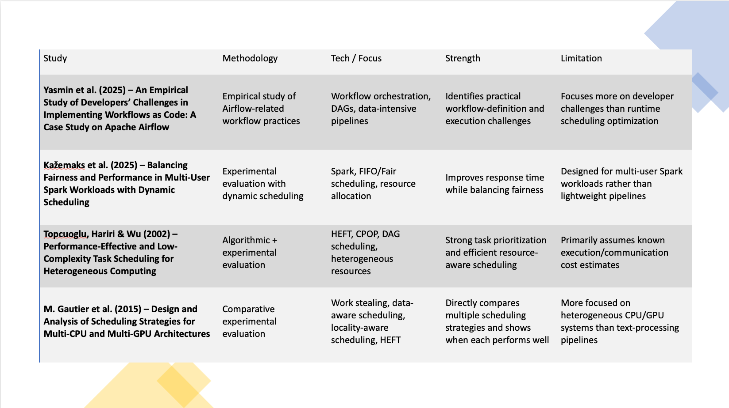

Slide 8
ANALYSIS OF EXISTING APPROACHES
Dimension
Airflow
Spark
HEFT
Dependency Handling
✓
✓
✓
Prioritization
✓
Policy-based
✓
Parallelism
✓
✓
✓
Resource Awareness
✓
✓
✓
Primary Focus
Workflow orchestration
Distributed processing
Task scheduling
Each approach emphasizes different scheduling concerns, providing complementary concepts relevant to our proposed scheduler.

Slide 9

IDENTIFIED GAP & PROPOSED FOCUS
Existing approaches emphasize different scheduling dimensions. Our study identifies an opportunity to integrate task priority, dependency analysis, resource availability, safe parallelism, monitoring, and recovery within a focused text-processing scheduler.
Priority
Dependencies
Task importance and scheduling order
Accurate readiness detection
Resource Availability
Parallelism
CPU/memory checks before dispatch
Safe concurrency limits per pipeline
Monitoring
Recovery
Resource and progress monitoring
Failure detection and task retry/recovery policies
EVALUATION METRICS
Makespan / execution time
Throughput (tasks/sec)
CPU utilization
Memory utilization
Recovery time after failure

Slide 10


PROPOSED SYSTEM ARCHITECTURE
Conceptual / Implementation Planned
Task Identification
Dependency & Priority
Intelligent Scheduler
Schedule & Monitor
No numerical results are presented; evaluation is planned after prototype implementation.

Slide 11

CONCLUSION & REFERENCES
Conclusion
References
Reviewed three representative scheduling approaches: Airflow, Spark, and HEFT.
Identified complementary strengths in dependency handling, prioritization, parallelism, and resource management.
Identified an opportunity for a focused text-processing scheduler integrating priority, dependencies, resource awareness, parallelism, monitoring, and recovery.
Next: Prototype implementation and systematic performance evaluation.
Study 1
Yasmin et al. (2025) – An Empirical Study of Developers’ Challenges in Implementing Workflows as Code: A Case Study on Apache Airflow
Study 2
Kažemaks et al. (2025) – Balancing Fairness and Performance in Multi-User Spark Workloads with Dynamic Scheduling
Study 3
Topcuoglu, Hariri & Wu (2002) – Performance-Effective and Low-Complexity Task Scheduling for Heterogeneous Computing
Study 4
M. Gautier et al. (2015) – Design and Analysis of Scheduling Strategies for Multi-CPU and Multi-GPU Architectures
“Intelligent scheduling is not about running more tasks—it is about running the right task, at the right time, with the right resources.”

