Slide 1
TEXT HACK
Advanced Text Analytics Engine with Intelligent Resource Scheduling
"A DSA-driven engine that maps text-processing problems to algorithms, schedules them as dependent tasks, executes them on heterogeneous logical resources, and reports measurable results."
Text Problem
DSA Algorithm
Task
Scheduler
Resource
Result
Kollu Sree Lasya
Shrenika Reddy
Pasham Meghana
Rishikha Reddy
2510030287
2510030022
2510030101
2510030130
Notes:
Good morning. We are Team TEXT HACK: Kollu Sree Lasya, Shrenika Reddy, Pasham Meghana and Rishikha Reddy.
Our project in one line: a DSA-driven engine that maps text-processing problems to algorithms, schedules them as dependent tasks, runs them on heterogeneous logical resources, and reports measured results.
The strip on screen is the whole story. A text problem is solved by a DSA algorithm. We wrap that algorithm as a task. The scheduler places the task on a resource. We get a result together with a measured runtime.
In the next nine slides we answer: what we built, why we built it, which algorithms we used and why, where each one runs, how they are integrated, how the scheduler decides, what results we measured, and what value it offers.

Slide 2
The problem: algorithms are also workloads
THE PROBLEM
Text-processing systems need different algorithms for different tasks:
OUR OBJECTIVE
Build one engine that combines DSA algorithms with dependency-aware resource scheduling.
Exact pattern matching
Fuzzy matching
Document similarity
Sequence alignment
Text algorithms solve the user's problem. The scheduler decides when and where each workload runs.
Text indexing
The challenge is not only implementing them, but managing their execution as computational workloads with different CPU/RAM needs and dependencies.
THE SOLUTION - COMPLETE FLOW
Problem
Algorithm Selection
Task Creation
Dependency DAG
HEFT Scheduling
Resource Assignment
Execution
Result
Notes:
Text-processing systems need different algorithms for different jobs: exact pattern matching, fuzzy matching, document similarity, sequence alignment and text indexing.
The hard part is not only writing these algorithms. Each one is also a computational workload: different CPU and memory needs, and some must wait for others. Running them in a fixed order on one resource wastes capacity.
So our objective is: build one engine that combines DSA algorithms with dependency-aware resource scheduling.
Read the flow along the bottom. The user's problem leads to algorithm selection, then task creation with CPU, RAM and priority, then a dependency DAG. HEFT scheduling assigns a resource, the real algorithm executes, and we get a result.
The key idea: the text algorithms solve the user's problem; the scheduler decides how and where those workloads run.

Slide 3
DSA algorithms: what, why, and cost
Problem | Algorithm | Why used | Complexity (as implemented)
CORE TEXT-PROCESSING PIPELINE (the 6 pipeline stages)
Exact pattern search | KMP | LPS failure table: text pointer never moves back | O(n + m)
Hash-based search | Rabin-Karp | Rolling hash; every hash hit verified character by character | Expected O(n + m); worst case O(nm)
Pattern structure | Z Algorithm | Z-array over pattern + "$" + text | O(n + m)
Text indexing / similarity | Suffix Array + LCP | Longest shared substring between two documents | Build: insertion sort, O(n²) compares*. LCP: O(n²) worst
Fuzzy matching | Edit Distance (DP) | Measures how different two texts are | O(nm) time and space
Sequence alignment | DP, Needleman-Wunsch style | Global alignment: match +2, mismatch −1, gap −2 | O(nm)
ADVANCED DSA DEMONSTRATIONS (separate menu options, not in the 6-stage pipeline)
Citation flow | Edmonds-Karp | BFS augmenting paths; max flow on a 12-node demo network | O(VE²)
Primality testing | Miller-Rabin | Randomized test; 8 witness rounds; supports n up to 2×10⁹ | O(k log n) modular multiplications
* n = text length, m = pattern length. Suffix array is built manually by insertion sort, which is fine for short documents (D04 + D06 index = 540 suffixes). O(n log n) construction is future scope.
Notes:
This is our algorithm map. Format for each: what it is, why we chose it, where we use it, and its cost.
KMP: exact search using a failure table so the text pointer never moves back. We use it for exact pattern search in stage 1. O(n+m).
Rabin-Karp: rolling-hash search; every hash hit is verified, so results stay correct. Stage 2, keyword verification. Expected O(n+m), worst case O(nm).
Z Algorithm: Z-array over pattern, dollar, text. Stage 3, pattern structure. O(n+m).
Suffix Array plus LCP: gives the longest shared substring between two documents. Stage 4. In our code it is built by insertion sort, so it is quadratic in comparisons. That is fine for our short documents, and we list faster construction as future scope.
Edit Distance and sequence alignment: dynamic programming, O(nm). Stages 5 and 6.
Edmonds-Karp and Miller-Rabin are advanced demonstrations in separate menu options. They are not part of the six-stage pipeline.

Slide 4
One pipeline, not separate algorithms
ROUND 1: independent tasks run in parallel
ROUND 2
ROUND 3
1 Exact Pattern Search
KMP
4 Text Index Construction
Suffix Array + LCP
2 Keyword Verification
Rabin-Karp
6 Cross-Document Alignment
Sequence Alignment
3 Pattern Structure Analysis
5 Fuzzy Document Similarity
Every task still needs its dependencies done first, but stages 1, 2 and 3 do not wait for each other. The console run finished 6/6 tasks in 3 rounds on R01, R02, R03.
Z Algorithm
Edit Distance
TASK LIFECYCLE
Task
Dependency
Ready
Scheduled
Executed
Completed
Edges: KMP, Rabin-Karp, Z → Index; Z → Fuzzy; Index, Fuzzy → Alignment (as built in the pipeline code).
Notes:
This slide shows that TEXT HACK is not a pile of separate algorithms. It is one pipeline with six stages, exactly as in our code.
Stages 1, 2 and 3 are KMP, Rabin-Karp and Z. They have no predecessors, so they are ready together and can run in parallel in round 1.
Stage 4, the suffix array index, waits for all three. Stage 5, edit distance, waits for Z. Stage 6, sequence alignment, waits for both the index and edit distance.
So not every task waits for every other task. Only real dependencies block a task.
Each task moves through a lifecycle: it is created with its dependencies, becomes ready when all predecessors complete, is scheduled onto a resource, executes the real algorithm, and completes.
In our console run this finished 6 of 6 tasks in 3 rounds, using R01, R02 and R03.

Slide 5
Runtime-aware HEFT V3 scheduler
Find ready tasks
Pick best-finish resource
LOGICAL WORKERS
1
status WAITING and all predecessors completed
6
lowest predicted finish time wins
R01
High Performance
4 CPU | 4096 MB
Rank by upward rank
Run the real algorithm
2
rank = own estimate + max successor rank
7
one worker thread per selected task
R02
Balanced
Respect dependencies
Measure actual runtime
2 CPU | 2048 MB
3
cycle check first; blocked tasks are tracked
8
timed with System.nanoTime()
R03
Lightweight
Check CPU / RAM fit
Update runtime estimate
1 CPU | 1024 MB
4
resource must be idle and fit the task
9
first run = actual; then 0.7 old + 0.3 actual
Logical scheduler resources, not three physical computers.
Estimate execution time
Schedule the next round
Adapted HEFT: ranks use computation estimates only; at most one task per worker per round.
5
estimate ÷ (worker CPU ÷ max CPU)
10
repeat until all tasks finish or block
HEFT is a heuristic: it picks good schedules quickly but does not guarantee an optimal schedule.
Notes:
This is the scheduler. Remember the sequence: Task, Dependency, Ready, Rank, Resource, Execution, Runtime.
A task is ready when it is waiting and every predecessor has completed. We compute an upward rank for each task: its own runtime estimate plus the largest rank among its successors. So tasks that sit at the start of long chains get priority.
For the highest-rank ready task we check which idle worker fits its CPU and RAM, estimate its time on that worker, and choose the worker with the lowest predicted finish.
The selected tasks then run in parallel, one thread each, executing the real algorithm. We measure actual runtime and update the estimate: the first run replaces it, later runs blend 70 percent old with 30 percent new. That is the runtime-aware part.
R01, R02 and R03 are logical workers with 4, 2 and 1 CPU. They are modeled capacities, not three physical machines.
HEFT is a heuristic. It does not guarantee an optimal schedule.

Slide 6
System architecture and core data structures
Corpus / Documents
Workload Analyzer
Text Analytics Algorithms
10 TXT files: metadata + CONTENT; only CONTENT is searched
characters, words → CPU and RAM estimate
KMP, Rabin-Karp, Z, Suffix Array+LCP, Edit Distance, Alignment
HEFT V3 Scheduler
Dependency Graph (DAG)
Task Model
upward ranks, resource choice, runtime estimates
Graph class: cycle check, dependency lookup, topological sort
CPU, RAM, priority, status, document IDs
Logical Resources
Task Execution
Runtime + Results + History
R01 (4 CPU), R02 (2 CPU), R03 (1 CPU)
TaskExecutor runs the real algorithm in worker threads
measured ms, result summary, saved request history
DATA STRUCTURES IN THE SOURCE
Graph (adjacency matrix DAG)
DP tables (int[][])
Suffix array + LCP (int[])
Flow matrices + array queue (BFS)
Task / Resource arrays
Worker threads
Notes:
This is the architecture, left to right and top to bottom.
Documents come from a corpus of ten text files, each with metadata and content. Only the content is searched. The workload analyzer estimates CPU and RAM from characters and words. The text algorithms then produce tasks.
Every task carries CPU, RAM, priority and status. Tasks are connected in a dependency graph, our Graph class, which supports cycle detection and topological sort. HEFT V3 reads that graph, ranks tasks, and chooses a resource. The executor runs the real algorithm in worker threads, and we record runtime, result and request history.
Data structures, only those that exist in the source: an adjacency-matrix graph for the DAG, DP tables for edit distance and alignment, suffix and LCP arrays, capacity and residual matrices with an array queue for Edmonds-Karp, and plain arrays for tasks and resources.
The engine uses no java.util classes: all of these are manual.
Note: we also wrote a custom priority queue class and tested it, but HEFT V3 picks the next task by scanning ranks.

Slide 7
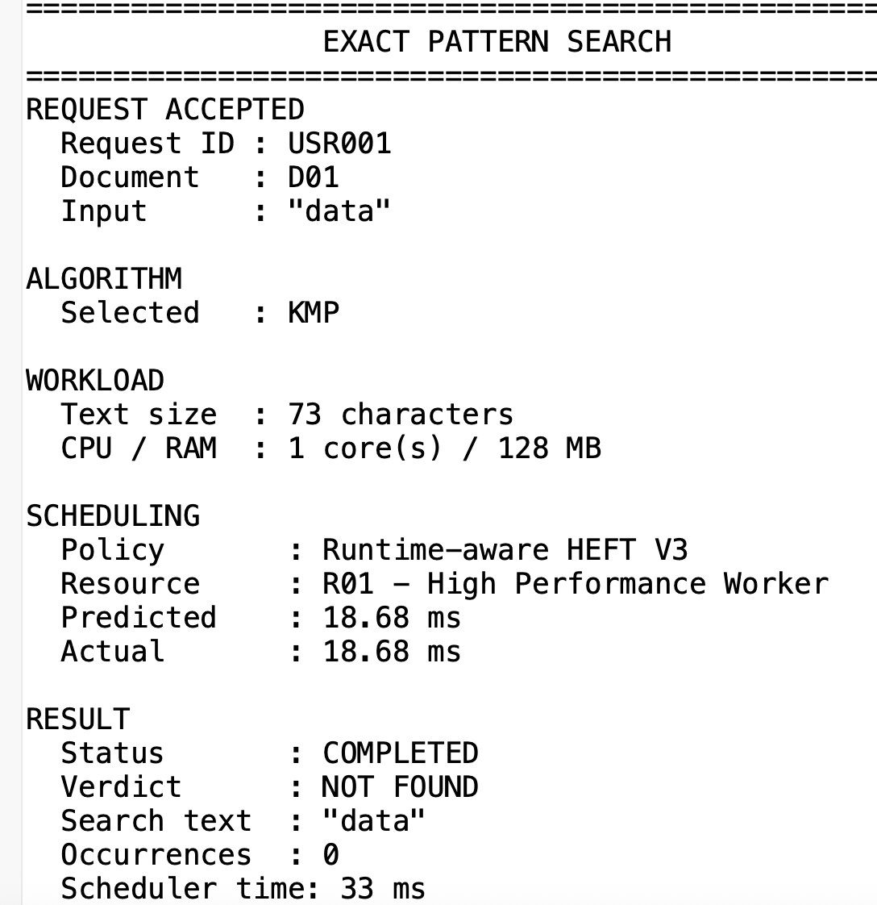
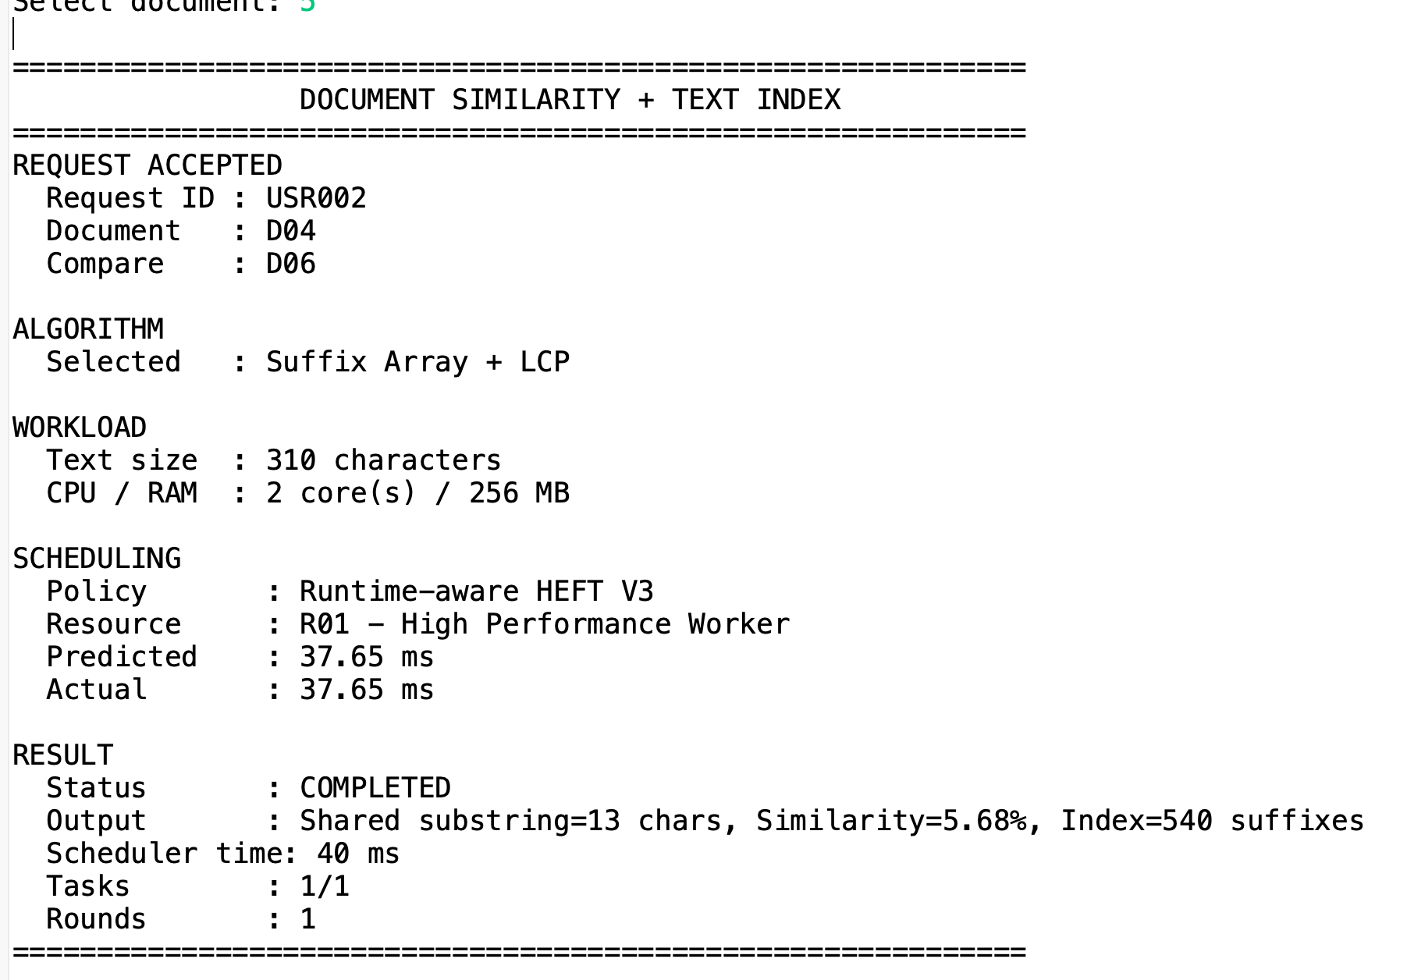
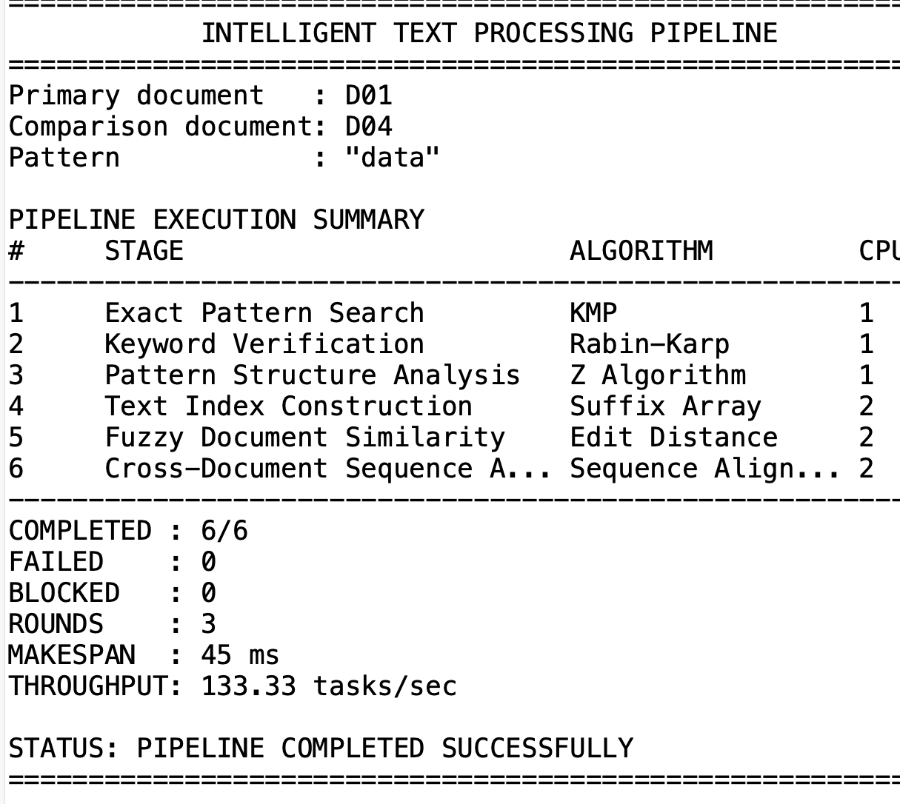
Real console results
PATTERN SEARCH
DOCUMENT SIMILARITY
INTELLIGENT PIPELINE
KMP on D01, "data"
Suffix Array + LCP, D04 vs D06
Tasks completed
NOT FOUND, 0 occurrences
13 chars shared, 5.68%, 540 suffixes
6/6 (0 failed, 0 blocked)
Tasks and rounds
Edit Distance, D01 vs D04
Scheduling rounds
1/1 tasks, 1 round, 20.77 ms
distance 253, similarity 18.39%
3
Z Algorithm on D04 (saved history)
Alignment, D01 vs D05
Makespan / throughput
1 match at position 209
score −353
30 ms / 200.00 tasks/sec
Also run: Edmonds-Karp max flow = 10 (4 augmenting paths) | Miller-Rabin on 3: PROBABLY PRIME
Runtime measured on the demonstration environment and may vary by machine.
Notes:
These are real values from our TEXT HACK console run. Screenshots go in the three boxes.
Pattern search: KMP on document D01 for the word "data" correctly reports NOT FOUND with zero occurrences, one task, one round. The saved history also shows the Z algorithm finding one match at position 209 in D04.
Document similarity: suffix array plus LCP on D04 and D06 found a longest shared substring of 13 characters, 5.68 percent similarity, from an index of 540 suffixes. Edit distance between D01 and D04 was 253, which is 18.39 percent similarity. Alignment of D01 with D05 scored minus 353.
Full pipeline: all 6 of 6 tasks completed, none failed or blocked, in 3 scheduling rounds, with a makespan of 30 milliseconds and throughput of 200 tasks per second.
We also ran Edmonds-Karp, giving a maximum flow of 10 in 4 augmenting paths, and Miller-Rabin, which classified 3 as probably prime.
Timings were measured on our demo machine and vary by machine.

Slide 8
Results, validation and performance
PIPELINE DASHBOARD (6 TASKS)
ALGORITHM COMPARISON (REAL CONSOLE RUNS)
Run | KMP | Rabin-Karp | Z | Matches
D01, "algorithm" (73 chars) | 20.500 µs | 19.000 µs | 1.590 ms | 0, all agree
D06, "7" (229 chars) | 474.875 µs | 36.250 µs | 104.375 µs | 0, all agree
6/6
0
0
Tasks completed
Tasks failed
Tasks blocked
3
30 ms
200.00
Consistency check: PASS in both runs. Single-run timings, so no speed ranking is claimed.
Scheduling rounds
Makespan
Tasks / sec
Saved request history: 18 requests recorded, each with algorithm, resource, runtime and result.
WHAT THIS ESTABLISHES
WHAT WE DO NOT CLAIM
Correctness: three string algorithms agree
Measured execution: real runtime per task
Scheduler behaviour: 6/6 tasks over 3 workers
Not faster than every other algorithm
Timings are machine-dependent single runs
Small 10-document corpus, not large-scale
Notes:
This slide is our evidence. On the left is the dashboard from the full pipeline: 6 of 6 tasks completed, 0 failed, 0 blocked, 3 scheduling rounds, a 30 millisecond makespan and 200 tasks per second throughput.
On the right is a real comparison of KMP, Rabin-Karp and Z. The important result is the consistency check: all three algorithms agree on the match count, here zero, in both runs.
Please read the timings carefully. They are single runs, in microseconds, on our machine, and the console itself notes they are machine-dependent. So we do not claim that any one algorithm is faster. What we claim is correctness, because they agree, and measured execution, because each task records its real runtime.
Our history file holds 18 saved requests, each with algorithm, resource, runtime and result.
What we do not claim: universal speed, large-scale results, or that these timings generalise to other machines.

Slide 9
Innovation, sustainability and social utility
INNOVATION
SUSTAINABILITY
UTILITY TO SOCIETY
Many DSA algorithms in one engine
Algorithms treated as schedulable tasks
Dependency-aware scheduling (DAG)
Runtime-aware HEFT V3 with learned estimates
Heterogeneous logical resources
Parallel execution of independent tasks
Runtime measurement and saved history
Tasks matched to workers that fit their CPU and RAM
Independent work runs in parallel, not in sequence
Estimates learn from measured runtimes
Better use of available compute
Digital libraries
Document analysis and similarity
Educational systems
Information retrieval
Research text processing
Large-scale text workflows
Computational efficiency angle only. We did not measure energy.
Potential applications. Not deployed.
Notes:
This slide targets the innovation, sustainability and utility criteria directly.
Innovation: most projects implement algorithms one by one. We integrate many DSA algorithms into one engine and treat each as a schedulable task with CPU, RAM, priority and dependencies. Our scheduler is dependency-aware, uses runtime-aware HEFT V3 that learns from measured runtimes, assigns work to heterogeneous logical resources, and runs independent tasks in parallel.
Sustainability: we did not measure energy and we do not claim to. The defensible angle is computational efficiency: matching each task to a worker that fits it, running independent work in parallel, and using learned runtimes to plan better.
Utility to society: realistic potential uses are digital libraries, document analysis and similarity, educational systems, information retrieval and research text processing. These are potential applications. Our prototype is demonstrated on a ten-document corpus and is not deployed.

Slide 10
Conclusion, future scope and takeaway
WHAT WE ACHIEVED
DSA Algorithms
Task Modeling
Dependency Graph
Intelligent Scheduling
Resource Assignment
Actual Execution
Measured Results
FUTURE SCOPE (not implemented)
KEY TAKEAWAY
Larger document corpus
Faster suffix array construction and smarter runtime prediction
Distributed execution and GPU acceleration
Energy-aware scheduling and more scheduling strategies
"TEXT HACK does not just implement DSA algorithms — it turns them into an intelligent, dependency-aware and resource-aware computational pipeline."
Thank You
Questions?
Notes:
To conclude. We took DSA algorithms and turned them into tasks, connected them with a dependency graph, scheduled them intelligently, assigned them to resources, executed the real algorithms, and measured the results.
For future scope, and these are not implemented: a larger corpus; a faster suffix array construction and more advanced runtime prediction; distributed execution and GPU acceleration; and energy-aware scheduling and additional scheduling strategies.
Our key takeaway: TEXT HACK does not just implement DSA algorithms. It turns them into an intelligent, dependency-aware and resource-aware computational pipeline.
Thank you. We are happy to take questions.

