Slide 1

IBM Data Analysis
Final Project
Sujan Shrestha
06/19/2024

Slide 2

OUTLINE
Executive Summary
Introduction
Methodology
Results
Visualization – Charts
Dashboard
Discussion
Findings & Implications
Conclusion
Appendix

Slide 3

EXECUTIVE SUMMARY
An Analytical Review of Programming Language and Database Trends in 2024
Current Technology Usage
The Top 10 Programming Languages Used
The Top 10 Databases Used
The Top 10 Platforms Used
The Top 10 Web Frameworks Used
Future Technology Trends
Top 10 Languages Desired Next Year
Top 10 Databases Desired Next Year
Top 10 Desired Platforms
Top 10 Desired Web Frameworks
Demographics
Respondents by Age
Respondent Count by Country
Respondent Distribution by Education Level
Respondent Count by Age, Classified by Education Level

Slide 4

INTRODUCTION
Analyzes developer preferences from the 2024 Stack Overflow Survey.
Focuses on current and future technology usage trends.
Includes insights into developer demographics worldwide.
Aims to guide tech leaders, educators, and recruiters.
Uses visual dashboards to present data clearly and comparably.

Slide 5

METHODOLOGY
Data Collection
Source: 2024 Stack Overflow Developer Survey dataset.
Data gathered from thousands of global respondents, including both professionals and students.
Data Cleaning & Preprocessing
Removed incomplete, inconsistent, or duplicate responses.
Standardized categorical variables (e.g., language names, database types).
Converted raw text responses into structured formats for analysis.
Data Analysis
Aggregated and ranked data to identify top 10 items in each category (e.g., languages, databases).
Calculated distributions and preference shifts using comparative metrics.
Used statistical summaries to highlight usage vs. aspiration gaps.

Slide 6
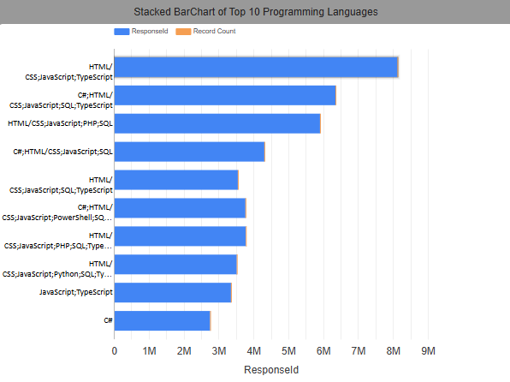
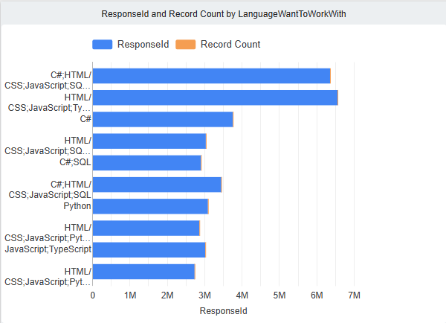
PROGRAMMING LANGUAGE TRENDS
Current Year
Next Year
<Bar chart of top 10 programming languages for the current year goes here.>
< Bar chart of top 10 programming languages for the next year goes here.>

Slide 7
PROGRAMMING LANGUAGE TRENDS - FINDINGS & IMPLICATIONS
Findings
JavaScript & Python dominate in usage, with Python growing due to its role in data science and AI.
TypeScript and Rust are rapidly gaining popularity, with TypeScript favored for large-scale web apps and Rust for system-level and performance-critical applications.
Go continues to rise, especially in cloud-native and microservices development.
Implications
Skill Demand: JavaScript, Python, TypeScript, and Rust will be key languages for developers, especially in web, cloud, and AI roles.
Institutions should focus on TypeScript, Go, and Rust to equip students with skills for modern development
Companies may shift from Java/C# to Kotlin and Go for modern, scalable solutions.

Slide 8
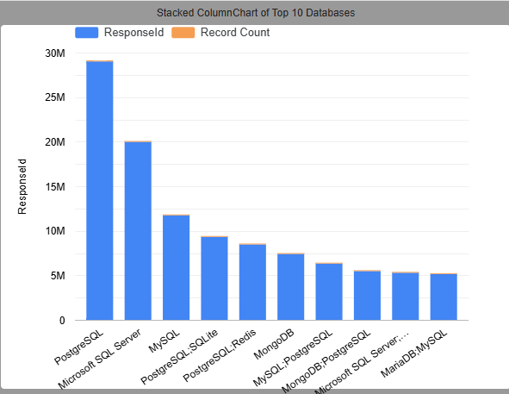
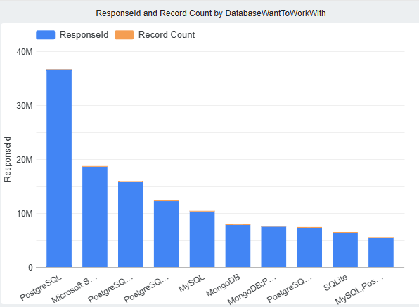
DATABASE TRENDS
Current Year
Next Year
< Bar chart of top 10 databases for the current year goes here >
< Bar chart of top 10 databases for the next year goes here.>

Slide 9
DATABASE TRENDS - FINDINGS & IMPLICATIONS
Findings
PostgreSQL is the most used and most admired database, signaling its dominance in both open-source and enterprise projects.
MySQL, SQLite, and MongoDB remain popular, with MongoDB leading among NoSQL solutions for flexible, document-based data handling.
Newer and cloud-native databases like Firebase, Supabase, and DynamoDB are rising quickly, especially in web, mobile, and serverless environments.
Implications
Developers should focus on PostgreSQL and MongoDB to align with current market demands and project preferences.
Companies are moving toward scalable, cloud-friendly databases, reducing reliance on legacy systems like Oracle and SQL Server.
The growth of real-time and backend-as-a-service platforms indicates a shift toward faster, lightweight development workflows, especially for startups and mobile-first teams.

Slide 10

DASHBOARD
<Link to the Dashboard>

Slide 11
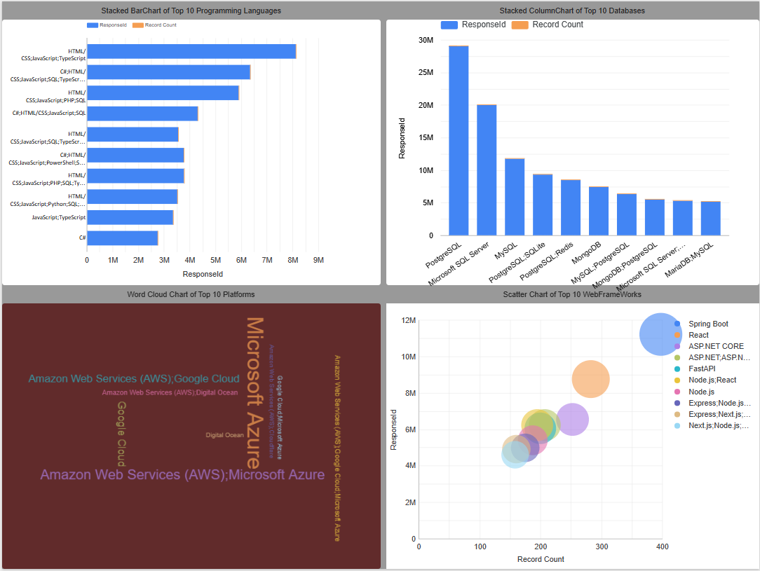
DASHBOARD TAB 1
Screenshot of dashboard tab 1 goes here

Slide 12
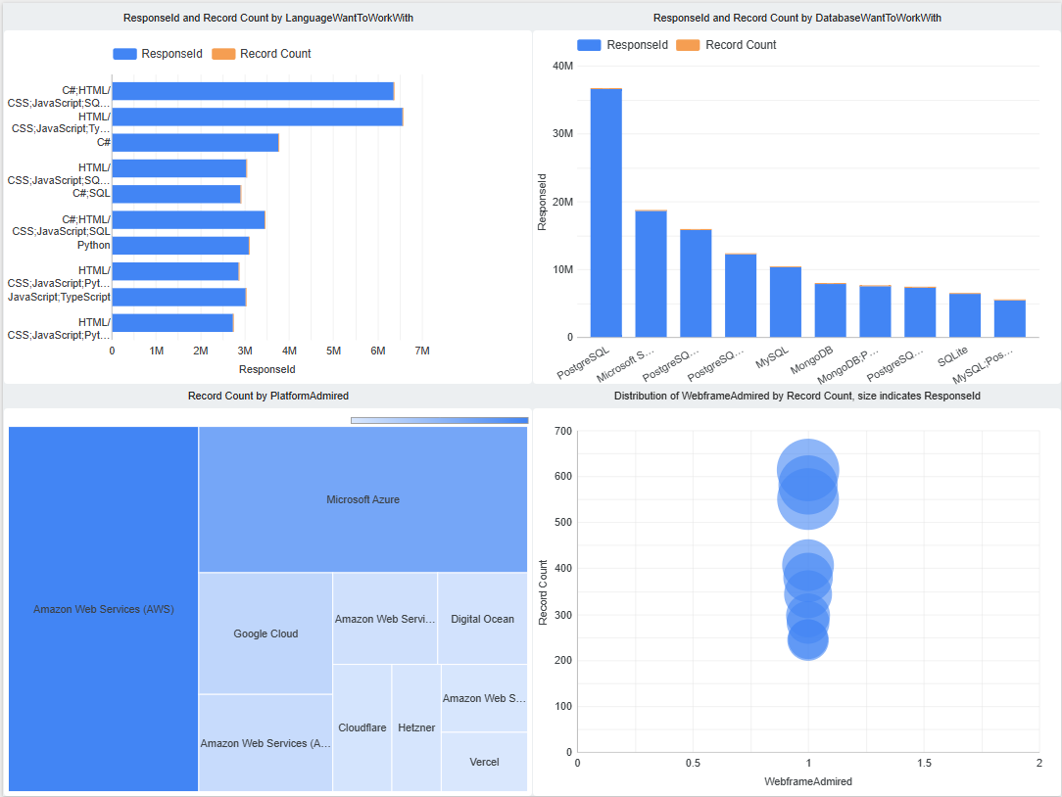
DASHBOARD TAB 2
Screenshot of dashboard tab 2 goes here

Slide 13
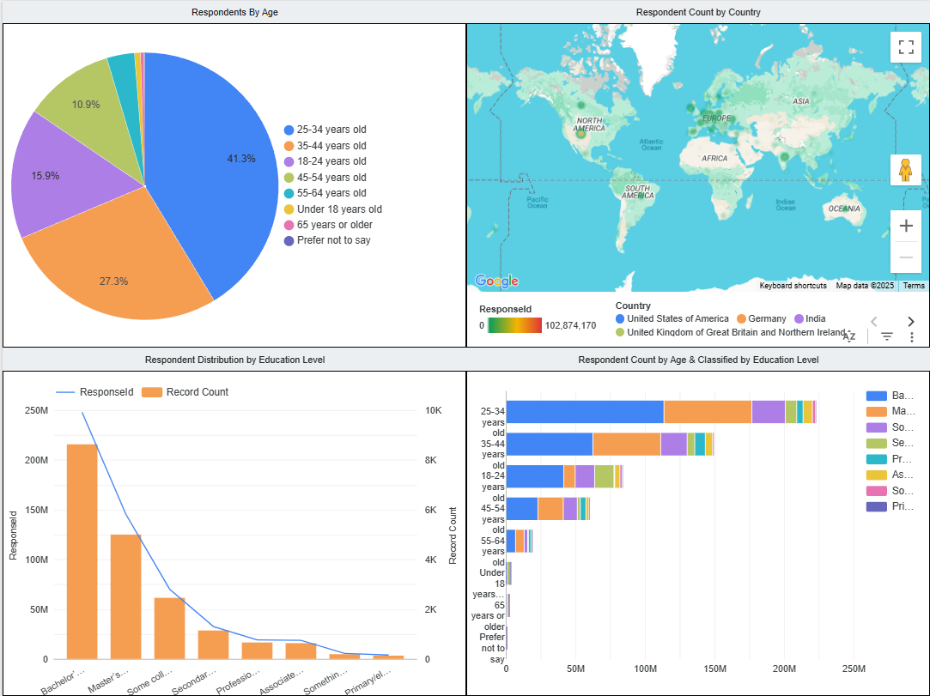
DASHBOARD TAB 3
Screenshot of dashboard tab 3 goes here

Slide 14
DISCUSSION

Slide 15
OVERALL FINDINGS & IMPLICATIONS
Findings
JavaScript, Python, and TypeScript dominate language usage, while newer languages like Rust and Go are gaining strong developer interest.
PostgreSQL leads database adoption, with rising use of MongoDB, Firebase, and Supabase in modern, cloud-based applications.
Linux, Docker, and cloud platforms (like AWS and Google Cloud) are the most used, reflecting the shift toward cloud-native and containerized development.
Implications
Developers should focus on modern, versatile languages and tools like Python, TypeScript, Rust, and Go to stay competitive.
There is a clear industry move toward open-source, scalable, and serverless databases, favoring PostgreSQL and cloud-integrated solutions.
Platforms built around cloud infrastructure, containers, and DevOps tools are now essential, highlighting the need for platform fluency in development roles.

Slide 16

CONCLUSION
Modern languages like TypeScript, Rust, and Go are reshaping development, while JavaScript and Python continue to dominate due to their versatility and wide adoption.
PostgreSQL leads a growing preference for open-source, feature-rich databases, with MongoDB, Firebase, and Supabase rising in popularity for modern app architectures.
Cloud-native platforms and tools such as Docker, Linux, and AWS have become essential, reflecting a strong shift toward containerization and scalable cloud solutions.
Developers and organizations must adapt to these evolving technology trends to stay relevant, competitive, and prepared for the next wave of innovation in software development.

Slide 17

APPENDIX

Slide 18
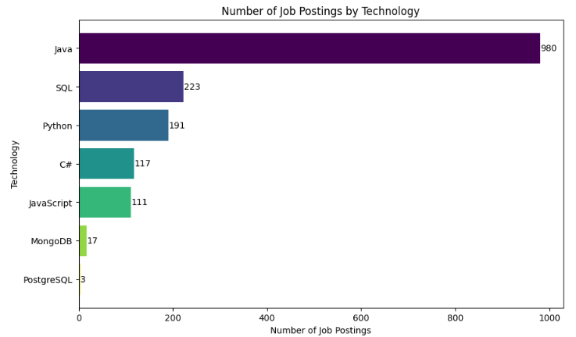
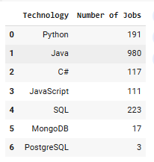
JOB POSTINGS

Slide 19
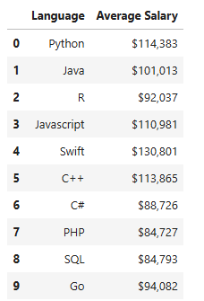
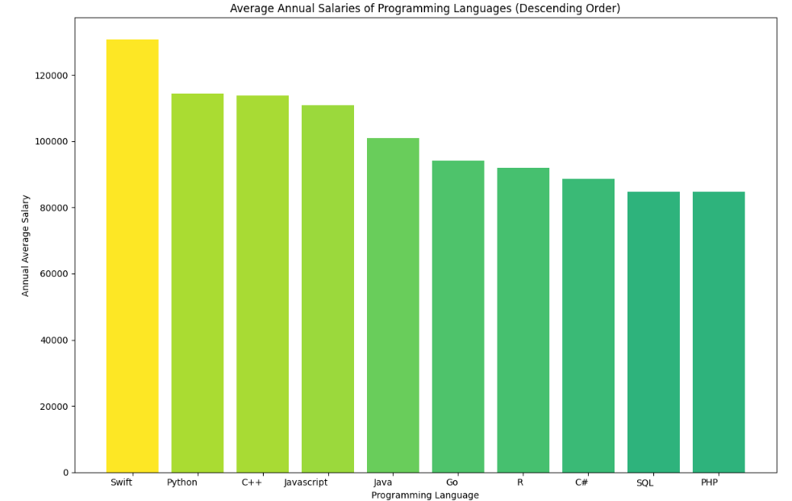
POPULAR LANGUAGES

