Slide 1
Display devices and interfaces

Slide 2
Monitor
It is a most common output device
A monitor or display (also called screen or visual display unit) is an electronic visual display for computers.
Originally, computer monitors were used for data processing while television receivers were used for entertainment.
CRT used in most of televisions and computer displays
The desktop computers are available with a variety of displays ranging from technologically obsolete CRT monitors to latest slim LCD, LED or OLED monitors.

Slide 3
CRT Monitor

Slide 4
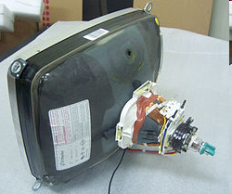
How Monitor Works?
Most use a cathode-ray tube as a display device.
CRT: Glass tube that is narrow at one end and opens to a flat screen at the other end.

Slide 5
How Monitor Works?
Electrons travel through a vacuum sealed container from the cathode (negative) to the anode (positive).
Because the electrons are negatively charged, they are repelled away from the cathode, and move across the tube to the anode.
The ray can be affected by a magnet because of its relation to positive and negative charges

Slide 6
Cathode ray tube (CRT)
1. Uses stream of electrons that activate dots or pixels to create full image.
2. Different types of monitors exists, which are
Monochrome
Grayscale
Color

Slide 7
Monochrome Monitor
A monochrome monitor is a type of CRT computer display which was very common in the early days of computing.
  From 1960s to 1980s, before color monitors .
They are still widely used in applications such as computerized cash register systems.
Green screen was the common name for a monochrome monitor.
It gives three signals video signal, horizontal sync and vertical sync.

Slide 8
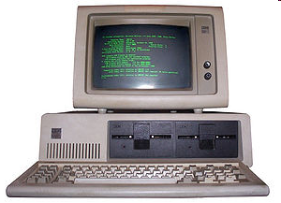
Monochrome Monitor

Slide 9
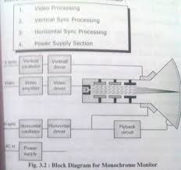
Monochrome Monitors

Slide 10
Monochrome Monitors
Video processing unit: contains video signals from display adopter card to video Amplifier Circuit.
Video signal controls brightness of beam only two levels to set brightness ON and OFF.
Vertical Sync Processing: vertical sync signal from video adopter cards informs monitor that entire screen is displayed, sync pulses are given to the vertical oscillator which generates required frequency for vertical scanning.
Horizontal Sync processing: Hsync signal from video adapter informs the monitor Horizontal oscillator is use to generate the required frequency horizontal oscillator.
Output of horizontal oscillator is used to generate high voltage needed for picture tube (extra high tension).
Power Supply section: generate the different voltage.

Slide 11
Color Monitors
A display monitor capable of displaying many colors.
Color Monitors works like a monochrome Monitor, except that there are three electron beams instead of one.
The three guns represent additive colors (red, green and blue) although the beam they emit are colorless.
Each pixel includes three phosphors, red, green and blue, arranged in a triangle.
When the beam of each of these guns are combined and focused on a pixel, the phosphors light up.

Slide 12
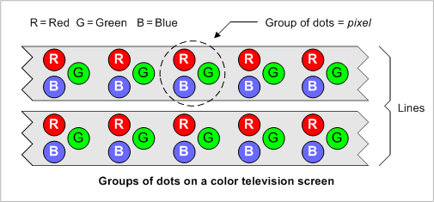
Color Monitors
The monitors can display different colors by combining various intensities of three beams.

Slide 13
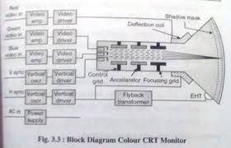
Color Monitors

Slide 14
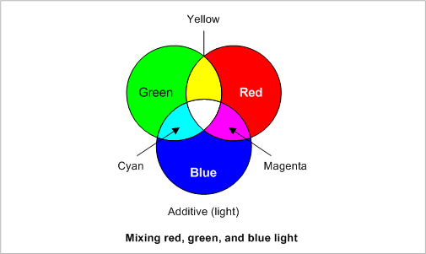
Mixing of Colors

Slide 15
How color Monitor Works?
Three different electron guns for three different colours .
  Video signal processing and amplifier
  vertical deflection and Sync
  Horizontal deflection and Sync
  Power supply

Slide 16
CRT Monitor working
Video Processing Amplifier:Transmission line or coaxial cables carry video signal i.e RGB(video signals) from host to the monitor for amplification before signals are applied to CRT cathode.
It provides high voltage amplification.
CRT video amplifier amplifies signal to control the emission current from the cathode.
Video driver drives the cathode of the tube and controls the number of electrons that reach the screen,and display the output.

Slide 17
CRT Monitor working
vertical deflection and Sync: Vertical Sync signal informs monitor that screen has been displayed VSync pulses fed to vertical oscillator are used to generate frequency
It detects the incoming vertical sync pulses and controls the vertical deflection.
Horizontal deflection and Sync: detect incoming signal puses and used to control horizontal oscillator.
It generates Extra High Tension voltage.
Power supply:generates voltages.

Slide 18
A CRT monitor contains millions of tiny red, green, and blue phosphor dots that glow when struck by an electron beam that travels across the screen to create a visible image. In a CRT monitor tube, the cathode is a heated filament. The heated filament is in a vacuum created inside a glass tube. The electrons are negative and the screen gives a positive charge so the screen glows.
Anode- Positively Charged, Ray travels towards this
Cathode- Negatively Charged, Ray travels away from this

Slide 19
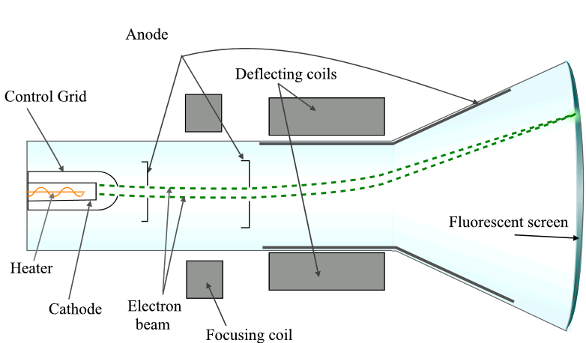

Slide 20
Cathode Ray Tube (CRT) Monitors
A CRT monitor contains millions of tiny red, green, and blue phosphor dots that glow when struck by an electron beam. Electron beam travels across the screen to create a visible image.
In a CRT monitor tube, the cathode is a heated filament.
The heated filament is in a vacuum created inside a glass tube. The electrons are negative and the screen gives a positive charge so the screen glows.

Slide 21
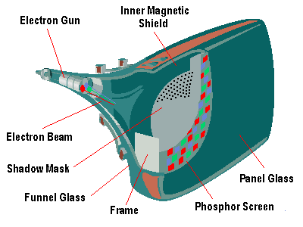
Basic Cathode Ray Tube
  Electrons excite phosphor to glow
  Electrons fired from the back
  Phosphor is arranged in dots called pixels
  Dot mask ensures proper pixel is lit

Slide 22
Phosphore
It is a semi-conducteur material which emits visible radiation in response to the impact of electrons.
(i.e. when it absorbs energy from some source such as an electron beam, it releases a portion of this energy in the form of light).
In response to a sudden change in the electron beam(from on to off), the light emission does not fall instantaneously, there is a gradual reduction challed ‘fluorescence’ .

Slide 23
CRT Monitor Specifications
Monitor Specifications
  Size
  Resolution
  Refresh rate
  Dot pitch(CRT)

Slide 24
Size
A monitor’s size affect how well we can see images.
With a larger monitor, we can make the objects on the screen appear bigger.
Monitors are measured diagonally, in inches, across the front of the screen.
A 17 inch monitor measures 17 inches from the lower left to the upper right corner.
CRT monitors viewing area is smaller than the monitor’s overall size.

Slide 25
Resolution
The images you see on your monitor are made of tiny dots called pixels.
The term resolution refers to the sharpness and clarity of an image.
A monitor resolution is determined by the number of pixels on the screen. It is expressed as a Matrix.
The more pixels a monitor displays, higher will be its resolution. Clearer will be images appear.
  For example 640 X 480 resolution means that there are 640 pixels horizontally across the screen and 480 pixels vertically down the screen.
  Resolution = total no of Horizontal pixels * total number of vertical pixels

Slide 26
Resolution
Actual resolution is determined by the video controller.
  Most monitors can operate at several different resolutions. They are
  640 X 480
  800 X 600
  1024 X 768
  1152 X 864
  1280 X 1024
As the resolution increases, image on the screen gets smaller.

Slide 27
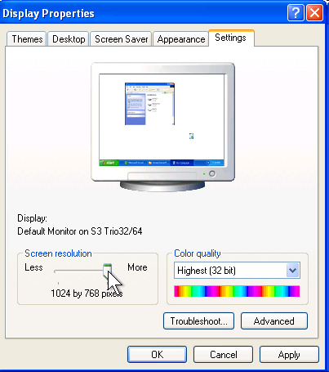
Resolution Settings

Slide 28
Refresh Rate(vertical Scanning frequency)
Monitor refresh rate is the number of times per second that the electron guns scan every pixel on the screen.
Refresh rate is important because phosphor dots fade quickly after the electron gun charges them with electrons.
If the screen is not refreshed, it will appear to flicker.
Refresh rate is measured in Hz or Cycles per second.
  If the monitor refresh rate is 100 Hz, it means that it refreshes its pixels 100 times every second.

Slide 29
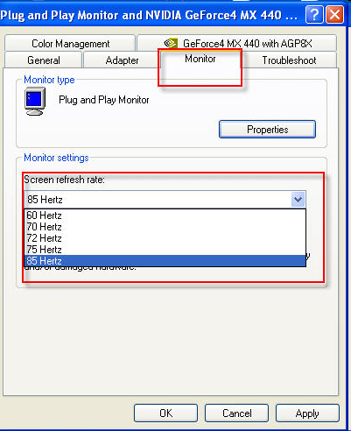
Refresh Rate

Slide 30
Dot Pitch
Ranges between 0.25 mm and 0.40 mm
Smaller creates a finer picture
Should be less than 0.22
Defines the sharpness of monitor display
Quality of monitor is given by dot Pitch It is the distance between the same color dots

Slide 31
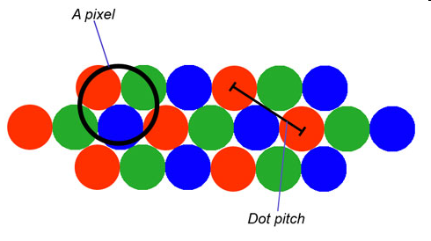
Dot Pitch

Slide 32
Horizontal Scanning Frequency
Frequency at which the monitor rewritten moves the electron beam from the left to display to the right refresh rate is dependent upon monitor HSF and number of horizontal lines displayed
The horizontal lines Screen resolution – 1024 x 768
HSF measured in kilohertz.
Eg HSF is 110Khz then 110,000 lines scanned per second

Slide 33
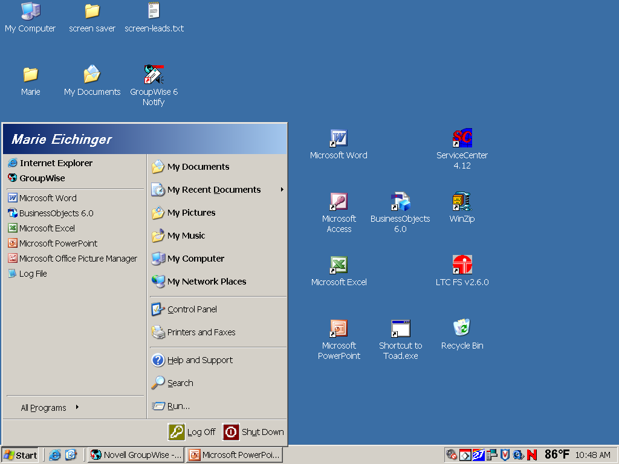
Changing your computer’s display settings
Then, click here to open the Control Panel
Click Start button

Slide 34
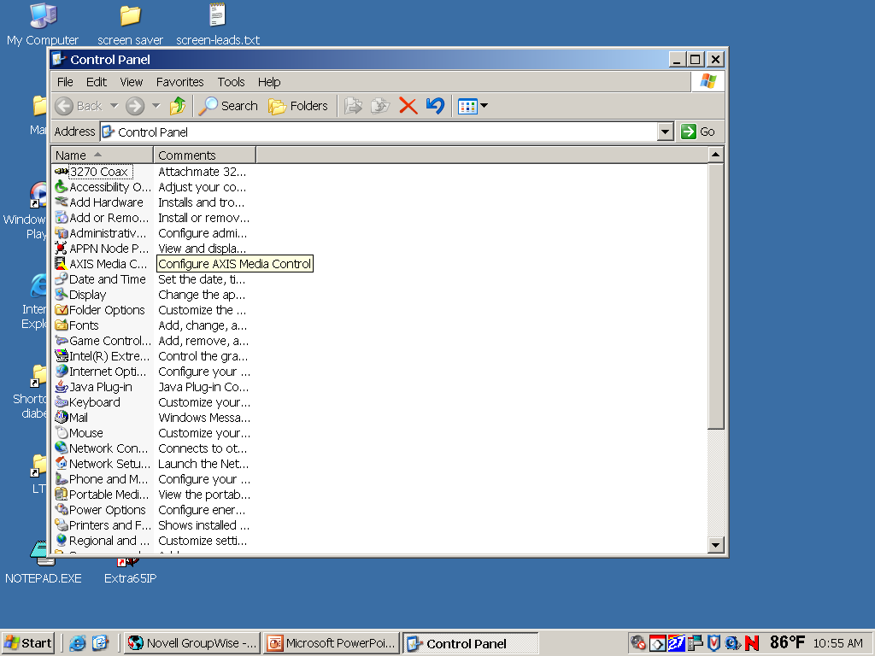
Opening “Display” window
Double-click on “Display”

Slide 35
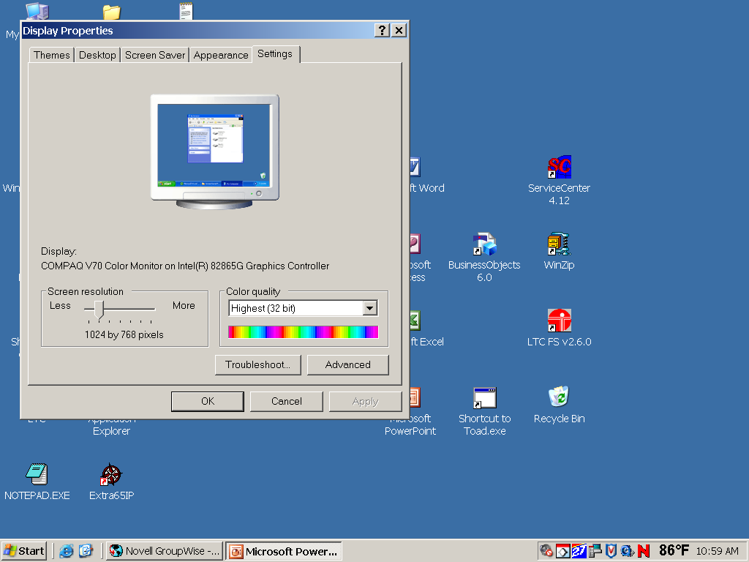
Re-setting Resolution
First, click “Settings” tab
Next, move slider-bar to adjust resolution to 1024 by 768 pixels

Slide 36
Getting to “Dots Per Inch”
Then, click the “Advanced” button to set Dots Per Inch

Slide 37
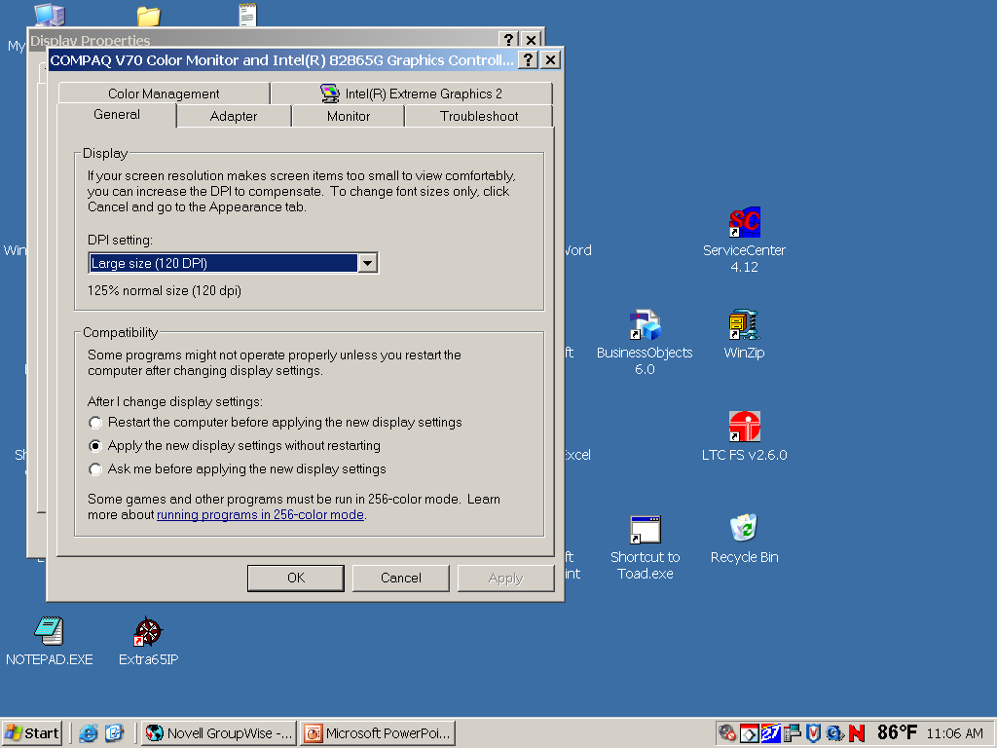
Resetting Dots Per Inch (DPI)
Change DPI setting to “Large Size” (120 DPI)

Slide 38
Scanning Pattern of CRT Electron Gun
The electron gun scans from left to right and
From top to bottom.
Refreshing every phosphor dot in a zig-zag pattern.

Slide 39
Advantages of CRT
The cathode rayed tube can easily increase the monitor’s brightness by reflecting the light.
They produce more colours
The Cathode Ray Tube monitors have lower price rate than the LCD display or Plasma display.
The quality of the image displayed on a Cathode Ray Tube is superior to the LCD and Plasma monitors.
The contrast features of the cathode ray tube monitor are considered highly excellent.

Slide 40
Disadvantages of CRT
They have a big back and take up space on desk.
The electromagnetic fields emitted by CRT monitors constitute a health hazard to the functioning of living cells.
CRTs emit a small amount of X-ray band radiation which can result in a health hazard.
Constant refreshing of CRT monitors can result in headache.
CRTs operate at very high voltage which can overheat system or result in an implosion
Within a CRT a strong vacuum exists in it and can also result in a implosion
They are heavy to pick up and carry around

Slide 41
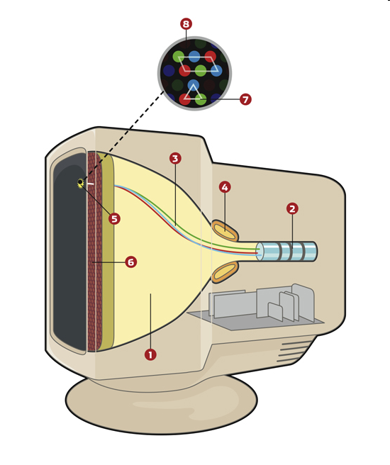
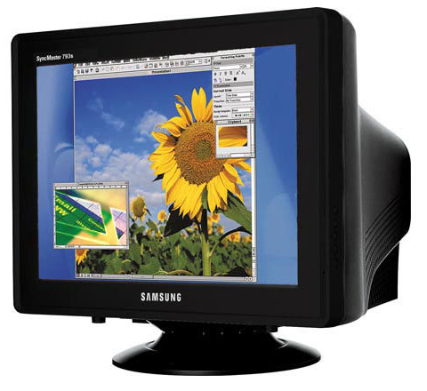
CRT Monitor

Slide 42
Liquid Crystal Display - Monitor
It is a flat panel display, electronic visual display, or video display that uses the light modulating properties of liquid crystals (LCs).
LCs do not emit light directly .

Slide 43
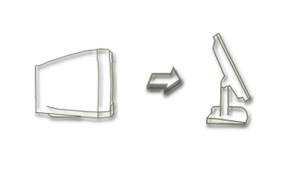
From CRT to LCD
CRT
  Bulky, heavy, use vacuum tube technology.
  Using technology that was developed in the 19th century.
LCD
  First LCD laptop monitors were very small due to manufacturing costs but now are available in a variety of sizes.
  Light, sleek, energy-efficient, have sharp picture.

Slide 44
Liquid Crystal Display
There are mainly two categories of LCD.
  The passive matrix LCD
  The Active matrix LCD

Slide 45
Passive Matrix LCD
Monochrome passive-matrix LCDs were standard in most early laptops.
  Still being used today for applications less demanding than laptops and TVs.
It consisting of a grid of horizontal and vertical wires.
  At the intersection of each grid is an LCD element which constitutes a single pixel, either letting light through or blocking it.
Passive matrix LCD
  Pixels arranged in a grid
  Pixels are activated indirectly
    Row and column are activated
  Animation can be blurry

Slide 46
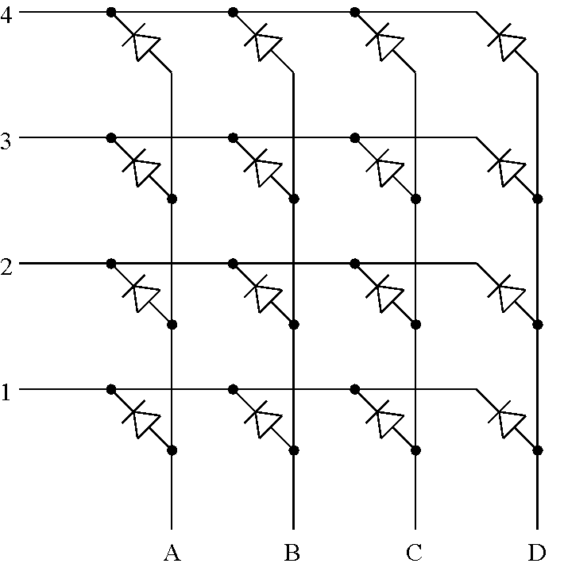

Slide 47
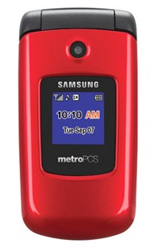
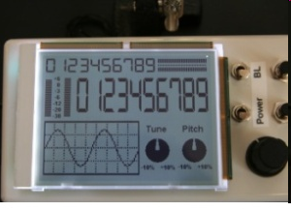
Passive Matrix Display

Slide 48
Active Matrix LCD
Active-matrix LCDs depend on thin film transistors (TFT).
  TFTs are tiny switching transistors and capacitors.
They are arranged in a matrix on a glass substrate.
  Each pixel is activated directly
  Pixels have 4 transistors
    One each for red, green, blue
    One for opaqueness
  Animation is crisp and clean

Slide 49
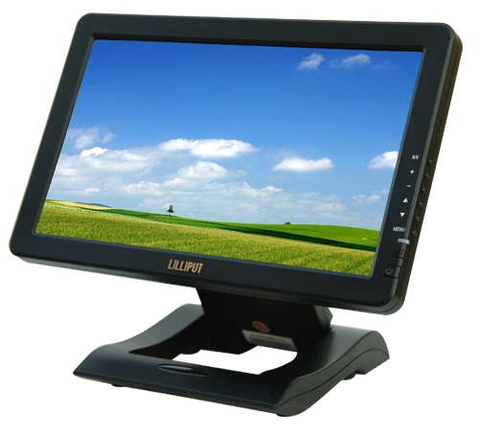
TFT LCD Screen

Slide 50
Advantages of LCD
The sharpness of a LCD display is at maximum tweak ness.
High peak intensity produces very bright images. Best for brightly lit environments.
Screens are perfectly flat.
Thin, with a small footprint. Consume little electricity and produce little heat
The LCD display unit is very light and can be put anywhere or moved anywhere in the house.
Lack of flicker and low glare reduce eyestrain.

Slide 51
Disadvantages of LCD
After a while the LCD display the some of the pixels will die you will see a discoloured spot on a black spot on the display.
The cost of a LCD is considerably at a high price.
The LCD display will have slow response times.
The LCD display has a fixed resolution display and cannot be changed.
The viewing angle of a LCD display is very limited.

Slide 52
Other types of Monitors
Paper-white displays
  High contrast between fore and background
Electro-luminescent displays (ELD)
  Similar to LCD
  Uses phosphor to produce light
Plasma monitor
  Gas is excited to produce light

Slide 53
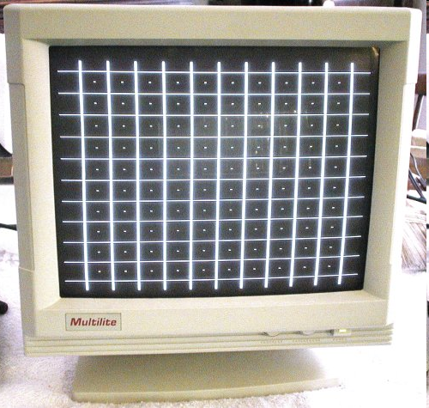
Paper White Display

Slide 54
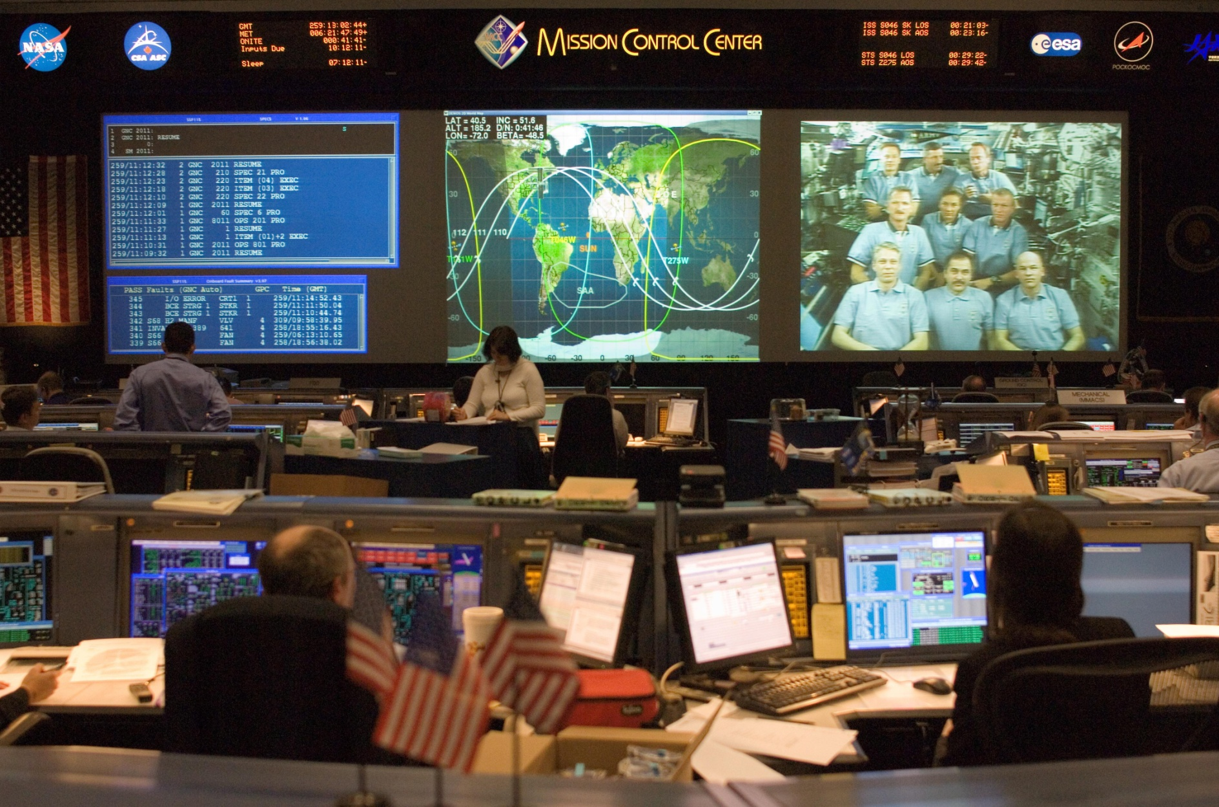
NASA -Electroluminescent displays

Slide 55
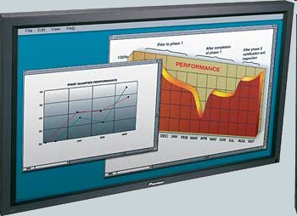
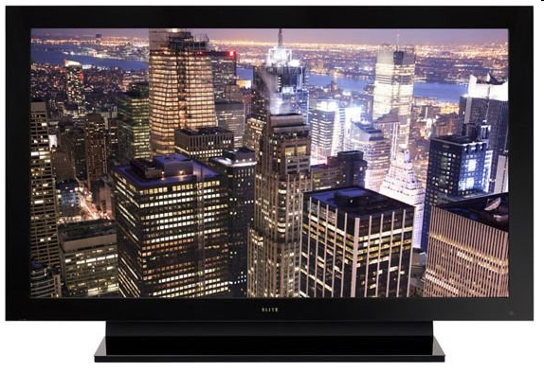
Plasma Monitors

