Slide 1
Graphics
Cathode Ray Tube
by
by Umesh Krishna Shrestha

Slide 2
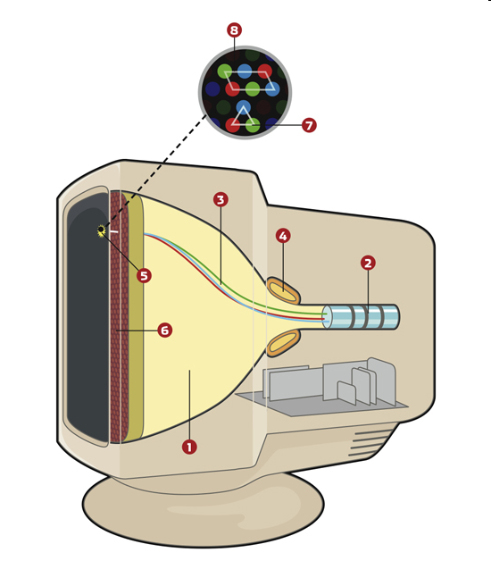
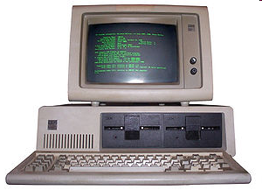
Monitor
most common output device
electronic visual display for computers.
CRT used in most of televisions and computer displays, Oscilloscope, Radar displays

Slide 3
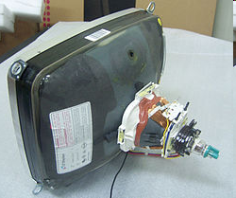
CRT Workings?
CRT: Basically a Glass tube that is narrow at one end and opens to a flat screen at the other end. Tube is vaccum sealed.
Electrons beam generated thermo-ionically and is acclerated through high electric field travel through a vacuum sealed container from the cathode (negative) to the anode (positive).
Energy of the electrons and the the sharpenss of beam is controlled by various electic and magnetic fields.
These electron dump energy when they hit the flat portion of the tube, where various chemicals are coated as per need of genration of the light.

Slide 4
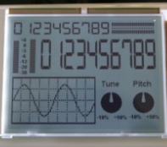
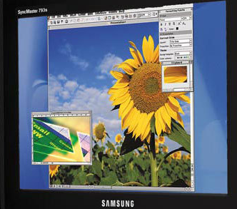
Cathode ray tube (CRT) can be
Monochrome
Grayscale
Color
The first cathode ray tube scanning device was invented by the German scientist Karl Ferdinand Braun in 1897. Braun introduced a CRT with a fluorescent screen, known as the cathode ray oscilloscope. The screen would emit a visible light when struck by a beam of electrons.

Slide 5
Monochrome Monitor
A monochrome monitor very common in the early days of computing. Green screen was the common name
From 1960s to 1980s, before color monitors .
They are still widely used in applications such as computerized cash register systems.
needs three signals video signal, horizontal sync and vertical sync for operation

Slide 6
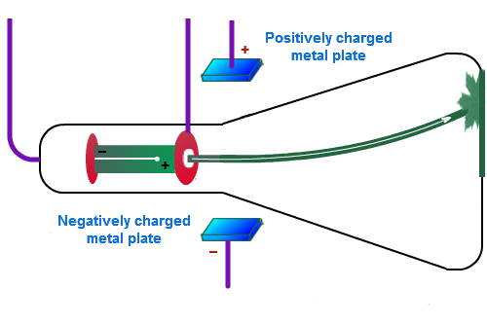
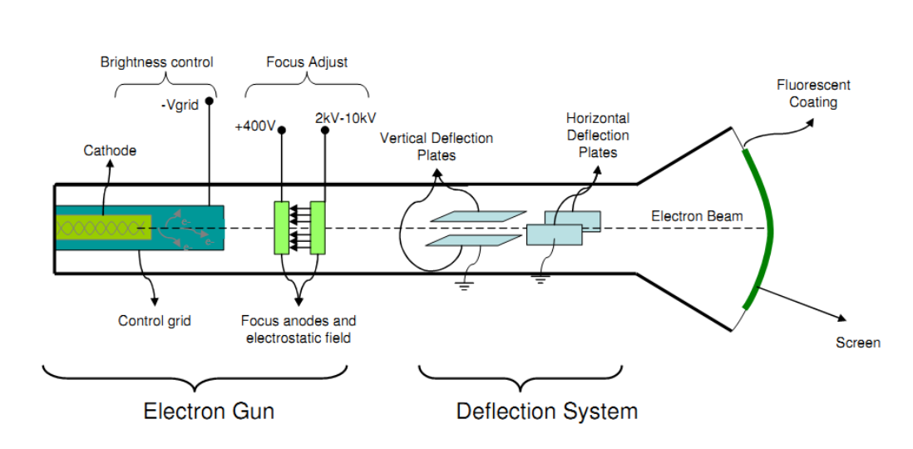
hardware of Monitors

Slide 7
Components of Monitors
Video processing unit: contains video signals from display adopter card to video Amplifier Circuit.
Video signal controls brightness of beam only two levels to set brightness ON and OFF.
Vertical Sync Processing: vertical sync signal from video adopter cards informs monitor that entire screen is displayed, sync pulses are given to the vertical oscillator which generates required frequency for vertical scanning.
Horizontal Sync processing: Hsync signal from video adapter informs the monitor Horizontal oscillator is use to generate the required frequency horizontal oscillator.
Output of horizontal oscillator is used to generate high voltage needed for picture tube (extra high tension).
Power Supply section: generate the different voltage.

Slide 8
Color Monitors
Bichrome monitor has one electron beam and 2 layers of phosphor, which are activated differently by using diff energy of beam.
True Color Monitors has additive colors (red, green and blue), works like a monochrome Monitor, except that there are three electron beams instead of one hitting array of phosphors arranged in pixels (each having sub pixel corresponding to each beam).
Each pixel includes three phosphors, red, green and blue, arranged in a triangle or vertically.
When the varied intensity beam of each of these guns are focused on a pixel, each sub pixel produce different colour at different intensity which is interperated as different hues and spectra by our eye.

Slide 9
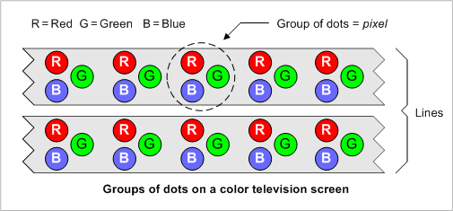
pixel arranged in triangles.

Slide 10
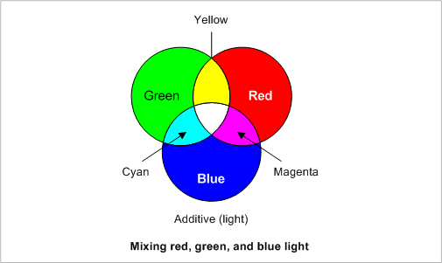
Mixing of Colors

Slide 11
How Monitor Works?
Three different electron guns for three different colours .
Video signal processing and amplifier
vertical deflection and Sync
Horizontal deflection and Sync
Power supply

Slide 12
CRT Monitor working
Video Processing Amplifier:Transmission line or coaxial cables carry video signal i.e RGB(video signals) from host to the monitor for amplification before signals are applied to CRT cathode.

Slide 13
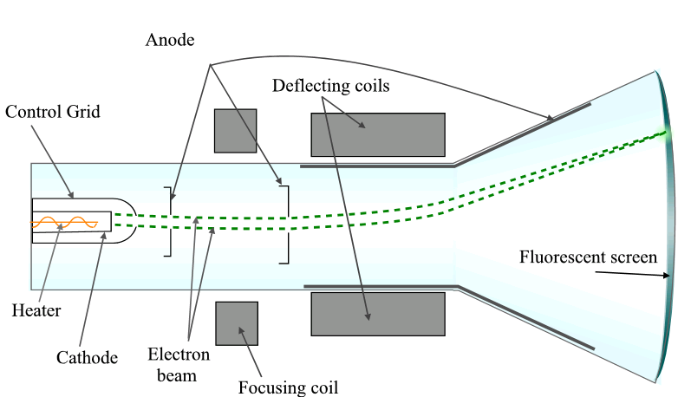

Slide 14
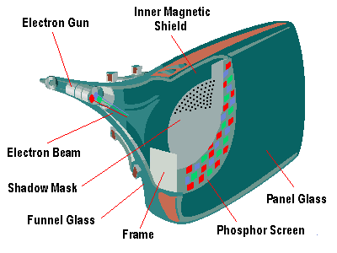
alingment of the dost to beam is achived with help of dotted shadow mask

Slide 15
Phosphore ( P, S, Se, Te, Zn, Sr, Mn, Rare earths, etc)
It is a material which emits visible radiation in response to the impact of electrons, which is termed as Phosphorescence / fluorescence’ .
In response to a sudden change in the electron beam(from on to off), the light emission does not fall instantaneously, there is a gradual reduction.
flouresence is used for the shorter phenomenon
while phosphorescence is used for longer one.

Slide 16
Monitor Specifications
Size
Resolution
Refresh rate
Dot pitch(CRT)

Slide 17
Size
A monitor’s size affect how well we can see images.
With a larger monitor, we can make the objects on the screen appear bigger.
Monitors are measured diagonally, in inches, across the front of the screen.
eg. 17 inch monitor measures 17 inches from the lower left to the upper right corner.

Slide 18
Resolution
The images on monitor are made of tiny dots called pixels.
The term resolution refers to the sharpness and clarity of an image.
It is determined by the number of pixels on the screen.
Resolution = total no of Horizontal pixels * total number of vertical pixels
The more pixels a monitor displays, higher its resolution and Clearer is images.
eg 640 X 480 resolution means that there are 640 pixels horizontally across the screen and 480 pixels vertically down the screen.

Slide 19
Resolution
Actual resolution is determined by the video controller.
Most monitors can operate at several different resolutions. They are
640 X 480
800 X 600
1024 X 768
1152 X 864
1280 X 1024
As the resolution increases, image on the screen gets smaller.

Slide 20
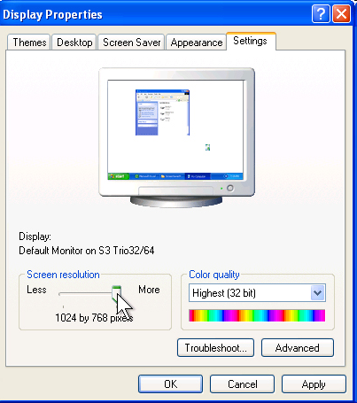
Resolution Settings

Slide 21
Refresh Rate(vertical Scanning frequency)
Monitor refresh rate is the number of times per second that the electron guns scan every pixel on the screen.
Refresh rate is important because phosphor dots fade quickly after the electron gun charges them with electrons.
If the screen is not refreshed, it will appear to flicker.
Refresh rate is measured in Hz or Cycles per second.
If the monitor refresh rate is 100 Hz, it means that it refreshes its pixels 100 times every second.
refresh rate has to do with persistance of vision

Slide 22
Dot Pitch
Ranges between 0.25 mm and 0.40 mm
Smaller creates a finer picture (or higher resoultion)
Should be less than 0.22
Defines the sharpness of monitor display
Quality of monitor is given by dot Pitch It is the distance between the same color dots

Slide 23
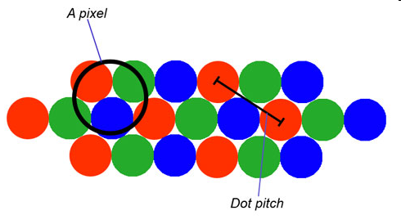
Dot Pitch

Slide 24
Horizontal Scanning Frequency
Frequency at which the monitor rewritten moves the electron beam from the left to display to the right refresh rate is dependent upon monitor HSF and number of horizontal lines displayed
The horizontal lines Screen resolution – 1024 x 768
HSF measured in kilohertz.
Eg HSF is 110Khz then 110,000 lines scanned per second

Slide 25
Scanning Pattern of CRT Electron Gun
The electron gun scans from left to right and
From top to bottom.
Refreshing every phosphor dot in a zig-zag pattern.

