Slide 1

SMART INDIA HACKATHON 2026
ANUPALAN – AI Compliance & Governance Command Centre
Problem Statement ID – SIH26024
Problem Statement Title- AI-Based Smart Governance and Compliance Monitoring System for Coal Mines
Theme- Smart Automation
PS Category- Software
Team ID- ◄ ADD TEAM ID FROM SIH PORTAL
Team Name (Registered on portal)- NeuraForge
Coal India Limited · Ministry of Coal | Presidency University, Bengaluru

Slide 2
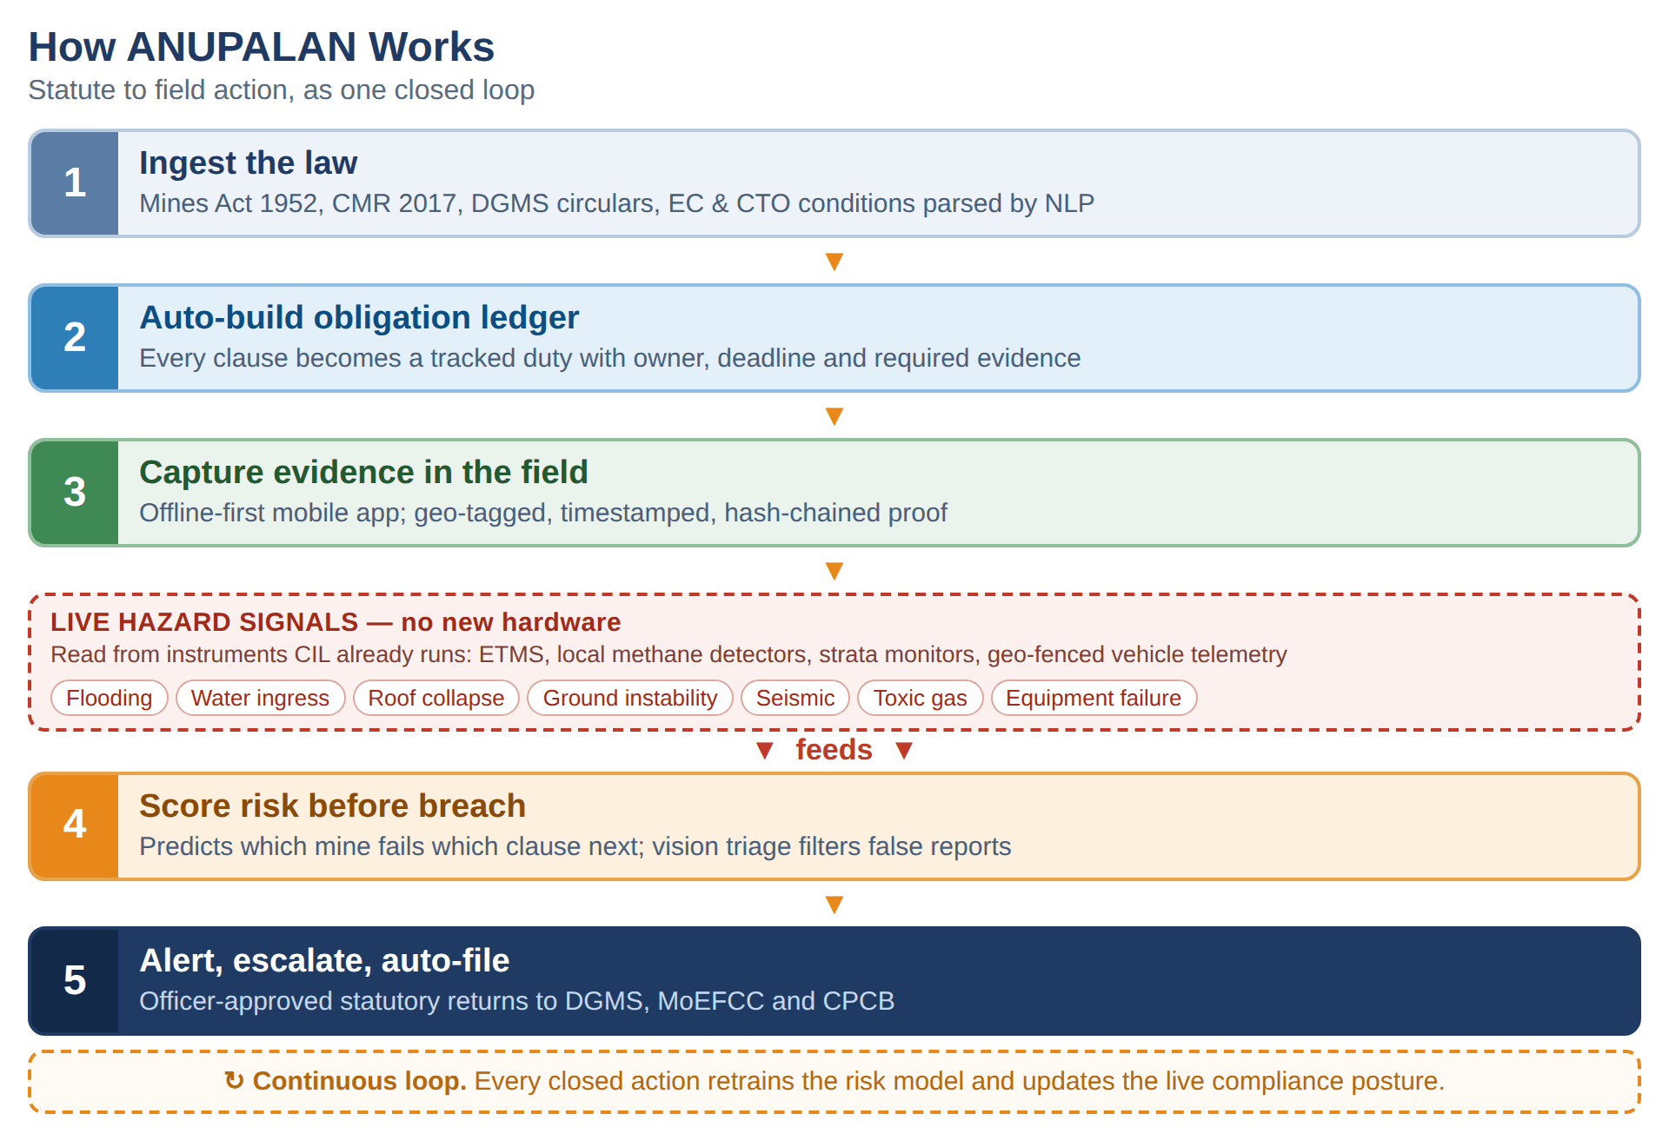
ANUPALAN – AI Compliance Command Centre
NeuraForge
Proposed Solution
Detailed explanation of the proposed solution
Digital Rulebook. Regulation-as-Code parses the Mines Act 1952, CMR 2017, DGMS circulars and EC/CTO conditions into tracked duties with owner, deadline and required evidence.
Offline-first field evidence. Geo-tagged, timestamped, hash-chained capture that works underground and syncs on reconnect.
Predictive risk engine. Scores which mine and which clause is most likely to fail next, from inspection and violation history.
Hazard early-warning, no new hardware. Reads CIL's existing ETMS, methane detectors, strata monitors and geo-fenced vehicle telemetry to flag inundation, roof and ground movement, gas build-up, seismic shift and equipment failure as live breaches.
Geospatial compliance layer. Lease, forest and eco-sensitive polygons in PostGIS; satellite change detection catches excavation outside sanctioned limits and screens expansion zones before they are planned.
How it addresses the problem
Fragmentation → one source of truth. Safety, environment, production and labour duties in a single auditable system instead of spreadsheets and paper registers.
Reactive → predictive. Hazard telemetry and inspection history combine into a score that flags the breach before it is recorded.
Weeks → hours. The inspection-to-report cycle collapses, and every entry traces back to the exact statutory clause.
Self-declared → verifiable. Tamper-evident evidence stands up in a DGMS enquiry; boundary breaches are caught from imagery, not complaints.
Scarce inspectors, better aimed. Risk ranking tells DGMS which mine to visit first instead of inspecting round-robin.
Innovation and uniqueness of the solution
A rulebook that updates itself. The Mines Act 1952 is repealed the day the OSH&WC Code 2020 is notified. Hard-coded rules break; a parsed corpus re-derives every duty overnight.
Predicts the breach, does not record it. Risk scoring fed by hazard telemetry CIL already collects, so it needs no new sensors.
Evidence that survives an enquiry. Offline, geo-tagged, hash-chained and pre-screened by vision.

Slide 3
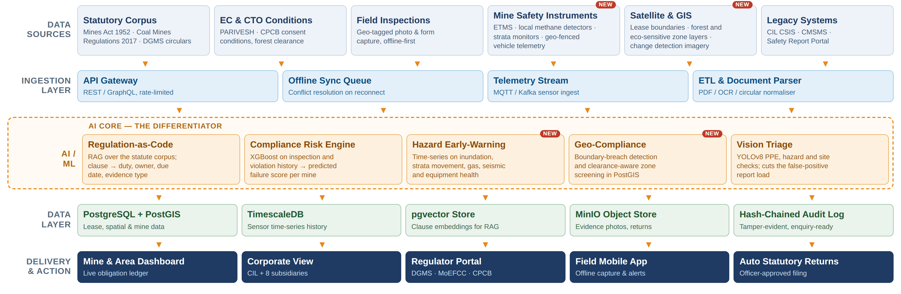
TECHNICAL APPROACH
NeuraForge
Technologies to be used (e.g. programming languages, frameworks, hardware)
Frontend
React 18 + TypeScript, Tailwind CSS, Recharts / D3, Leaflet maps
Mobile
React Native, SQLite / WatermelonDB offline-first, geo-tagged camera
Backend
FastAPI (Python), Node.js services, REST + GraphQL, MQTT / Kafka ingest
AI / ML
pgvector RAG + sentence-transformers, XGBoost risk model, YOLOv8 vision, time-series hazard detection
Data
PostgreSQL + PostGIS, TimescaleDB, Redis, MinIO object store
Infra & Security
Docker, Kubernetes, NIC MeghRaj cloud, Parichay SSO, RBAC, AES-256, hash-chained audit log
Methodology and process for implementation (Flow Charts/Images/ working prototype)

Slide 4
FEASIBILITY AND VIABILITY
NeuraForge
Analysis of the feasibility of the idea
Potential challenges and risks
Strategies for overcoming these challenges
No connectivity underground. Field capture cannot assume a network.
Legal text is messy. Long, unstructured and amended often by fresh circulars.
AI misreading the law. A hallucinated statutory interpretation is a serious liability.
Sensor data is patchy. Instruments differ by mine, by vintage and by vendor; some feeds are analogue.
Adoption resistance. Field staff are used to paper and may distrust a scoring system.
Data sensitivity. Safety and violation data spans eight subsidiaries with different owners.
Thin training history. Early risk scores have limited labelled violation data to learn from.
No new hardware. The sensors already exist. CIL runs ETMS, methane detectors, strata monitoring and geo-fenced vehicle tracking today; we read them.
Zero licence cost. Entire stack is open source and deploys on existing NIC MeghRaj or CIL data-centre capacity.
Inputs are already public. Statutes, DGMS circulars, EC and CTO conditions are published on DGMS, MoEFCC and PARIVESH.
No retraining needed. Screens mirror the Form A/B registers field staff already fill; regional language support.
Buildable in 36 hours. Working prototype on a seeded corpus of the top 50 statutory duties and one demo mine.
Proven components. Nothing is research-grade — RAG, gradient boosting and YOLOv8 are production-standard.
Phased rollout. Pilot one subsidiary, then scale. No big-bang migration across 313 mines.
Offline-first architecture. Local queue with conflict resolution; uploads on reconnect.
Versioned corpus, scheduled re-index. A new circular automatically recomputes the duties it touches.
Human-in-the-loop, always. AI drafts and cites the clause; a qualified officer signs. It never auto-files a return.
Adapter pattern for instruments. One driver per sensor type, with manual entry as the fallback so no mine is blocked.
Mirror the familiar. Existing register formats, 15-minute onboarding, no workflow change.
Isolate by design. On-premise deployment, RBAC, subsidiary-level partitioning, AES-256 at rest.
Rules first, model later. Ship deterministic rule checks on day one; the model augments as data accumulates.

Slide 5
IMPACT AND BENEFITS
NeuraForge
313
CIL working mines (April 2024)
8
producing subsidiaries on one platform
3.3 lakh
workforce, incl. 1.15 lakh on contract
781 MT
CIL output, FY 2024-25
16
CIL units run without valid clearance (CAG)
Potential impact on the target audience
Benefits of the solution (social, economic, environmental, etc.)
Mine managers & safety officers — every duty, deadline and piece of evidence in one place, with hazard alerts arriving before an inspection does.
CIL corporate & its subsidiaries — live compliance posture across 313 mines and early warning ahead of a recorded violation.
DGMS, MoEFCC & CPCB — verified, timestamped, clause-linked evidence in place of self-declared PDFs, so scarce inspector time goes to the highest-risk mines.
3.3 lakh workers, contractors included — the safety committee's own minutes record contract labour being left out of safety committees; here every duty carries a named owner.
Citizens near coalfields — clearance conditions and lease boundaries monitored continuously instead of self-certified twice a year.
Social — preventive action against the 25 fatal accidents recorded at CIL mines in 2025, and safer conditions for a 3.3 lakh workforce.
Economic — fewer stoppages, show-cause notices and penalties; sharply lower paperwork and audit-preparation cost.
Environmental — EC and CTO conditions monitored continuously: air and water quality, land reclamation, plantation targets.
Governance — a complete, tamper-evident audit trail makes accountability provable rather than asserted.
Scalable — the same engine covers metalliferous and non-coal mines under DGMS, and any sector governed by statutory conditions.
SDG alignment — SDG 8 (decent work and safe workplaces), SDG 9, SDG 12, SDG 13 and SDG 16 (accountable institutions).
Measurable targets for a one-subsidiary pilot
Inspection to filed report
weeks → under 24 hours
False-positive field reports
54% → under 15%
Statutory returns auto-drafted
0% → 80%
Mines with a live risk score
0 → all 313

Slide 6
RESEARCH AND REFERENCES
NeuraForge
Details / Links of the reference and research work
1
CAG of India — Report No. 12 of 2019, environmental impact of mining in CIL
The auditor found 16 CIL units operating without valid statutory clearance, 6 of 7 subsidiaries with no environment policy, and only 58 of 96 required air-quality stations installed.
cag.gov.in — Report No. 12 of 2019
5
PIB — Coal Mine Surveillance & Management System and Khanan Prahari
Of 462 reports, 251 were verified false and 77 genuine; a later release records only 78 of 483 complaints acted upon. That verification load is what our triage targets.
pib.gov.in/PressReleasePage.aspx?PRID=1898772
2
Standing Committee on Safety in Coal Mines — 49th meeting minutes, Feb 2025
80 fatal accidents occurred between sittings, and the committee recorded dust-suppression discrepancies between documented records and field conditions. That gap is the problem we close.
coal.gov.in/sites/default/files/2025-02/10-02-2025b-wn.pdf
6
Directorate General of Mines Safety, Ministry of Labour & Employment
The enforcement body: 8 zones, 38 regional offices, roughly 19,012 registered mines. Source of the circulars the Digital Rulebook ingests.
dgms.gov.in
3
Ministry of Coal — Annual Report, Ch. 14 “Safety in Coal Mines”
CIL fatality rates, the National Coal Mines Safety Report Portal, CSIS, and the instrumentation ANUPALAN reads: ETMS, methane detectors, strata monitoring, geo-fenced vehicle tracking.
coal.gov.in/sites/default/files/2025-02/chap14AnnualReport2025en2.pdf
7
PARIVESH and CPCB — clearance and consent conditions
Environmental clearance and Consent to Operate conditions, plus the half-yearly compliance report that is filed today as a self-declaration.
parivesh.nic.in · cpcb.nic.in
4
The Mines Act 1952 · Coal Mines Regulations 2017 · Mines Rules 1955 · OSH&WC Code 2020
The statutory corpus mapped clause-by-clause into the obligation ledger. The Code repeals the Mines Act on notification, which is why the rulebook is parsed rather than hard-coded.
indiacode.nic.in
8
Ministry of Coal Annual Report Ch. 1 and 8 — scale of the estate
313 CIL working mines (131 underground, 168 opencast, 14 mixed), 8 producing subsidiaries, 781 MT in FY 2024-25, 2.14 lakh employees and 1.15 lakh contract workers.
coal.gov.in — Annual Report, Chapters 1 and 8

