Slide 1
Traffic Sign and Signal Recognition in Bad Conditions
Fuzzy-logic image enhancement, neural network classification and YOLO detection
One project for Deep Learning · Image Processing and Analysis · Neural Networks and Fuzzy Logic
0.819
macro F1 on 203,374 real damaged test signs
97.9%
accuracy on 281,547 traffic-light test images
106
sign and light classes from 7 datasets
0.786
on worn real signs after wear training (0.597 before)
Presented by: Keshav Kumar (20241CAI0072) Department: PSAIAC
Notes:
One pipeline reads traffic signs and lights from damaged images. Fuzzy logic decides how to repair each image, and neural networks name the sign. Every score is the mean of 3 training runs, tested once.

Slide 2
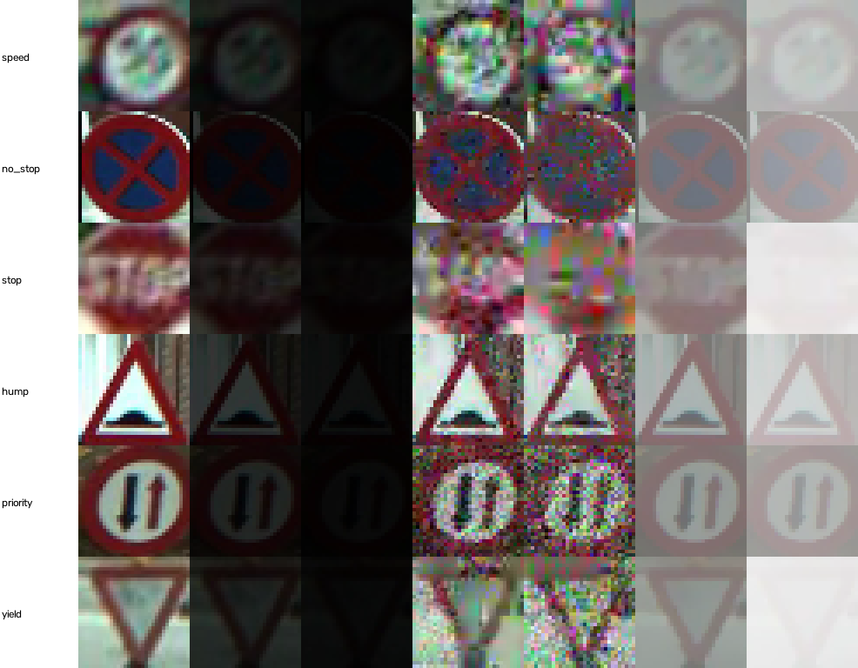
Signs must be read in the conditions where vision fails
Problem statement
Objectives
Night, haze, rain, snow, noise, blur and worn paint damage the image a driver-assistance camera sees.
A CNN trained on clean images reads only 0.683 macro F1 on real damaged signs, against 0.819 when trained on damage.
Can image processing, steered by fuzzy logic, repair images enough to help, and how does that compare with training on damage?
1
Image processing
filters, histograms, convolution, measured with PSNR and SSIM
2
Fuzzy logic
a Mamdani controller that chooses denoise, stretch and darken strengths
3
Neural networks
MLP, feature MLP and backpropagation written by hand
4
Deep learning
CNNs on clean, damaged and enhanced images, 17 to 106 classes, worn signs
CURE-TSR signs: clean, then darkening, noise and haze at levels 3 and 5
5
Detection and app
YOLO finds signs; a Streamlit app shows every step; honest scoring
Notes:
The three courses map onto the objectives: image processing (1), fuzzy logic and neural networks (2, 3), and deep learning (4). Objective 5 makes the work usable and the results trustworthy.

Slide 3
Solution: measure, enhance with fuzzy logic, then classify
1. Input
phone or street photo,
or a damaged sample
2. YOLO26n detector
finds signs and lights
confidence ≥ 0.30,
or the user drags a box
3. Crop and resize
square crop, margin 1.15
resized to 32 × 32 × 3
4. Measure quality
brightness (mean)
contrast (RMS)
noise (colour roughness)
the original crop is classified too
8. Show the answer
two result cards, top 3
confidence and verdict
rules fired, PSNR, SSIM
7. CNN classifier
original and enhanced crop
106 classes, softmax
sign or light from YOLO
6. Enhance
Gaussian denoise
→ RGB levels stretch
→ gamma darken
5. Fuzzy controller
14 Mamdani rules
centroid defuzzification
→ 3 strengths, 0 to 1
Data
Image processing
Fuzzy logic
Neural networks and deep learning
Detection and app
Denoising goes first, because stretching would amplify leftover noise. Colours show which course each step belongs to.
Notes:
Walk through one photo: YOLO finds the sign, the crop is measured, the fuzzy controller sets three strengths, the image is enhanced in a fixed order, and the CNN classifies both the original and the enhanced crop so the app can show whether enhancement changed the answer.

Slide 4
Architecture: four layers, from datasets to the app
Data sources
CURE-TSR + LISA
2.2 M signs
41,923 lights
GTSRB + Indian
real sign photos
43 + 85 classes
Mapillary
40,968 photos
six continents
Kaggle + Roboflow
5,190 photos
of damaged signs
Technology stack
Layer | Tools
Language | Python 3.11, virtual environment
Deep learning | PyTorch 2.15 to train, 2.5.1 for the app; RTX 4050 6 GB
Detection | Ultralytics 8.4, YOLO26 nano
Image processing | OpenCV, scikit-image, NumPy
Fuzzy logic | scikit-fuzzy sets, NumPy inference
Evaluation | scikit-learn, pandas, matplotlib
App | Streamlit, streamlit-cropper, Cloudflare tunnel
Preparation
Pack arrays
32 × 32 × 3
merged labels
Add damage
5 types × 5 levels
incl. worn paint
Leak-free splits
clip, track, block
+ validation gap
Enhanced copies
fuzzy controller
on every image
Core modules
image_processing
filters, convolution
PSNR, SSIM
fuzzy_logic
14 rules
controller
deep_learning
MLP, CNN
NumPy MLP
YOLO26n
39,301 frames
fine-tuned twice
Evaluation and app
Experiments
3 seeds
choose on validation
Scored once
test sets
untouched
262 checks
data, models,
fuzzy, app
Streamlit app
4 tabs
phone via tunnel
All 262 automated checks pass.
Notes:
image_processing, fuzzy_logic and deep_learning hold the methods; experiments runs training and scoring; app.py is the interface. Datasets are packed once into 32 x 32 arrays, which made training on 1.9 million images possible on a laptop GPU.

Slide 5
7 datasets, 51 classifier runs, every test set scored once
Dataset | What it adds | Images used
CURE-TSR | 14 signs, 12 damages × 5 levels | 2,206,100
LISA | red, yellow, green lights, day and night | 41,923 crops
GTSRB | real German sign photos | 51,839 crops
Indian set | real Indian sign photos | 4,359 crops
Mapillary | street signs, 6 continents, 'other sign' | 48,863 crops
Kaggle damaged | faded, rusted, vandalised signs | 3,194 photos
Roboflow damaged | close-ups by kind of damage | 1,996 photos
51
classifier training runs, 3 seeds each
2
YOLO detectors, 9.4 hours of training
1.92 M
training images for the final CNN
106
classes: 17 → 84 → 106
No leakage: splits by whole clip, track or block of frames; near-duplicates removed; test street photos kept out of training.
Clean crops before synthetic damage; Kaggle and Roboflow frames also train YOLO.
Train
3 seeds per model
Choose on validation
mean ± spread
Score test once
never change after
Notes:
CURE-TSR is the core because every damaged image has a clean original, so image quality can be measured exactly. The other datasets widen the classes and add real photos and real damage. The protocol at the bottom applies to every model.

Slide 6
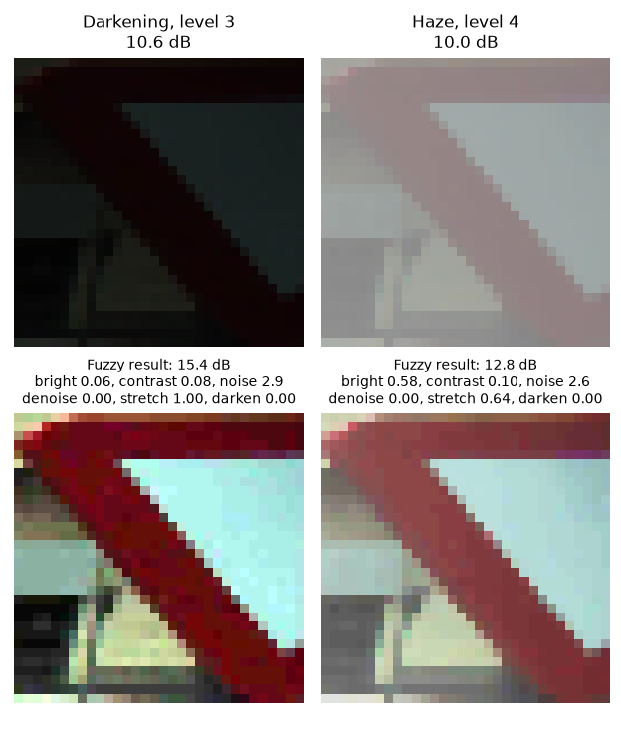
Three courses, one pipeline
Image Processing
Fuzzy Logic
Neural Nets and Deep Learning
34.83 dB
median filter on 2% salt-and-pepper (from 22.16)
0.683 → 0.715
real signs F1, clean-trained CNN with fuzzy input
5.2 × 10⁻⁷
worst gradient error of the hand-written MLP
point operations, histogram equalization, CLAHE
convolution by hand, equal to OpenCV
new colour-roughness noise measure
3 inputs, 3 outputs, 3 sets each
14 Mamdani rules, centroid output
within 0.0001 of scikit-fuzzy
MLP, feature MLP, CNN compared
CNN: 6 conv layers, batch norm, dropout
17 → 106 classes, YOLO, worn signs
Darkening and haze: damaged (top) and after fuzzy enhancement (bottom)
IF brightness is bright
AND contrast is medium
THEN darken is strong
816 K
CNN weights
6
conv layers
2
YOLO models
one of 14 rules: min for AND, max to combine, centroid output
17 → 84 → 106 classes over 4 stages
Notes:
Image processing repairs and measures images; fuzzy logic decides how much of each repair to apply; neural networks and deep learning name the sign. The hand-written MLP proves backpropagation is understood, not just used.

Slide 7
Results: training on damage beats repairing it
Model (test, macro F1) | Classes | Real signs | Simulated | Lights | Worn real
Feature MLP, all conditions | 17 | 0.701 | 0.825 | 0.898 | –
MLP, all conditions | 17 | 0.733 | 0.878 | 0.960 | –
CNN, clean + fuzzy input | 17 | 0.715 | 0.791 | 0.936 | –
CNN, all conditions | 17 | 0.819 | 0.909 | 0.980 | –
Wide CNN, all conditions | 84 | 0.757 | 0.881 | 0.946 | –
Global CNN, all conditions | 106 | 0.816 | 0.888 | 0.951 | 0.597
Global CNN + worn signs (app) | 106 | 0.808 | 0.881 | 0.959 | 0.786
YOLO detector 2, test mAP50: 0.701 signs · 0.680 lights · 0.853 Kaggle damaged · 0.893 Roboflow close-ups (0.003 before fine-tuning)
Best 17-class CNN: 89.8% accuracy on 203,374 real signs, 97.9% on 281,547 lights. Fuzzy enhancement raised PSNR from 17.90 to 18.35 dB.
Worn-sign training: worn real signs 0.597 → 0.786, worn GTSRB 0.629 → 0.867; the usual test sets moved by under 1 point.
Notes:
All scores are means of 3 seeds, tested once. The chart shows the main lesson: training on damaged images (green) beats enhancing images for a model that never saw damage (orange). Wear training raised worn real signs from 0.597 to 0.786 while the usual sets moved by under 1 point.

Slide 8
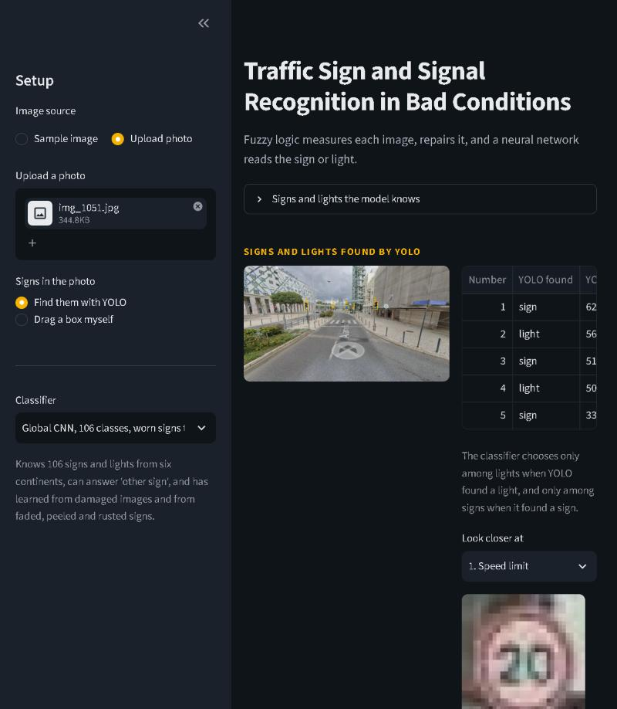
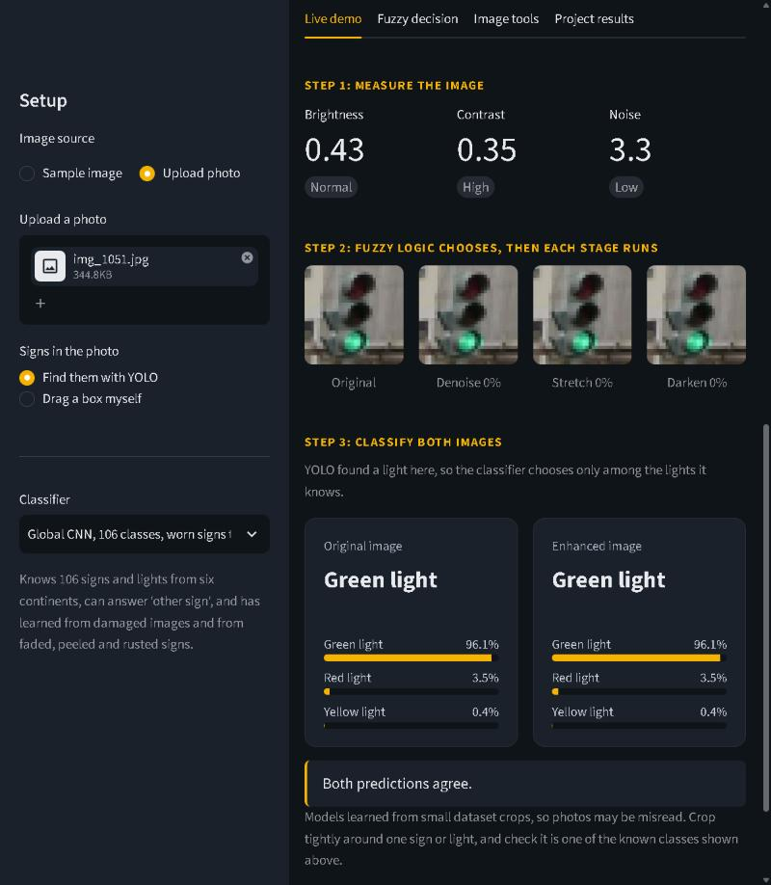
A working app, and what we learned
Conclusions
Training on damaged images beats repairing them: 0.819 against 0.715 macro F1.
Fuzzy enhancement still helps every model that never saw damage, and leaves clean images alone.
Real photos exposed too few classes, close-up lights and worn paint; each fix was measured before it was kept.
Next steps
Larger input or a pretrained backbone, to read text and numbers
Stronger sun-bleaching and real photos of old signs
Night and rain photo tests; YOLO trained on damaged frames
Left: the worn-sign YOLO finds five objects in a street photo. Right: fuzzy stages and both answers, green light 96%.
Thank you · Questions?
Notes:
The app runs every step live. The main lesson is measured, not assumed. Limitations: 32 x 32 input cannot read text, and extremely faded signs still fail.

