Slide 1
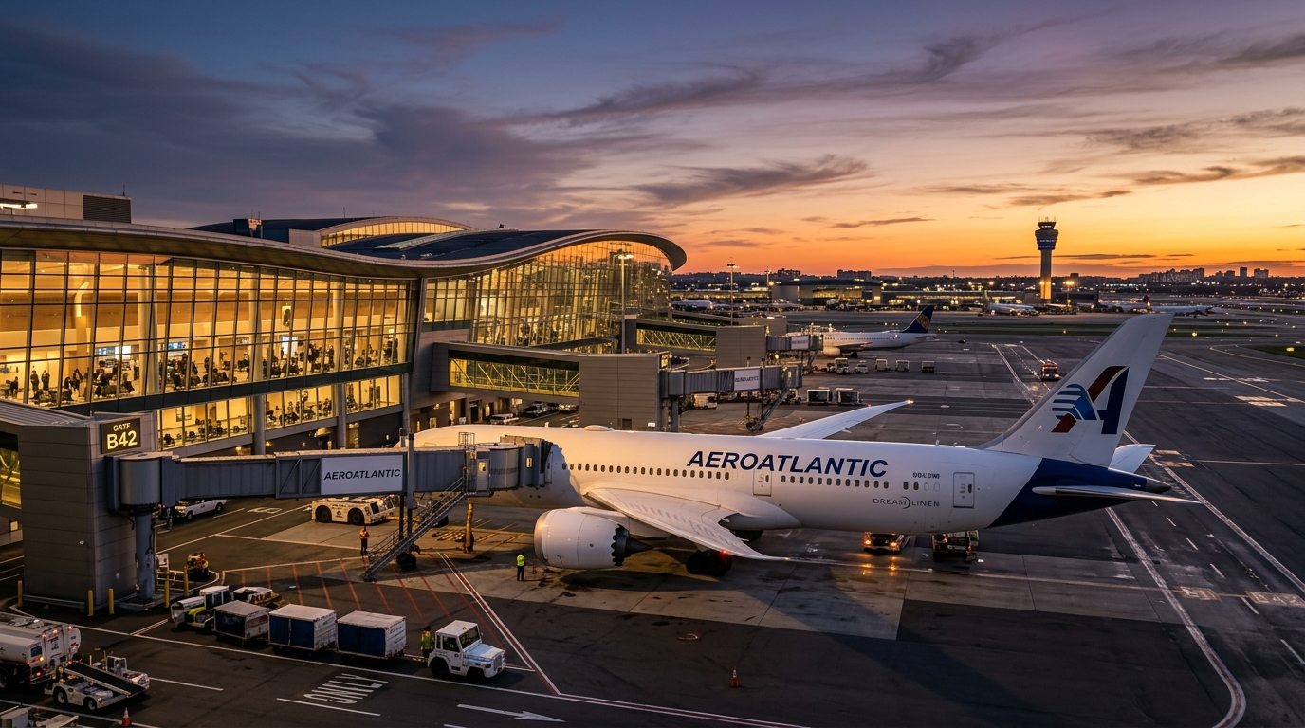
Commercial Fleet Operations &
Turnaround Optimization Model
Predicting Cascading Delays to Maximize Aircraft Utilization and Reduce Operational Costs

Slide 2
The Operational Bottleneck: Cascading Delays
Airlines operate on incredibly tight turnaround schedules.
  The Turnaround Buffer
    The scheduled ground time allocated for cleaning, fueling, and boarding.
  The Domino Effect
    When ground operations exceed the buffer, the delay directly propagates to the next flight.
  Financial Hemorrhage
    Every minute of delay costs approximately $75 in overtime and fuel inefficiencies.

Slide 3

Phase 1: Robust Data Ingestion & Engineering
1. Raw Data Parsing
2. Transformation
3. SQLite Database
Scans root directories for CSV/ZIP datasets.
Transforms complex float time-series data into standard DateTime objects.
Derives Actual vs Scheduled durations.
Heuristically adjusts for complex edge-cases like overnight flight arrivals.
Loads data into local 'operations.db'.
Builds B-Tree indexes on Tail Numbers to guarantee rapid downstream SQL querying.

Slide 4
Phase 2: The Analytical SQL Engine
Unlocking Network Intelligence using Window Functions
  Common Table Expressions (CTEs)
    Instead of Python loops, we utilize highly optimized SQL CTEs to trace aircraft history.
  Physical Aircraft Sequencing [ LAG() ]
    Partitioning data by 'Tail_Number', we dynamically lookup the exact arrival time of the aircraft's prior flight.
  Isolating Network Choke Points
    We aggregate these metrics by Airport and Carrier, flagging cascading delay choke points.

Slide 5
Phase 3: Machine Learning Prediction
The Predictive Engine
  Predict if a flight will breach its turnaround buffer.
Feature Engineering
  Turn Buffer Volume
  Inbound Delay Stress
  Route Congestion Profiles
Random Forest Classifier
  Explicitly combats class-imbalance utilizing computationally balanced class weights.

Slide 6
Phase 4: Operational Financial Translation
Translating data science metrics into executive financial value.
Predicted Delay Cost Exposure
Potential Operational Savings
$51.2 M
$10.2 M
FAA Benchmark: $75 / min
Assuming 20% Intervention Mitigation

