Slide 1
BLOCK GAME

Slide 2
Summary:
We will work towards creating a fully functioning block game where shapes fall down the screen. The games difficulty increases at regular intervals causing the shapes to fall faster. This game will include scoring and saving those scores so we can compare which ones are the best.

Slide 3
Contents:
•Multi-Dimensional List Processing
•Game Loops
•Basic Pygame Graphics
•Advanced Python Functions & Methods
•Scoring & Saving High Scores
•Increasing Game Speed and Difficulty
•End Screens
•Start Menu’s

Slide 4
Introduction:
block game is a tile-matching puzzle video game and it is one of the most famous game in the world. It is played on a board with 20 rows and 10 columns. There are seven shapes of Tetriminos, and Tetriminos fall from top of the board and come to rest at the bottom every time. The player has to control the Tetriminos by moving left and right and rotating clockwise, and the player is needed to get the score as high as possible by clearing lines, which is filling the horizontal row in the board. The rules of block game are very simple but it is not easy to master it, like clearing more 500 of lines. Players need to find the solution to keep the board in good shape meanwhile clear the lines as many as possible. More lines have been cleared, the falling speed of the Tetriminos increases, which means the difficulty increases and the player has less time to decide the best move in the later part of the game. Therefore, the player will be prone to make the wrong decision, and finally lose the game.
In this project, we aimed to implement an AI playing block game using and feature-based representation and reinforcement learning. This AI can be divided into two parts, the decisionmaking part for optimal action and learning part for the evaluation functions. When the Tetriminos is generated in the top of the board, the AI will search the optimal action every time using the evaluation function based on the state of the current board. And its goal is get the score as high as possible and to “survive” in the game for long period. After losing the game, it would adjust the current and optimal evaluation function and the performance in the game.

Slide 5
Multi-Dimensional List Processing
CREATING GRIDS
The way that we will keep track of pieces in the game is using a grid data structure. We will create a multidimensional list that contains 20 lists of 10 elements (rows and columns). Each element in the lists will be a tuple representing the color of the piece in that current position. This will allow us to draw all of the colored squares quite easily as we can simply loop through the multidimensional list.
The locked position parameter will contain a dictionary of key value pairs where each key is a position of a piece that has already fallen and each value is its color. We will loop through these locked positions and modify our blank grid to show these pieces.

Slide 6
Game Loops
In every game we have something called a game loop or a main loop. This is what will be running constantly and checking to see if events occur. Our game loop will go inside the main() function.
In this function we will start by defining some variables and then move into the while loop. Inside the while loop we will check for key press events and see if the user wants to exit the game.
When the user presses the up arrow key the piece will rotate. We can do this by simply increasing our shapes rotation attribute to be the next shape in the list we set up at the beginning of the program.
When the user hits the left or right arrow keys we will move accordingly bu changing the x value of our piece.
Finally when the user hist the down arrow key we will move down one square allowing the user to increase the speed at which the shape falls.
We will be adding more to this function in the future.

Slide 7
Scoring & Saving High Scores
Adding Score
We will implement a very simple scoring system that simply gives the player 10 points each time they clear a row. We will later be saving this score and displaying the best score for the player as well. This means we need to define score = 0 and last_score = max_score() at the top of our main() function. Then we need to make a slight modification to our clear_rows() function so that it returns how many rows were cleared. Then when we are calling clear_rows() from within the main() function we will simply do score += clear_rows() * 10 so that it adds the returned value to our score.

Slide 8
Increasing Game Speed and Difficulty
Increasing the Difficulty
As time goes on we probably would like to make the game more difficult. To do this we will simply increase the speed at which the pieces fall down the screen.
First we need to add the variable level_time = 0 into our main() function above the while loop.
Now at the top of our while loop inside the main() function we will add the following.

Slide 9
Limitations:
Since the game is only represented by four features, it may not be able to capture some special cases. One or two more features may be introduced to have a better and accurate representation of the game. For example, if we take how sum of stones above the empty in one of our features, then the AI would no longer to put too many Tetriminos above the empty, therefore increase the efficiency to clean the empty. Also, based on our observation, some strategies played by the AI may heavily rely on some particular pieces of stones. If those stones do not appear for a long period of time, the board would become unfavourable for the AI to play and therefore increase the risk to lose the game.

Slide 10
Conclusion:
Our Tetris AI is nearly perfect as our algorithm is well designed and trained. Our reinforcement learning is very useful and effective to play Tetris game as Tetris AI does not require to learn from lots of game. We can simplify the state of the board in four features and determine the value of the board using the optimal weighting among these features. We can easily get the final weighting of the features based on the score and get the optimal weighting to make the AI perform well in the game. In conclusion, we have applied what we learned in this course, and we are able to apply this techniques in AI field in this project.

Slide 11
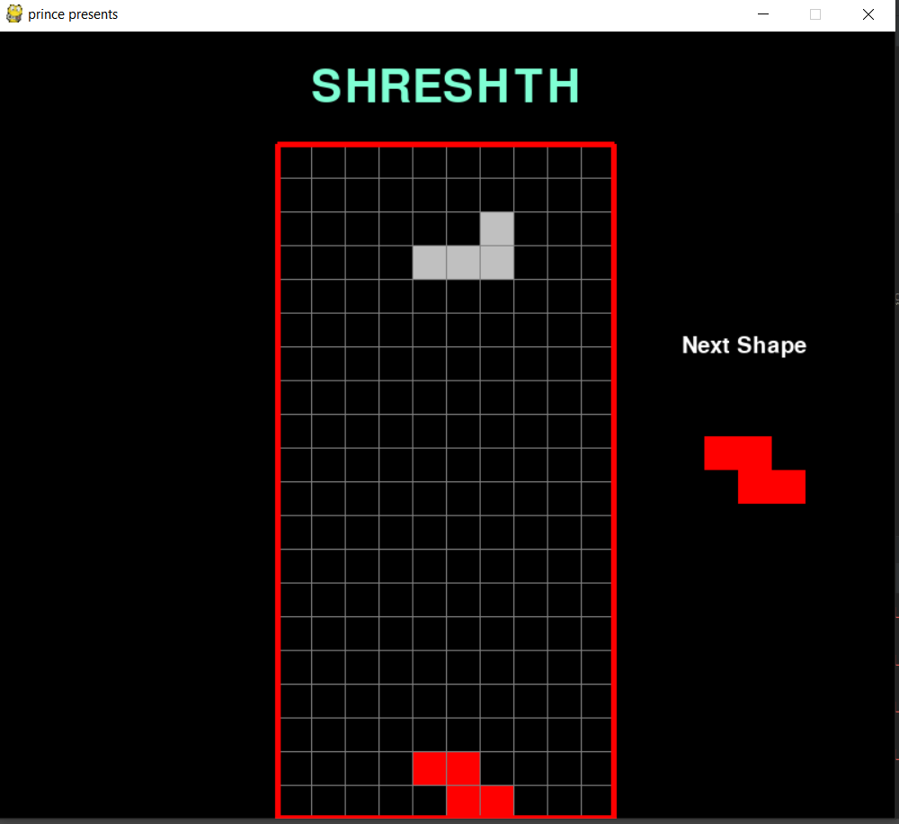
END SCREEN

