Slide 1
Video-based Eye Tracking with Gaze Detection for Reading
01.16.12
Shresth Singhal
Mohammed Shoaib

Slide 2
Outline
Motivation
Algorithmic approach
Continuous video capture
Correlation-based eye segmentation
Eigen-eye based gaze detection
Multi-class SVM based gaze detection
System demo

Slide 3
Eye Tracking and Gaze Detection
Reading gaze detection can help in human computer interaction (HCI)
Popular low-level gaze tracking methods
Single-point based
Two-point based
Our algorithm employs high-level vision, viz., Eigen-eyes and multi-class SVM classification

Slide 4
Goals and challenges
Robust segmentation
Should be fast (literature survey presented in paper)
Should be robust to head movements, occlusions
Accurate gaze tracking
Has no positional information except the image
Should be robust to variations in lighting
Detection
Less sensitive to lighting/ appearance variations

Slide 5
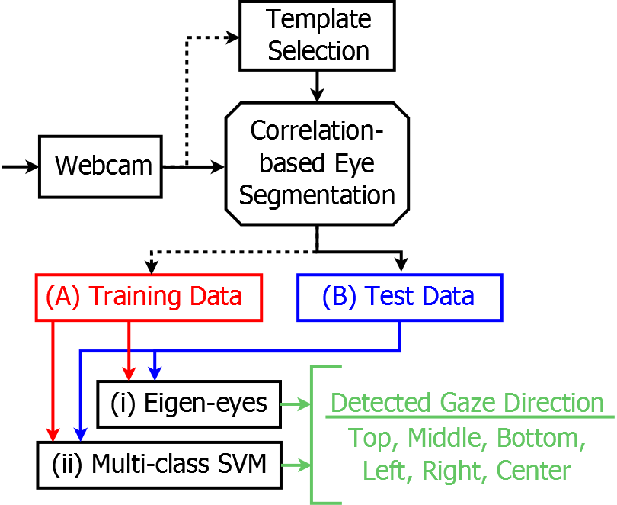
Gaze Detection Algorithm
Multi-class SVM params
SVM classification kernel
Number of data classes
Eigen-eye params
Number of PCs

Slide 6
Summary
Advantages of our approach
Robust segmentation with large occlusion and variance in appearance
Gaze tracking is fast
Limitations
Segmentation is slow
Segmentation is inaccurate in poor lighting conditions

Slide 7
System Demo

Slide 8
Thank You

