Slide 1
TITLE PAGE
Project Title - Autonomous Vehicle Route
One - Line Idea - An AI-powered simulator that helps autonomous
vehicles find and dynamically change the safest and
shortest route while avoiding obstacles and changing
road conditions.
Team Names – B.Shreshtha
K.Likhitha
A.Kusuma Kumari
Ch.Surya Teja Sree
Problem Domain - Artificial Intelligence & Machine Learning (AI/ML) +
Autonomous Vehicles & Intelligent Transportation
Systems (ITS).

Slide 2
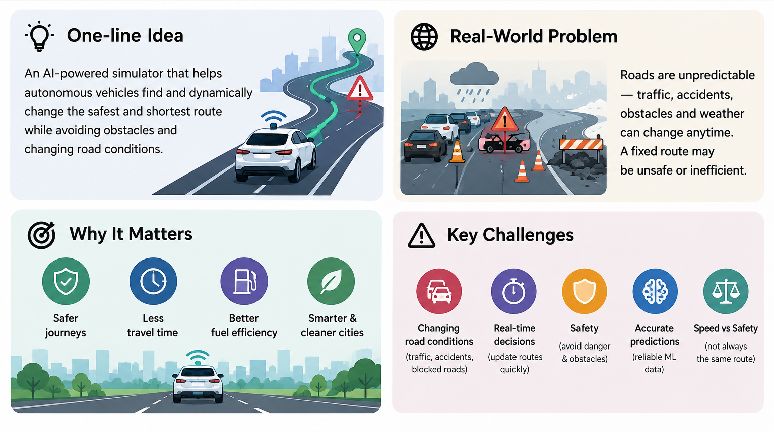
THE CHALLENGE

Slide 3
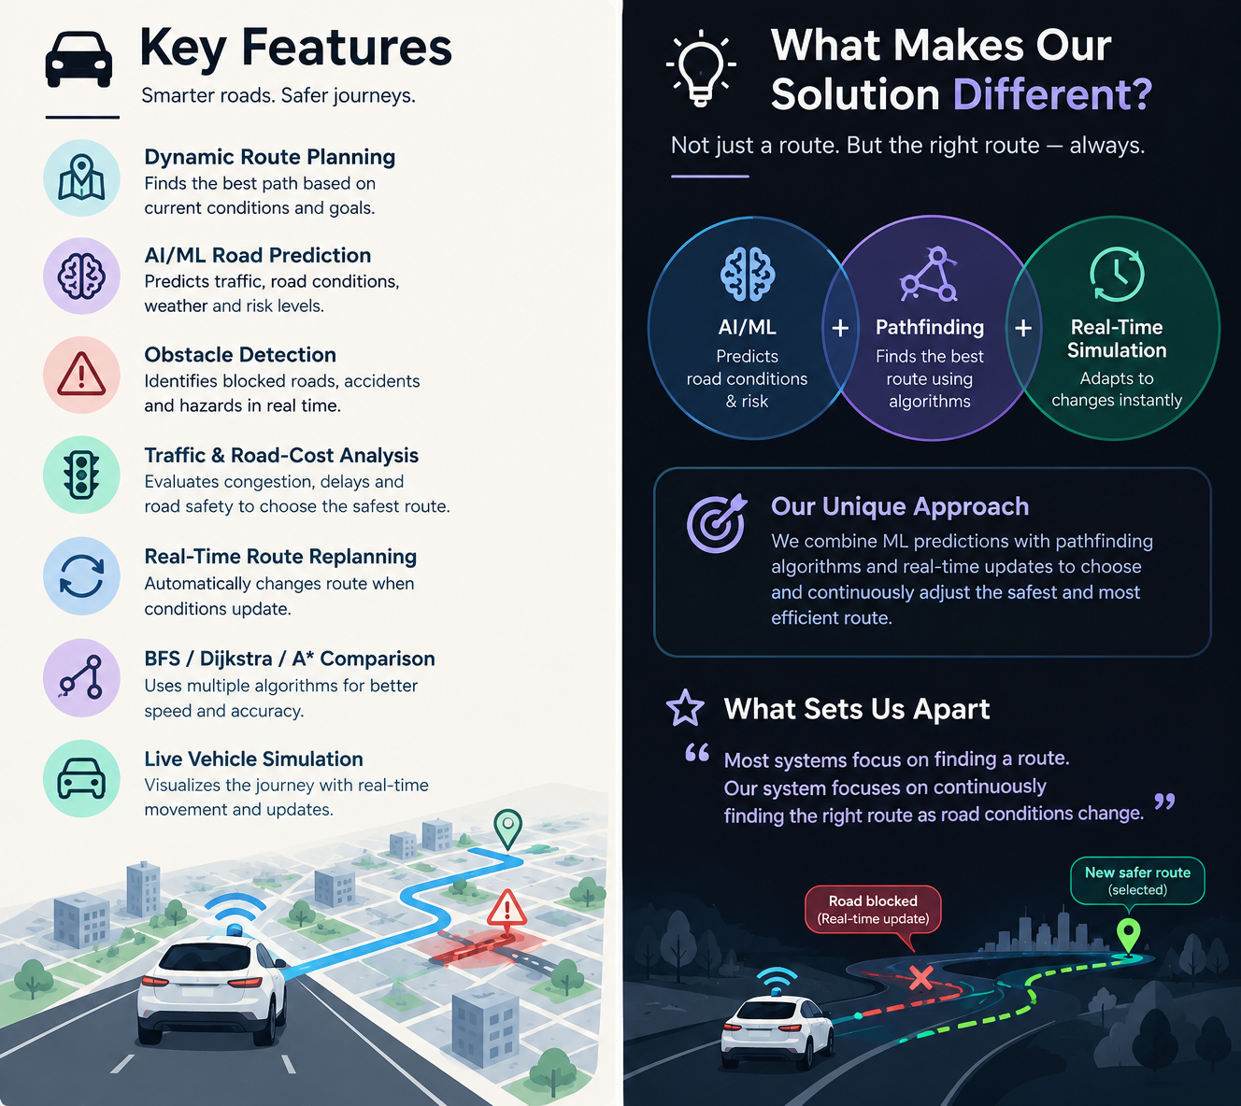
OUR INNOVATION

Slide 4
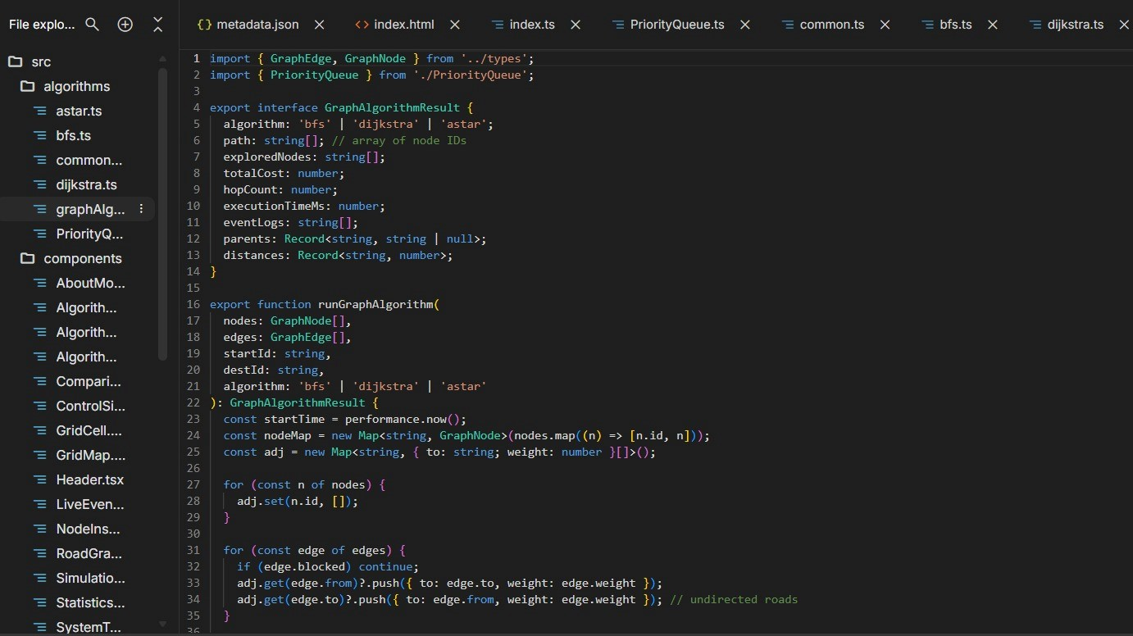
WORKING MECHANISM
Road Data
↓
AI/ML Prediction
↓
Risk + Traffic Cost
↓
Pathfinding
(BFS / Dijkstra / A*)
↓
Best Route
↓
🚗 Live Simulation
↓
Road Changes?
↓
Recalculate Route

Slide 5
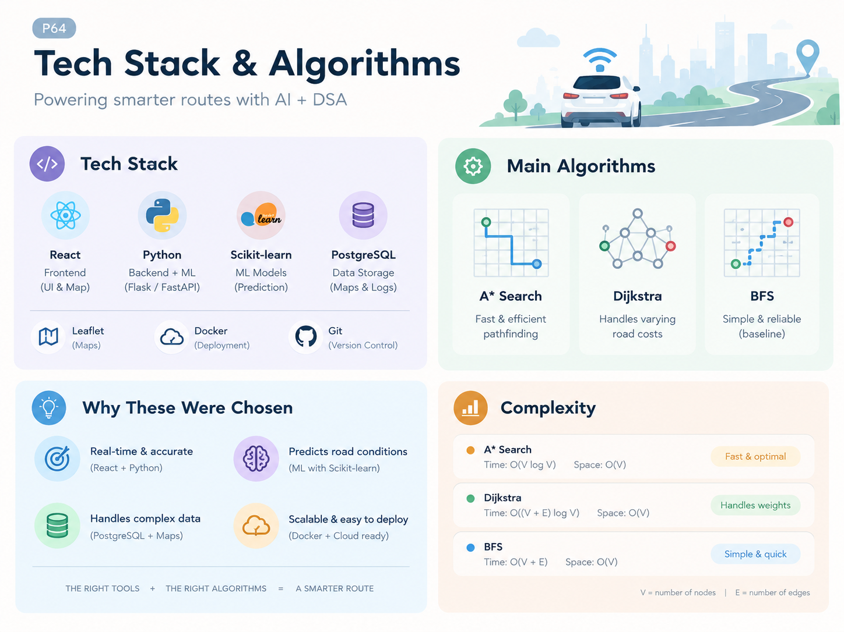
TECHNOLOGY & ALGORITHM

Slide 6
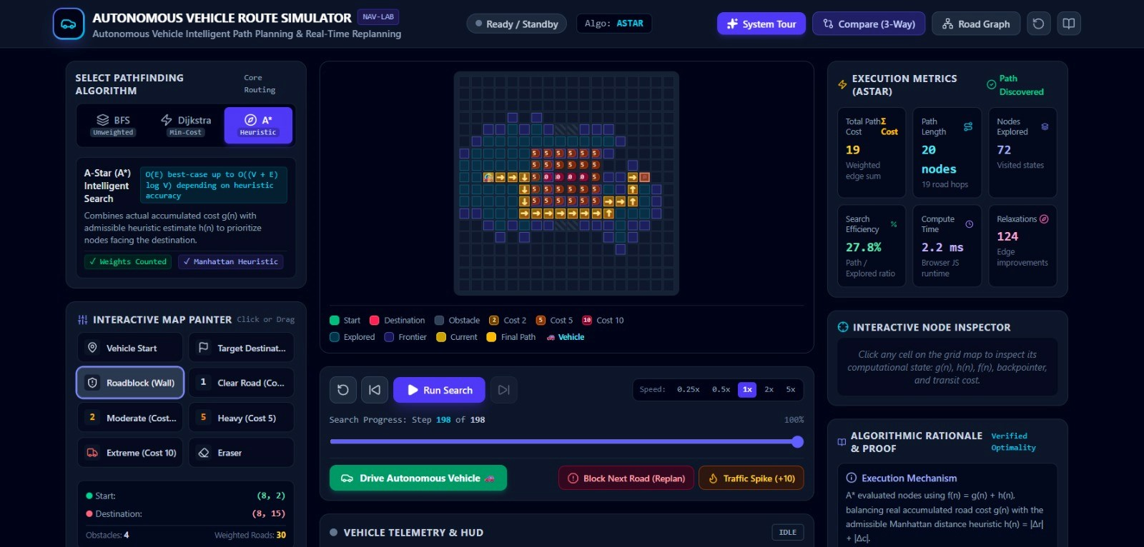
DEMO AND IMPACT

Slide 7
FUTURE VISION
📈 Scalability
Multi-vehicle simulation.
City-level road networks.
Cloud-based processing.
Real-time data integration.
Smart-city transportation applications.
🎯 Final Takeaway
Demonstrates intelligent autonomous route planning.
Enables dynamic obstacle avoidance.
Provides a foundation for real-world autonomous driving systems.
🏆 Current Achievements
Interactive route simulation.
A* and Dijkstra algorithms.
Dynamic obstacle detection.
Automatic route recalculation.
Traffic simulation.
Real-time vehicle monitoring.
🚀 Future Improvements
Real-time GPS and map integration.
AI-based route optimization.
Camera, LiDAR and radar integration.
Live traffic prediction.
Real-world autonomous vehicle
simulation.
THANK YOU

