Slide 1

Groww
GROWTH TEAM · SIP CONTINUATION CASE STUDY
NORTH STAR · ASSIGNMENT DEFINITION
12-month first-SIP continuation rate
A first SIP shouldn't end by accident.
Eligible cohort investors with ≥ 1 successful SIP instalment in the 30 days ending at month 12
× 100
All eligible first-time MF investors who started their first SIP in that cohort
Keeping a first SIP workable when money arrives late, runs short or changes schedule. No fund advice, no return promises, no pressure to pay.
Active SIP = at least one successful instalment in the last 30 days. Any active SIP counts.
3 misses in a row cancel a monthly SIP
Month 12
Start
1
Autopay set-up
2
First debit
3
Missed instalment
4
A tight month
5
Red or flat returns
Prototype: nl-groww-sip.vercel.app/companion · Discovery engine: nl-groww-engine.vercel.app · Independent study, not affiliated with Groww
Notes:
Cover (Session 1 redesign). Objective (assignment): increase the percentage of first-time mutual fund investors who still have an active SIP 12 months after starting their first SIP; active SIP = at least one successful instalment in the last 30 days. North star = eligible first-time MF investors in the starting cohort with ≥ 1 successful SIP instalment in the 30 days ending at month 12, ÷ all eligible first-time investors who started their first SIP in that cohort, × 100. '10 of 12 instalments' is only a secondary diagnostic (slide 2). The five moments are shown in order on a bridge illustration (generated with Gemini, labels added natively); the months between Start and M12 are not to scale. Three-misses rule: Groww Help 'Why was my SIP cancelled?' and the AMFI uniform SIP cancellation process (effective 1 April 2024): 3 consecutive failures cancel daily, weekly, fortnightly and monthly SIPs; 2 for longer frequencies. Primary research: 5 completed interviews (not all verified first-time Groww investors; see slide 5) and a separate survey (n = 20 starters). Compact redesign: the workstream list was removed from the slide; the footer links to the prototype and the engine.

Slide 2

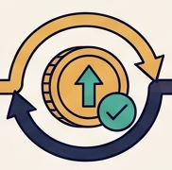
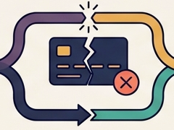


Continuation depends on five critical investor moments
02 · BUSINESS METRIC DECOMPOSITION
Groww
Proactive readiness
Recovery
Financial flexibility
Long-term confidence
BUSINESS METRIC
12-month first-SIP continuation
Cohort investors with ≥ 1 successful instalment in the 30 days ending at month 12
1
Autopay set-up
2
First debit
3
Missed instalment
4
Tight month
5
Red or flat returns
Outcome
Autopay live before debit 1
Early debits clear first time
A miss is fixed, not left to cancel
SIP flexes to fit cash flow
Informed choice in a red month
All eligible first-time investors who started a first SIP in the cohort
Diagnostic metric
% of new SIPs with mandate live by debit 1
First-try success, instalments 1–3
% of misses resolved before next debit
Adjust-not-lapse rate in tight months
% of red-month stops after an explainer
× 100
Public 20 set-up posts
Survey 10/20 to payday
Public 52 stories
Public 71 stories
Public 58 stories
Evidence
Secondary diagnostic only: % paying ≥ 10 of 12
Internal not measured
Survey 4/20 failed
Survey 7/20 money tight
Survey 3/20 returns
Interview 4/5 align to income
Interview 1/5 (P03)
Interview 4/5
So what
Continuation can be lost at five moments. Each has its own metric Groww could track, so each can be fixed and measured separately.
Public = coded posts · Survey = Google Form, n = 20 · Interview = 5 interviews · Internal = proposed Groww metric
Notes:
Business metric → product outcomes → user behaviours → diagnostic metrics, across five lifecycle moments grouped into four phases: proactive readiness (moments 1–2), recovery (3), financial flexibility (4), long-term confidence (5). Icons are cropped from a Gemini illustration; every label on the slide is native text. All diagnostic metrics are proposed internal metrics Groww could compute from instalment and mandate data; none has been measured. Evidence is labelled by type and never combined across types. Public: 20 posts asking how autopay or mandates work were reclassified as set-up questions in codebook v1.2 (override log); 52 payment-failure, 71 amount-or-pause (38 amount + 33 pause), 58 returns-gap stories of 352 lapse stories. Survey (convenience sample, mixed platforms, n = 20 starters): 10/20 matched the SIP date to payday (this is behaviour, not proof that first debits succeed); 4/20 reported a failed instalment, 0 of the 4 paid by hand; 7/20 gave money being tight as the main reason they stopped or paused; 3/20 gave disappointing returns. Interviews (5): 4/5 tie the debit to when money arrives or check the balance first (P01 balance check; P02 1st after salary; P03 after tuition income; P04 salary date with buffer); 1/5 reported a failed auto-debit (P03); 4/5 say money limits their contributions (P02, P03, P04, P05). Moment 5: stopping after losses can be a reasonable choice, so the metric measures whether the decision was informed, not whether the investor kept paying.

Slide 3

19,005 conversations, distilled into 8 scored lapse drivers
03 · AI DISCOVERY ENGINE
Groww
01 Collect 19,005
02 Filter 2,518
03 AI label 450
04 Score 8
05 Human check 60
public posts, 5 sources
topic + first-hand (13%)
352 lapse stories + 98 others
lapse drivers ranked
labels, 3 blind rounds
Collected by source (n = 19,005)
Two different checks, never combined
Limitations
κ 0.50 is moderate and preliminary (n = 20). The 2,518 → 450 selection is partly documented (Reddit sampled to 280; other rules not recorded). First-hand labels weren't human-checked. Public posts skew negative.
Reddit
11,802
62%
Reddit skew
Agreement human vs AI, κ
n = 20 per blind round
Stability of the #1 rank
payment stays first in
TradingQ&A
3,445
YouTube
1,610
v1.0
0.15 slight
945/1,000 resamples
Play Store
1,160
v1.1
0.29 fair
937/1,000 nudges ±0.15
App Store
988
v1.2
0.50 moderate
Live: nl-groww-engine.vercel.app · Golden set and 60 label changes: /quality · Method · Trace one record (P91)
Notes:
Five-stage workflow (Session 2 redesign; the station illustration is cropped from Gemini S3-B, all labels and numbers are native). Collect: 19,005 public posts (Reddit 11,802; TradingQ&A 3,445; YouTube comments on 32 SIP videos 1,610; Play Store 1,160; App Store India 988). Reddit = 62% of everything collected and 159 of the 450 coded records (35%). Filter: a topic gate then a first-person gate; 2,518 passed (13%). Label: Claude coded 450 records with a written codebook (one primary driver of ten, stage, feeling, segment signals only when stated, first-hand STRONG or WEAK); 352 lapse stories, 50 continuer stories, 48 context records. Codebook v1.0 → v1.1 → v1.2; 60 labels changed between v1.1 and v1.2, each with a logged rule (e.g. 20 set-up questions no longer counted as payment failures). Score: share of the 352 lapse stories × exit-relevance weight × addressability weight × evidence (0.5 + 0.5 × first-hand share); the two weights are analyst judgements; payment failure = 14.8 × 1.0 × 0.9 × 1.0 = 13.3, #1 of 8. Check: three blind golden rounds of 20 records each (60 human labels in total); agreement κ 0.15 → 0.29 → 0.50 (v1.0, v1.1, v1.2); round-3 AI labels were hash-locked before human labelling. κ 0.50 is on n = 20 (round 3). Ranking stability: 945/1,000 bootstrap resamples (unit = lapse story) and 937/1,000 weight nudges of ±0.15 keep payment failure first; this is stability, not label accuracy; with the analyst weights removed payment failure ranks 4th by volume. Sampling: how the 450 were drawn from the 2,518 is only partly documented — Reddit's 1,553 filtered matches were sampled to 280 candidates; the method and the rules for other sources were not recorded; rejected records were not retained. Worked example P91 is a real record, human-checked in blind round 2 (human and AI both said payment failure). Evidence Log: the engine's /quality page holds the golden set, disagreements and corrections.

Slide 4


Trust leads in volume, payment failure in addressability
04 · DISCOVERY FINDINGS AND OPPORTUNITY SELECTION
Groww
Lens 1 · Volume
% of 352 lapse stories (count)
Lens 2 · Opportunity
share × exit × fixable × evidence
Why the order flips
Payment
Trust
Discussed
14.8%
18.2%
#1
Platform trust
18.2% (64)
#1
Payment failure
13.3
Link to exit*
1.0
0.5
Fixable in app*
0.9
0.3
#2
Returns gap
16.5% (58)
#2
Decides to stop
9.7
First-hand
100%
94%
#3
Decides to stop
16.2% (57)
#3
Returns gap
8.1
Score
13.3
2.6
#4
Payment failure
14.8% (52)
#4
Amount vs cash flow
7.8
#5
Confusing screens
11.4% (40)
#5
Skip or pause
7.5
Leading candidate for research: payment failure
Closest to an exit (three misses cancel a SIP), most fixable in the app, present in all 5 sources. Volume alone puts it 4th, so the weights had to be tested with people.
#6
Amount vs cash flow
10.8% (38)
#6
Platform trust
2.6
#7
Skip or pause
9.4% (33)
#7
Confusing screens
2.2
#8
Asks outside the app
2.8% (10)
#8
Asks outside the app
0.4
Taken to interviews →
Prevention P01, P02, P04
Recovery P03
Affordability P05
Not shown: that failures cause exits
* Analyst-set weights (0–1); the score is a prioritisation heuristic, not a measured retention effect.
Notes:
Session 2 redesign: lens illustrations cropped from Gemini S4-B; bars are editable shapes so the rank connectors line up exactly. Two independently sorted rankings of the same 8 drivers (352 lapse stories). Volume: Trust 64 (18.2%), Returns gap 58 (16.5%), Decides to stop 57 (16.2%), Payment failure 52 (14.8%), Confusing screens 40 (11.4%), Amount vs cash flow 38 (10.8%), Skip or pause 33 (9.4%), Asks outside the app 10 (2.8%). Opportunity score: PAY 13.3, STOP 9.7, EXPECT 8.1, AMOUNT 7.8, PAUSE 7.5, TRUST 2.6, CONFUSE 2.2, OUTSIDE 0.4. Why the order flips: the score multiplies the share by two analyst-set weights. Trust gets 0.5 for exit relevance and 0.3 for addressability because allotment delays, statement mismatches and redemption timelines are largely operations and registrar processes rather than screens; payment failure gets 1.0 and 0.9 because three consecutive failures cancel a monthly SIP and the status, reason, retry and debit date all live in the app. First-hand share: payment 52/52, trust 60/64. With the weights removed (volume only), payment failure ranks 4th; in 945/1,000 resamples it stays first under the weights. Quotes removed from the slide in the compact redesign (T173, R27, Y84 remain in the engine). Quote T173 is a user's report that they received no notification; it is not verified evidence that Groww failed to send one. Research bridge (interviews; see slide 5): prevention = P01 balance checks, P02 debit on the 1st after salary, P04 salary-timed date moved after a job change; recovery = P03 reported two consecutive low-balance failures (23 Sep, 23 Oct), opened the app and took no action because the resolution window was unclear; affordability = P05 missed instalments twice when pocket money arrived late or was spent, and assumed it would 'auto adjust' to the next month; whether these were bounced auto-debits is unclear. The interviews do not establish that payment failures cause SIP exits: P03's stated reason for stopping was needing money.

Slide 5



Five interviews reveal how investors protect SIP continuity
05 · PRIMARY RESEARCH AND TARGET SEGMENT
Groww
Proactive planners
keep debits on track by hand
Adapting to cash flow
move, miss or shrink the SIP
Recovery
after failures
Across the 5 interviews
Participant
1
2
3
4
5
Debit timed to income
4/5
P01 · 18+ mo
Balance checker
P02 · 18+ mo
Payday planner
P04 · 7–12 mo
Date mover
P05 · 7–12 mo
Student budget
P03 · 4–6 mo
Recovery seeker
Money limits SIP
4/5
Checks the bank balance before each debit
Debit on the 1st after salary, with a buffer
Moved the debit date after a job change
Missed twice when pocket money was late
Two low-balance failures; waited, rules unclear
Looks outside app
4/5
Failed auto-debit
1/5
Groww-eligible
1/5
No failure
No failure
Q10 yes · Q11 no
Unverified
Reported
Active per log
5/5
Survivor sample: all 5 active per the log. P03 unclear: log says Active, P03 says they stopped and withdrew.
Filled = yes · dashed = conflicting answers
Survey · separate sample, n = 20 · never added to interview counts
TARGET SEGMENT (PROVISIONAL)
First-year investors whose SIP money arrives on someone else's schedule. Only 1/5 Groww-eligible; not validated.
4/20
10/20
9/20
had a failed instalment: 3 waited, 1 paused, 0 paid
set the SIP date to payday
skipped or paused on purpose; 8 restarted
Survey = convenience sample, mixed platforms, never added to interview counts · Interview workbook P01–P05 (P06 not held)
Notes:
Session 3 redesign (illustrations cropped from Gemini S5-A; $ symbols and generated captions removed). Evidence labels: Observed = behaviour described consistently in interviews; Reported = one participant's account of an event; Contradictory/Unverified = conflicting or unconfirmed answers; Inferred = our synthesis. Dot matrix: filled = yes, dashed amber = conflicting answer (P04 failure Q10 vs Q11; P05 failure log vs Q10; P02 and P05 platform; P03 status log Active vs Q06/Q08). Source: Groww_SIP_Interview_Kit.xlsx (Participant Log + Interview Response Log), 5 completed interviews (P06 empty). The Post-interview Synthesis sheet is blank, so the synthesis here is ours. Everything in the matrix is an interview observation paraphrased from the workbook; no quotation marks are used because several answers are written in the third person. ELIGIBILITY: P01 log 'First-ever MF SIP on Groww? No'. P02 log Yes, but Q04 describes opening a demat account and Zerodha Coin. P03 log Yes. P04 log NO. P05 log yes, but Q16 says 'In the zerodha app I see the charts'. Only P03 has a Groww first-SIP answer with no conflicting response. ANSWER CONFLICTS: P01 Q07 and Q08 duplicate Q06, so no pause experience is inferred. P03: log says Active and 4–6 months; Q06 'I took all my money out', Q08 'Yes I did stop cuz I needed some money', Q09 urgent personal financial needs prioritised; Q03 says they invested on the 4th of the month while the reported failures are on 23 Sep and 23 Oct — date and current status need confirming. P04: Q10 'Yes. Unsure of when and how it happened' vs Q11 'Nothing as such ever took place'; Q18–Q23 blank or NA. P05: log says no failure, Q10 says yes (pocket money late or spent elsewhere), twice in the past year; Q12 says it 'auto adjusted itself to next monthly investment' — unclear whether these were bounced auto-debits and whether P05 knows a missed instalment is not made up. P05 interview date is logged as 2026-01-11 (likely a date-format error). COUNTS: times debit to income or checks balance = P01 (balance), P02 (1st after salary), P03 (invests after tuition income), P04 (salary date with buffer); money limits contributions = P02, P03, P04, P05; looks outside the app = P01 father/online, P02 friends, P03 Reddit/YouTube/peers, P04 communities/videos (P05 looks at charts in the app). SURVEY (Google Form responses sheet, 22 responses, 20 had started a SIP; closed 31 Oct): 4/20 reported a failed instalment; 3 waited for the next month, 1 paused, 0 paid manually; 2 of the 4 had no idea why, and both have since stopped, citing money being tight, so the failure is not shown to have caused the stop; 10/20 matched the date to payday; 9/20 skipped or paused on purpose and 8 restarted; 7/20 money tight as the main reason; 8/20 started on Groww; 4/20 started within the last 12 months, 3 of them on Groww. Convenience sample, mixed platforms; never combined with interview counts. HYPOTHESES: H1 failed debit → unintended exit: unvalidated (no interview shows it; P03's stated reason was needing money; survey failures who stopped cited money). H2 reason understood but not recovery: contradictory (P03 knew the reason but not the rules; survey 2/4 didn't know the reason). H3 income timing: observed (4/5; survey 10/20). H4 cash squeeze → skip/stop: observed (P03, P05; survey 7/20, mostly temporary: 8/9 restarted). H5 outside guidance: emerging (4/5 look outside; P01 says father's advice kept them going). H6 pre-debit visibility: needs research (asked for by P01 and P03, not tested). SEGMENT is provisional: behaviourally identifiable in product (first SIP < 12 months; date changes, near-miss or failed debits), relevant to the metric, reachable in-app; not statistically validated. Survivor bias: all 5 are active per the log, 2 for 18+ months; only P03 describes stopping.

Slide 6
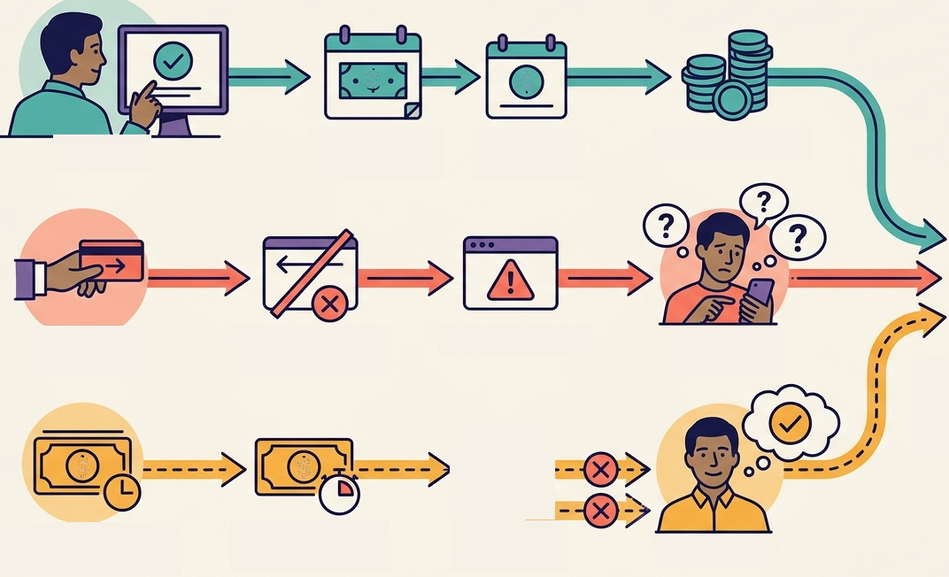
Cash-flow disruption exposes a need for clearer next steps
06 · ROOT CAUSE AND PROBLEM DEFINITION
Groww
1 · Prevent
P01, P02, P04
Five whys
1
Verified rule
Observed
Funds due 4 days before debit
Checks balance
After salary
Moves date
Keeps a buffer
Same end
What can I still do, by when, and what happens next?
2
Observed 4/5
2 · Fail
P03
Income timing shifts
Reported
3
Observed 4/5
Deadline unclear
Covered by hand
Debit fails twice
Alert arrives
Searches outside
4
1 case + survey
3 · Misread
P05
If it breaks, next step unclear
Misses ×2
Inferred
Unverified
5
Hypothesis
Pocket money late
No action
Recovery exists, found too late
“It auto-adjusts”
PROBLEM First-year investors whose SIP money arrives on someone else's schedule keep instalments on track by hand. When cash flow shifts or a debit fails, they see that something went wrong but not what they can still do, by when, or what happens next.
Value: deciding instead of drifting
Business: fewer accidental exits
Not the gap: Pay Now already exists
Unknown: does a failure cause exits?
Policy, checked 1 Nov 2026: Groww Help: Pay Now · Groww Help: funds 4 days ahead · AMFI uniform SIP cancellation
Notes:
Session 3 redesign (lane icons cropped from Gemini S6-A; its generated labels and 'database' endpoint were not used). Lane 1 end state reworded from 'Debits clear; SIP continues' to 'Works, but only by hand' to make the inference explicit: the prevention path depends on manual effort (balance checks, buffers, date moves). The shared ending of paths 2 and 3 is our inference, tagged Inferred. Three paths from the five interviews (Interview Kit workbook). Path 1 Prevent (observed): P01 checks the bank balance before each auto-debit (Q11–Q15); P02 sized the SIP after monthly essentials, keeps savings for unexpected costs, and the debit is on the 1st after salary (Q03); P04 set the date by salary with a buffer and pushed it later after a job change with a different pay date (Q03, Q08). Path 2 Fail (reported by P03): two consecutive auto-debit failures for low balance on 23 Sep and 23 Oct (Q10); bank SMS then an in-app 'Needs attention' notification (Q11); opened the app but took no action because the resolution window was unclear (Q12); feared cancellation and penalties (Q13–Q15); looked on Reddit and YouTube and asked peers (Q16). P03 separately says they stopped because they needed money (Q08–Q09) and took all their money out (Q06). The participant log says Active and that P03 invests on the 4th (Q03), so the status and the debit date are unresolved. The stated reason for stopping is a money need, not the failure. Path 3 Misread (P05, unverified): pocket money arrived late or was spent elsewhere; missed twice in the past year (Q10, Q15); took no action and believed it 'auto adjusted itself to next monthly investment' (Q12). Whether these were bounced auto-debits is unverified; the log says no failure, and the first-SIP platform is unclear (Q16 mentions Zerodha). Survey (Google Form, 22 responses, 20 starters, convenience sample, mixed platforms): 4/20 reported a failed instalment; 3 waited for next month, 1 paused, 0 paid manually; 2 of 4 had no idea why and both have since stopped, citing money being tight — this does not establish that the failure caused the stop. 9/20 skipped or paused on purpose; 8 restarted; 7/20 gave money being tight as the main reason. Policy (checked 1 Nov 2026): Groww Help 'How do I pay for a missed instalment?' — if a SIP failed due to insufficient balance, a Pay Now option shows on the MF dashboard for 2 working days; otherwise a one-time investment can be made (not possible in some funds). Groww Help 'Why did my instalment fail?' — keep funds in the account 4 days before the instalment date so AutoPay succeeds. AMFI uniform SIP cancellation process (Taurus MF FAQ, effective 1 April 2024): 3 consecutive failed debits cancel daily, weekly, fortnightly and monthly SIPs; 2 for bi-monthly, quarterly or longer; investors are emailed or SMSed after the first failure and after cancellation. Groww's own cancellation help article could not be re-found on 1 Nov, so the AMFI source is used. So Groww already has a recovery mechanism; the possible gap is discoverability, timing, understanding and decision support. Five whys: step 1 is a verified rule; steps 2–3 are observed in 4 of 5 interviews (P01–P04; P05 for income timing); step 4 rests on one reported case (P03) plus survey signals; step 5 is a hypothesis. Segment carried from slide 5: first-year investors whose SIP money arrives on someone else's schedule — provisional; only P03 has an unconflicted Groww first-SIP answer.

Slide 7
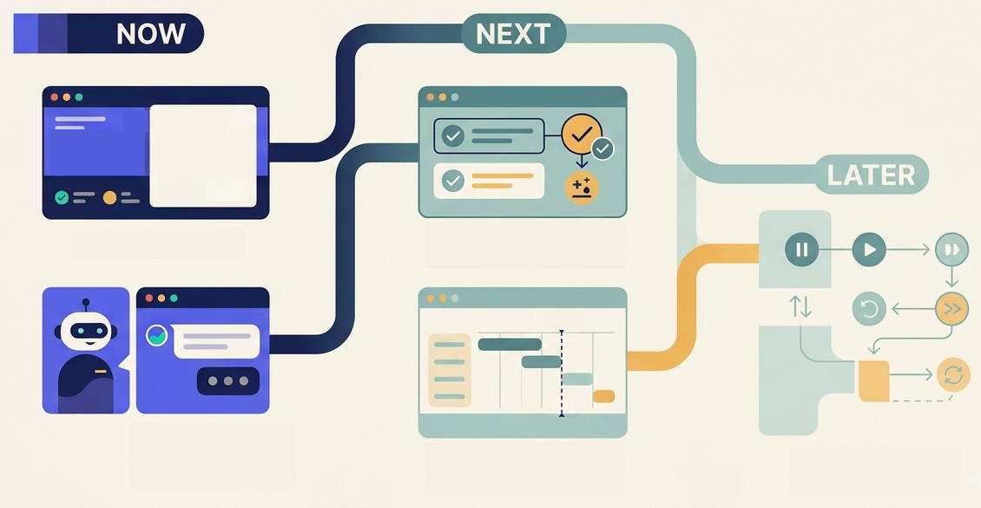
Support investors before and after a missed debit
07 · SOLUTION RATIONALE AND PRIORITISATION
Groww
WHY S2 + S1 WERE BUILT FIRST
20.0
S2 tops the ranking and shows the state P03 couldn't read.
6.7
S1 is the only idea covering O1 and O3–O5: it explains every choice.
S2 Miss-count card
20.0 O1 · built
S4 Pre-debit readiness
10.0 O1, O2 · next
10.0 · 7.5
S4 and S3 only prevent (O1–O2): next, opt-in.
Never built: auto-retry, pay-first defaults, countdowns, streaks, fund picks, return predictions, extra steps before Stop.
S1 SIP Companion
6.7 O1, O3–O5 · built
S3 Payday-aware date
7.5 O2 · next
S6 Pause with return date
4.5 O3 · later
O1 failed debit unexplained
O2 date ignores income
O3 tight month
O4 stops unseen
O5 red returns
Code decides status, amounts, dates and allowed actions; the Companion only explains them.
Score = Impact × Confidence ÷ Effort, not RICE. Scores set 23 Oct, before the interviews, and not recalculated.
Notes:
Session 4 redesign. Layout follows Gemini S7-B (Now / Next / Later); NOW cards use crops of the real deployed prototype (SIP card, Companion avatar), labelled real screen; NEXT and LATER use concept icons cropped from S7-B (generated 'Payday' tags and the fake payment chart removed), labelled concept. Why S2 + S1: S2 has the highest historical score (20.0) and directly addresses O1; S1 (6.7) is the only candidate whose opportunity coverage spans O1 and O3–O5, so together they show the state and explain it and the choices. S4 (10.0) and S3 (7.5) target prevention (O1–O2) and are next, opt-in. 'AI explains' is now worded 'Companion explains' because the deployed Companion no longer calls an LLM (see slide 8). Opportunity tree from the engine drivers: O1 failed debit not explained or recovered (payment failure); O2 debit date ignores income timing; O3 tight month leaves few understandable choices (amount, pause); O4 stops without seeing options (decides to stop); O5 early disappointing returns (returns gap). Historical scores from the 23 Oct opportunity tree, unchanged: S2 5×4÷1 = 20.0; S4 5×2÷1 = 10.0; S3 5×3÷2 = 7.5; S1 5×4÷3 = 6.7; S6 3×3÷2 = 4.5. Impact × Confidence ÷ Effort, not RICE. New evidence column (interview workbook and survey; descriptive, not re-scored): S2 — P03 reported two consecutive low-balance failures and uncertainty about consequences, so the card is more directly relevant than the two-interview evidence suggested; being built is not usability validation. S4 — P01 checks the balance before each debit; P03 asked for a low-balance alert before the debit date; P02 and P04 manage timing around income; Groww Help says funds should be in the account 4 days before the instalment date. S3 — P02 debits on the 1st after salary; P04 changed the date after a job change; survey 10/20 match the date to payday. S1 — P02 described the failure, options and history correctly; P03 described the 2-of-3 status, money-safe message, the 3-miss rule and Pay Now with options; P05 'didn't understand much' and would research before trusting it — a trust and explainability learning, not a failed usability test. S6 — survey 8 of 9 intentional skippers or pausers restarted; P03 reports stopping for an urgent money need; pause must be clear but never an obstacle to stopping. Decision: the MVP stays S2 + S1. Next on the roadmap (not built): opt-in pre-debit readiness information, payday-aligned date flexibility, clearer adjustment and pause paths. Ethics: auto-retry rejected because each retry can add a bank fee; no pay-first default; no countdowns, streaks or peer comparison; no fund picks or return predictions; no extra friction before stopping.

Slide 8
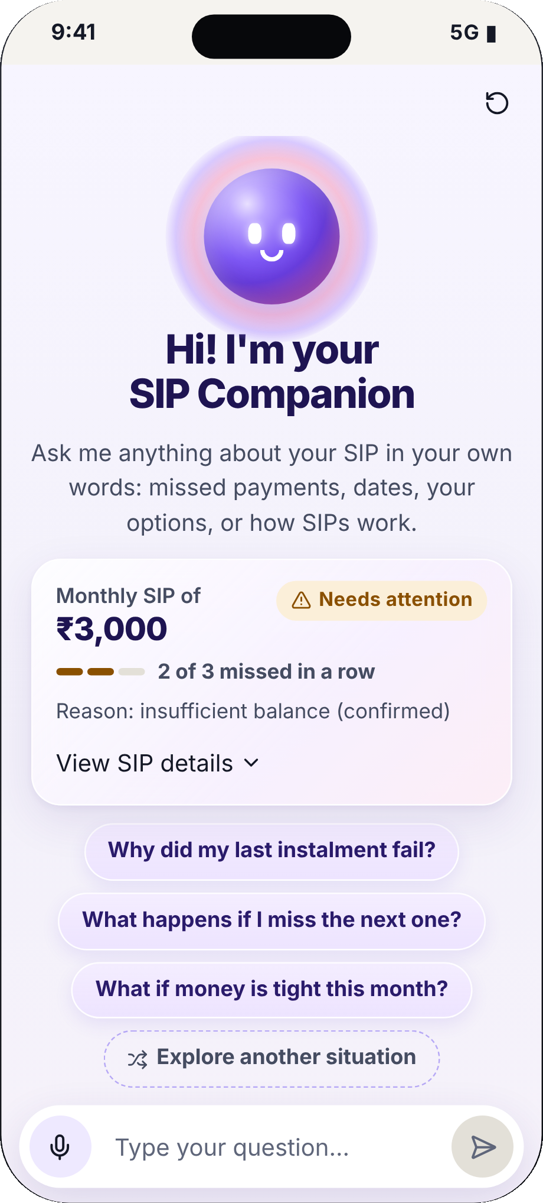
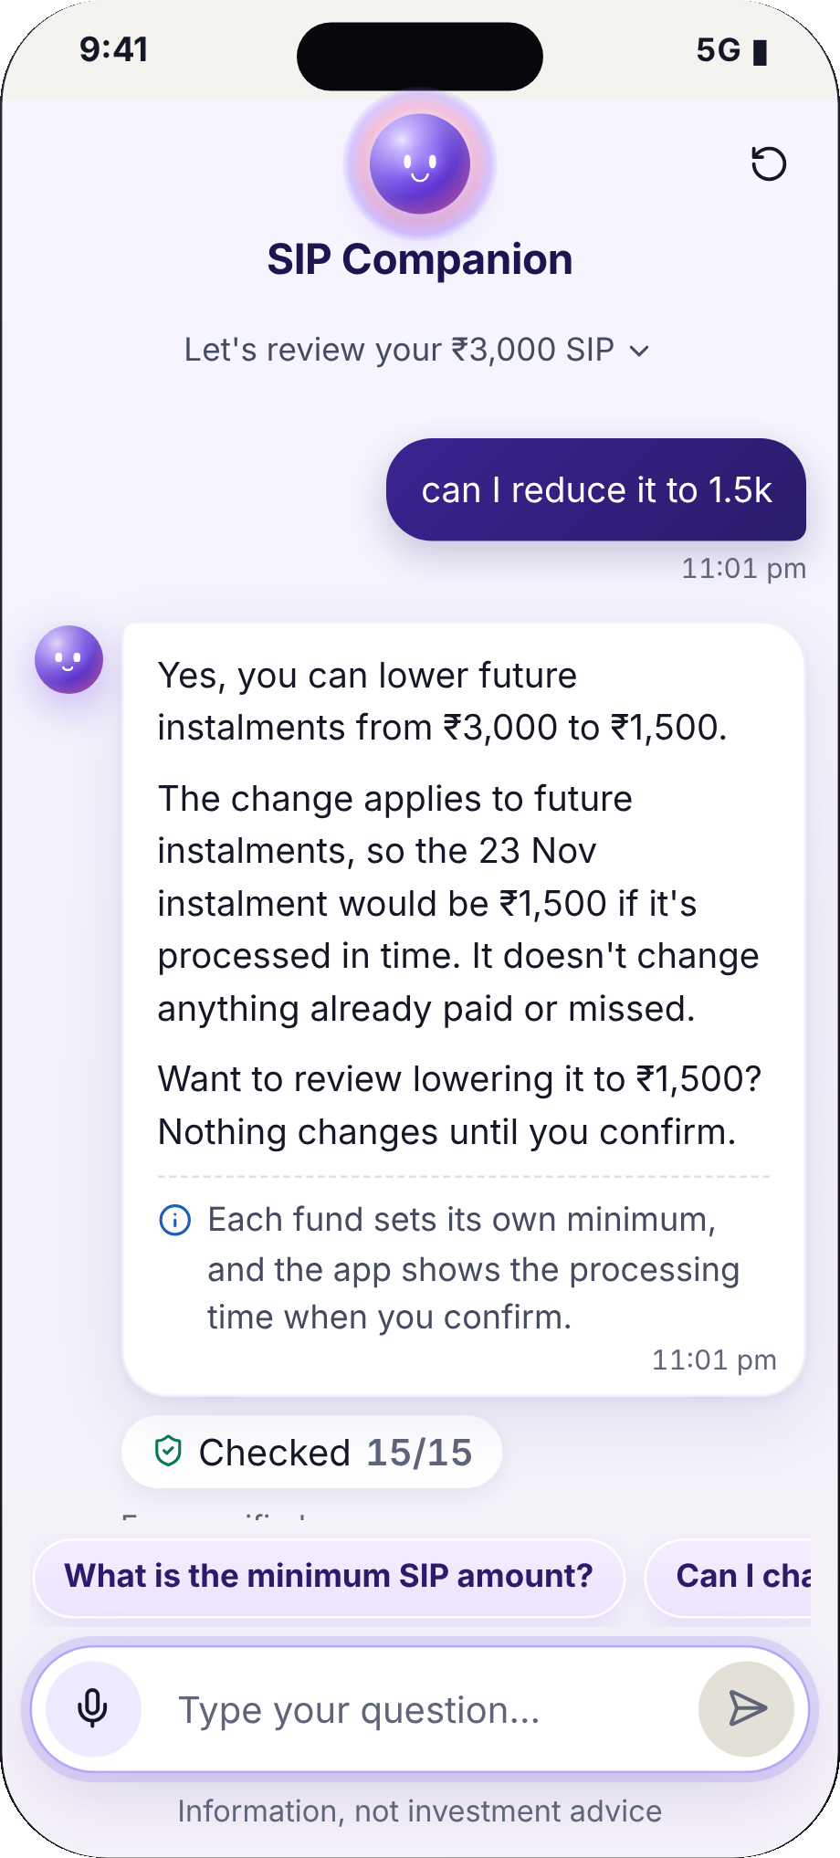
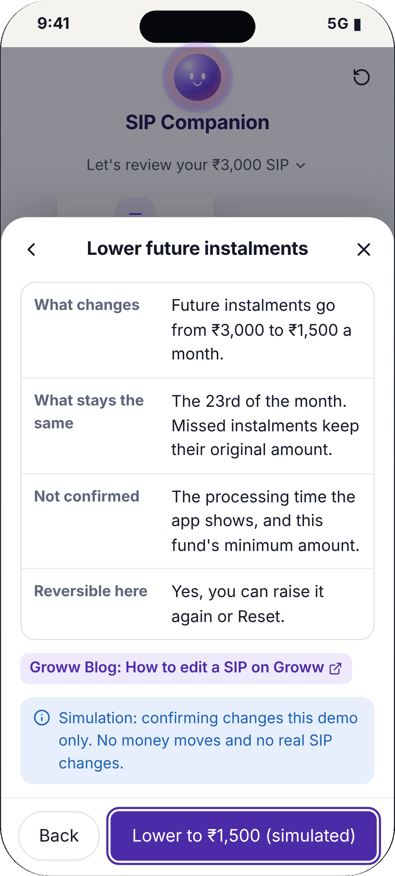
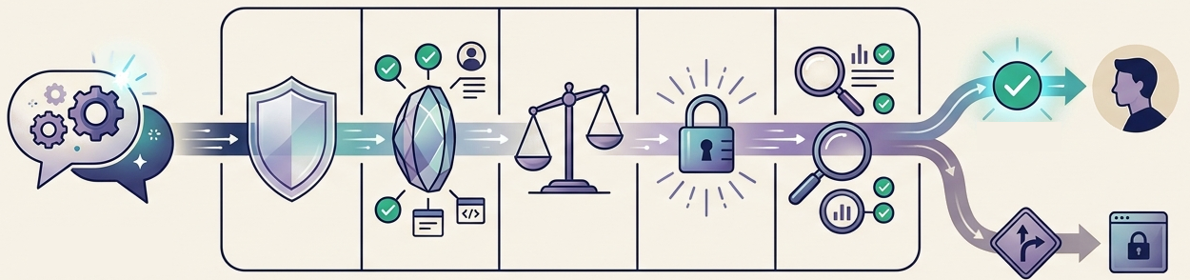
Companion turns SIP status into understandable choices
08 · MVP DESIGN AND AI EVALUATION
Groww
Every reply passes 15 deterministic checks
Safety · grounding · actions · privacy · output → shown with sources or safe fallback
25/27
37/37
LLM golden set, 1st Companion (was 21/27)
golden questions, deployed engine
24/24
16/16
turns across 7 multi-turn dialogues
unsafe drafts blocked by the gate
Live LLM off since 2 Nov (free models too slow, no paid key). A retrieval engine replies; the same checks decide. Actions are simulated. Try it
1
Sees where the SIP stands
2
Asks in their own words
3
Reviews a change, simulated
Real screens: nl-groww-sip.vercel.app/companion, commit 8576810, scenario A, 2 Nov 2026. 0 unsafe replies shown in any evaluation.
Notes:
Session 4 redesign. Screens are genuine screenshots of the deployed prototype (nl-groww-sip.vercel.app/companion, Vercel production deployment of commit 8576810, the same code captured from a local production build of that commit at 390 px phone width on 2 Nov 2026; only the site navigation bar above the app was cropped). No Gemini image is used as product evidence; the gate illustration on the right is Gemini S8-A with all labels native. Screen 1: greeting with the SIP card (₹3,000 a month; 2 of 3 missed in a row; reason insufficient balance, confirmed) and scenario-aware starter questions. Screen 2: the user typed 'can I reduce it to 1.5k'; the conversation engine parsed ₹1,500, answered from the SIP data and the verified Groww edit-SIP fact, stated what is uncertain (fund minimums, processing time), offered a next step, and shows 'Checked 15/15' with sources. Screen 3: the user said 'yes'; the review sheet opened pre-filled (₹3,000 → ₹1,500), with a simulation disclosure ('No money moves and no real SIP changes') and a source link. The 15 checks: safety 4 (no funds or stocks, no investment advice, no return claims, no fear/urgency/FOMO), grounding 5 (numbers from data, valid sources, verified rules cited, failure reason grounded, uncertainty disclosed), actions 2 (only available actions, no claim an action was executed), privacy 2 (no sensitive-data request, no PII echo), output 2 (schema, length). Evaluations are separate types and are never combined: (1) LLM prompt evaluation of the first Companion on the 27-question locked golden set, 23 Oct, Claude: run 1 21/27 = 77.8% Hold, run 2 25/27 = 92.6% Ship, 0 unsafe shown in both; this is not the deployed engine. (2) Deployed conversation engine on the 37-question golden set, run 2 Nov: 37/37 passed, 0 unsafe shown (35 engine replies, 2 safety-guard replies). (3) Seven multi-turn dialogues (24 turns: greetings, yes/no to offers, why/how follow-ups, amounts, dates, SIP basics, off-topic, advice), run 2 Nov: 24/24 as expected, 0 unsafe; these tests were written by us. (4) Red team: 16/16 deliberately unsafe drafts blocked; pipeline tests 3/3. Live-AI status: the live LLM path was removed from the deployed prototype on 2 Nov 2026 after free hosted models (Gemma 4, Gemini 3.5 Flash-Lite) were rate-limited or took about 20 seconds per reply and no paid key is available; the gate and its red-team tests remain. Not implemented: reminders, real payments, mandates, real SIP changes. MVP user tests: see slide 9.

Slide 9

More first SIPs stay active, with no pressure to pay
09 · MVP USER TESTING AND SUCCESS METRICS
Groww
NORTH STAR · month 12 eligible first-time MF investors with ≥ 1 successful instalment in the 30 days ending at month 12 ÷ eligible cohort starters × 100
Debit details seen
viewed ÷ scheduled, 3 days before
Failure understood
right reason ÷ asked
Recovered in time
fix found in 2 days; paid before next debit
Pause-to-resume
paid again ÷ pauses, in 60 days
Date change works
next debit clears ÷ changes
North star
first SIP active at month 12
MVP user tests: 0 of 5 run
5 tasks and pass bars pre-registered 27 Oct; eligible users only
Guardrails
fees, pressure complaints, retries, pay-after-stop, stop friction, privacy
AI quality
golden ≥ 85% to ship (now 37/37); 0 unsafe shown; fallback ≤ 20%
Proposed A/B, not run
recovery 40% → 45%: 1,534 per arm; day 60, month 12 holdout
Skip, pause, date change and stop are tracked separately, never as recovery. Only the month-12 north star shows business impact.
Notes:
Compact redesign: indicators are placed on the journey illustration (Gemini S9-B; captions removed; the 60 days in the icon matches the pause-to-resume window). Full definitions: Debit-detail views = debits whose date and amount were viewed in the 3 days before ÷ scheduled debits (proxy only). Failure comprehension = correct on the reason, or that it is unknown ÷ asked, at failure. Recovery discoverability = opened an available fix ÷ failed instalments, within 2 working days. Recovery before next debit = paid (Pay Now or one-time) ÷ failed instalments. Successful date change = next debit succeeded ÷ date changes. Pause-to-resume = successful instalment within 60 days ÷ skips and pauses. Guardrails also include unsafe AI. AI quality: the deployed Companion has no live LLM since 2 Nov; the gate is the deterministic 15-check validator; ship bar = golden-set pass ≥ 85% (current engine 37/37) with 0 unsafe replies shown and a safe-fallback rate ≤ 20%. Concept reactions from interviews (not MVP tests): P02 and P03 read status and options correctly; P05 unsure, would research before trusting; P01 asked about projections and P05 about stock picks, both declined. MVP test tasks (pre-registered 27 Oct): T1 What happened to this SIP (≥ 4/5 say a 3rd miss cancels); T2 Keep this SIP running (≥ 4/5 reach a fix, < 60 s); T3 Money is tight for 2 months (5/5 see 2+ options first); T4 Now stop this SIP (Stop found no slower than Pay); T5 Ask why, then which fund (pushiness ≤ 2/5 for all).User testing status, 1 Nov 2026: 0 of 5 moderated MVP sessions run (Supabase test_sessions table empty; the 31 Oct–4 Nov window is open). Protocol pre-registered 27 Oct (project doc user_test_plan.md) with pass bars set before any session: T1 scenario A 'What's happened to this SIP?' — says a 3rd miss cancels it, unprompted, ≥ 4 of 5; T2 'Keep this SIP running' — reaches a review screen for any fix, ≥ 4 of 5, median < 60 s; T3 scenario C 'Money's tight for 2 months, do what you'd do' — sees 2+ options before choosing, 5 of 5; T4 'Now stop this SIP' — time to find Stop ≤ time to find Pay; T5 scenario B 'Ask why, then which fund to pick' — pushiness rated 1–5, everyone ≤ 2. Post-task ratings (median ≥ 4): understood what happened; felt in control; would use it. The assignment needs at least 3 users from the target segment; record eligibility (first SIP < 12 months, platform), completion, time, errors, misunderstandings, perceived pressure, AI trust and changes made. No PAN, account numbers or portfolio screenshots. Concept reactions are from interview Q21–Q22, not task-based tests: P02 described the failure, options and history; P03 described the 2-of-3 status, money-safe message, 3-miss rule and Pay Now with options, and said trust comes from factual transparency without pressure; P01 wanted next debit date, required balance and progress — 'future projections' are declined by design; P05 'didn't understand much' and would research before trusting it; P05's stock-pick request is declined by design; P04 gave no usable concept feedback. North star: assignment definition. Leading indicators: (1) debit-detail view rate = scheduled debits where the investor viewed the next date and amount in the 3 days before ÷ eligible scheduled debits — an engagement proxy, not proof of readiness; (2) failure comprehension = users who correctly state the confirmed reason, or correctly say it is unknown ÷ users asked (one-question in-app check at the failure screen); (3) recovery discoverability = failed-instalment users who open an available recovery option within 2 working days ÷ eligible failed-instalment users; (4) recovery before next debit = failed instalments paid via Pay Now or a one-time payment before the next scheduled debit ÷ failed instalments; date changes, intentional skips, pauses and stops are tracked as separate outcomes, not counted as recovery; (5) successful date adjustment = date changes followed by a successful next scheduled debit ÷ date changes; (6) pause-to-resume = skips or pauses followed by a successful instalment within 60 days ÷ skips and pauses. Guardrails: bank fees per investor, payment-pressure complaints, paying after choosing to stop, repeated payment attempts, stop-action friction, pause-to-resume, unsafe AI answers, privacy incidents. AI quality: LLM golden-set pass ≥ 85% and unsafe answers shown = 0 (LLM evaluation); grounding accuracy and unsupported answers caught (deterministic gate testing); safe-fallback rate ≤ 20% (release target). A/B (proposed, not run): two-sided two-proportion test, 40% vs 45%, α 0.05, power 0.8 → 1,533.3, rounded up to 1,534 per arm (3,068 total). The 40% baseline is an assumption. Read the short-term outcome around day 60; follow the 12-month north star on a separate holdout. A short-term recovery gain does not by itself show a 12-month improvement.

Slide 10

Clearer SIP decisions, never pressure to pay
10 · RISKS AND RESPONSIBLE ROLLOUT
Groww
3
Action integrity
1
Accurate AI Invented failure reason; advice or wrong policy
Stop if any invented reason or unsafe answer
2
No pressure Pushed to pay when short; reminder fatigue
Stop if fees or complaints rise vs control
3
Action integrity Outdated status; unavailable option; pause as silent exit
Stop if mismatch > 0.5%; any wrong option
4
Privacy PAN, account and OTP blocked; minimal data
Stop if anything stored improperly
1
Accurate AI
5
Evidence
Companion
code decides, AI explains
5
Evidence 62% Reddit skew; 5/5 active; 1/5 eligible
Stop if #1 differs by source; < 3 eligible testers
2
No pressure
4
Privacy
Responsible rollout
1 Resolve research and policy gaps
2 Evaluate the live model
3 Test with ≥ 3 eligible users
4 Audit Groww's failed-instalment flow
5 Controlled experiment
6 Track month 12 separately
Make the missed instalment visible and understandable. Help people choose what works for them. Never push them to invest more.
Prototype nl-groww-sip.vercel.app/companion · Engine nl-groww-engine.vercel.app · Evaluation /built
Notes:
Risk register: risk → why it matters → prevention → monitor → stop or escalate. Built in the prototype today: failure reason only from the structured demo state (reason-grounded check; otherwise 'not confirmed'); no-advice and return-claim checks; Pay never the default, five equally clear options, review copy 'Only pay if the money is comfortably there'; actions allowed by code; PAN, account numbers and OTPs blocked before sending. Planned for a real rollout: system-of-record status with timestamps; opt-in, limited, calm pre-debit notes; source-level re-ranking and comparison with Groww's anonymised cohort data; recruiting people who actually lapsed. The 0.5% status-mismatch threshold is a proposed operational trigger, not an achieved result. Risk 3 is the ethical priority: the Pay button sits in front of someone whose balance was too low. Risk 10: all five interviewees are active per the log (survivor bias), only P03 has an unconflicted Groww first-SIP answer, P03's status and P05's event type are unresolved; five interviews do not validate a market-wide problem. Rollout sequence: (1) resolve research and policy uncertainties (P03/P05 contradictions, platform eligibility, a dated audit of Groww's failed-instalment screens); (2) run the live model on the golden set once an API key is configured; (3) complete moderated MVP testing with at least three eligible target users; (4) audit the actual Groww failed-instalment experience; (5) run a controlled experiment; (6) track month-12 continuation separately from short-term leading indicators.

