Slide 1




Bhasha Bandhu Hackathon
Innovating for a Multilingual Judiciary
Innovating for a Multilingual Judiciary
Team/Individual Name: EVARA Team/Individual bio: Action Oriented Learner Date 25 February 2025
Supported by

Slide 2
Problem Statement
Promoting Legal Literacy Across Communities
Many communities, especially in rural and linguistically diverse regions, lack access to accurate legal information due to language barriers and limited resources. This hinders their ability to understand their rights and seek legal aid.
Notes:
Idea Submissions Form – Details of the form Topic
Thesis Abstract Concept Note What is the solution Build? Business use case (Less than 100 – 200 words) Judge and filter becomes easy

Slide 3
Solution
Overview:
A multi-platform solution designed to enhance legal literacy by offering localized content, interactive learning, and real-time legal aid access.
Basic Tech Architecture:
Frontend: React.js (for user-friendly interfaces)
Backend: Node.js with Express (to manage APIs)
Database: MongoDB (secure data storage)
Language Integration: Google Translate API & Bhashini API (for real-time translations)
Legal Aid Matching: Real-time matching engine connecting users with legal aid databases
Notes:
Idea Submissions Form – Details of the form Topic
Thesis Abstract Concept Note What is the solution Build? Business use case (Less than 100 – 200 words) Judge and filter becomes easy

Slide 4
Use of Azure OpenAI & Bhashini API
Azure OpenAI:
Generates legal summaries and quiz questions tailored to user profiles.
Bhashini API:
Provides real-time, accurate translations for legal content.
Notes:
Idea Submissions Form – Details of the form Topic
Thesis Abstract Concept Note What is the solution Build? Business use case (Less than 100 – 200 words) Judge and filter becomes easy

Slide 5
Techstack/Technology Used
Programming Languages: JavaScript, Python
Frameworks: React.js, Node.js
APIs: Azure OpenAI, Bhashini, Google Translate
Database: MongoDB
Cloud Services: Microsoft Azure
Notes:
Idea Submissions Form – Details of the form Topic
Thesis Abstract Concept Note What is the solution Build? Business use case (Less than 100 – 200 words) Judge and filter becomes easy

Slide 6
Unique Selling Proposition
Inclusive Design: Accessible for all age groups and languages.
Real-Time Legal Aid: Direct connection to verified legal services.
Gamified Learning: Interactive modules with certification.
Scalable Platform: Easily adaptable to new languages and laws.
Notes:
Idea Submissions Form – Details of the form Topic
Thesis Abstract Concept Note What is the solution Build? Business use case (Less than 100 – 200 words) Judge and filter becomes easy

Slide 7
Business Potential
Government Partnerships: Collaboration with NALSA and judiciary bodies.
Education: Integration into school and college curriculums.
NGOs: Community partnerships for grassroots impact.
Corporate CSR: Engage companies like Google.org for funding.
Subscription Models: Premium features for personalized legal consultations.
Notes:
Idea Submissions Form – Details of the form Topic
Thesis Abstract Concept Note What is the solution Build? Business use case (Less than 100 – 200 words) Judge and filter becomes easy

Slide 8
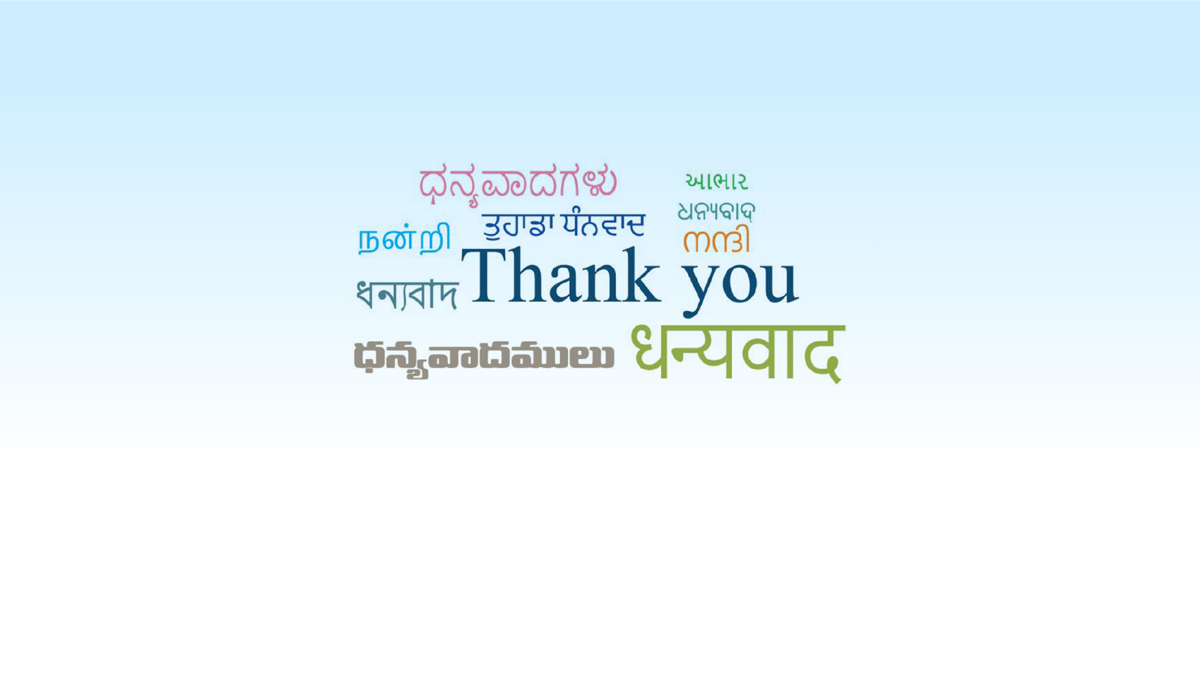
Innovating for a Multilingual Judiciary
Supported by

