Slide 1
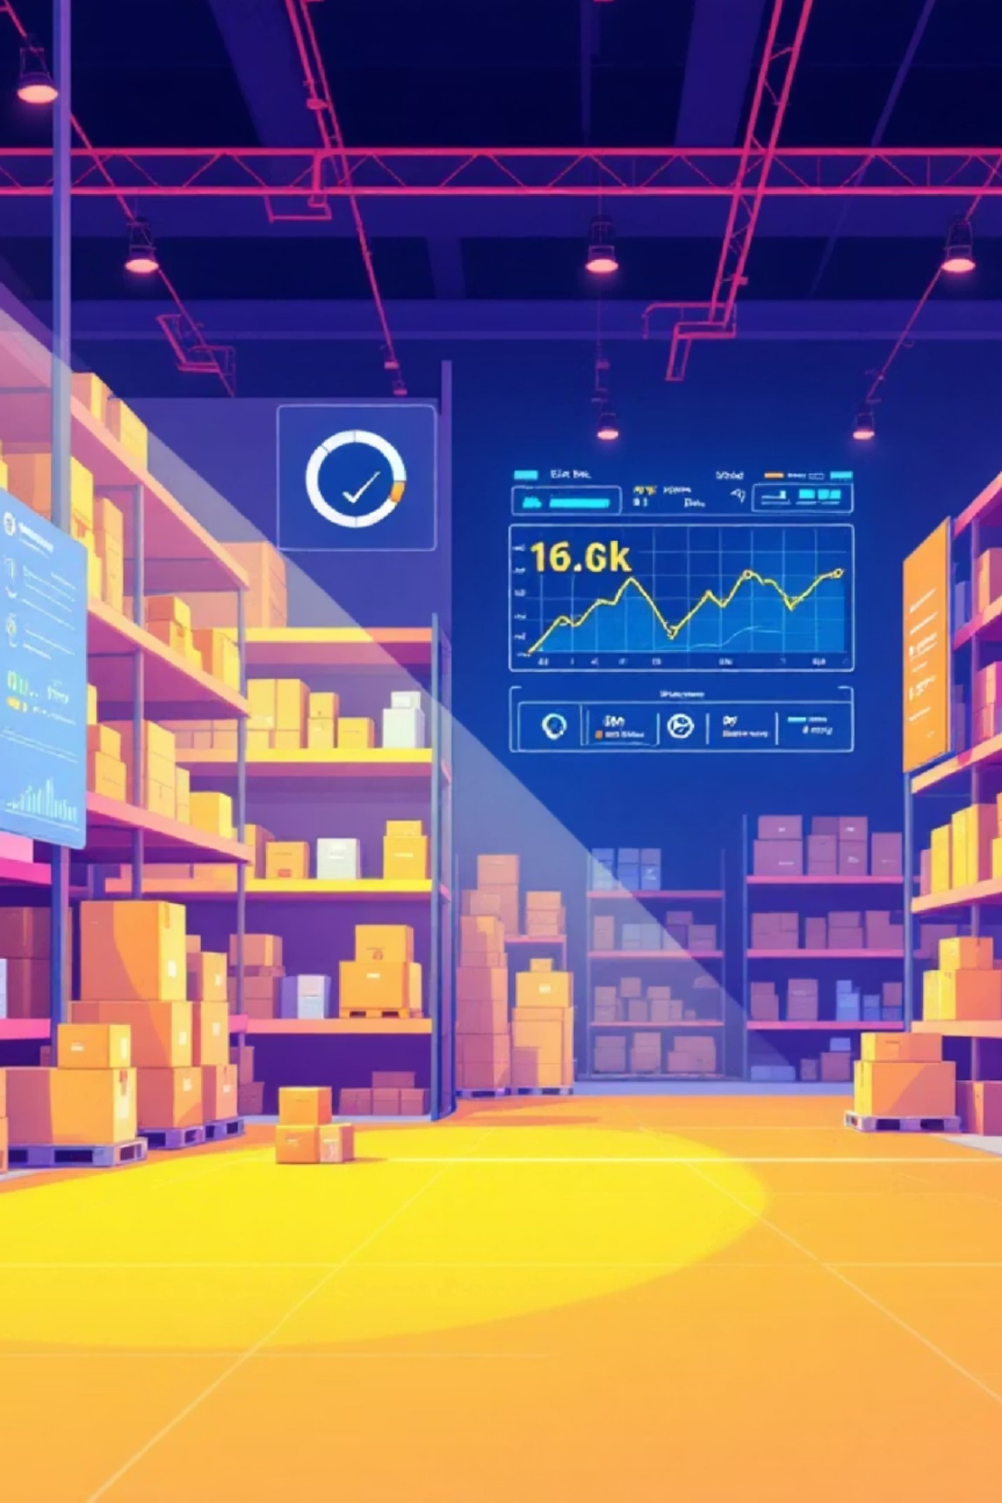
Smart Order & Inventory Management System

Slide 2
Smart Order & Inventory Management System
Capstone Project
Presented by: Shrest Gangatkar
Tech Stack: Spring Boot | Angular | Microservices | Docker | RabbitMQ

Slide 3
Problem Statement
Manual order and inventory tracking is inefficient
Lack of real-time stock visibility
No role-based access control
Monolithic systems are hard to scale

Slide 4
Solution Overview & Key Features
Core Features:
Product management (Add, Edit, View)
Order placement and order history
Warehouse and inventory management
Invoice generation and payment update
Advanced Features:
Cart functionality
Invoice viewing with financial graph for Finance Manager
Role-based navigation bar (Admin / User / Finance Manager)
Product-wise and warehouse-wise stock views

Slide 5
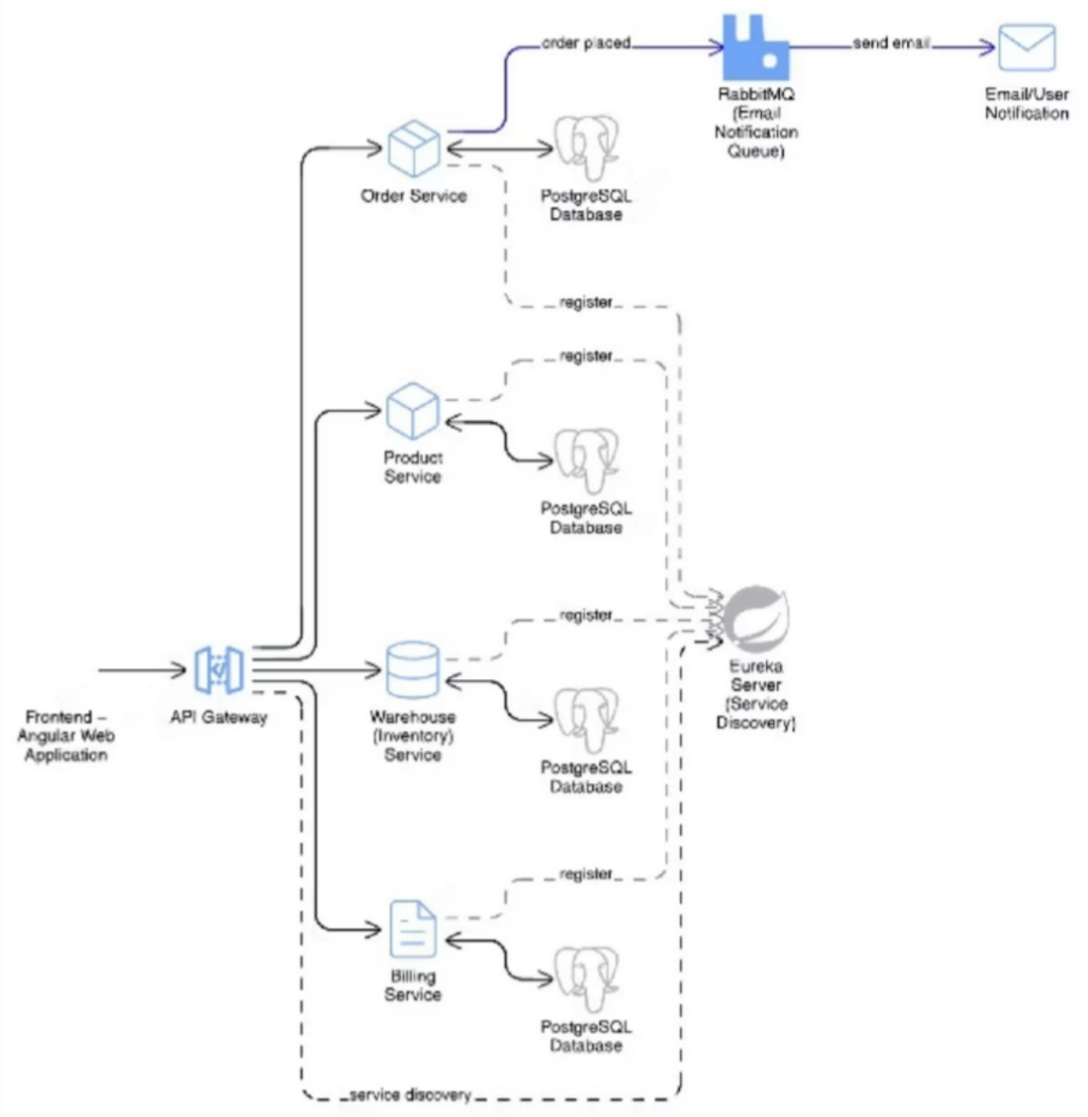
System Architecture

Slide 6
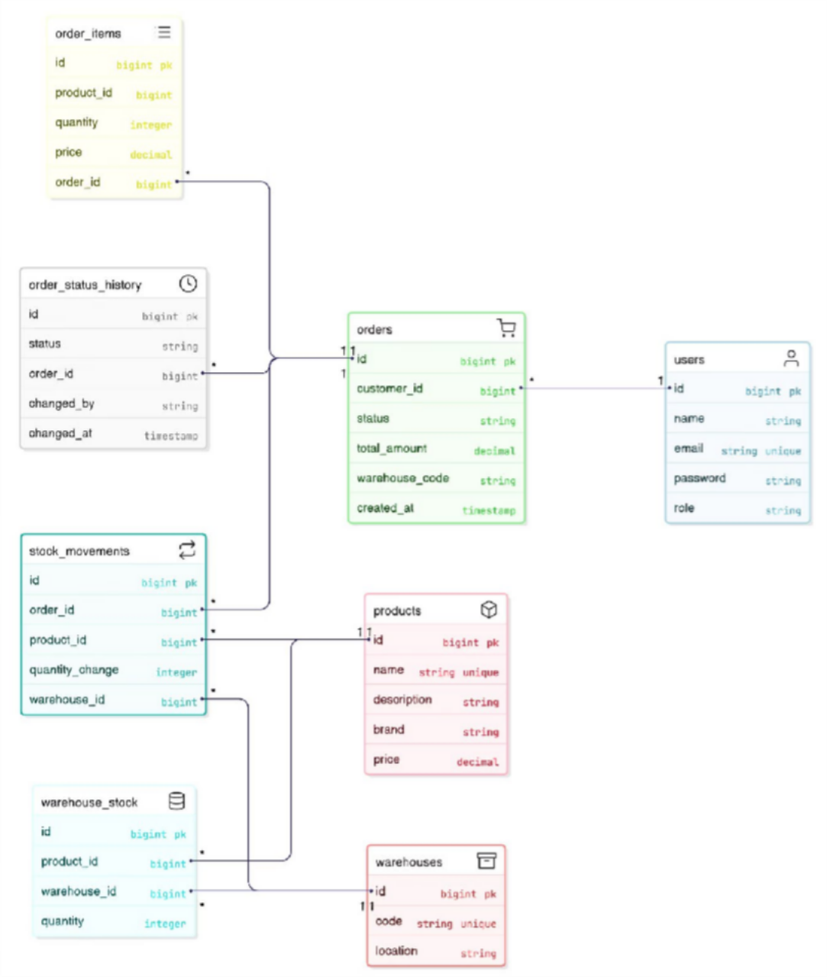
ER Diagram

Slide 7
Backend – Microservices Overview
Order Service | Order placement & lifecycle
Product Service | Product management
Warehouse Service | Inventory & warehouse management
Billing Service | Invoices & payments
API Gateway | Routing & security
Eureka Server | Service discovery

Slide 8
Frontend – Application Structure
Angular standalone components
Feature-based folder structure
Services for backend API communication
Centralized routing using Angular Router

Slide 9
Frontend Routes & Navigation
/register User registration
/login User login
/products Product listing
/cart Cart management
/order Place order
/vieworders View order history
/warehouses View warehouses
/warehouses/:code Warehouse stock view
/productstock/:id Product stock view
/invoice View invoices
/updatepayment Update invoice payment
Navigation bar changes dynamically based on logged-in user role.

Slide 10

Frontend to Backend Interaction
User Action
Angular Component
Angular Service
API Gateway

Slide 11
Order Processing Flow
01 02
User Adds Product to Cart Places Order
The customer initiates the process by adding desired products to their shopping cart within the Angular frontend.
Upon reviewing the cart, the customer proceeds to checkout and places the order, sending the request to the backend via the API Gateway.
03 04
Order Service Validates Product Inventory Stock is Checked
The Order Service receives the request, validates the product details, and confirms product existence with the Product Service.
The Order Service then communicates with the Warehouse Service to check the current inventory stock for the ordered products.
05 06
Invoice is Generated Order Confirmation Displayed
Once stock is confirmed and the order is finalized, the Billing Service generates an invoice for the transaction.
Finally, the system displays an order confirmation to the user, summarizing their purchase and next steps.

Slide 12




Inventory Management Flow
Stock Maintained per Warehouse
Each warehouse independently tracks its inventory, providing granular control and accurate stock levels for specific locations.
Product-wise and Warehouse-wise Stock Visibility
Users can view real-time stock levels broken down by individual products across all warehouses, or aggregated stock within a specific warehouse.
Low Stock Events Handled Asynchronously
Critical low stock notifications are processed in the background using message queues, triggering alerts or reorder processes efficiently without delaying user operations.
Stock Automatically Updated After Order Placement
Upon successful order confirmation, the system automatically adjusts inventory levels, ensuring up- to-date stock counts without manual intervention.

Slide 13
Security & Role-Based Access
JWT Authentication
Securely verify user identity and session validity using JSON Web Tokens for all API requests, ensuring trust and integrity.
API Gateway Security
The API Gateway enforces authentication and authorization policies, acting as a critical perimeter defense before requests reach individual microservices.
Protected Frontend Routes
Unauthorized access to specific frontend routes is prevented, ensuring that only users with appropriate permissions can navigate to sensitive sections of the application.
Role-Based UI Rendering
Frontend components and navigation paths are dynamically rendered based on the user's assigned role (Admin, User, Finance Manager), providing a tailored user experience.

Slide 14




Docker & Deployment
Dockerized Microservices
Each microservice (Order, Product, Warehouse, Billing) is independently containerized with its own dependencies, ensuring isolation and portability.
Docker Compose Orchestration
Utilizes Docker Compose to define and run the multi- container Docker application, simplifying the setup and management of all services.
PostgreSQL Containers
Each microservice uses its own dedicated PostgreSQL database running in a Docker container, providing isolated and persistent data storage.
Consistent Environment
Docker ensures a consistent development, testing, and production environment, eliminating "it works on my machine" issues and streamlining deployments.

Slide 15
Thank You

