Slide 1
Shared Task on Toxic Span Identification

Slide 2
Team Members
Supervised by: Dr. Sunil Saumya
Shresth Bharadia (19BCS100)
Sourav Bhagat (19BCS103)
Sutrave Krishna Sambhaji (19BCS105)

Slide 3
Problem Statement
Shared task on Toxic Span Identification: The Toxic Spans Detection task aims to build a model for identifying toxic words in whole posts. Here by toxic words we mean the words that is provocative, hateful, rude and disrespectful etc.
Example:
“Damn, a whole family. Sad indeed.”
Toxic Span is ‘Damn’

Slide 4
Span Identification over Classification
Gives the complete text that is toxic
For Example:
“Damn, a whole family. Sad indeed.”
Span Identification
Classification
Output: “Damn”
Output : 1

Slide 5
Motivation
Our motivation behind taking this topic are:
Support healthy online discussions.
Identifying offensive content.
Lack of annotated data for offensive content.
In this shared task, we have code-mixed social media text for English language with offensive spans for which we are trying to develop systems.

Slide 6
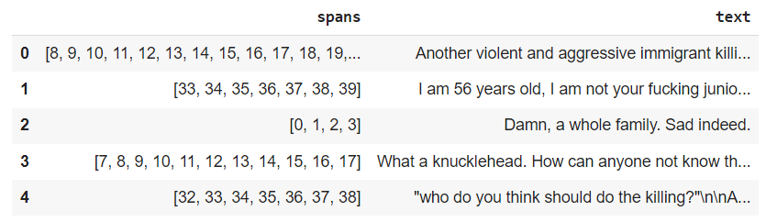
Datasets
We took data set from a competition named SemEval 2021 Task 5: Toxic Spans Detection
Sample data set:

Slide 7
Flow-Diagram
Data Reading
Data Preprocessing and
Data Cleaning
Word Embedding
Model Performance
Model Testing
Model Training

Slide 8
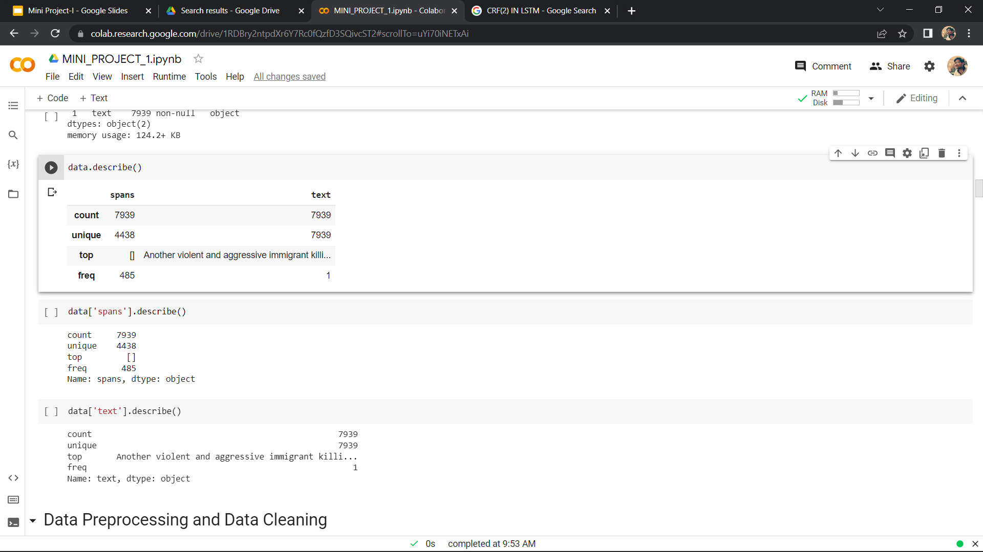
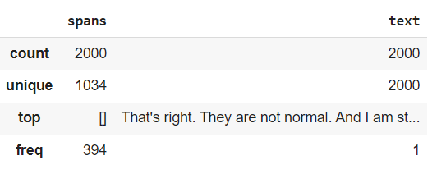
Data Reading
Training dataset
Test dataset

Slide 9
Data Preprocessing and Data Cleaning
Cleansing of data
Removing NULL Values
Removing Duplicates
Few basic operation on the data
Tokenization of Data and Modification of data

Slide 10
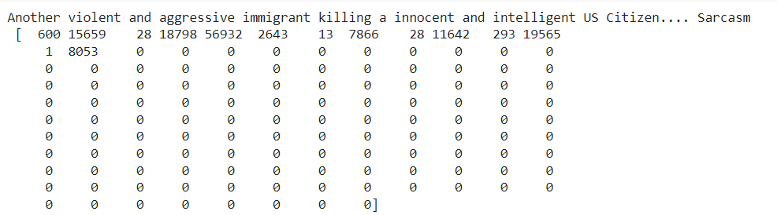
Data Preprocessing and Data Cleaning
PADDING: Ensure that all sequences in a list have the same length.

Slide 11
Word Embedding
Word embeddings are numerical vectors representing strings
Words or phrases from the vocabulary are mapped to vectors of real numbers. For example,
“dad” = [0.1548, 0.4848, 1.864]
‘mom” = [0.8785, 0.8974, 2.794]
We had used a pre-trained Embedding models(Glove Embedding) for our dataset.

Slide 12
Model Training
We have Trained are dataset with Bi-LSTM Model.
The model includes three main layers:
The word representation layer uses embedding matrix from the GloVe word embedding
The BiLSTM layer with or without dropout layer for sequence labeling
The Conditional Random Field (CRF) layer or the Sigmoid Function to control the probability of output labels.

Slide 13
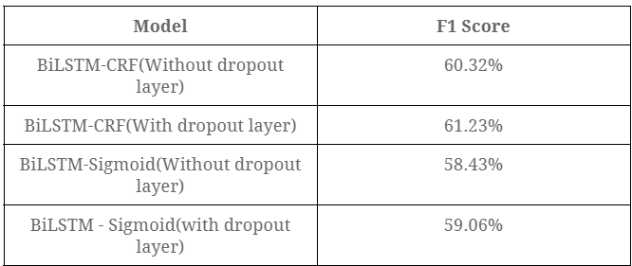
Model Testing
We used F1-Score for evaluation of model.

Slide 14
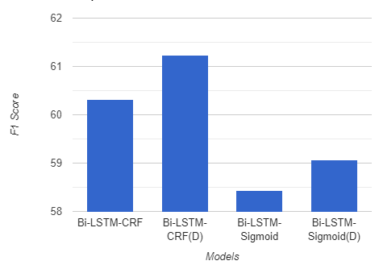
Comparison between Different Models

Slide 15
Thank You

