Slide 1

Internship at Global-Tech Solution Pvt. Ltd
Presented By
Ankit Shrestha(23863/076)
Supervised By
Er. Dhiraj Kumar Jha.

Slide 2

Introduction
Position: Intern, .NET Development
Company Details: Global-Tech Solution Pvt. Ltd is recognized as Nepal's first cloud-based accounting software company. It stands as the nation's premier 100% cloud service provider, offering a diverse range of cloud services from a secure data center, ensuring protected disaster recovery measures. Additionally, it specializes in providing professional accounting training and on-demand business consulting services, tailored to empower businesses to thrive in today's competitive landscape.
Start Date: March 11th, 2024
End Date: June 3rd, 2024
Working Hours: 7 hours
Mentor Name: Anish Koju Shrestha
Motivation: I chose Global-Tech Solution for my internship due to its pioneering work in expertise in .NET development and cloud technology. The company's innovative environment and focus on professional growth perfectly align with my career goals.

Slide 3
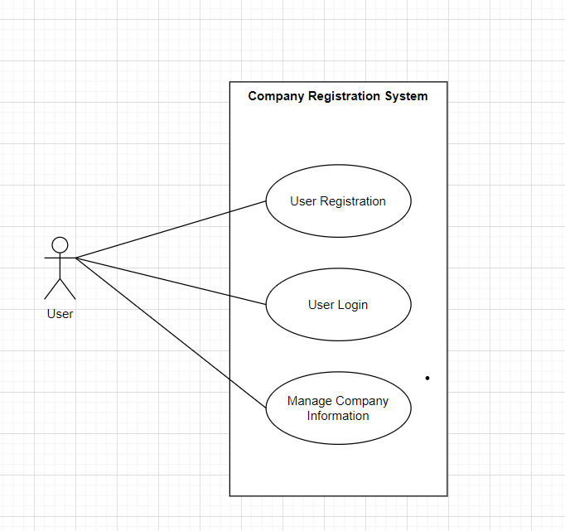
Activities Performed
Project 1: Company Registration System
Figure : Use Case Diagram of Company Registration System
Notes:
Objectives: Develop a system for company registration and management.

Slide 4
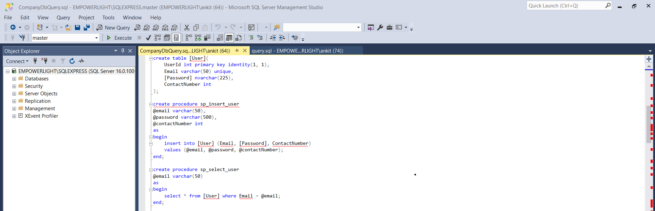
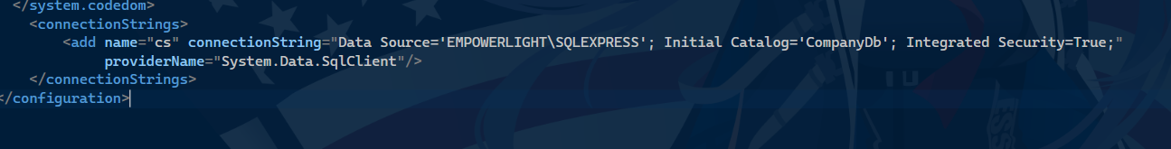
Activities Performed…
Configured and managed connection strings, implementing effective handling mechanisms for database access.
Established connections between the server(ASP.NET MVC) and the database.
Figure: SQL Script
Figure: Connection string Configuration

Slide 5
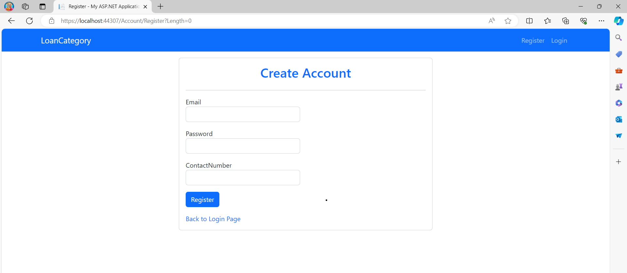
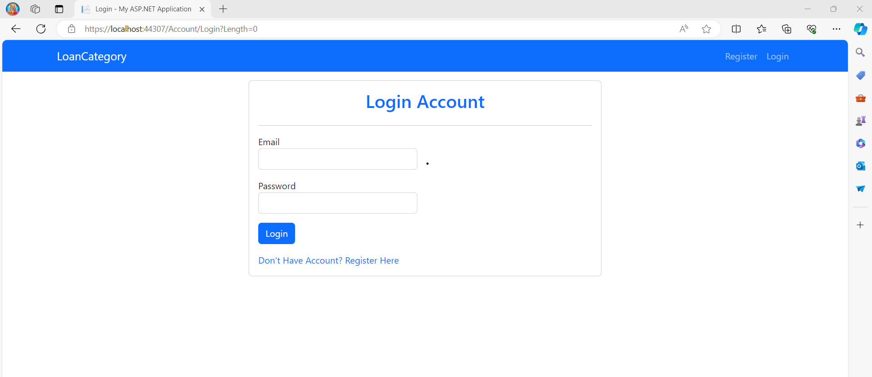
Activities Performed…
Registration View
Login View

Slide 6
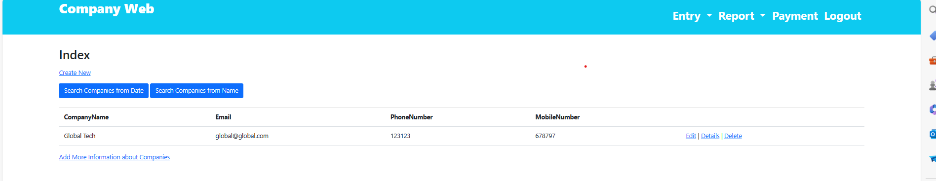
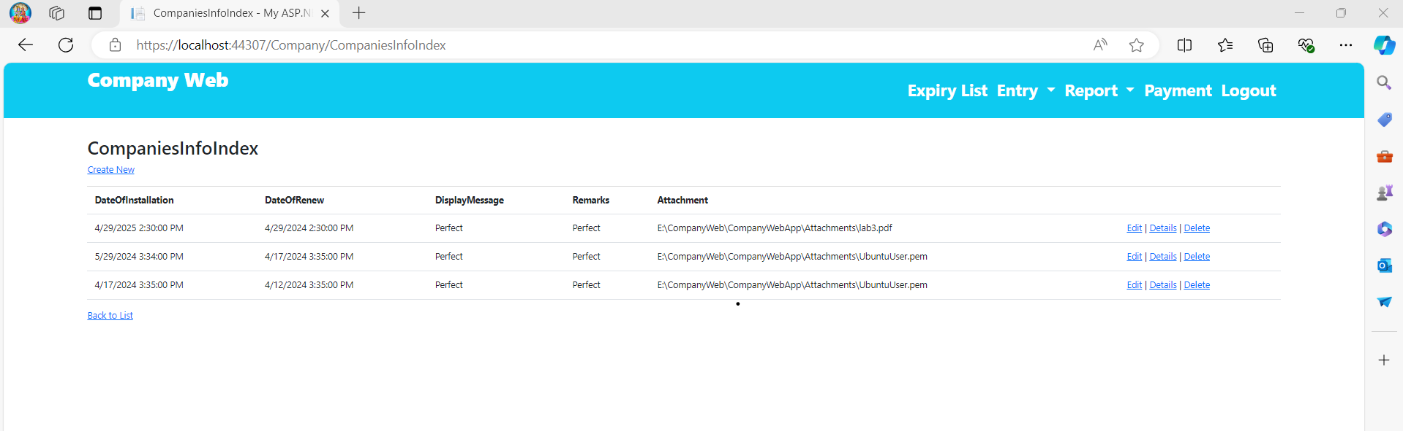
Activities Performed…
Executed CRUD (Create, Read, Update, Delete) operations for data management within the application.
Integrated data from “Companies” and “Companies_info” tables using JOIN operations for comprehensive data analysis and reporting.
Figure: Company List View
Figure: Company Info View

Slide 7
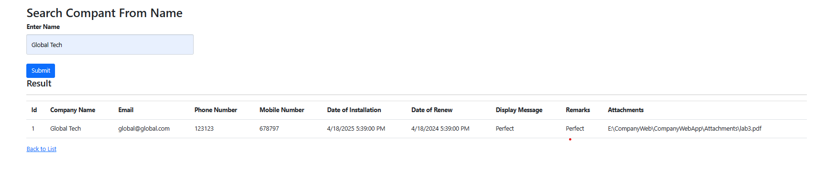
Activities Performed…
Add a search feature to retrieve company data based on specified criteria such as date and name.

Slide 8
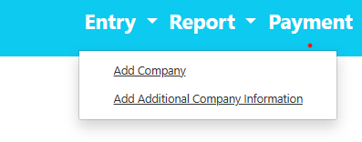
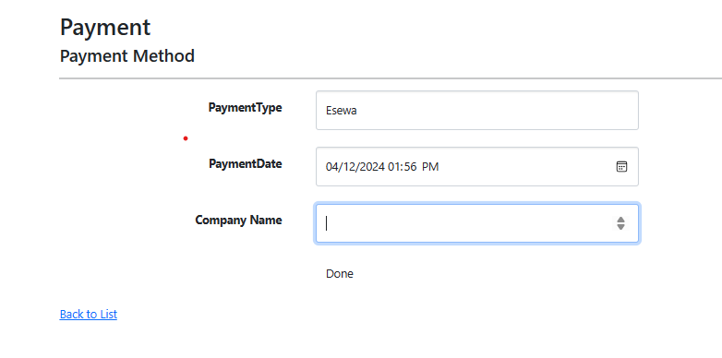
Activities Performed…
Implementing drop-down menus for data entry and reporting functionality.
Integrated Payment Page and implemented functionality to update date of installation and date of renew, enhancing the application’s financial management capabilities.

Slide 9
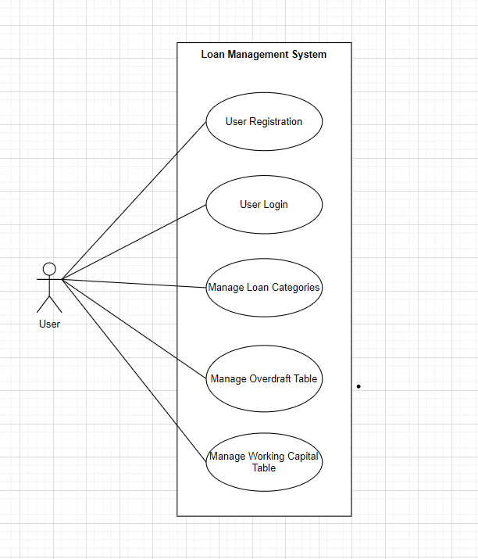
Activities Performed…
Project 2: Loan Management System
Figure: Use Case Diagram of Loan Management System

Slide 10
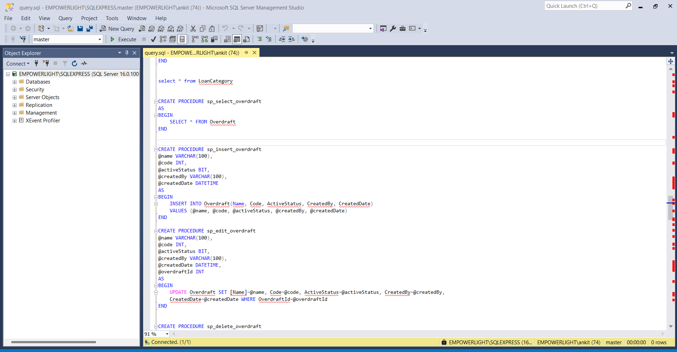
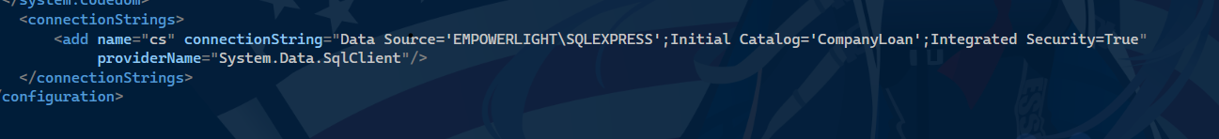
Activities Performed…
Figure: Connection Strings
Figure: SQL Scripts

Slide 11
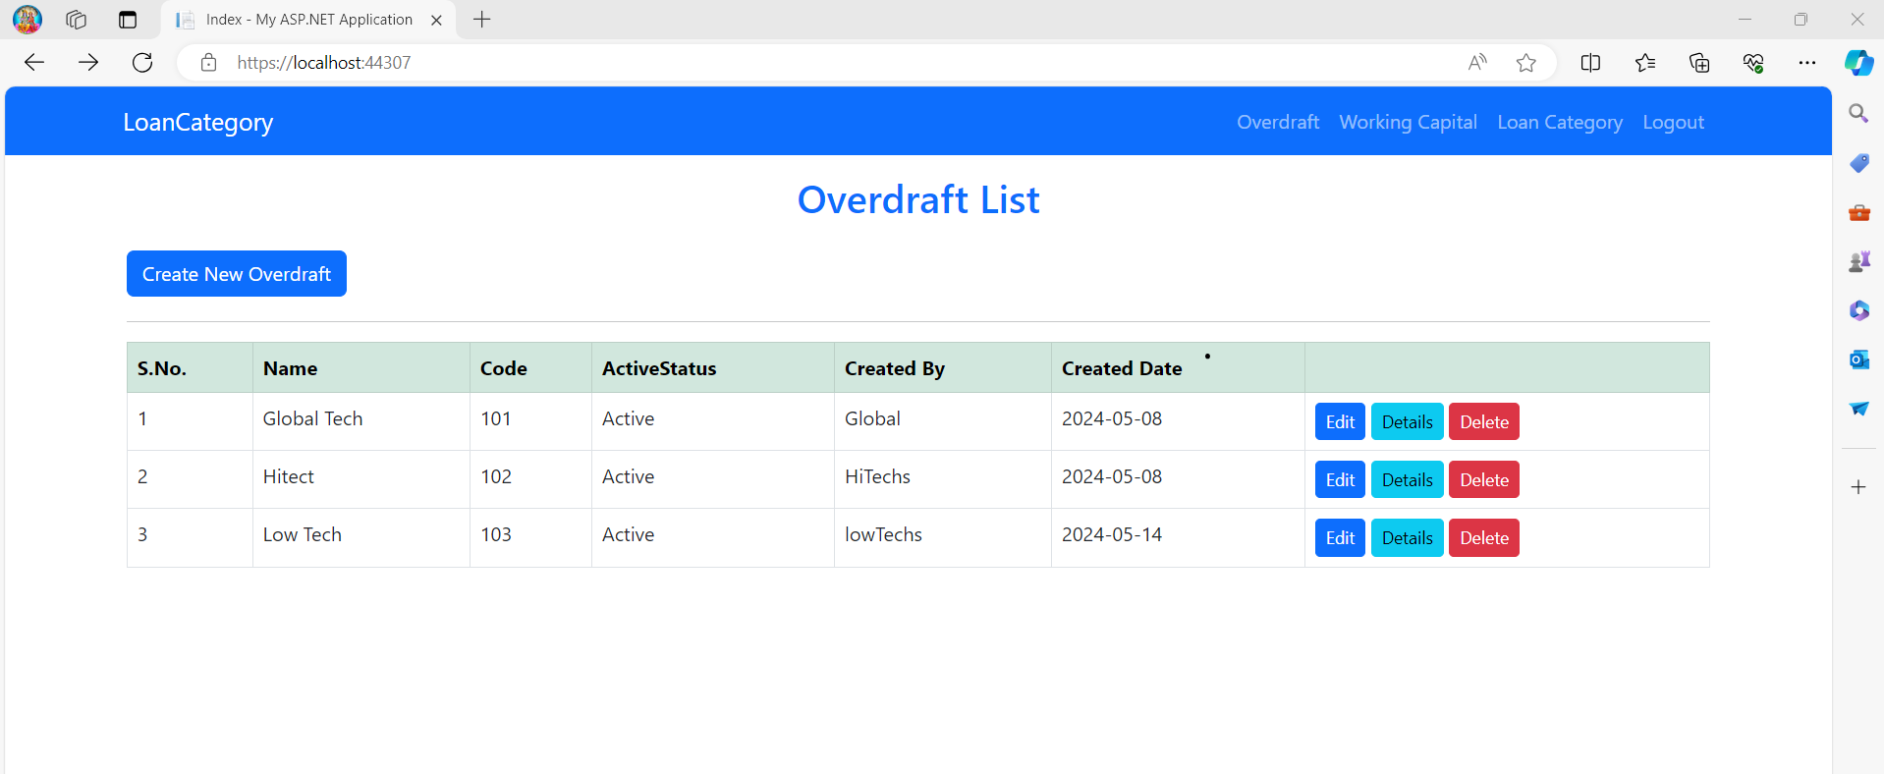
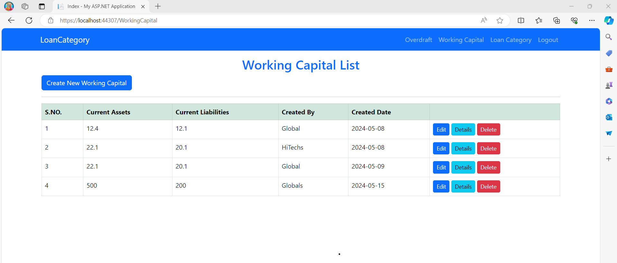
Activities Performed…
Figure: Overdraft list View
Figure: Working Capital list View
Notes:
Objectives: Create a system for managing different loan categories.

Slide 12
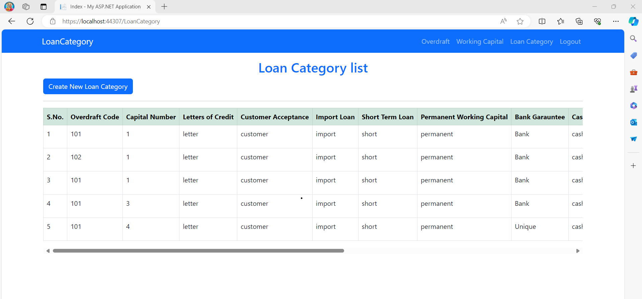
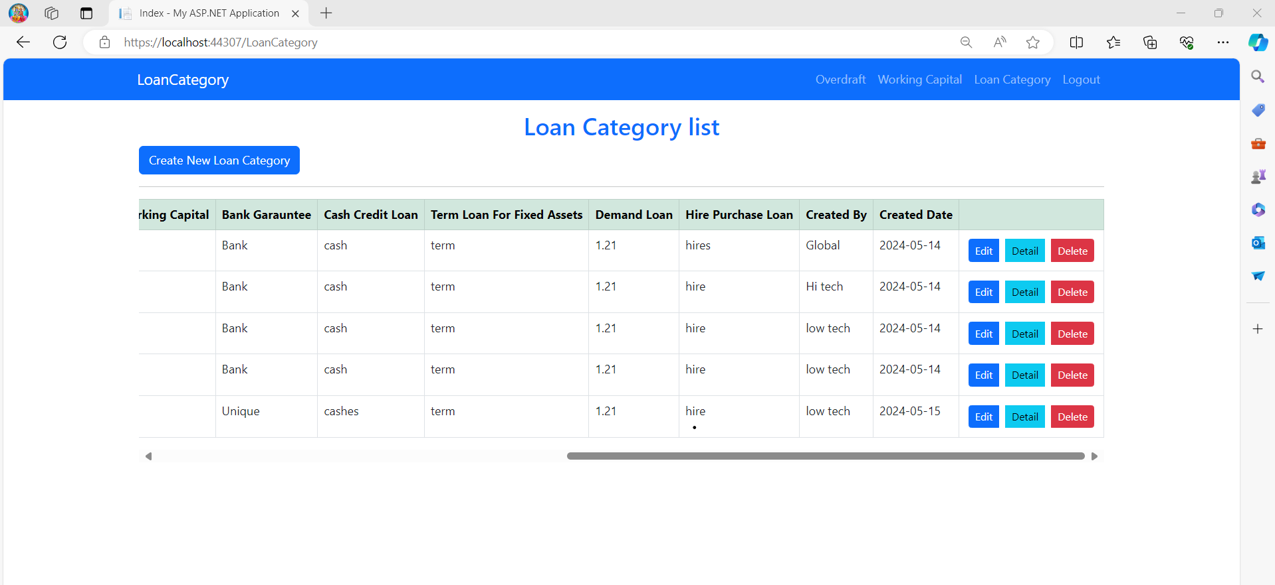
Activities Performed…
Loan Category List View

Slide 13
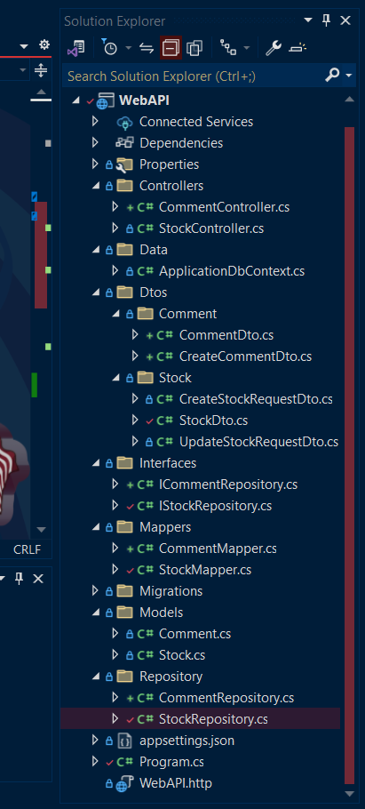
Activities Performed…
Project 3: Web API Development
Figure: Connection String
Figure: Web API Folder

Slide 14
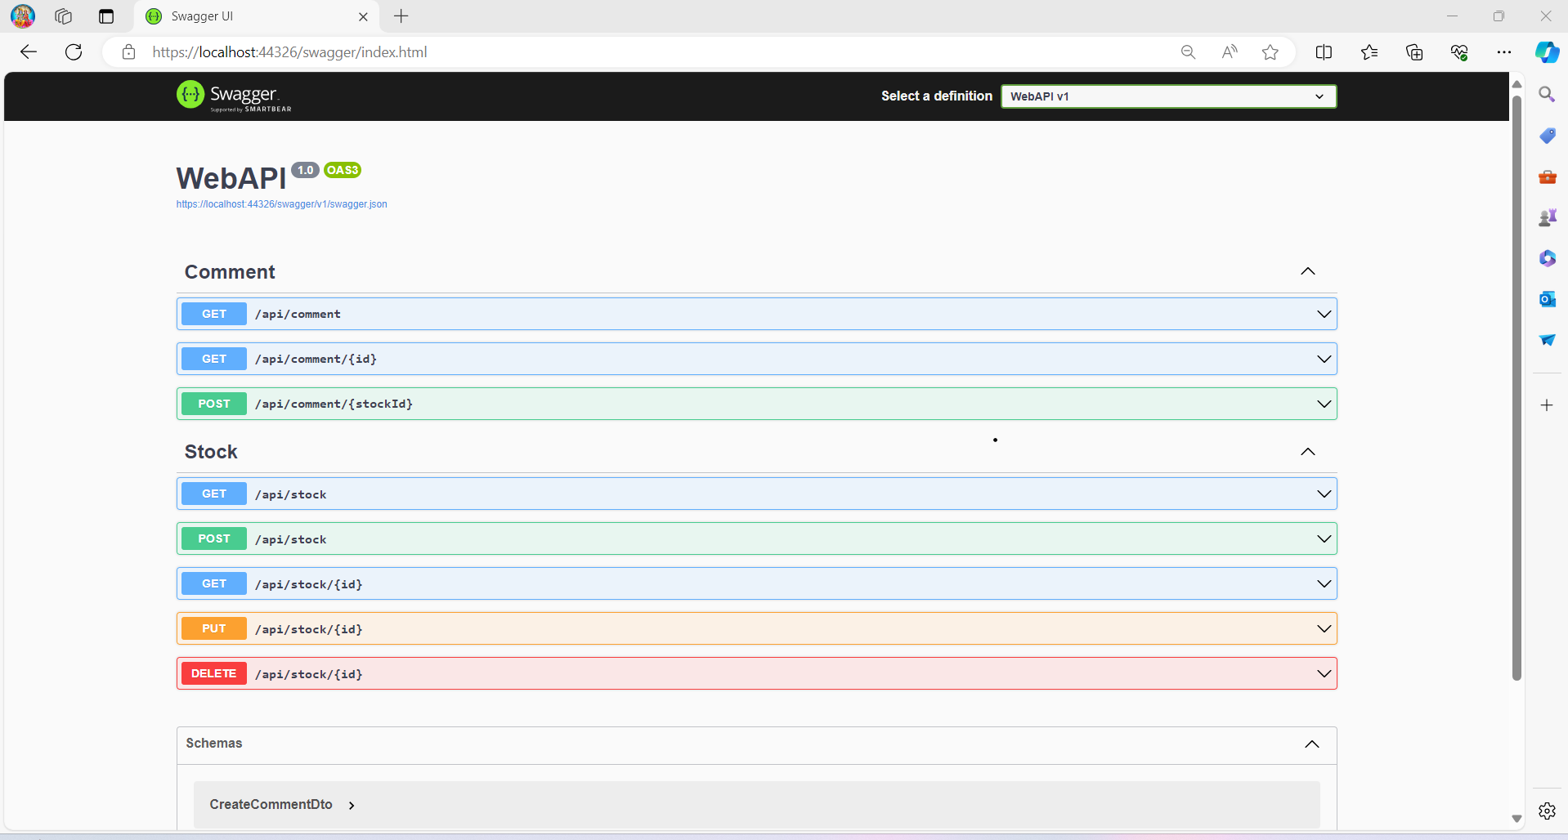
Activities Performed…
Figure: Web API

Slide 15
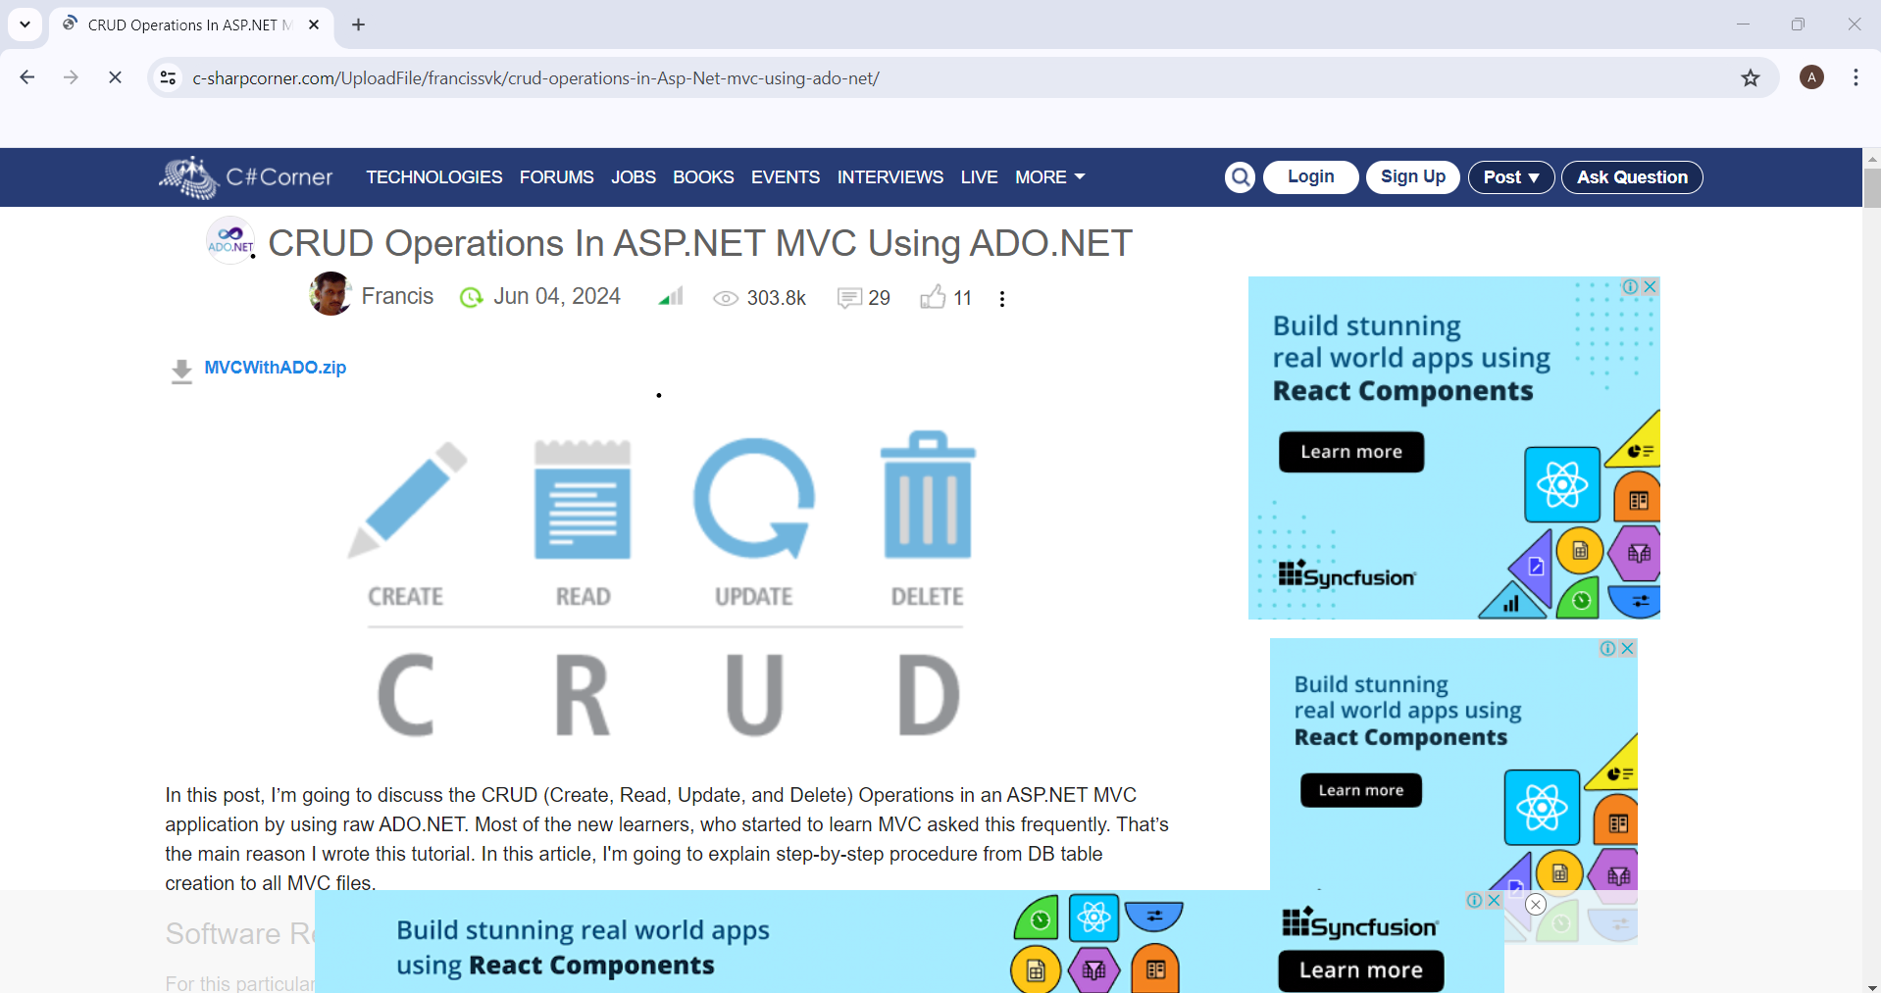
Research Site
URL: https://www.c-sharpcorner.com/UploadFile/francissvk/crud-operations-in-Asp-Net-mvc-using-ado-net/
Figure: CRUD Operation Documentation

Slide 16
Conclusion
The internship at Global-Tech Solution Pvt. Ltd has been immensely worthwhile. Organized tasks and a support environment facilitated valuable learning and skill development. The experience has been instrumental in shaping my future in the tech industry.

