Slide 1

Emergency Response System Using Dijkstra’s Algorithm In The Context of Kathmandu Valley
Presented By
Ankit Shrestha(23863/07)
Anusha Giri(23865/076)
Ritika Joshi(23883/076)
Supervised By
Er. Nipun Thapa

Slide 2
INTRODUCTION
Nepal’s healthcare system has major obstacles while reacting to emergencies, specially in the Kathmandu Valley.
This system seeks to close the gap between theoretical algorithms and real-world emergency management by doing significant research and practical implementation.
It offers a practical simulation by applying Dijkstra's algorithm to optimize ambulance routing and hospital allocation in the Kathmandu Valley.
By exploring the geographical and infrastructural complexities of Nepal, this study aims to contribute valuable insights to enhancing emergency response efficiency in regions with limited resources.

Slide 3
OBJECTIVES
To develop an emergency response system optimized for the unique topography and urban complexities of the Kathmandu Valley.
To implement advanced routing algorithms, improving ambulance response times by navigating congested urban areas and intricate road networks efficiently.
To enhance coordination among emergency services in the Kathmandu Valley, ensuring a timely and efficient response for improved patient outcomes.

Slide 4
SYSTEM ANALYSIS
Functional Requirement
User Location Display
Zone Classification
Nearest Ambulance Selection
Optimal Ambulance Route Calculation
Hospital Selection
Optimal Hospital Route Calculation
Simulation of Real-Time Visualization

Slide 5
SYSTEM ANALYSIS…
Non-Functional Requirement
Performance
Security
Usability

Slide 6
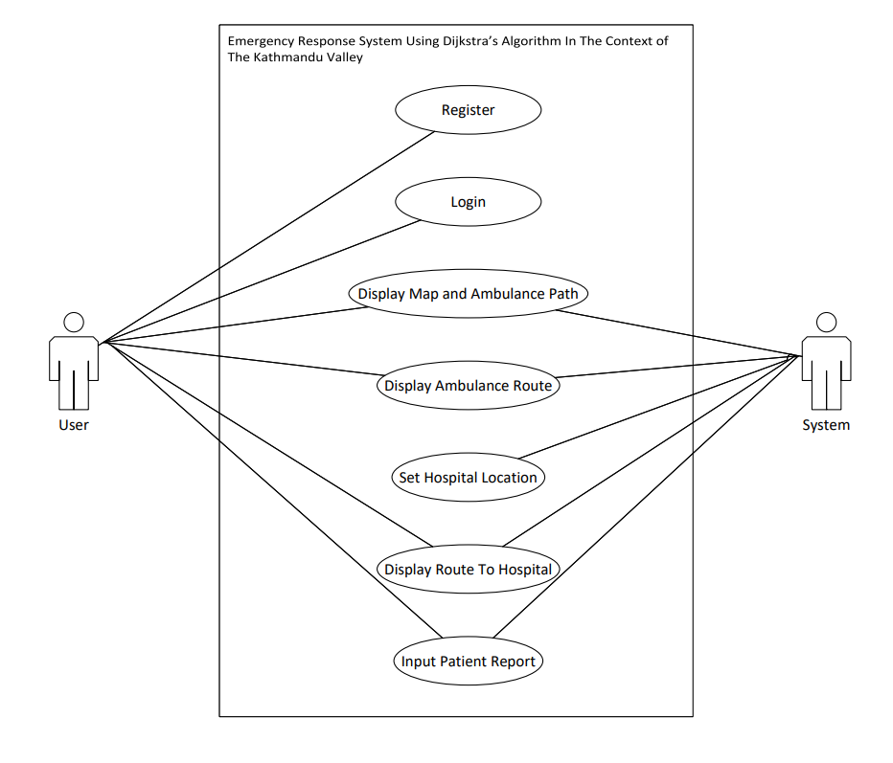
SYSTEM ANALYSIS…
Figure: Use Case Diagram

Slide 7
SYSTEM ANALYSIS…
Feasibility Analysis
Technical Feasibility:
Use of well-established web development technologies, including HTML, CSS, JS, Python, Flask, and SQLite, indicates a solid foundation for implementation.
Integration of the Leaflet API for mapping demonstrates a practical approach to handling location features, enhancing technical feasibility.
Operational Feasibility:
Focus on user-centric design and automated selection of the nearest ambulance enhances operational efficiency
Integration of ambulance, event, and hospital data from CSV files addresses operational needs.

Slide 8
SYSTEM ANALYSIS…
Economic Feasibility:
Reliance on widely used and open-source technologies suggests potential cost-effectiveness.
Leveraging the Leaflet API for mapping needs ensures a cost-effective approach.
Schedule Feasibility:
The provided WBS outlines a structured project plan with defined tasks, durations, and dependencies.
Allocation of realistic durations and consideration of dependencies indicate a thoughtful approach to schedule feasibility, aligning with the project's scope.

Slide 9
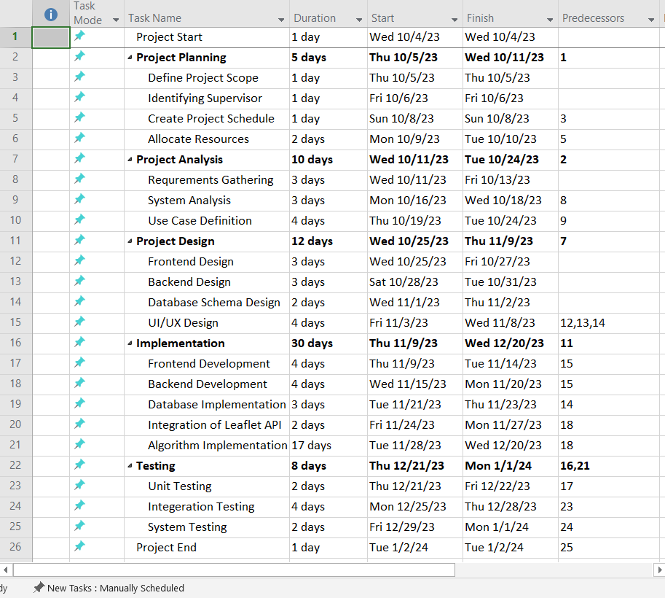
SYSTEM ANALYSIS…
Figure: Work Break Structure

Slide 10
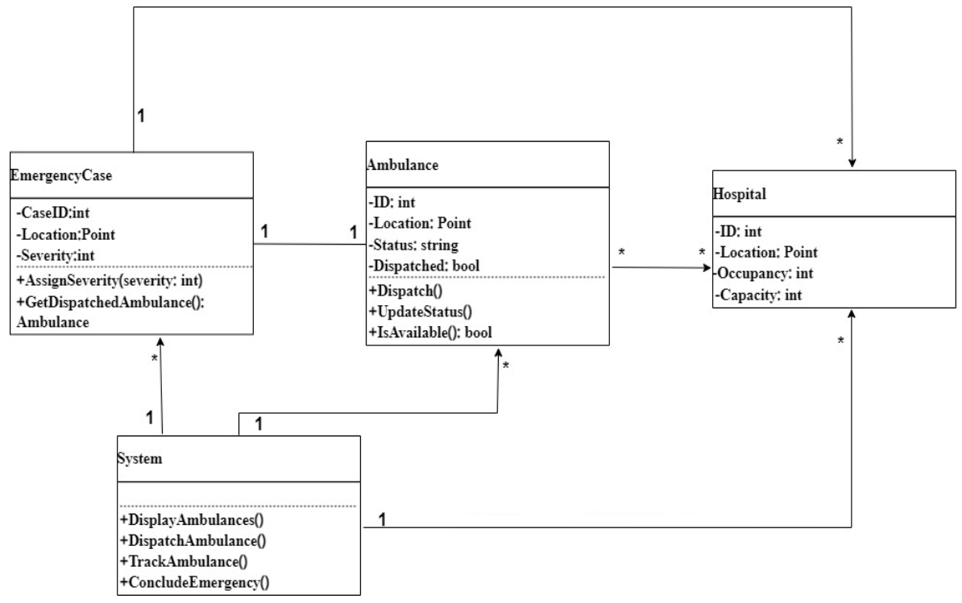
SYSTEM DESIGN
Figure: Descriptive Class Diagram of the system

Slide 11
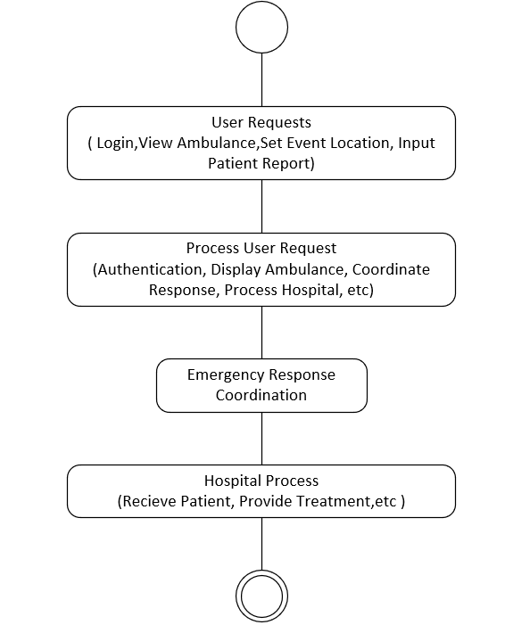
SYSTEM DESIGN…
Figure Activity Diagram of the system

Slide 12
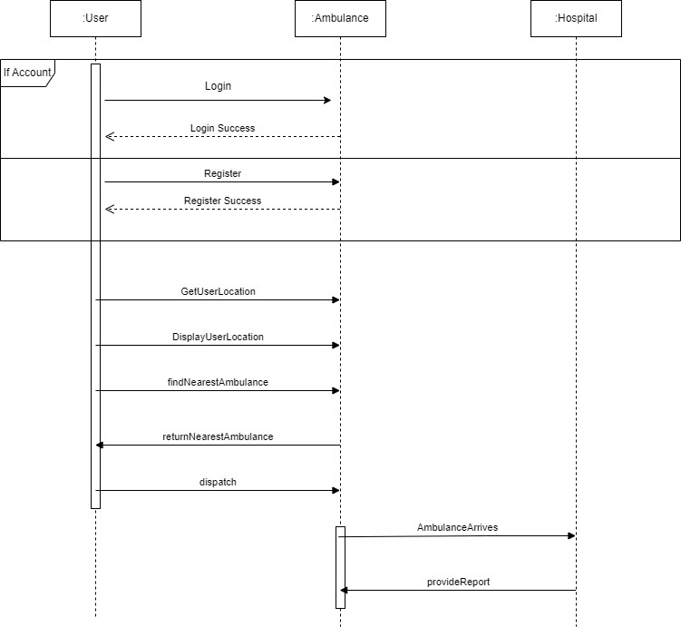
SYSTEM DESIGN…
Figure Sequence Diagram of the System

Slide 13
SYSTEM DESIGN…
Algorithm Details:
The system integrates three fundamental components to optimize ambulance routing and ensure efficient emergency response.
Zone Classification and Priority Determination
Process of dividing geographical locations into separate zones.
Based on ambulance service demand, population density, and access to healthcare facilities.
It enables emergency response systems to better distribute resources.

Slide 14
SYSTEM DESIGN…
Zone Classification and Priority Determination
Red Zone (High Priority):
Identifies based on highest demand for ambulance services.
It can be typically due to a high volume of emergency incidents .
Blue Zone (Medium Priority):
Represents regions with a moderate demand for ambulance services.
This is because emergency incidents occur less frequently compared to red zones.
Green Zone (Low Priority):
Regions with minimal demand for ambulance services,
It can be due to fewer emergency incidents or lower population density.

Slide 15
SYSTEM DESIGN…
Haversine Formula:
It calculates the distance between two points on the Earth's surface.
The Haversine Formula is based on spherical trigonometry.
Provides an accurate approximation distance between two locations, considering the Earth as a sphere.
It determines distance of accident event locations, ambulance positions, and hospitals.

Slide 16
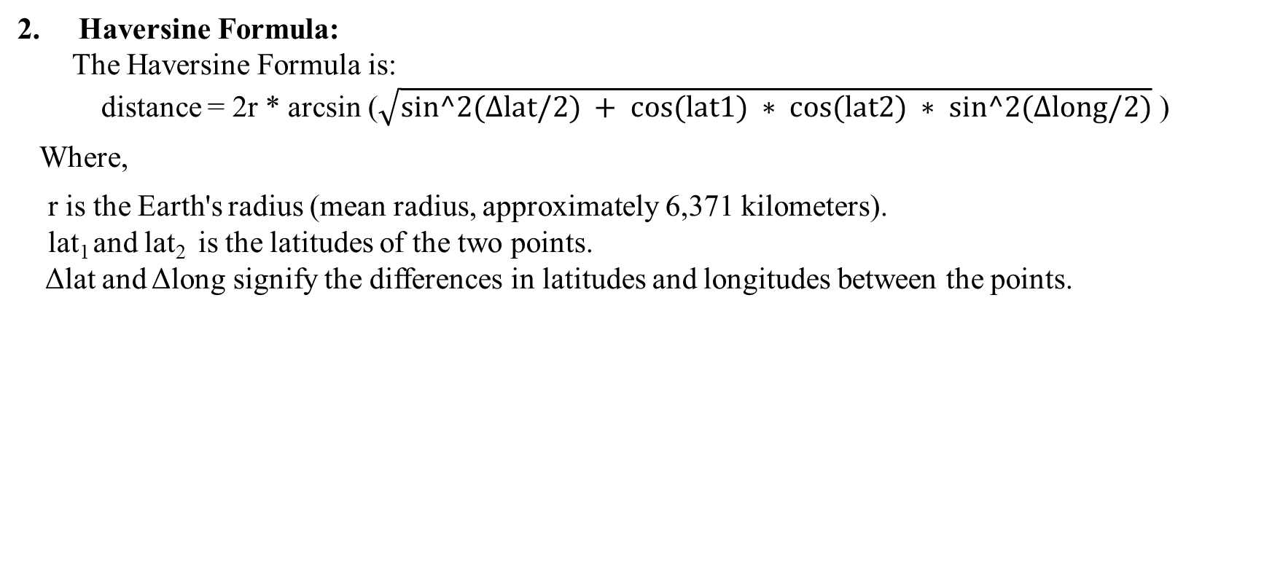
SYSTEM DESIGN…
Haversine Formula:
The Haversine Formula is:
distance = 2r * arcsin ($\sqrt{sin^2(Δlat/2) + cos(lat1) ∗ cos(lat2) ∗ sin^2(Δlong/2)}$ )
Where,
r is the Earth's radius (mean radius, approximately 6,371 kilometers).
lat₁ and lat₂ is the latitudes of the two points.
Δlat and Δlong signify the differences in latitudes and longitudes between the points.

Slide 17
SYSTEM DESIGN…
Dijkstra’s Algorithm:
Dijkstra's algorithm is a graph traversal algorithm.
It finds the shortest path between nodes in a graph.
The algorithm begins at a specified starting node.
Then iteratively explores neighboring nodes, updating distances and marking visited nodes.
The algorithm terminates when it has visited all nodes or when it finds the shortest path to the destination node.

Slide 18
SYSTEM DESIGN…
3. Dijkstra’s Algorithm:
Key Components:
Priority Queue (Q):
Select the node with the smallest tentative distance for exploration in each iteration.
Distance Array (dist):
Stores the tentative distances from the start node to each node
It is initialized with infinity for all nodes except the start node, which is set to 0.

Slide 19
SYSTEM DESIGN…
3. Dijkstra’s Algorithm :
Adaptability:
Dijkstra's algorithm adapts well to dynamic scenarios.
This makes it suitable for real-time applications.
It consistently explores and updates the shortest paths.
Such as road closures or traffic updates.
Optimality:
It always selects the node with the smallest tentative distance.
It guarantees once a node is marked as visited, its distance is finalized, ensuring the shortest path.

Slide 20
IMPLEMENTATION AND TESTING
Implementation
Tools Used:
Front End:
HTML5
CSS3
Bootstrap5
JavaScript
Back End:
Python(Flask)
SQLite(V3)

Slide 21
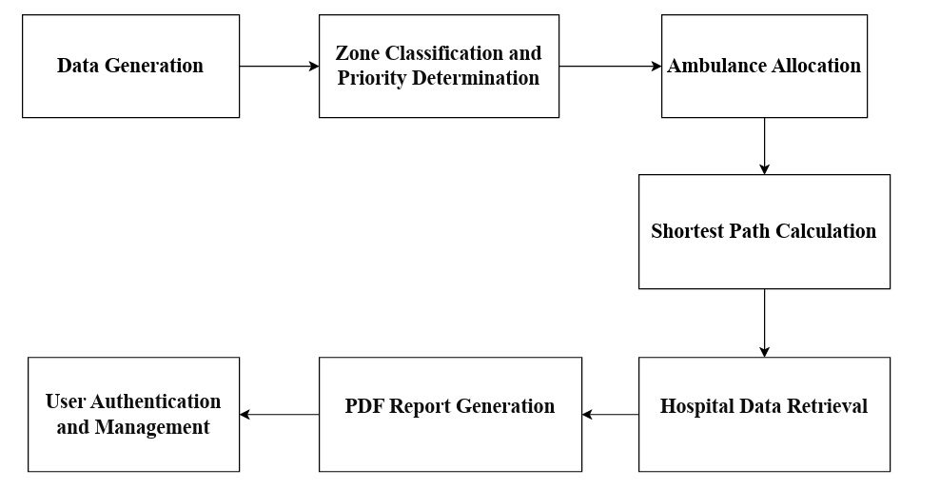
IMPLEMENTATION AND TESTING…
Implementation Detail:
Figure: Algorithm Implementation Procedure

Slide 22
IMPLEMENTATION AND TESTING…
Testing:
Three testing approaches: unit testing, interaction testing, and system testing.
Each step was carefully prepared to test the emergency response system's dependability and performance at various levels of integration.
Based on the testing conducted, the emergency response system achieved an efficiency rate of 88%.
Result Analysis:
Task | Time(Seconds)
Response Time Calculation | 15
Routing Efficiency Analysis | 15
Nearest Location Calculation | 10
Resource Utilization Assessment | 0.5
Total Execution Time | 135

Slide 23
DEMONSTRATION

