Slide 1
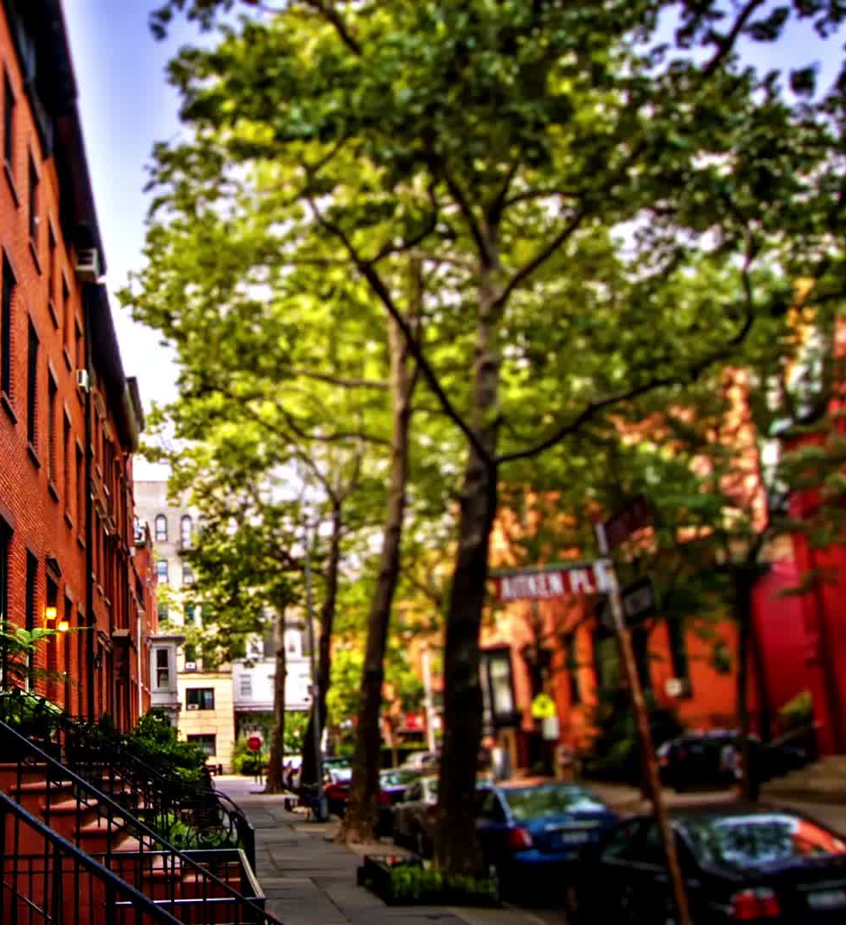
NYC Street Tree Health Analysis
What factors are associated with the health of NYC street trees?
Capstone Project
Sumit Shrestha
CUNY LaGuardia Community College

Slide 2
Goal & Motivation
NYC street trees provide environmental and community benefits.
Tree health can vary across different areas of the city.
This project looks for patterns in tree health.
Research question: What factors are associated with the health of NYC street trees?

Slide 3
Data Source
Source: NYC Open Data — 2015 Street Tree Census
Original dataset contains information about NYC street trees.
Data includes tree health, diameter, species, borough, and other characteristics.
100,000 records were imported for this project.
After cleaning: 94,811 trees
Final analysis used 9 variables.

Slide 4
Data Cleaning & Methodology
Cleaning
Selected relevant columns.
Removed non-living trees.
Removed missing health and borough values.
Removed trees with zero diameter.
Transformations
Cleaned text columns.
Created tree size categories.
Created a healthy-tree indicator.
Analysis
Descriptive statistics
Bar charts
Percentage comparisons
Chi-square test

Slide 5
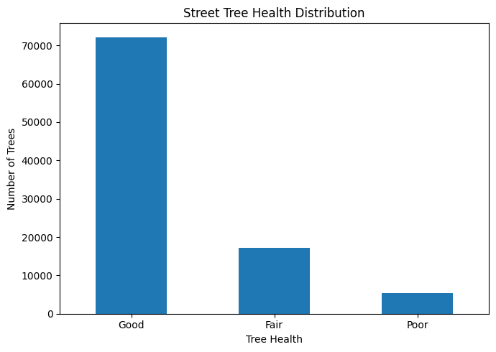
Overall Tree Health
Health Distribution
Good: 76.13%
Fair: 18.19%
Poor: 5.68%
Median diameter
Good: 10 inches
Fair: 10 inches
Poor: 7 inches

Slide 6
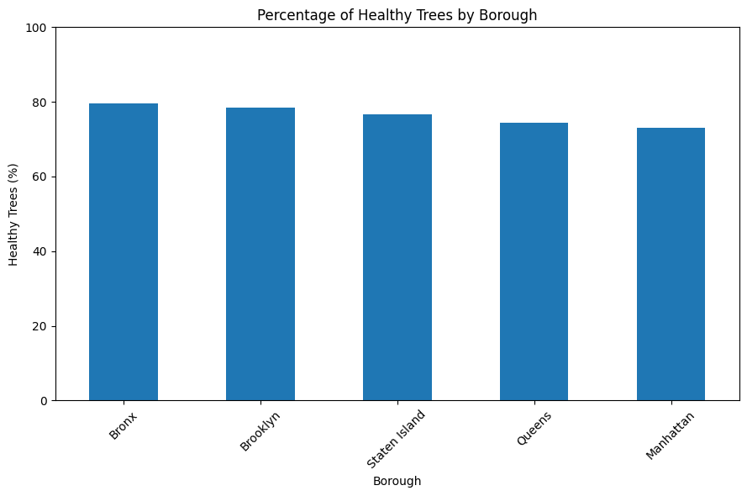
Main Finding: Tree Health by Borough
Percentage of Healthy Trees
Bronx: 79.58%
Brooklyn: 78.49%
Staten Island: 76.58%
Queens: 74.46%
Manhattan: 73.07%
Chi-square test:
χ² = 402.81
p < 0.001
Result: Borough and tree health have a statistically significant association.

Slide 7
Conclusion
Tree health varies across NYC boroughs.
The Bronx had the highest percentage of healthy trees.
Manhattan had the lowest percentage.
Borough and tree health showed a statistically significant association.
Poor-health trees had a lower median diameter.
Association does not mean causation.
Limitation:
The analysis uses 100,000 records from the 2015 dataset and does not represent current tree conditions.
Source: NYC Open Data, 2015 Street Tree Census — Tree Data
Official NYC Open Data Dataset

