Slide 1
Rent Space

Slide 2
Background
“RentSpace” mainly focuses on establishing the platform to exchange information about rental space through various posts and advertisements on the application
It provides an extended knowledge about the facilities of the space based on the reviews and comments of the previous owners and landlords.
Increasing population growth and urbanization with increasing demands for rental space
Inconvenient way of searching all around the place

Slide 3
Objectives:
Provide a common platform to ease with the rental space searching and ensuring the best rental space suiting the needs of the seeker.
Lease and rent spaces based on location and price.
To learn the concepts of android development, database management system.

Slide 4
Tools required:
Software Specifications
• For Android User
1. OS: API level higher or Froyo version
• For Development
1. 32 or 64-bit OS
2. Firebase Real-time Database
3. Android Studio
4. Web Browser
Hardware Specification
For Android User
1. RAM: minimum 512MB
2. Memory: minimum 50MB space
For Development
1. RAM: 3GB minimum, 8GB Recommended
2. Memory: 2 GB of available disk space minimum,4 GB recommended

Slide 5
Related works:
Problems in finding rental space for tenants, over the years
Problems for landlords in finding appropriate tenants, thus leaving rooms unnecessarily vacant

Slide 6
Gharbeti
It is a web portal designed to reshape the conventional pattern of rental solution for building, flat, room, space, apartment, hostel
Allows people to search and book properties from available property list via online presence.
It offers clients to set preferences for location as well as budget, as per their need.

Slide 7
Ropani
It provides comprehensive detail on real estate properties which are for sale or rent, including current news and information about real estate market.
Ropani.com brings together property information- location, price, pictures, interactive maps and property features through dynamic website, mobile interface and SMS
It to overcome the limitation of traditional method of real estate advertisement, like newspaper, brochures, leaflets or other forms of mass media, which are confined to limited time, space and audience.

Slide 8
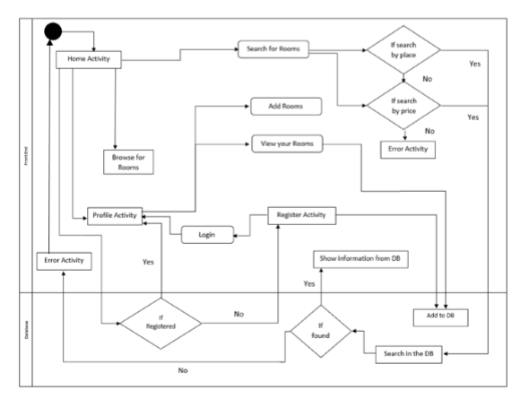
System diagrams
Fig: System Flow Diagram

Slide 9
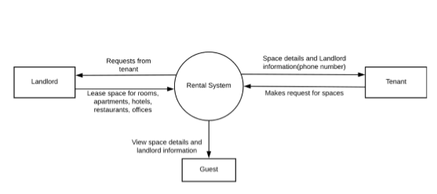
Fig: Context Diagram

Slide 10
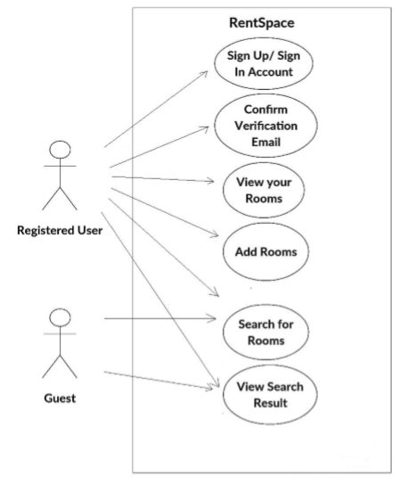
Fig: User Case Diagram

Slide 11
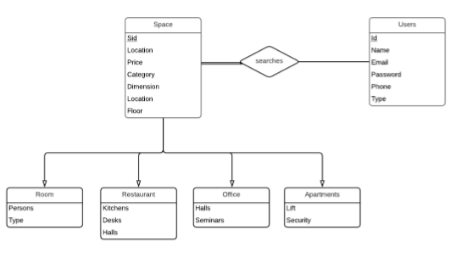
Fig: Entity Relationship Diagram

Slide 12
Major Features
Posting Advertisements for Rental Space(as a landlord)
Category based search
Location based search
Price based search

Slide 13
Limitations
• The use of firebase database system as our main database restricted us to perform our main searching query only on one keyword at a time, rather than multiple keywords.
• Some dynamism to the application, including comment section, user reviews, and ratings will be added in the coming versions.

Slide 14
Future plans
Integrate map
Advanced query searching
Dynamic System
More Interactive UI

Slide 15
Testing and Debugging
The beta version of this application was thoroughly tested on all separate versions of android for compatibility and bugs
Encountered bugs were successfully removed with necessary cautions and preventions.

Slide 16
Conclusion
The project concluded with most of its objectives fulfilled, a user friendly android application, location and price based search, guest mode of surfing
Context based development of the application, especially for Kathmandu and Dhulikhel, wii be our future enhancement to this application

Slide 17
Thank You

