Slide 1
Self Diagnosis
Project Members:
Bipin Bohara (10) Jasmin Karki (23) Divash Ranabhat (42) Kamal Shrestha (49)

Slide 2
Introduction
Machine learning based project that helps users to predict the risk of the disease by analysing the available data set given to the machine
Predicts how much the disease is likely to occur analysing the previously recorded diagnosis.
Help patients analyse the disease forehand and take necessary preventions before consulting any medical professionals

Slide 3
Motivation
Late diagnosis
Negligence
Unhealthy diet
Expensive medical procedure
Long Queues
Carelessness/Wrong diagnosis treatment

Slide 4
Objectives:
Predicting diseases and sub diseases with 75% to 80% accuracy based on the preliminary symptoms from patients.
Guessing the risk of obtaining Hepatitis and Diabetes by Computer Aided Diagnosis
To get familiar with Data Analysis and Machine Learning using Python Development Environment and its libraries

Slide 5
Features
Disease prediction is based upon the underlying symptoms and medical test results of the patients
User will be able to list out their preliminary symptoms and tests for a specific disease and know if they might be suffering from that certain disease or not

Slide 6
Related Works
Heart Disease Prediction System using Naive Bayes(Arun R, 2018)
Uses Naive Bayes Algorithm to anticipate probability of getting a disease
To model Heart Disease Expectation System (using Decision Trees, Naive Bayes, Neural Network)
Uses Advanced Encryption Standard(AES) to encrypt for securing unclassified data
2) Automated Disease prediction System(ADPS) (Rashid, 2016)
Relies on user input and provides a list of topmost disease
User inputs are Symptom name, Time, Intensity, Organ Name, Duration
The input then is fed to the database to find a match from the existing disease

Slide 7
General Disease Prediction System(GDPS) (Shratik J Mishra, 2018)
This system focuses on identifying disease at earliest phase to avoid unwanted casualties
Uses Data Mining Techniques and ID3(Iterative Dichotomiser 3) to predict disease based on user input symptoms
Predicts most possible disease based on given symptoms and precautionary measures to avoid aggression of disease
Disease Predictor: A Disease Prediction App (Bharat, Gandhi, 2017)
Helps user to diagnose disease in real time using various symptoms through a given list
Symptoms selected are processed to take out chances of a disease to occur(multiple disease different %)
Detailed Explanation of the disease and the next steps to be taken to prevent disease without going to the doctor are given
Creates an alert in regular time interval to ensure whether user has followed the steps post the diagnosis

Slide 8
Disease Prediction Using Machine Learning Over Big Data (Vinita S, 2018)
This journal helps solve risk organization based on Big Data analysis
It shows disease and sub disease
First system uses Decision Tree map algorithm to generate pattern and cause of disease Second, by using Map Reduce Algorithm for sub disease

Slide 9
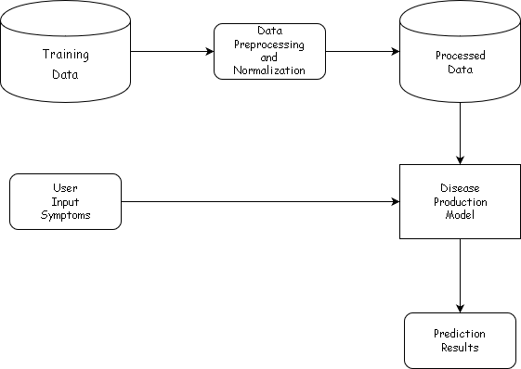
Block Diagram

Slide 10
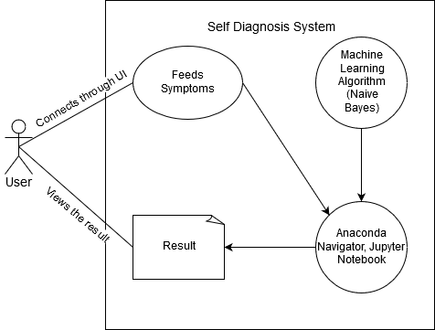
Use Case Diagram

Slide 11
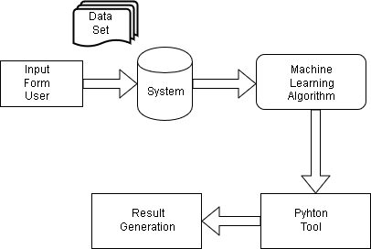
Flow Chart

Slide 12
METHODOLOGY

Slide 13
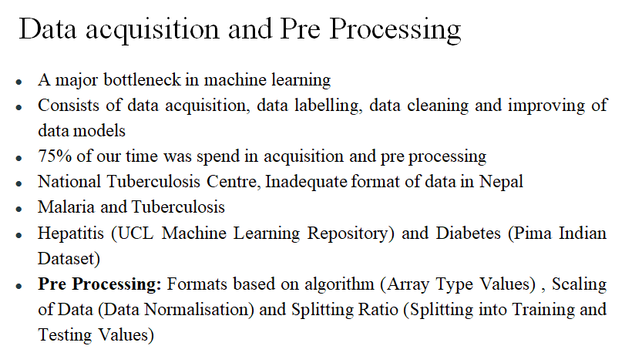

Slide 14
Naive Bayes Algorithm
BAYESIAN ALGORITHM
is an intuitive method that uses the probabilities of each attribute belonging to each class to make a prediction
simplifies the calculation of probabilities by assuming that the probability of each attribute belonging to a given class value is independent of all other attributes.
is a strong assumption but results in a fast and effective method
is often described using categorical data because it is easy to describe and calculate using ratios

Slide 15
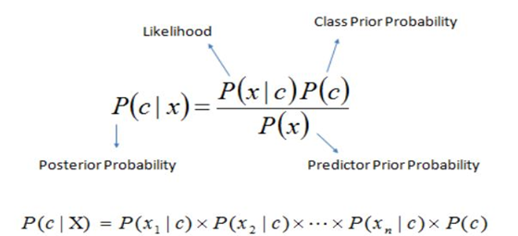
P(c|x) is the posterior probability of class (target) given predictor (attribute).
P(c) is the prior probability of class.
P(A|B) = P(A ^B)/P(B)
P(A^B) = P(A|B).P(B) – also known as Chain Rule

Slide 16
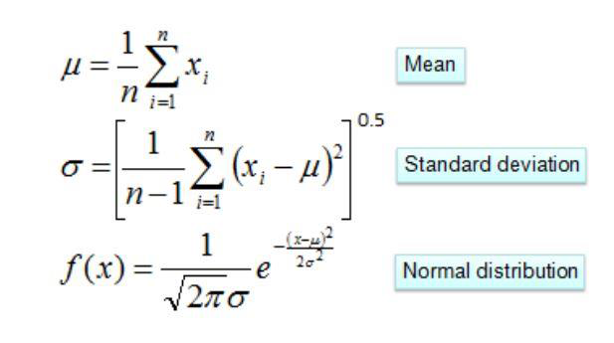

Slide 17
Algorithm
Step 1: Handle Data:
Step 2: Summarize Data:
Step 3: Make a Prediction:
Step 4: Make Predictions:
Step 5: Evaluate Accuracy:
Step 6: Tie it together:

Slide 18
Applications of Naive Bayes algorithm
Naïve Bayes Text Classification
Disease Prediction along with including mapping algorithm, random forest and decision tree
Spam Filtering
Recommendation System
Online applications like Emotion Modelling

Slide 19
Data Visualization

Slide 20
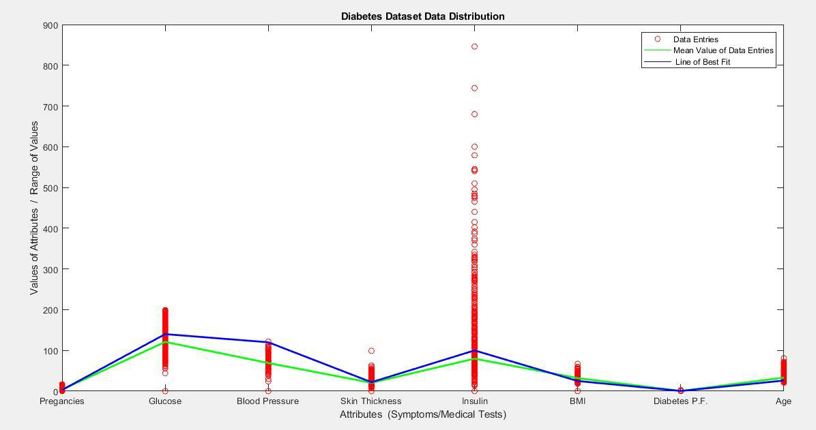

Slide 21
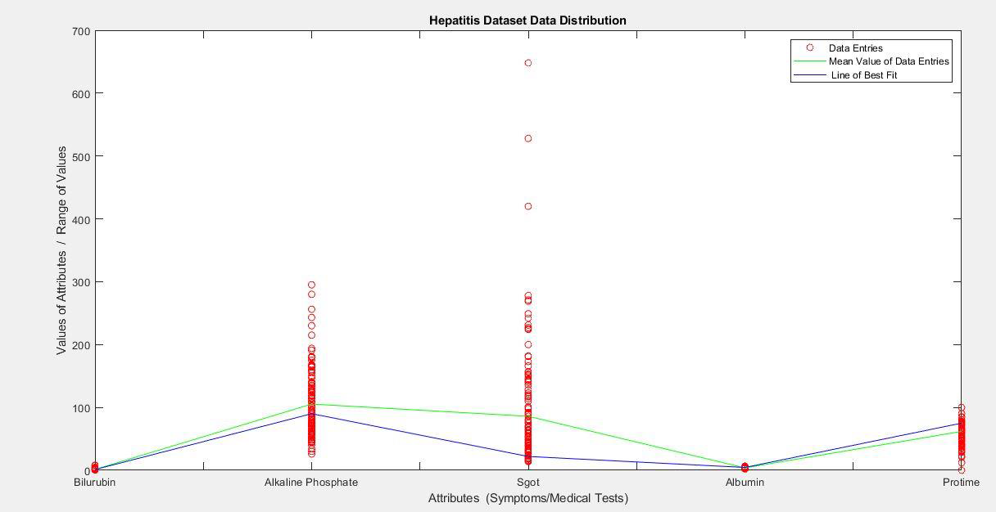

Slide 22
Result
Accuracy for Hepatitis is calculated to be 77.41935% (+/- 2%)by splitting the dataset into 70-30 split ratio (ideal 82% with 10 folds cross validation, 80% with Splitting the training ratio in 70-30 ratio calculated using WEKA tool for the same dataset).
Accuracy for Diabetes is calculated to be 76.30283%(+/- 2%)by splitting the dataset into 70-30 split ratio (ideal 77.47% accuracy using the best performing algorithm “Logistic Regression” and 81.5% accuracy using WEKA tool experimenter )

Slide 23
Metrics of Result Evaluation: Confusion Matrix
is a table that is often used to describe the performance of a classification model (or "classifier") on a set of test data for which the true values are known.
 | Predicted YES | Predicted NO
Actual YES | False Positive(FP) | False Positive(FP)
Actual NO | False Negative(FN) | True Negative(TN)

Slide 24
HEPATITIS:
Hepatitis | Predicted YES | Predicted NO
Actual YES | TP=27 | FP=5
Actual NO | FN=30 | TN=93
DIABETES:
Diabetes Confusion Matrix | Predicted YES | Predicted NO
Actual YES | 421 | 79
Actual NO | 103 | 165

Slide 25
Percentage Accuracy:
Accuracy for Hepatitis Dataset: (27+93)/155=0.7741935
Accuracy for Diabetes Dataset: (421+165)/768=0.763020
Recall = TP/(TP+FN)
What proportion of actual positives was identified correctly?
it is the number of positive predictions divided by the number of positive class values in the test data.
It is also called Sensitivity or the True Positive Rate.
Recall for Hepatitis Dataset: 0.4736
Recall for Diabetes Dataset: 0.8034

Slide 26
Precision = TP/(TP+FP)
What proportion of positive identifications was actually correct?
Precision can be thought of as a measure of a classifiers exactness. A low precision can also indicate a large number of False Positives.
Precision for Hepatitis Dataset: 0.843
Precision for Diabetes Dataset: 0.842
F1 Score=(2*Precision *Recall)/(Precision + Recall)
F1 score conveys the balance between the precision and the recall.
F1 Score for Hepatitis Dataset: 0.606 F1 Score for Diabetes Dataset: 0.822

Slide 27
Result Interpretation:
With the accuracy of 77% or 76% approx. in Hepatitis and Diabetes respectively, also based on the symptoms of the individual entry we can successfully predict whether the person might or might not suffer from the given disease with the give accuracy.
For example: For person A with symptoms from 1-9 (attributes), in Hepatitis evaluation, if the result is shown positive for a determining class value, we can say that the person A will be suffering from Hepatitis with 77% accuracy.

Slide 28
Error Analysis
Missing data were either deleted (the entire entry) or randomly filled either using the concept of normal distribution, mean and standard deviation or scaling down with mean value compared to the minimum or maximum or simply median value.
most influencing attributes has a huge variation gaps from the lowest to the highest and a diverse standard deviation from the mean
Insufficient amount of data for proper training set
Inconsistency in data

Slide 29
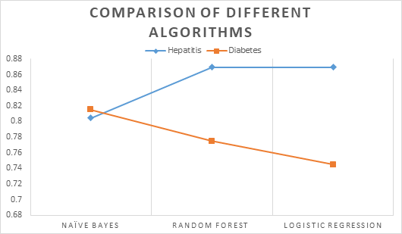
Discussion on Achievements

Slide 30
Project | Algorithms | % Accuracy
Self Diagnosis | Naive Bayes | 76.30%
References | Naive Bayes (10 folds Cross Validation) | 81.02%
 | Keras | 78.52%
 | Two Class Logistic Regression | 78.00%
 | SVC | 76.43%
 | Random Forest Classifier | 77.21%
 | LDA | 76.30%

Slide 31
Limitations:
Noisy & Sparse Data Set
Use of only one algorithm (Naive Bayes Algorithm(70-30 split ratio) with two class classifier)

Slide 32
Future Enhancements:
Proper Data Collection
Tackling Missing values (Random Forest, LR, KNN, Decision Tree)
Weighted Attributes Selection
Diagnose many diseases
Focus on UI
Add recommendation

Slide 33
Conclusion
Objectives met
Found room for improvement (Multiclass Classifier)

Slide 34
Thank You

