Slide 1

A Proposal Defense on Online Hospital Appointment Booking System
Presented By:
Amisha Bhattarai Chhettri
Bigyan Paudyal
Om Prakash Shrestha
Supervised By:
Dhiraj K. Jha

Slide 2
Introduction
Web-based system for hospital appointment management
Enables patient registration, login, and appointment booking
Allows doctor search by specialization and availability
Supports patient, doctor, and administrator modules
Improves hospital workflow efficiency and service delivery
Designed using secure, scalable web technologies
Uses database-driven architecture for reliable data management

Slide 3
Background
Many hospitals rely on manual appointment processes
Manual systems cause long queues and mismanagement
Existing online systems focus on basic booking
Most systems assume literate and tech-savvy users
Semiliterate users face language and navigation difficulties
Limited support for medical history and reporting
Clear gap for accessible, scalable digital solution

Slide 4
Literature Review (Existing Systems)
Studies address inefficiencies of manual hospital appointments [1][4]
Web-based systems improve scheduling efficiency and reduce waiting [1][5]
Patients can register, view doctors, and book appointments [1][4]
Doctors manage schedules and patient information digitally [4][5]
Administrators handle users, appointments, and reporting tasks [1][5]
Technologies include Angular, PHP, Python, Spring Boot, MySQL [1][4][5]
OOAD and UML widely used for system design [1][4]

Slide 5
Literature Review (Findings & Gaps)
Online systems significantly reduce queues and paperwork [1][3][5]
Appointment efficiency improved during high patient inflow [3][5]
National systems show increased adoption and reduced waiting [3]
Most systems focus on functional efficiency, not inclusivity [2][4]
Semiliterate users face usability and navigation challenges [2]
Limited emphasis on accessibility and user-centered interfaces [2][5]
Gap exists for inclusive, adaptable appointment management system [2][5]

Slide 6
Objectives
To be able to design and develop a web-based system that allows patients to register, log in, search doctors by specialization, and book or cancel appointments in real time.
To be able to implement a secure backend with role-based access for patients, doctors, and administrators to ensure proper login, access control, and data safety.
To be able to store, retrieve, and manage patient, doctor, and appointment records, and generate basic reports such as daily appointments and doctor availability.

Slide 7
Software Process Model
Project follows Agile software development methodology
Scrum framework applied within Agile approach
Development divided into short, iterative sprints
Continuous feedback incorporated after each sprint
Incremental feature development and testing approach
Allows requirement changes during development phases
Improves collaboration, flexibility, and delivery quality

Slide 8
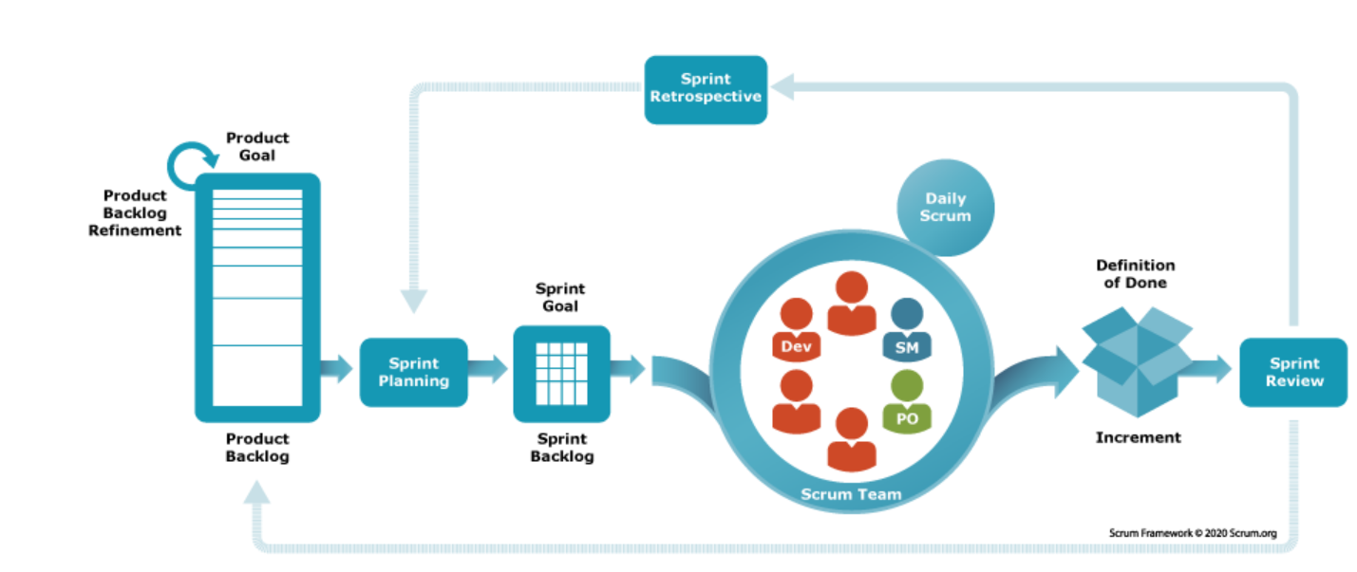
Figure: Scrum Framework

Slide 10
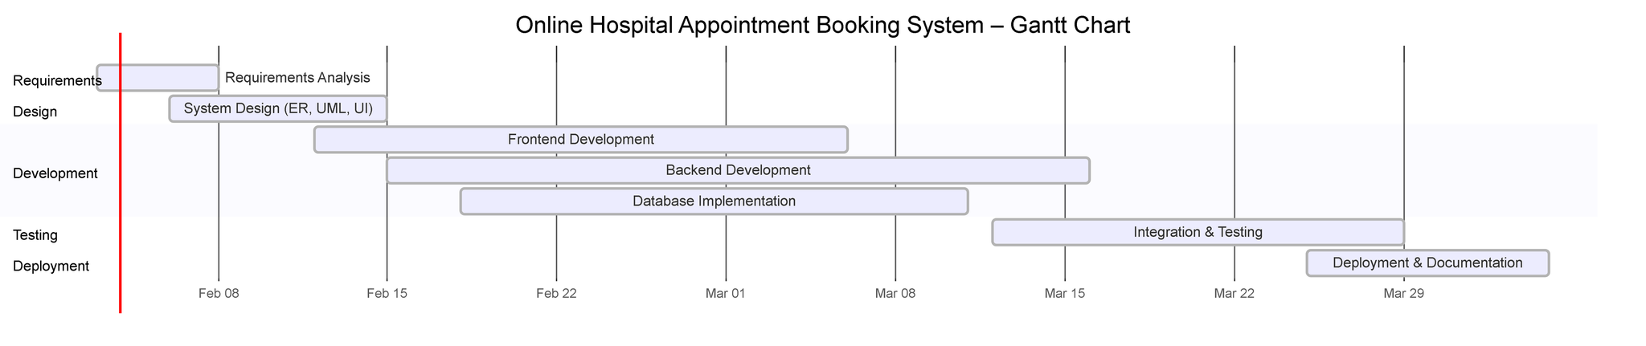
Gantt Chart

Slide 11
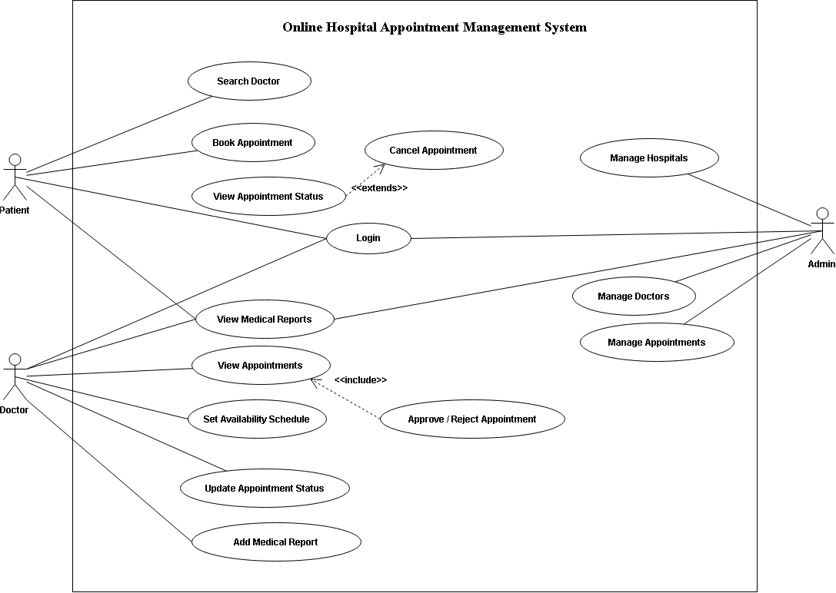
Use Case Diagram

Slide 12
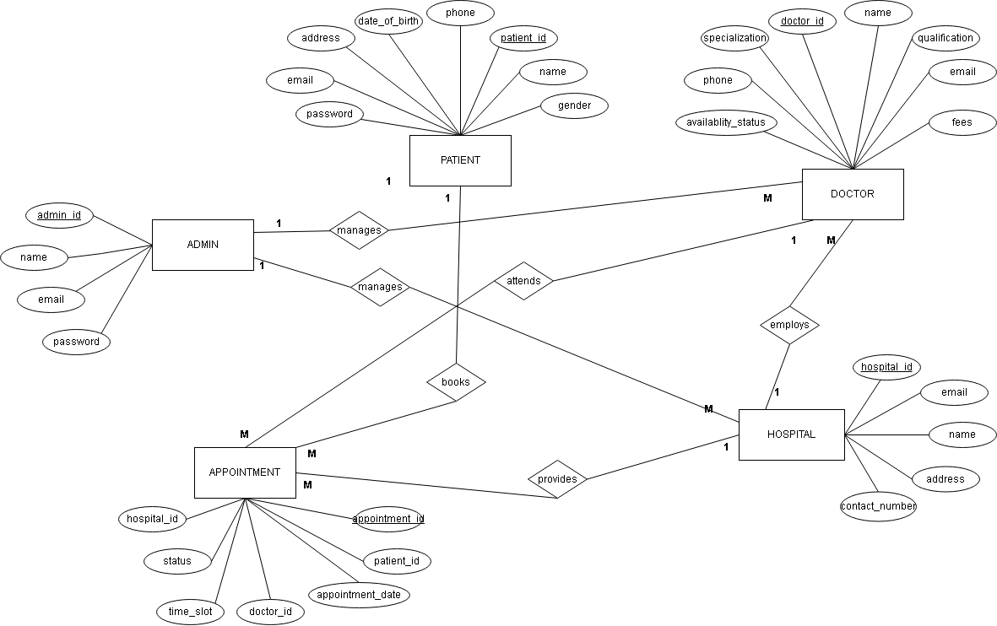
ER Diagram (Core Entities)

Slide 13
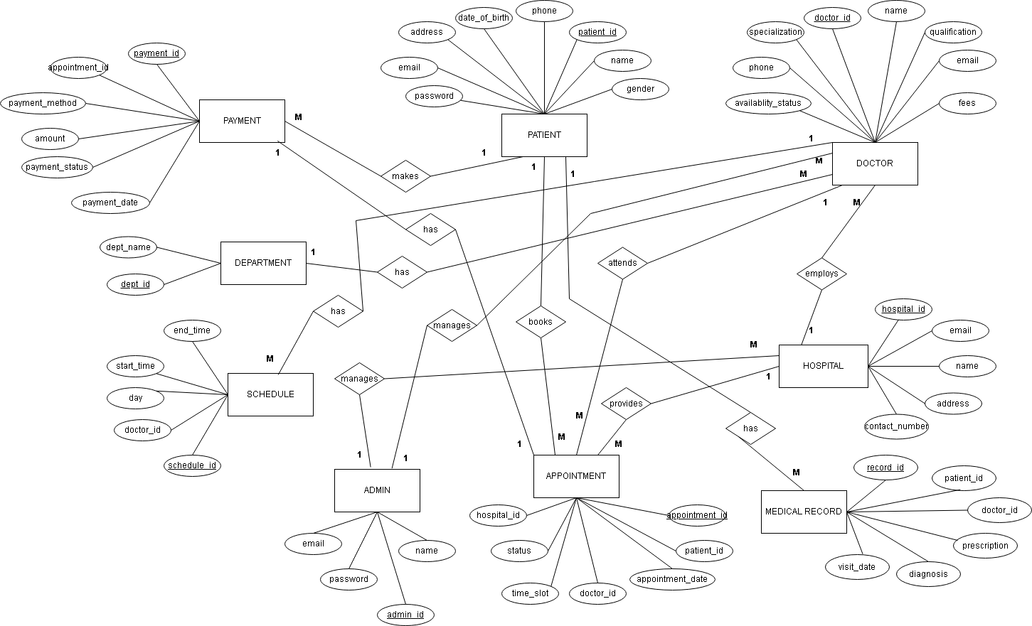
ER Diagram (Advanced Features)

Slide 14
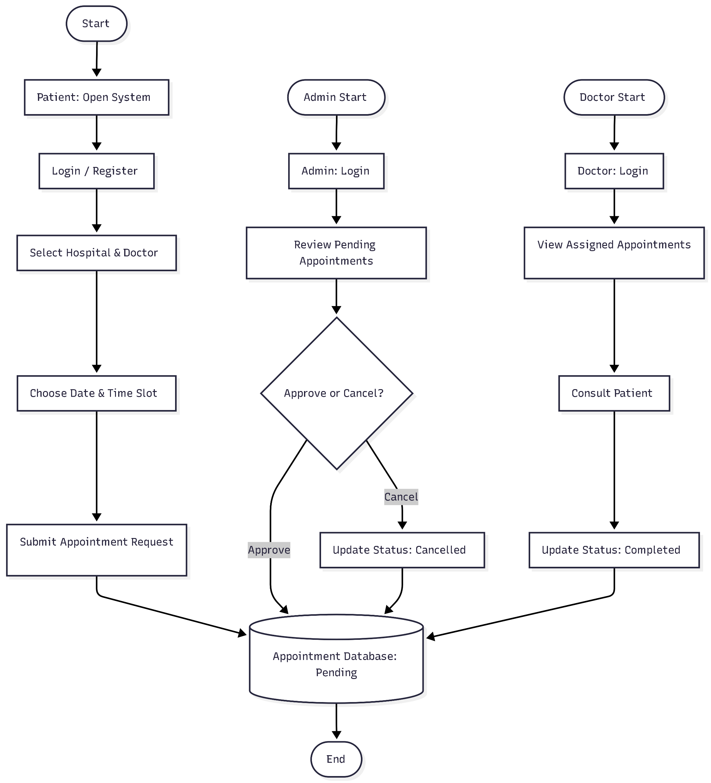
System Flow Diagram

Slide 15
Why Doctor Recommendation Is Needed?
Many patients do not know specific doctors
Patients often know only:
--Symptoms
--Required department
Manual searching is:
--Time Consuming
--Confusing for first time users
Intelligent recommendation mechanism is required to guide patients.

Slide 16
Content-Based Ranking (Algorithm)
Recommend/prioritize items by comparing their attributes
Each doctor is evaluated based on profile attributes
System calculates a relevance score
Doctors are sorted by highest score
Factors:
-Specialization match
- Experience
-Availability
-Hospital location

Slide 17
Data Processing ( Input-Processing-Output)

Slide 18
Input – Data Entering the System
Patient Inputs
-Registration & login details
-Doctor/hospital details
-Disease / Symptoms
-Preferred date & time
-Appointment request

Slide 19
Input – Data Entering the System
Doctor Inputs
-Login details
-Availability Schedule
-Appointment approval / rejection
-Prescription
-Medical remarks

Slide 20
Input – Data Entering the System
Admin inputs
-Hospital details
-Doctor details & assignment
-System management actions (adding, updating or removing)

Slide 21
Processing (what the system does with the data)
Authentication & Authorization Processing
-Validates user credentials
-Identifies user role
-Manages session securely

Slide 22
Processing
Doctor Ranking (Content-Based Processing)
Each doctor is assigned a recommendation score based on:
-Specialization match
-Years of experience
-Patient ratings
-Availability of time slots

Slide 23
Processing
Appointment Processing
-Checks doctor availability
-Prevents double booking
-Stores appointment request
-Set initial appointment status as Pending
-Sends notification to doctor

Slide 24
Processing
Doctor Decision Processing
-Doctor approves or rejects appointment
-System updates appointment status: Approved / Rejected

Slide 25
Output (What the System Produces)
Patient Outputs
-Recommended doctors list (if doctor unknown)
-Available appointment slots
-Appointment confirmation & status update
-Medical reports and prescriptions
- Appointment history

Slide 26
Output
Doctor Outputs
-Daily appointment schedule
-Patient details and medical history
-Appointment requests list
-Consultation records summary

Slide 27
Output
Admin
-Hospital and doctor records
-Appointment statistics
-System activity reports

Slide 28
Final Outcome

Slide 29
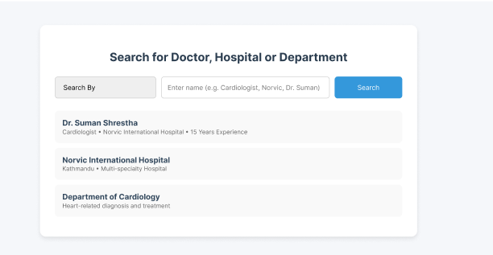

Slide 30
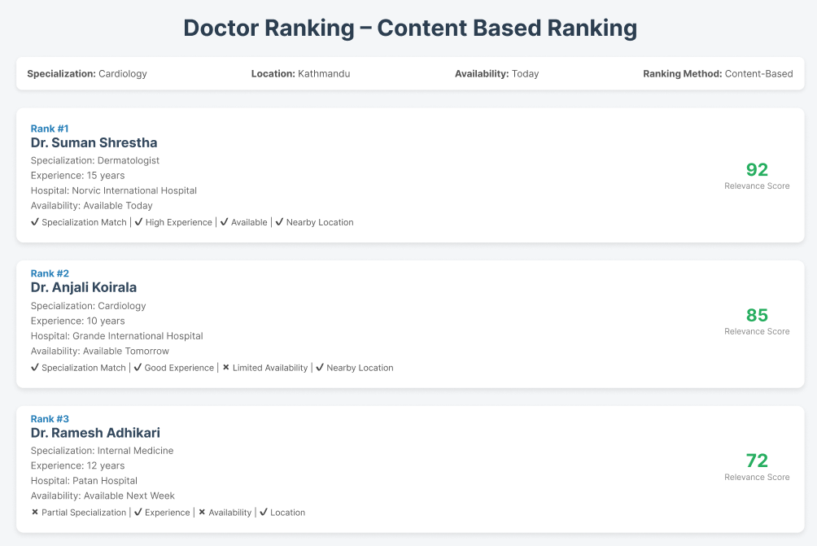

Slide 31
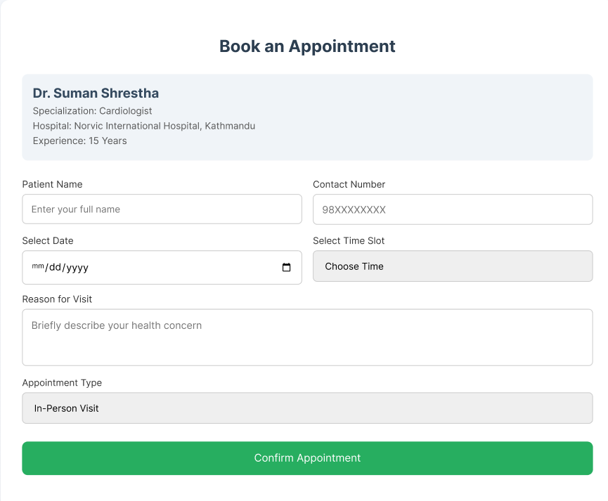

Slide 32
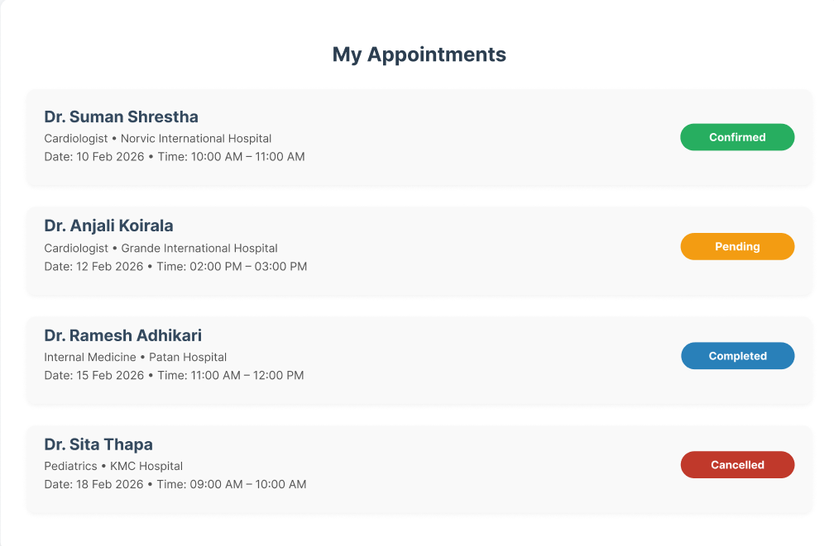

Slide 33
Testing Methodology Overview
Verify correctness of appointment workflow
Validate doctor recommendation logic
Ensure system reliability for all user roles

Slide 34
Testing Approach
Unit Testing
Integration Testing
System Testing
User Acceptance Testing

Slide 35
Unit Testing
Test individual system modules independently
Ensure each component works correctly in isolation
Modules to test
-User registration & Login
-Contest-Based Doctor Ranking
-Appointment Booking Module
-Appointment Approval / Rejection
-Medical Report Upload & View

Slide 36
Integration Testing
Smooth interaction between modules
Booking → Approval → Notification
Report upload → Patient access
Department → Doctor Ranking

Slide 37
System Testing
Validate the complete system functionality
Ensure all modules work together in real-life scenarios

Slide 38
User Acceptance Testing
End users test the system to see if it works for them
Validate system usability and ease of use
Identify issues from a real user’s perspective
Users Involved in UAT
-Patients
-Doctors

Slide 39
References
[1] Perera, S., et al. “Online Appointment System for Kotelawala Defence University Hospital.” University of Colombo School of Computing, Sri Lanka. Available: UCSC Digital Repository.
[2] Ahmed, R., et al. “Designing an Online Appointment System for Semiliterate Users.” Academia.edu, 2021. Available: https://www.academia.edu/77737445
[3] Atun, R., et al. “Evaluating Hospital Appointment Systems in Turkey: Challenges and Opportunities.” Journal of Innovation & Knowledge, Elsevier, 2020. Available: ScienceDirect.
[4] Patel, A., et al. “Online Doctor Appointment Booking System.” International Journal of Computer Applications, 2021. Web-based healthcare system study.
[5] Fernando, N., et al. “Online Hospital Registration and Appointment Management System (OHRAMS).” Angular–Spring Boot based healthcare system. University Research Project Report.

