Slide 1

WhatsTheScore
Live scores and results in real-time, with video highlights and statistics, teams and players profiles

Slide 2
About the App
WhatsTheScore App is the best way to follow the NFL, NCAA Football, MLB, NBA, NHL, EPL, La Liga, Champions League and all major sports! The App delivers completely customizable scores, stats, news, alerts & much more.

Slide 3

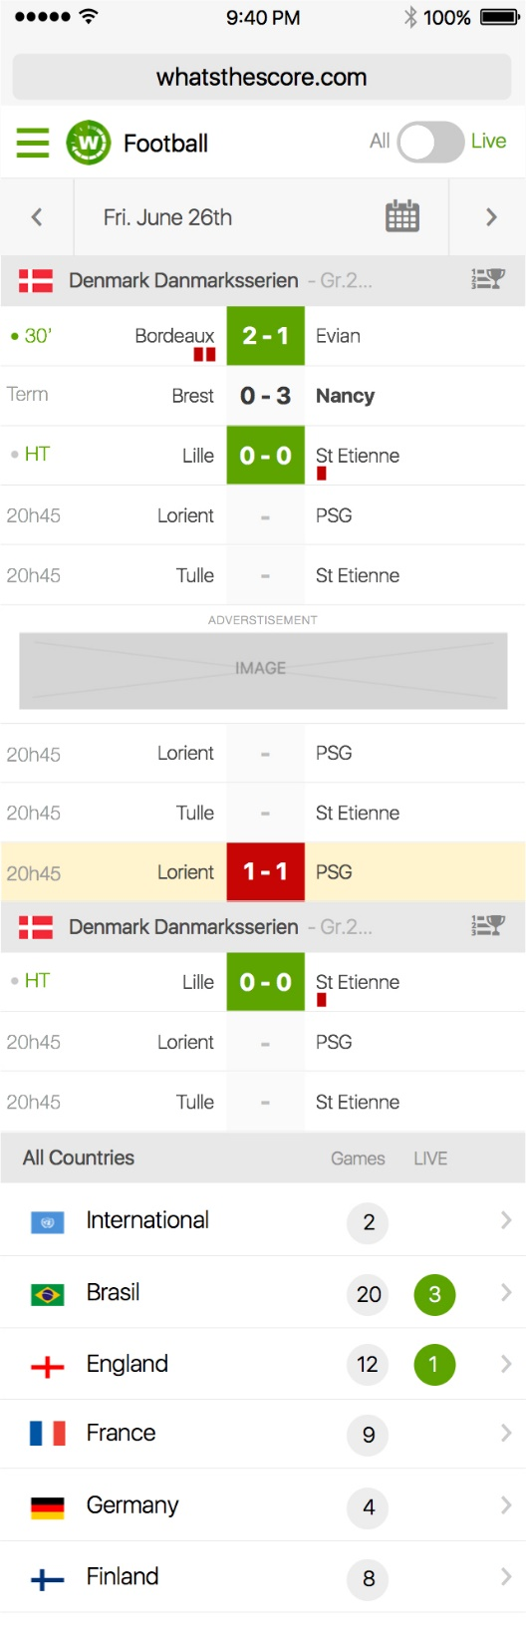
Home Page

Slide 4
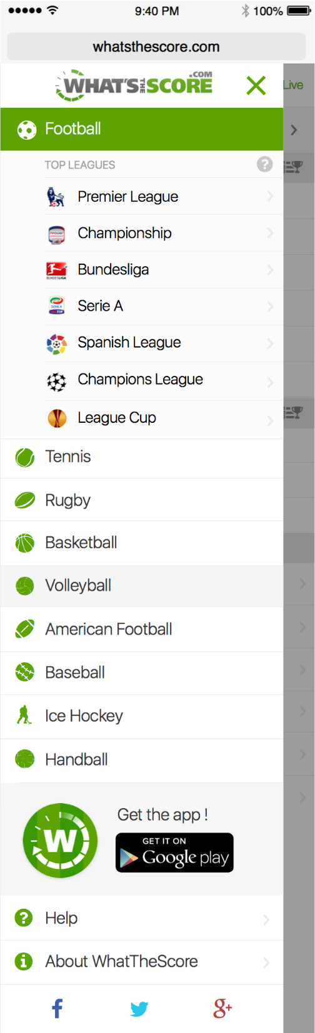
Navigation

Slide 5
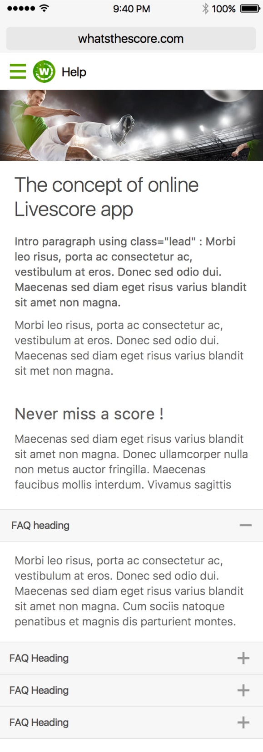
Content Page

Slide 6
Football Match

Slide 7
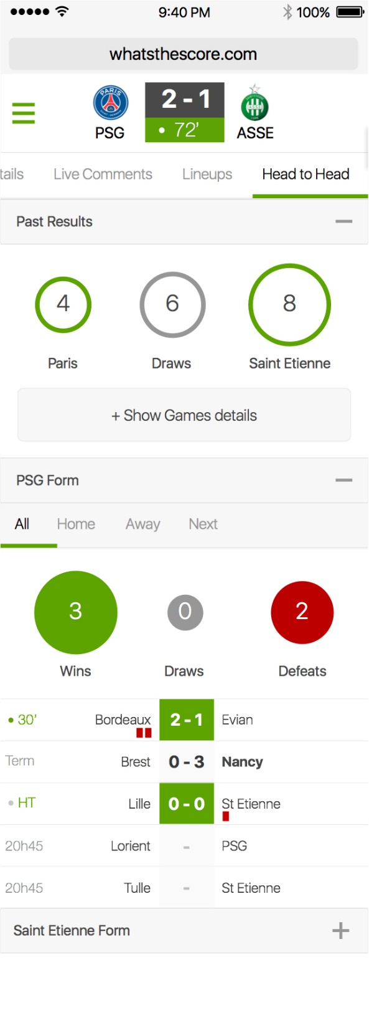
Match Tie Sheet

Slide 8
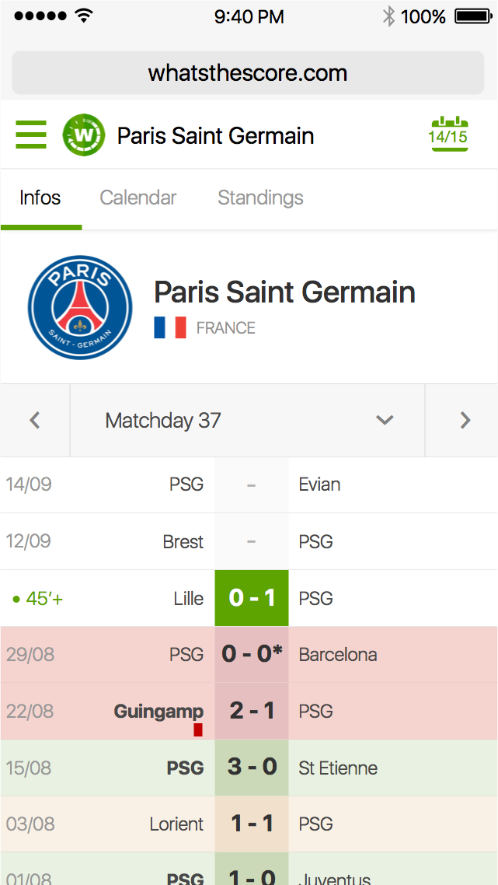
Team Information

Slide 9
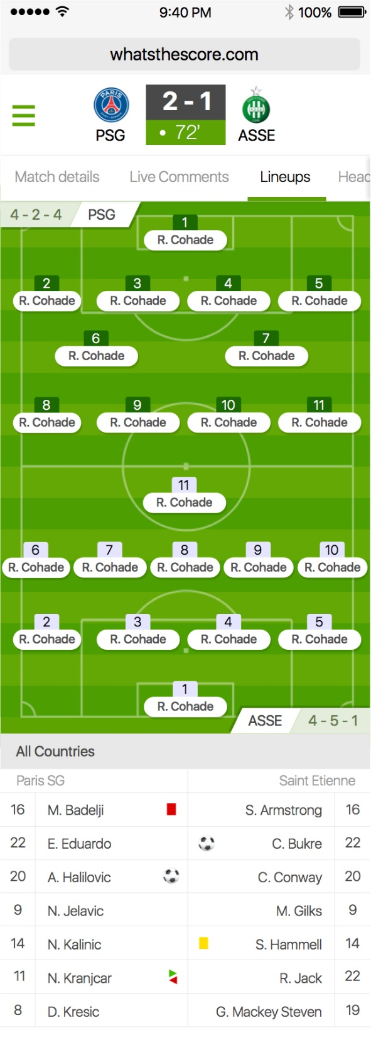
Match Line-Ups

Slide 10
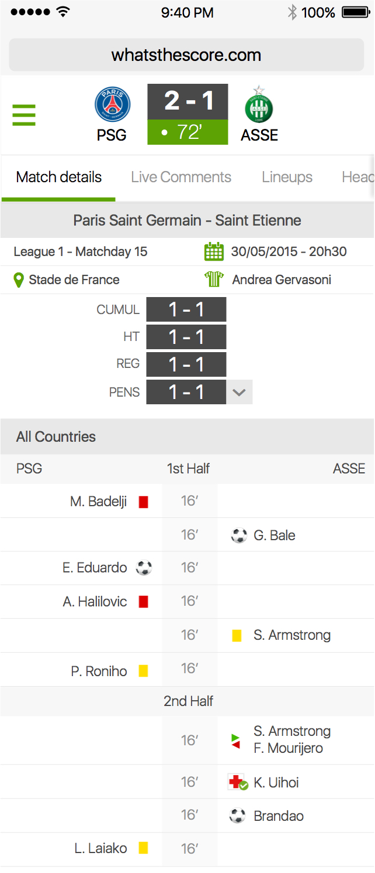
Match Details

Slide 11
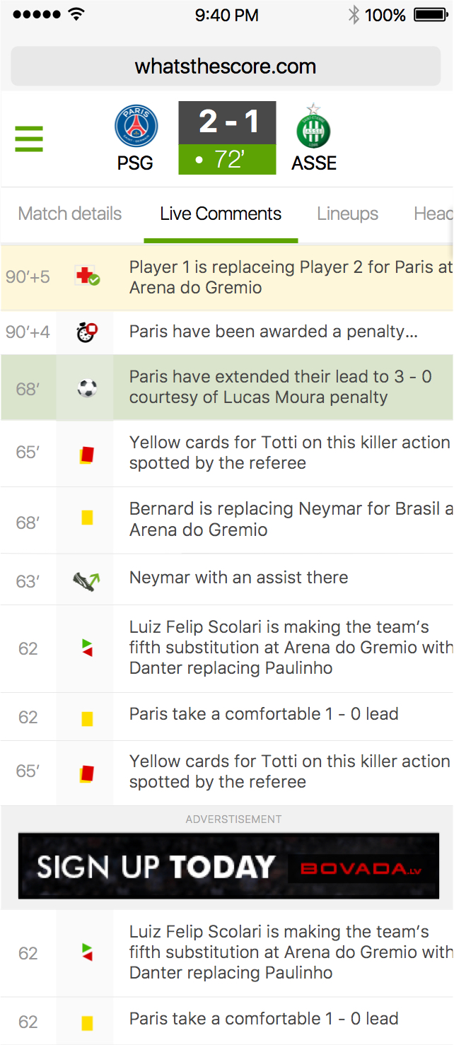
Match Comment

Slide 12
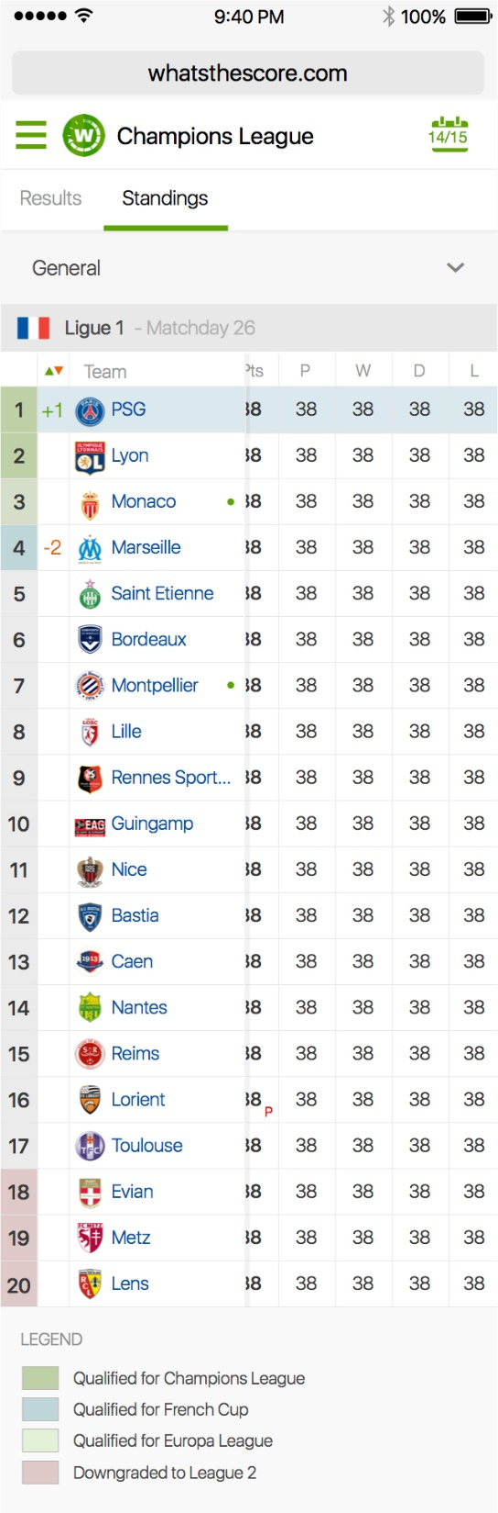
League Standings

Slide 13
Tennis Match

Slide 14
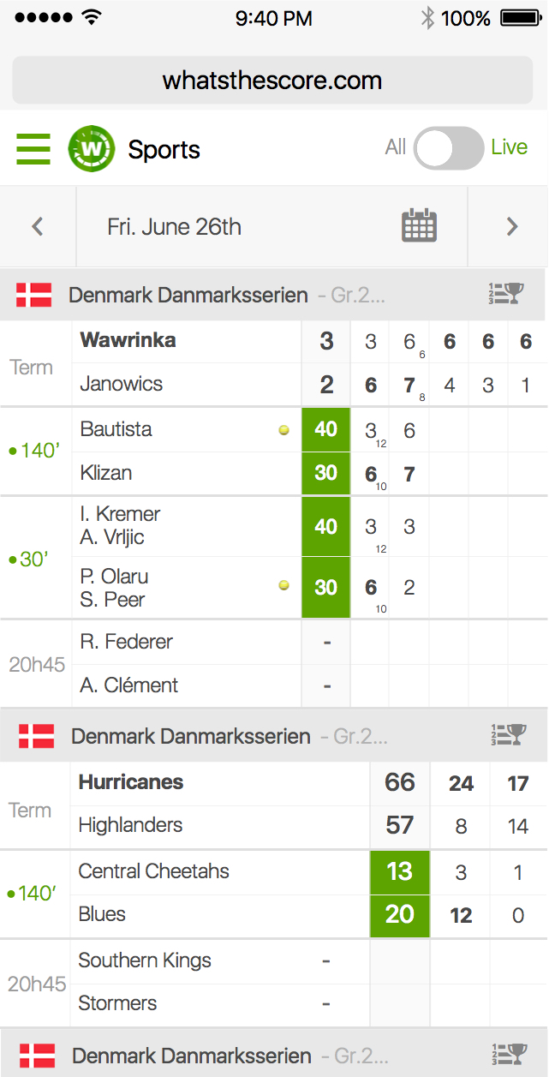
Match Details

Slide 15
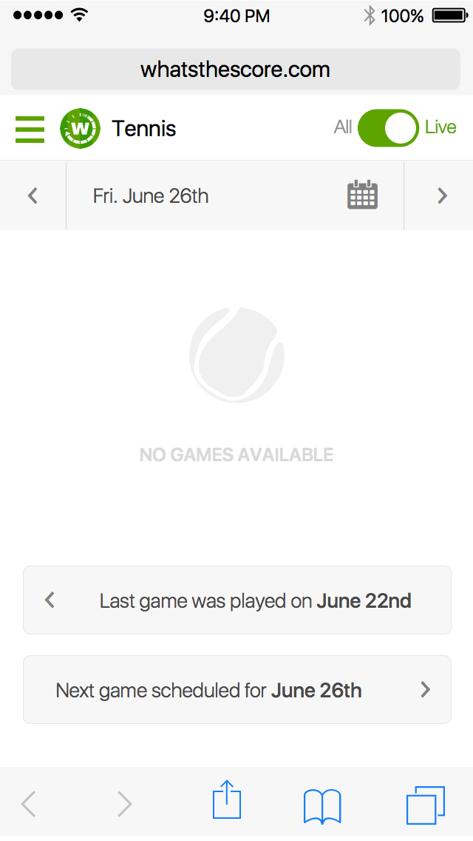
Match Empty

