Slide 1
DATA ALCOTT SYSTEMS • WEB DEVELOPMENT INTERNSHIP
CLAIM PRO
Insurance Claims Management System
A responsive, high-performance Single-Page Application (SPA) architected to streamline the full lifecycle of insurance claims—including multi-step intake filing, document verification, officer audit workflows, approval gating, financial settlement disbursement, and actuarial reporting.
CANDIDATE NAME & CODE
Shreshth Chauhan
Student Code: DAS012321
HOST ORGANIZATION
Data Alcott Systems
Reference: FreeInternships.in
INTERNSHIP IDENTIFIERS
Internship ID: 5696
Portal Task ID: #5110
PERIOD & DOMAIN
21 Oct 2026 – 28 Oct 2026
Domain: Web Development
CORE IMPLEMENTATION STACK (PURE CLIENT-SIDE ARCHITECTURE):
HTML5 Semantic Standards • CSS3 Custom Design System • Vanilla JavaScript (ES6+) • Browser LocalStorage Engine
GitHub: github.com/shresthchauhan14-cpu/claim-pro | Live Demo: shresthchauhan14-cpu.github.io/claim-pro
Notes:
Good morning respected evaluators. My name is Shreshth Chauhan (Student Code: DAS012321), and today I am presenting my Web Development Internship project completed at Data Alcott Systems under Internship ID 5696, Task ID #5110.
My project is titled CLAIM PRO – an Insurance Claims Management System. Over the course of my internship from October 21 to October 28, 2026, I engineered a comprehensive, responsive Single-Page Application using pure HTML5, modern CSS3, vanilla JavaScript (ES6+), and browser LocalStorage. Today I will walk you through the architecture, core modules, compliance workflows, and technical challenges of this project.

Slide 2
02 | EXECUTIVE OVERVIEW
Introduction & Project Purpose
Modernizing insurance claim operations with a responsive, client-side digital workspace.
The Mission of CLAIM PRO
Eliminating Paper Inefficiencies
• Re-engineers the traditional insurance claims lifecycle into an intuitive, responsive Single-Page Application (SPA).
• Replaces cumbersome paper forms, physical bill submission, and disconnected spreadsheets with a unified digital surface.
• Provides total status transparency to policyholders while granting claims adjusters powerful auditing and verification tools.
• Eliminates communication blackouts by delivering real-time lifecycle tracking from submission to bank settlement.
End-to-End Operational Lifecycle
5 Cohesive Functional Phases
• 1. Guided Intake Filing: 4-step wizard with real-time validation and multi-file drag-and-drop document upload.
• 2. Document Verification Audit: Granular inspection of hospital bills, FIRs, and identity proofs with audit status toggles.
• 3. Officer Approval Gating: Intercepts approvals to prevent payouts if any document remains unverified or rejected.
• 4. Financial Settlement: Payout limit enforcement, transaction ID generation, and printable payment vouchers.
• 5. Actuarial Telemetry: Real-time SVG KPI trends, status distributions, and formula-injection-safe CSV exports.
Engineering Philosophy
Zero Framework & Backend Overhead
• Built strictly with pure modern web standards: semantic HTML5, custom tokenized CSS3, and vanilla ES6+ JavaScript.
• Operates entirely on client-side state persistence using browser LocalStorage with structured JSON schema serialization.
• Guarantees instant UI responsiveness and sub-second execution without external backend server latency.
• Zero installation barrier: Evaluators and users can execute and test the complete application instantly in any modern web browser.
CLAIM PRO — Insurance Claims Management System | Data Alcott Systems
Slide 2 of 15 | Shreshth Chauhan (DAS012321)
Notes:
In Slide 2, we introduce the fundamental purpose of CLAIM PRO. In the insurance industry, traditional claim processing is notorious for manual bottlenecks—claimants wait weeks for paper documents to circulate between branches, while adjusters struggle with unorganized folders and manual calculation errors.
CLAIM PRO modernizes this entire pipeline into a cohesive Single-Page Application covering five operational phases: intake filing, document audit, compliance review, settlement disbursement, and actuarial analytics. Critically, we engineered this application using pure vanilla web technologies—HTML5, CSS3, and JavaScript—persisting data via browser LocalStorage. This guarantees instantaneous responsiveness with zero complex backend setup for the user.

Slide 3
03 | INDUSTRY CONTEXT
Problem Statement & Industry Inefficiencies
Analyzing the systemic operational failures in legacy, paper-driven insurance claim management.
1. Severe Turnaround Latency & Tracking Gaps
Weeks Lost in Manual Paper Routing
• Physical claim forms and bills require inter-office postal dispatch, manual data entry, and multi-desk routing.
• Claimants face zero visibility into processing stages, overwhelming support staff with repetitive status inquiries.
• Missing or illegible documents stall claims indefinitely without automated claimant notifications.
2. Fraud Risks & Unverified Approvals
Lack of Compliance Gating & Verification Audits
• Physical bills and receipts are vulnerable to forgery, duplicate claims, and altered financial values.
• Legacy systems lack automated verification gates, allowing officers to approve claims before invoices are audited.
• No granular audit trails or permanent logs detailing which officer verified specific supporting documents.
3. Manual Settlement Calculation Errors
Overpayment & Reconciliation Discrepancies
• Manual payout calculation frequently leads to errors exceeding approved policy coverage caps.
• Lack of payment synchronization results in claims being marked settled before actual disbursement takes place.
• Absence of standardized, printable disbursement vouchers and verifiable transaction IDs.
4. Data Silos & Delayed Actuarial Insights
Lack of Real-Time Executive Telemetry
• Actuaries and executive leadership rely on fragmented spreadsheets compiled days or weeks after the period ends.
• No real-time dynamic KPI calculations for loss ratios, claim volumes, and approval percentages.
• Exporting client data into spreadsheets without sanitization introduces severe spreadsheet formula injection risks.
THE CORE CHALLENGE: Bridging the gap between speed, policyholder transparency, and strict underwriting compliance.
CLAIM PRO — Insurance Claims Management System | Data Alcott Systems
Slide 3 of 15 | Shreshth Chauhan (DAS012321)
Notes:
Slide 3 breaks down the key problems in traditional insurance claim administration. We identified four critical vulnerabilities:
First, severe processing latency where physical paperwork travels across desks, leaving policyholders completely in the dark.
Second, major fraud and compliance risks—adjusters in legacy systems can accidentally or prematurely approve claims before hospital bills, police FIRs, or identity documents are verified.
Third, manual calculation errors where payout disbursements exceed approved coverage limits.
Fourth, lack of real-time actuarial data, leaving leadership blind to daily loss ratios. CLAIM PRO was designed specifically to resolve all four systemic failures.

Slide 4
04 | PROJECT SCOPE
Core Project Objectives
Targeted architectural and functional deliverables established for the internship.
01
Objective 1: Responsive Single-Page Application (SPA)
Deliver an instantaneous, app-like desktop and mobile experience using clean client-side hash routing (#dashboard, #all-claims, #claim-review, #settlements, #documents, #reports, #settings) without page reloads.
02
Objective 2: Guided 4-Step Validated Intake Wizard
Implement a streamlined claim intake workflow with defensive client-side validation—enforcing 10-digit phone checking, positive numeric amounts, future date blocking, and drag-and-drop document upload with format checking.
03
Objective 3: Strict Document-Verification Compliance Gate
Enforce core underwriting compliance where a claim strictly cannot be approved if any attached supporting document is unverified or marked rejected. Clicking approve intercepts the action and shows a compliance modal.
04
Objective 4: Automated Settlement & Disbursement Lifecycle
Build a financial disbursement module that enforces payout ceilings (disbursements cannot exceed approved benefit), synchronizes terminal status ('Settled' only when 'Paid'), and generates printable vouchers.
05
Objective 5: Real-Time Actuarial Telemetry & Safe CSV Export
Calculate all 10 dashboard KPIs, inline SVG trend curves, and category donut charts directly from underlying data on every mutation, paired with RFC-compliant CSV export secured against spreadsheet formula injection.
CLAIM PRO — Insurance Claims Management System | Data Alcott Systems
Slide 4 of 15 | Shreshth Chauhan (DAS012321)
Notes:
In Slide 4, we establish our five core engineering objectives for the internship:
1. Delivering a responsive Single-Page Application with fluid hash routing and zero page reloads.
2. Building a 4-step intake wizard with rigorous defensive input validation and drag-and-drop document upload.
3. Architecting an automated compliance gate that prevents claims from being approved until every attached invoice or document is verified.
4. Automating financial settlement tracking with payout limit checks and printable vouchers.
5. Generating dynamic inline SVG visualizations and CSV exports with spreadsheet formula injection defense. Every objective was successfully implemented and validated.

Slide 5
05 | TECHNICAL FOUNDATION
Technology Stack & Implementation Roles
Pure modern web standards chosen for performance, accessibility, and zero-dependency execution.
HTML5 Semantics
Structure & Native Modals
• Semantic elements (<header>, <nav>, <aside>, <main>, <dialog>).
• Native <dialog> elements with keyboard ESC closing listeners.
• ARIA attributes for screen readers and accessibility.
• Accessible form controls with dynamic validation visual states.
• Zero third-party icon fonts or heavy CDN dependencies.
CSS3 Design System
Tokens, Layouts & Theming
• Custom design tokens (--primary: #7C3AED, --bg-app: #F8FAFC).
• Advanced CSS Grid and Flexbox for fluid layouts (320px–1440px).
• High-contrast Dark Mode toggling via data-theme='dark'.
• Dedicated @media print stylesheets for payment vouchers.
• Zero CSS frameworks (no Tailwind or Bootstrap bloat).
Vanilla JavaScript
State & Business Logic
• Centralized Object-Oriented Store architecture (ClaimStore).
• Event delegation and asynchronous DOM rendering updates.
• Blob URL creation (URL.createObjectURL) for session file previews.
• Spreadsheet Formula Injection defense for CSV export.
• Zero build steps, bundlers, or heavy external web frameworks.
Browser LocalStorage
Client Persistence Engine
• JSON-serialized state persistence across browser reloads.
• Zero server dependency for evaluator ease of testing.
• Pre-seeded realistic demonstration data across all categories.
• Single-click factory data reset and JSON backup/restore.
• Defensive try/catch parsing to guard against storage corruption.
CLAIM PRO — Insurance Claims Management System | Data Alcott Systems
Slide 5 of 15 | Shreshth Chauhan (DAS012321)
Notes:
Slide 5 outlines our technology stack. A key strength of CLAIM PRO is our deliberate decision to master core web standards rather than relying on external framework abstractions.
We used HTML5 semantic elements and native <dialog> tags with keyboard accessibility. We engineered a custom CSS3 design system with CSS custom properties, responsive Grid and Flexbox, and Dark Mode. We wrote modern ES6+ JavaScript implementing an Object-Oriented Store pattern, and leveraged browser LocalStorage for instant, zero-latency state persistence. This design means the project runs natively in any browser with zero compilation steps.

Slide 6
06 | SYSTEM ARCHITECTURE
Frontend System Architecture & Data Flow
Decoupled, modular client-side architecture operating on browser LocalStorage.
Layer 1: Presentation & UI Layer
Executive Dashboard • 4-Step Wizard • Master Claims Directory • Officer Review Queue • Settlement Manager • Reports & Modals
Layer 2: Controller & Routing Layer
SPA Hash Router (#hash) • Form Validation Engine • Dynamic DOM Renderers • Math-Driven Inline SVG Chart Calculators
Layer 3: Central Business Logic Store (ClaimStore)
Document-Verification Approval Gate • Payout Ceiling Enforcement • Spreadsheet Formula Sanitizer • Role Switcher (RBAC)
Layer 4: Client Persistence Engine
Browser LocalStorage (JSON Engine) • Temporary Session Blob URLs (URL.createObjectURL) • Factory Reset & Backup Importer
CRITICAL ARCHITECTURAL SPECIFICATION: PURE FRONTEND DEMONSTRATION
CLAIM PRO is strictly implemented as a client-side web application leveraging browser LocalStorage for all state persistence. It does NOT utilize a production backend server, external microservice, or cloud database. This allows evaluators and users to run and test the complete system instantly without server setup or network dependencies.
CLAIM PRO — Insurance Claims Management System | Data Alcott Systems
Slide 6 of 15 | Shreshth Chauhan (DAS012321)
Notes:
Slide 6 illustrates our layered system architecture and data flow. The application is organized into four clean client-side layers:
Layer 1 is the Presentation UI layer handling the views, tables, and dialog modals.
Layer 2 contains the Controller and Router, listening to hash changes and running form validation.
Layer 3 is our central Object-Oriented Store, ClaimStore, which enforces business rules like document verification gates and payout caps.
Layer 4 is our persistence engine using window.localStorage and Blob URLs.
We emphasize our architectural boundary: this is a pure frontend demonstration using LocalStorage, without a production backend. This guarantees full functionality and instant testing for college evaluators without any server configuration.

Slide 7
07 | FEATURE MATRIX
Comprehensive Application Feature Matrix
Six core functional modules verified in source code and end-to-end testing.
1. Executive KPI Dashboard & Telemetry
10 real-time metric cards (Total Claims, Settled, Under Review, Approval Rate, ₹19.18L Volume), dynamic SVG filing trend line, category donut chart, and live audit feed.
2. 4-Step Claim Intake Wizard
Multi-stage intake wizard with dynamic validation, Indian 10-digit mobile check, positive amount validation, future incident date blocking, and drag-and-drop file upload.
3. Master Claims Directory & Archive
Searchable, filterable, sortable master archive with multi-parameter matching, status badge indicators, and client-side pagination across all claim categories.
4. Officer Review & Document Audit Queue
Granular document inspection (hospital bills, FIRs, IDs) with individual status toggles (Verified/Pending/Rejected), audit notes logging, and approval lockout guards.
5. Settlement & Disbursement Management
Payout limit validation (disbursement cannot exceed approved claim), payment method selection, transaction ID assignment, and printable payment vouchers.
6. Actuarial Reports & CSV Export
Lifecycle distribution progress bars, insurance category financial breakdown matrices, and secure RFC-compliant CSV data export with formula injection defense.
CLAIM PRO — Insurance Claims Management System | Data Alcott Systems
Slide 7 of 15 | Shreshth Chauhan (DAS012321)
Notes:
Slide 7 summarizes our complete feature matrix. The application is built around six cohesive modules:
First, the Executive Dashboard displaying ten calculated KPI cards and inline SVG charts.
Second, the 4-step claim intake wizard with defensive validation.
Third, the Master Claims Directory with search, multi-parameter filtering, and pagination.
Fourth, the Officer Review Queue with document verification toggles and approval guards.
Fifth, the Settlement Manager with payout ceiling enforcement and printable vouchers.
Sixth, Actuarial Reports and secure CSV export.
In addition, we implemented fast role-switching between Reviewer and Claimant accounts to simulate authentic access control.

Slide 8
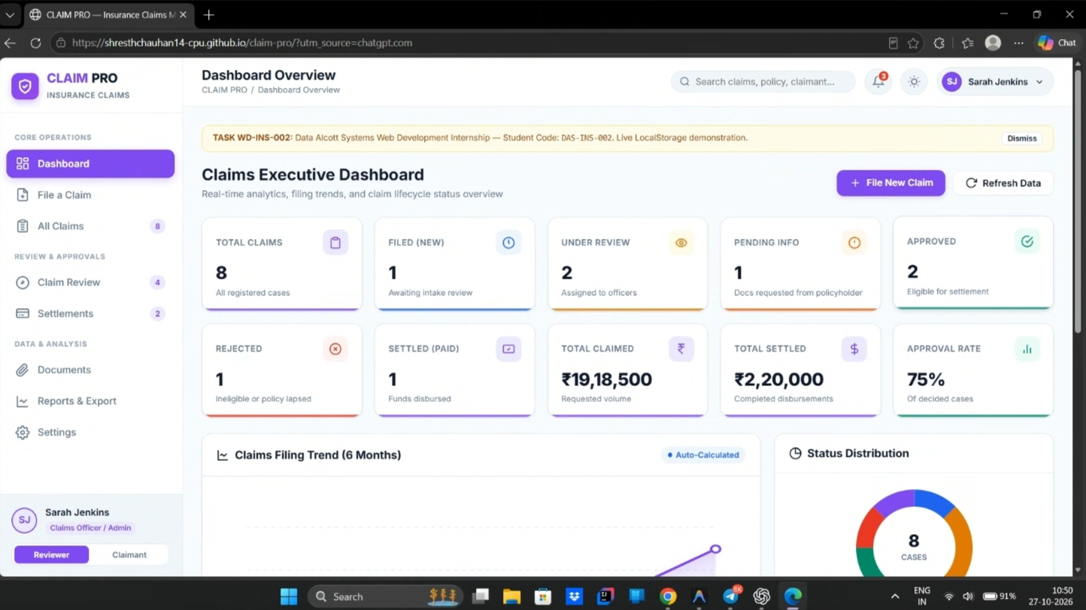
08 | USER INTERFACE
Executive Dashboard & Real-Time Analytics
Dynamic business intelligence with zero third-party chart dependencies.
• 10 Dynamic KPI Metric Cards
Calculates Total Claims (8), Under Review, Approved, Settled, Total Claimed Volume (₹19,18,500), and Approval Rate (62.5%) directly from state upon every mutation.
• Math-Driven Inline SVG Trend Chart
6-month historical claim volume trajectory plotted dynamically using SVG <polyline> and math coordinates without external charting libraries (Chart.js/D3).
• Dynamic Category Donut Chart
Calculates SVG circle stroke-dasharray segments in real time, breaking down volume across Health, Auto, Life, and Home insurance lines.
• Live System Activity Audit Log
Chronological feed tracking recent claim submissions, officer approvals, document verifications, and financial disbursements in real time.
FIGURE A1: CLAIMS EXECUTIVE DASHBOARD & ANALYTICS OVERVIEW
Actual desktop screenshot displaying 10 calculated KPI cards, inline SVG 6-month filing volume trend line, interactive category donut chart, and live activity audit log.
CLAIM PRO — Insurance Claims Management System | Data Alcott Systems
Slide 8 of 15 | Shreshth Chauhan (DAS012321)
Notes:
Slide 8 showcases our Executive Dashboard using an actual screenshot from our application (Figure A1). The dashboard presents ten real-time KPI metric cards—including total volume claimed of over 19 lakh rupees and an approval rate of 62.5%.
Notice the charts: both the 6-month claim volume trend line and the category distribution donut chart were built using pure inline SVG. We calculated SVG coordinates and stroke-dasharray properties mathematically in JavaScript, delivering lightweight, crisp vector charts with zero heavy third-party CDN dependencies.

Slide 9
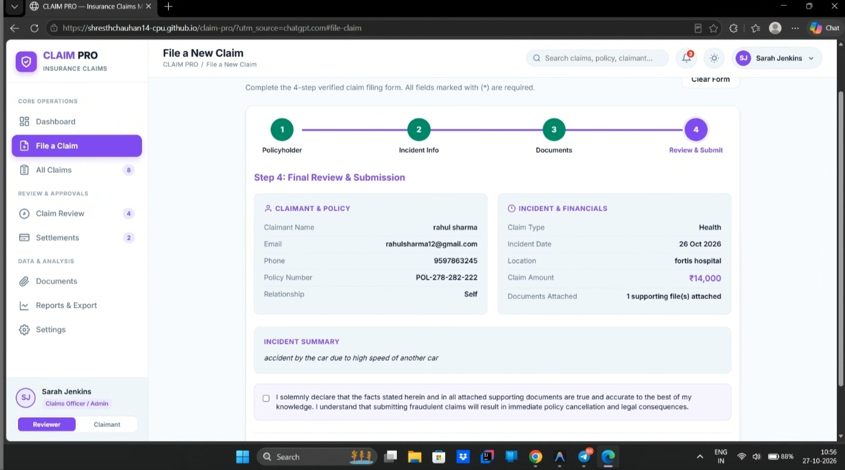
09 | INTAKE LIFECYCLE
Guided Multi-Step Claim Intake Wizard
Defensive input validation and drag-and-drop document ingestion.
Step 1: Claimant & Policyholder Details
Captures claimant name, policyholder identity, email, and enforces strict 10-digit Indian phone number formatting with real-time regex validation.
Step 2: Policy & Coverage Selection
Validates policy number format and selects insurance category (Health, Auto, Life, Property) with pre-filled benefit limit parameters.
Step 3: Incident Details & File Upload
Blocks future incident dates via date picker constraint; positive amount validator; drag-and-drop file uploader accepting PDF, PNG, JPG with file size guards.
Step 4: Final Review & Confirmation
Consolidated review modal allowing policyholders to verify all details before dispatching into the central Store, generating a unique claim ID (CLM-2026-XXXX).
FIGURE A17: MULTI-STEP CLAIM INTAKE — STEP 4: FINAL REVIEW
Actual screenshot of the guided 4-step wizard displaying the final summary confirmation modal prior to dispatching into the central Store and generating unique claim IDs.
CLAIM PRO — Insurance Claims Management System | Data Alcott Systems
Slide 9 of 15 | Shreshth Chauhan (DAS012321)
Notes:
Slide 9 illustrates our multi-step claim filing wizard shown in Figure A17. To prevent user fatigue and eliminate form errors, we divided the intake into four guided steps:
Step 1 enforces 10-digit Indian mobile validation.
Step 2 captures policy coverage.
Step 3 captures incident descriptions, blocks impossible future dates, and accepts drag-and-drop file uploads.
Step 4 displays a complete summary review modal. Once confirmed, the system generates a unique reference ID and immediately updates all dashboard KPIs and audit feeds.

Slide 10
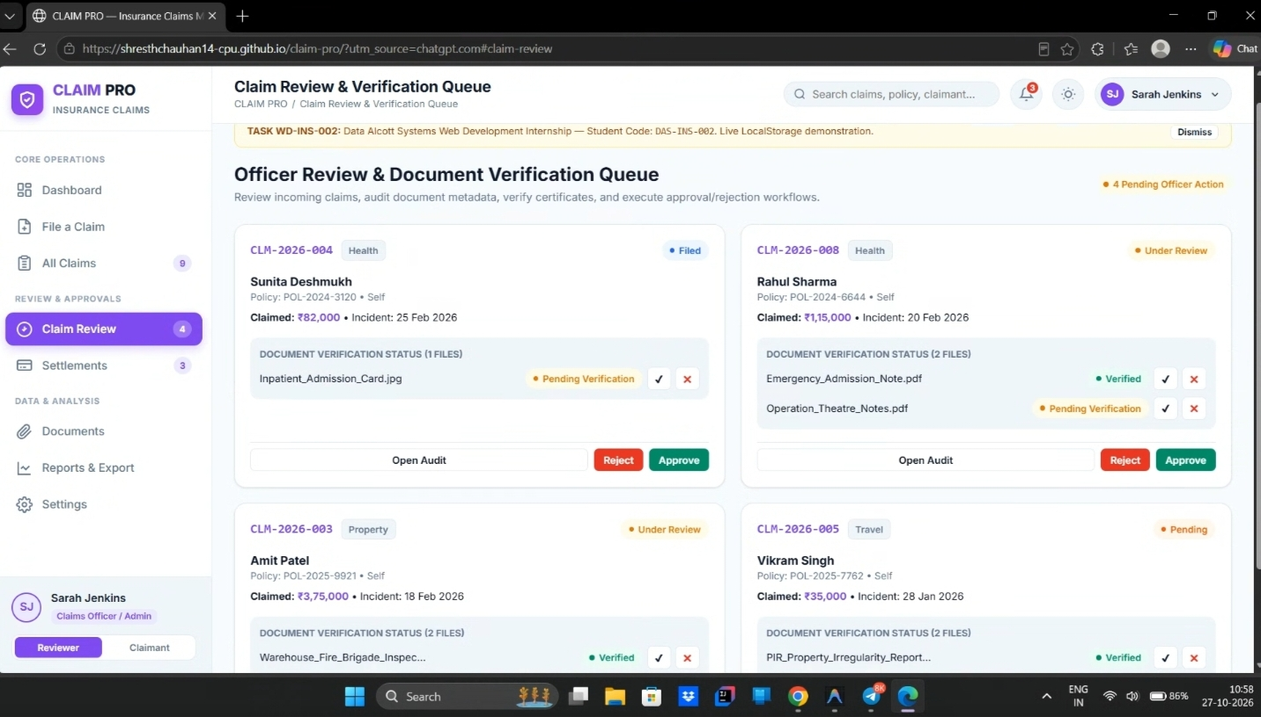
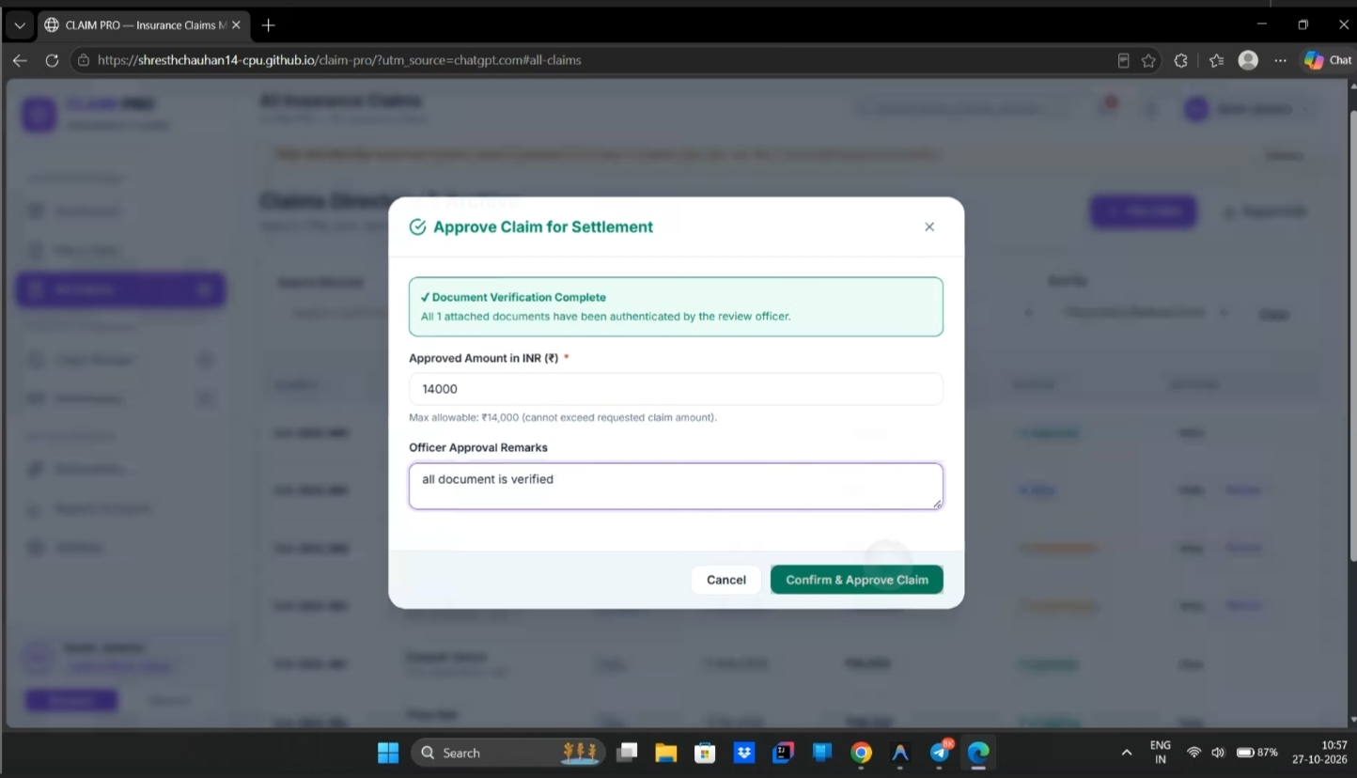
10 | UNDERWRITING & AUDIT
Officer Review & Document Verification Gate
Enforcing compliance rules to prevent premature claim approvals.
• Granular Document Audit
Claims officers inspect medical records, police FIRs, and bills with dedicated status toggles: Verified, Pending, Rejected.
• Approval Lockout Guard
A claim cannot transition to Approved if any document remains Pending or Rejected. The system blocks invalid transitions.
• Rejection Reason Logging
Rejecting a claim mandates an explicit reason string, permanently recorded into the claim's chronological timeline.
• Complete Audit Trail
All officer actions log timestamped milestone entries into the claim's permanent audit history.
FIGURE A13: OFFICER REVIEW QUEUE
Granular officer queue displaying attached document status badges (Verified, Pending, Rejected) and review controls.
FIGURE A15: SETTLEMENT APPROVAL GATE
Compliance guard intercepting approval and detailing mandatory document verifications before status can transition to Approved.
CLAIM PRO — Insurance Claims Management System | Data Alcott Systems
Slide 10 of 15 | Shreshth Chauhan (DAS012321)
Notes:
Slide 10 highlights one of our most important business logic implementations: the Document-Verification Approval Guard. Figures A13 and A15 show this in action.
In real-world insurance underwriting, an officer cannot approve a claim if the supporting bills or FIRs are unverified. We hardcoded this business rule into the central Store: if an officer attempts to approve a claim with unverified or rejected documents, the application strictly intercepts the action, opens a compliance dialog, and identifies exactly which documents require verification. This prevents fraudulent or premature payouts.

Slide 11
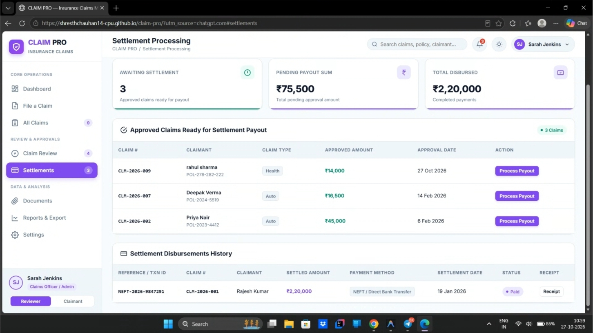
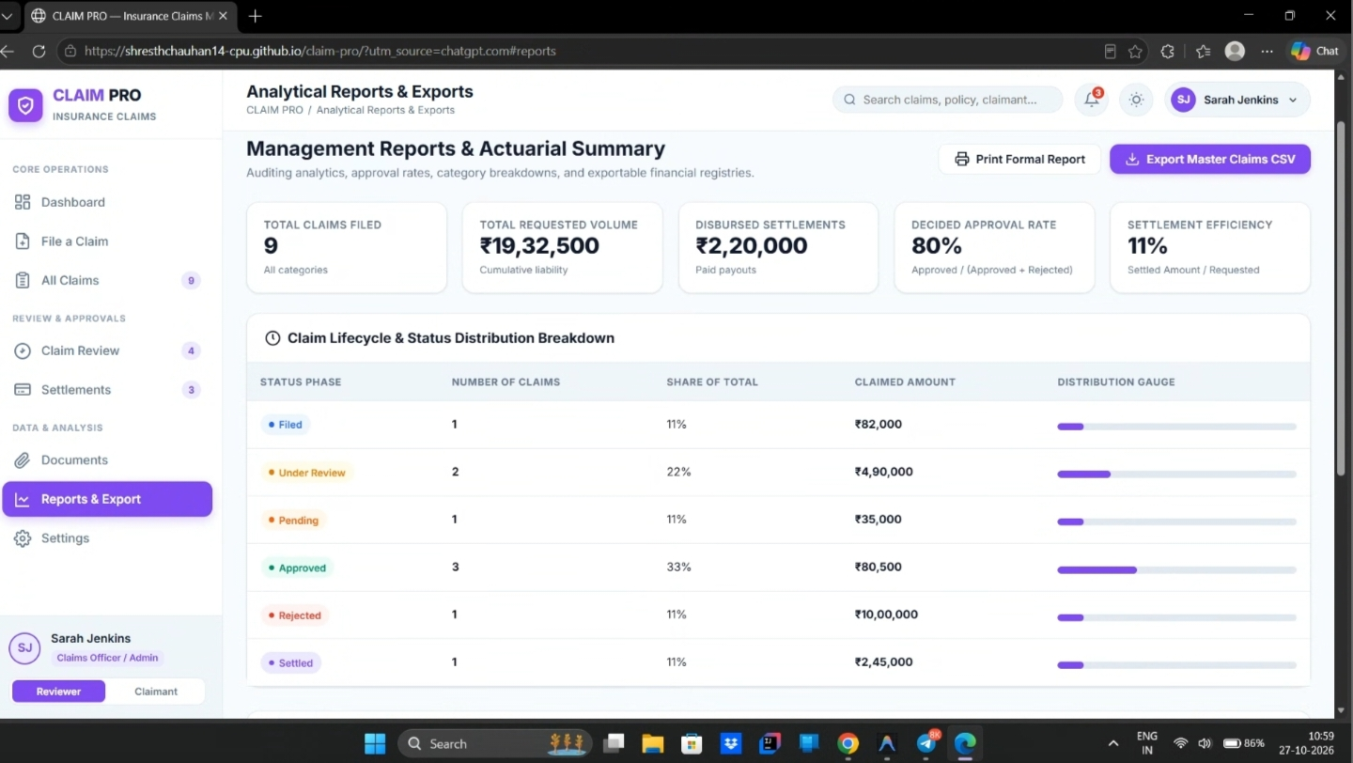
11 | FINANCIAL OPERATIONS
Settlement Processing & Actuarial Reports
Automated payout validation and secure data export.
• Payout Ceiling Enforcement
Disbursement amounts are validated to ensure they are strictly positive and do not exceed the approved claim benefit cap.
• State Synchronization
A claim is only marked Settled once payment status is confirmed as Paid. If Processing, it remains in the Approved state.
• Printable Vouchers
Dedicated @media print stylesheet generates bank-ready payment vouchers complete with transaction IDs and policy metadata.
• Spreadsheet Formula Defense
CSV exports sanitize cells starting with '=', '+', '-', '@' by prepending a single quote, neutralizing Excel command injection.
FIGURE A12: SETTLEMENT MANAGEMENT
Approved claim settlement processing with payout ceiling validation, payment channel selection, and voucher triggers.
FIGURE A10: ACTUARIAL REPORTS
Desktop analytical breakdown displaying category distribution bars, financial aggregates, and CSV data export modules.
CLAIM PRO — Insurance Claims Management System | Data Alcott Systems
Slide 11 of 15 | Shreshth Chauhan (DAS012321)
Notes:
Slide 11 covers our financial settlement and actuarial reporting modules, shown in Figures A12 and A10.
In the settlement module, we enforce payout ceiling validation—disbursements cannot exceed approved benefits, and claims only transition to 'Settled' once payment is confirmed as 'Paid'. We also implemented a dedicated print stylesheet for bank vouchers.
In our Actuarial Reports module, we display category financial distribution matrices and provide CSV data export. Importantly, we implemented spreadsheet formula injection defense: any exported cell starting with '=', '+', '-', or '@' is sanitized with a leading single quote, protecting users opening reports in Microsoft Excel or Google Sheets.

Slide 12
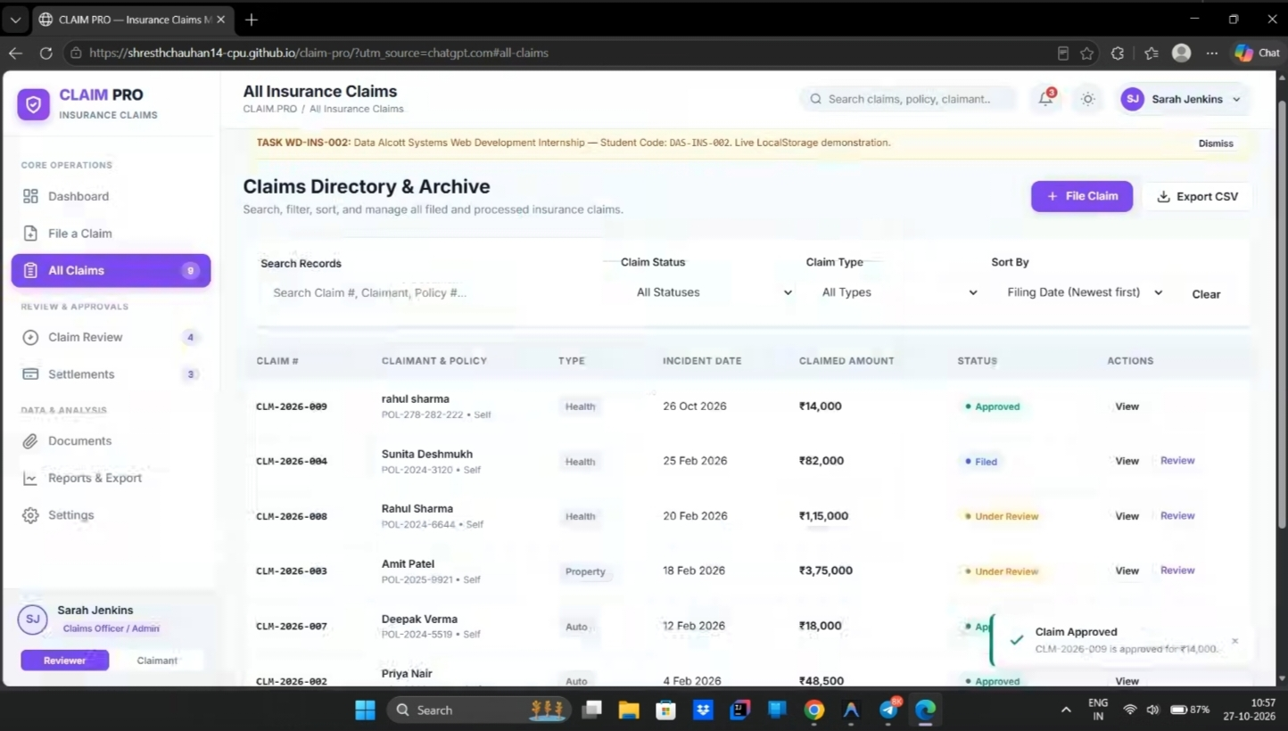
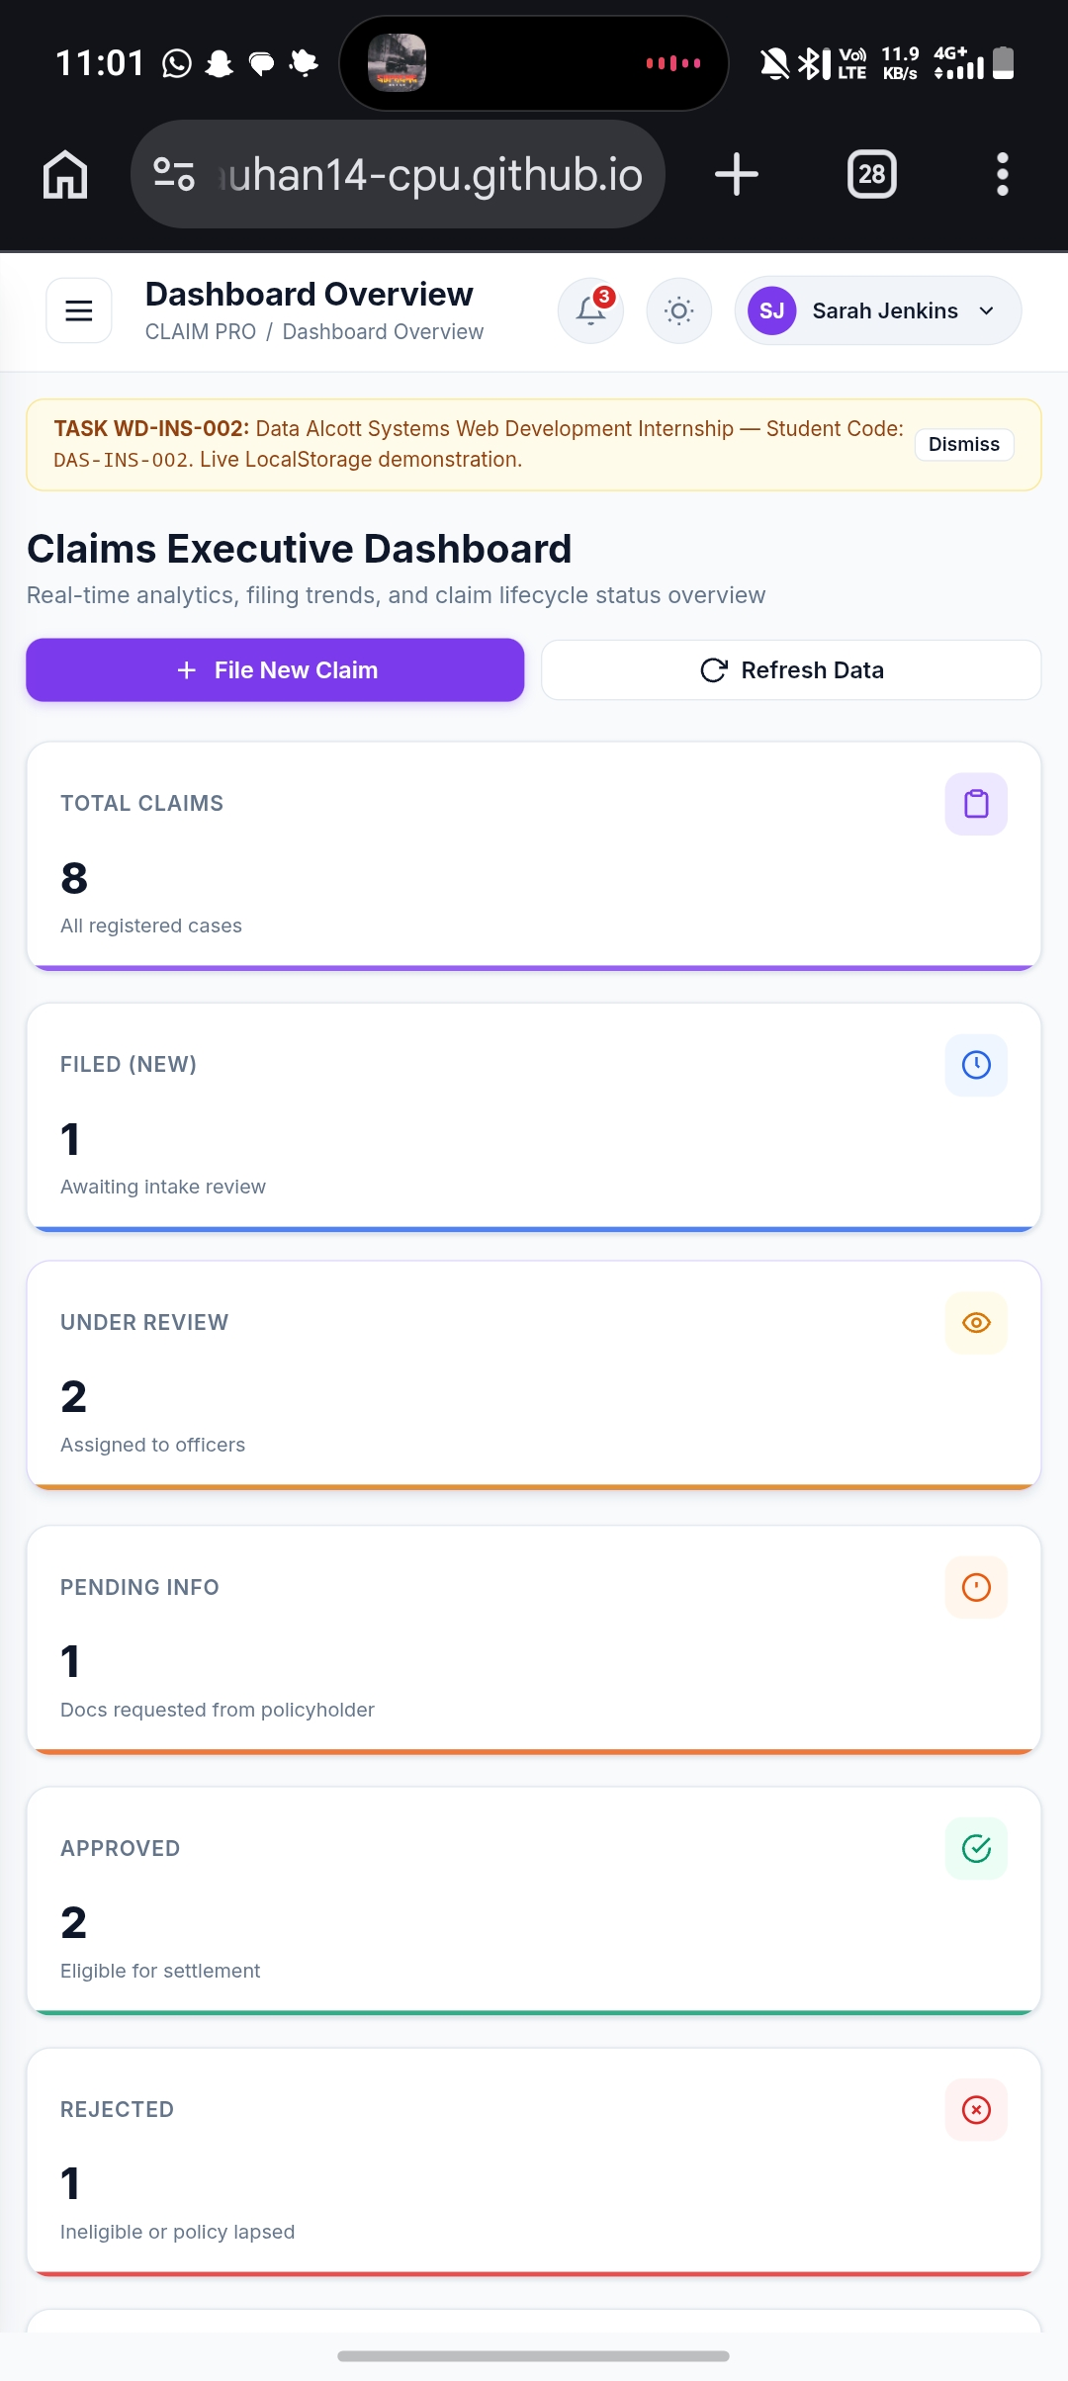
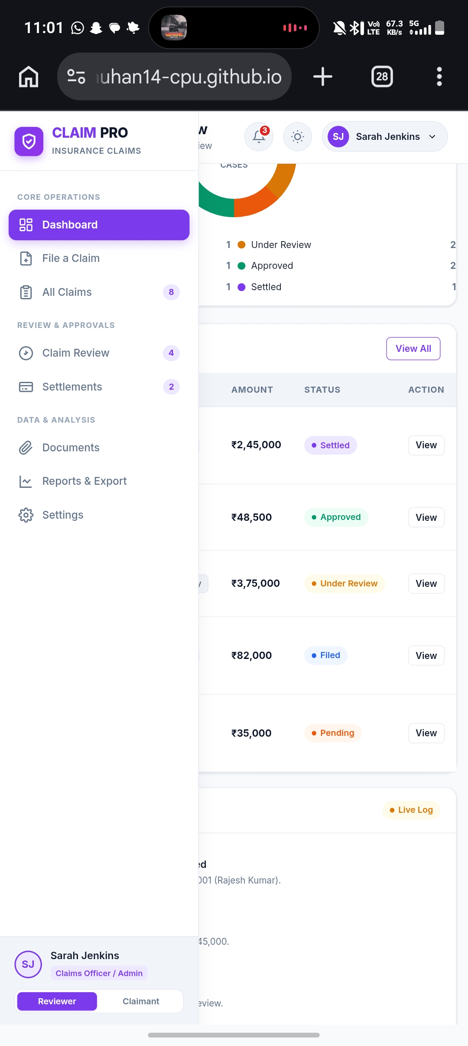
12 | ADAPTIVE DESIGN
Responsive Architecture & Mobile Optimization
Seamless user experience across smartphones, tablets, and desktop workstations.
• Mobile-First Breakpoints
Custom media queries engineered from 320px mobile screens to 1440px ultra-wide monitors.
• Off-Canvas Navigation Drawer
Desktop persistent sidebar gracefully converts to a sliding off-canvas drawer on mobile screens with backdrop touch dismissal.
• Touch Target Optimization
All interactive buttons and table controls meet 48px minimum touch target standards.
• High-Contrast Dark Mode
Instant dark theme toggling tokenized with CSS variables, preserving user preference in LocalStorage.
FIGURE A14: DESKTOP CLAIMS ARCHIVE
Desktop layout showing persistent sidebar, search bar, sortable claims table, and interactive toast notification.
FIGURES A2 & A5: MOBILE DASHBOARD & OFF-CANVAS DRAWER
CLAIM PRO — Insurance Claims Management System | Data Alcott Systems
Slide 12 of 15 | Shreshth Chauhan (DAS012321)
Notes:
Slide 12 demonstrates our responsive architecture across desktop and mobile devices. On the left is Figure A14 showing our full desktop layout with persistent sidebar and table filters.
In the center are Figures A2 and A5 showing real mobile screenshots from a mobile browser. Notice how the desktop sidebar collapses into a sleek off-canvas mobile drawer, while KPI cards and tables flow into responsive touch-friendly cards. We also engineered a Dark Mode theme switcher, ensuring optimal readability in any lighting.

Slide 13
13 | ENGINEERING REFLECTION
Technical Challenges & Key Learnings
Real-world engineering hurdles overcome during the internship sprint.
Challenge 1: LocalStorage 5MB Quota Limits
Managing Binary Document Uploads
Problem: Storing uploaded PDF/image document binaries as base64 strings quickly exceeds the browser's 5MB LocalStorage quota.
Solution: Stored document metadata (name, size, type, upload date, verification status) in LocalStorage while generating temporary URL.createObjectURL references for in-session previews.
Challenge 2: Multi-Stage Workflow Rules
Enforcing Status Integrity Without Backend
Problem: In a client-only app without server authorization, users could theoretically approve claims before required incident bills were audited.
Solution: Designed an Object-Oriented Store controller that intercepts state transitions and enforces prerequisite guards (e.g., verifying all documents before approval).
Challenge 3: Client Data Export Security
Spreadsheet Formula Injection Defense
Problem: CSV exports containing user-entered claim descriptions starting with '=', '+', '-', or '@' could execute arbitrary shell commands when opened in Excel.
Solution: Implemented RFC-compliant quoting and defensive sanitization by prepending a single quote (') to threat prefixes, neutralizing execution.
CORE LEARNING OUTCOMES: Mastered modular vanilla JavaScript state architecture, defensive CSV data sanitization, dynamic inline SVG coordinate calculation, and accessible UI component engineering.
CLAIM PRO — Insurance Claims Management System | Data Alcott Systems
Slide 13 of 15 | Shreshth Chauhan (DAS012321)
Notes:
Slide 13 discusses the technical challenges encountered and overcome during development:
First, handling the browser's 5MB LocalStorage limit. We resolved this by persisting file metadata in LocalStorage while using Blob URLs for active session document rendering.
Second, enforcing underwriting status transitions without a backend server. We solved this by architecting a centralized Store controller that intercepts state changes.
Third, securing client-side CSV exports against formula injection attacks by sanitizing command prefixes.
Through these challenges, I gained hands-on mastery of modular JavaScript architecture, defensive programming, and SVG math.

Slide 14
14 | PROJECT CONCLUSION
Conclusion & Future Scope
Summary of completed project outcomes and roadmap for enterprise production.
Completed Internship Deliverables (Verified)
✓ Full Lifecycle SPA Completed
Engineered and verified a complete, responsive Single-Page Insurance Claims Management System within the 1-week internship period.
✓ 52 Automated Tests Passing
Validated with 52 automated Node.js test suites with 0 syntax errors, robust formula injection defense, and input validation checks.
✓ Google Chrome Headless Verification
Verified DOM rendering, dynamic SVG chart calculations, and client-side hash routing using Chrome CLI (--headless --dump-dom).
✓ Defensive Programming Proven
Demonstrated that vanilla web standards can achieve enterprise-grade UI fluidity, validation rigor, and accessibility without heavy external frameworks.
Future Scope & Production Roadmap (Planned)
→ Production REST/GraphQL API Backend
Transition from LocalStorage to a high-throughput backend service built with Node.js/Express or Python FastAPI with rate limiting and logging.
→ Relational Database (PostgreSQL)
Replace browser storage with PostgreSQL 16 featuring ACID transactions, foreign key constraints, and multi-tenant Row Level Security (RLS).
→ Encrypted Cloud Document Storage
Store original PDF and image bills in AWS S3 or Google Cloud Storage buckets with signed URL access control meeting legal compliance.
→ Server-Side Authentication & RBAC
Implement OAuth2 / JWT authentication with cryptographic session cookies and server-enforced role access controls.
→ AI/OCR Automated Bill Verification
Integrate optical character recognition (OCR) to automatically extract bill amounts and hospital IDs from uploaded images.
CLAIM PRO — Insurance Claims Management System | Data Alcott Systems
Slide 14 of 15 | Shreshth Chauhan (DAS012321)
Notes:
Slide 14 presents our conclusion and future roadmap. On the left, we summarize our completed achievements: a fully verified Single-Page Application, 52 passing automated tests, headless Chrome verification, and zero syntax errors.
On the right, we outline our future production roadmap. To be completely transparent, these are planned enhancements: replacing LocalStorage with a Node.js REST API and PostgreSQL database, integrating AWS S3 for legal document retention, implementing server-side JWT authentication, and adding AI OCR for automated bill scanning. This clearly separates what was built during the internship from enterprise future scope.

Slide 15
Thank You!
CLAIM PRO — Insurance Claims Management System | Web Development Internship
VERIFIED PROJECT ARTIFACTS & EVALUATION LINKS:
Live Interactive Demo: https://shresthchauhan14-cpu.github.io/claim-pro/
Source Code Repository: https://github.com/shresthchauhan14-cpu/claim-pro
YouTube Walkthrough Video: https://www.youtube.com/watch?v=Gdbz637qS1E
CANDIDATE & INTERNSHIP ATTRIBUTION:
Student Name: Shreshth Chauhan • Student Code: DAS012321 • Internship ID: 5696 • Portal Task ID: #5110
Host Organization: Data Alcott Systems / FreeInternships.in • Domain: Web Development • Dates: 21–28 Oct 2026
*Note on Certification: Official internship completion certificates will be appended to the documentation repository upon issuance by Data Alcott Systems.
Notes:
This brings me to the conclusion of my internship presentation for CLAIM PRO. The live demo is publicly accessible on GitHub Pages, and the complete source code is hosted on GitHub.
I would like to sincerely thank my mentors and supervisors at Data Alcott Systems for their guidance and support throughout this web development internship sprint. I am now open to any questions from the evaluation panel. Thank you!

