Slide 1
AI-Based Health Monitoring System
Project report: classifying wearable vitals into normal, warning, critical and sensor-fault states, with alerts that fire only when it matters
Notes:
Title slide. The project builds a monitoring pipeline for heart rate, body temperature and motion from a wearable, and compares an AI model against a textbook threshold rule.

Slide 2

Threshold alarms cannot tell exercise from illness
Bedside and wearable monitors usually alarm on fixed ranges: heart rate outside 60-100 bpm, temperature outside 36.1-37.5 °C.
A fixed range ignores context. A brisk walk pushes heart rate past 100 and the rule raises a warning for a healthy patient.
Every false alarm costs staff attention, and too many lead to alarms being ignored.
Faulty sensors (a loose strap, a stuck reading) look like emergencies or like normal data.
94%
of healthy exercise windows are flagged abnormal by the threshold rule (2,154 test windows)
AI model: 0.2%
Notes:
The motivating problem. The headline number comes from this project's held-out evaluation: normal windows with high motion.

Slide 3




Objectives
Classify every sample into four states
Cut false alarms without missing events
NORMAL, WARNING, CRITICAL and SENSOR_FAULT from heart rate, temperature and motion.
Beat the threshold rule on false alarms per hour while catching every critical event.
Recognise faulty sensors
Run in real time on small hardware
Separate dropouts, spikes and stuck readings from real physiological change.
Sub-millisecond predictions and a model small enough for an edge device.

Slide 4






System overview: from sensor stream to alert
Wearable stream
1-minute window
15 features
MLP classifier
Persistence filter
Dashboard
HR, temperature, motion every 10 s
Last 6 samples in a rolling buffer
Level, spread, range and trend per signal
4-class prediction per sample
Alert after 3 abnormal windows, re-alert on escalation
Ward replay with true and false alarms
Code: generate_data.py (simulator), train_models.py (training and evaluation), infer_demo.py (live loop), export_dashboard.py and dashboard/ (replay UI), make_figures.py (charts), test_pipeline.py (smoke check).

Slide 5
Dataset: 30 simulated patients, 6 hours each
64,800 samples, 64,650 windows
One sample every 10 s per patient.
What the simulator injects
Activity bouts (rest, walk, run) that raise heart rate and temperature
Tachycardia, bradycardia, fever and hypothermia, each in a warning and a critical grade
Sensor faults: dropout, spike and stuck value
First-order physiological lag, sensor noise and a per-patient temperature bias

Slide 6

Features and evaluation protocol
Signal | Features (window of 6 samples)
Heart rate | last, mean, std, min, max, slope, last change
Temperature | last, mean, std, min, max, slope
Motion | mean, max
Patient-wise split
20 patients train, 10 patients test. No test patient is seen in training.
Model selection
5-fold GroupKFold cross-validation on the training patients, ranked by macro F1.
Alert metrics
False alarms per hour, event recall, critical-event recall and median detection delay over 60 test hours.
15 features per window, identical code path in training and live inference (checked by test_pipeline.py).

Slide 7
MLP deployed: best CV score and fewest false alarms
Model | CV F1 | False alarms/h
Threshold rule | n/a | 9.6
Logistic Reg. | 0.381 | 4.5
Gradient Boost. | 0.862 | 10.4
Random Forest | 0.869 | 6.7
MLP (deployed) | 0.874 | 3.8
CV F1 picks the deployed model before the test set is touched. On test, Random Forest edges macro F1 (0.895) but raises 1.8x the false alarms. Logistic regression fails: the classes are not linearly separable here.

Slide 8
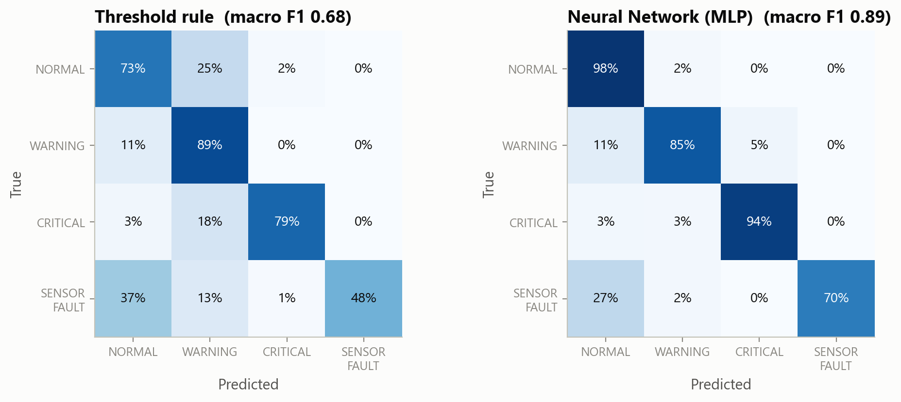
Where each method makes its mistakes
Rule: 25% of normal windows called Warning
Mostly exercise, which the rule cannot see.
AI: 98% of normal windows correct
Critical recall rises from 79% to 94%.
Weak spot: sensor faults
27% of fault windows still read as normal, mostly stuck-value faults.
Rows are normalised: each row shows how windows of that true class were predicted.

Slide 9
Per-class recall: AI vs threshold rule
Fault type | Rule | AI
Dropout | 100% | 100%
Spike | 23% | 66%
Stuck value | 0% | 37%
The rule only sees dropouts (reading 0). The AI also catches spikes and some stuck readings by looking at variance and trend.

Slide 10
Alert persistence: one-third the false alarms of the rule
3.0 to 1.1
false alarms per hour at K=3, rule to AI
30 s
median detection delay at K=3 (rule: 50 s)
At K=3 the AI still catches 100% of the 64 test events. The live loop uses K=3.

Slide 11
Why it works: motion gives context
0.889 to 0.843
macro F1 when motion features are removed
AUC 0.90
unsupervised Isolation Forest, but only 14% recall at a 2% false-positive budget
Supervised AI as abnormal-vs-normal detector: F1 0.92 (rule 0.65).

Slide 12
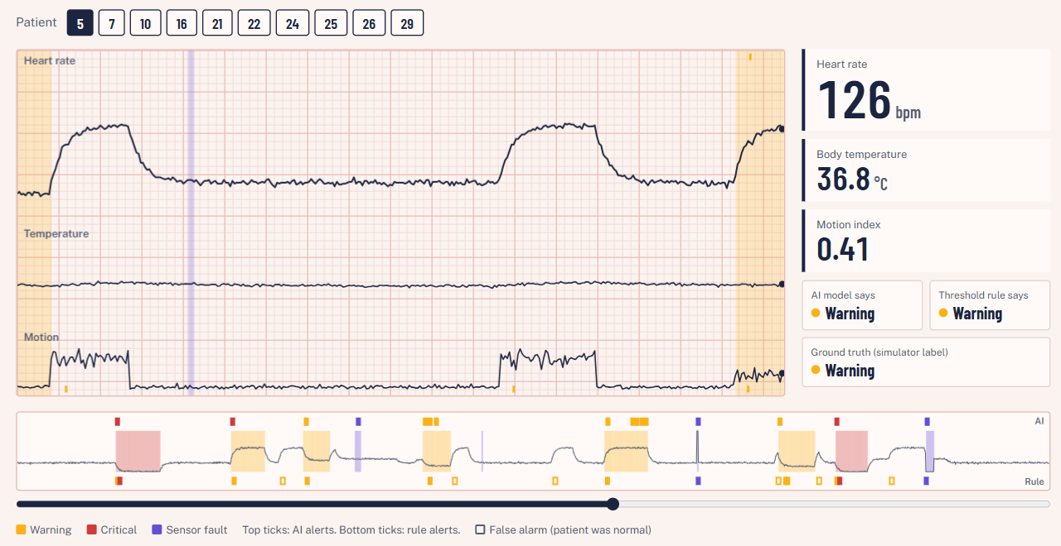
Ward telemetry dashboard
Replays the 10 test patients through the same live loop as infer_demo.py.
Strip chart of the last hour, live readouts, and what the AI, the rule and the ground truth each say.
Alert log marks every alert as a true or a false alarm.
Static HTML: open dashboard/index.html, no server needed.

Slide 13
Small and fast enough for an edge device
0.4 ms
86 KB
10 s
per single prediction on a laptop CPU
serialised model (joblib)
sampling interval, so the model idles over 99.99% of the time
Live loop (infer_demo.py)
Rolling 6-sample buffer, one prediction per incoming sample.
Alert after 3 consecutive abnormal windows; re-alert only if the episode escalates (Warning to Critical), so de-escalation does not spam staff.
test_pipeline.py checks that live features equal training features and that the alert logic behaves as specified.

Slide 14
Limitations and future work
Limitations
Simulated data: metrics are optimistic and are not clinical evidence.
Labels come from the simulator, not clinicians.
Stuck-value faults remain the weakest class.
Only three signals; no SpO2, ECG morphology or blood pressure.
Future work
Re-validate on real wearable recordings (e.g. PhysioNet, MIMIC waveform data).
Add SpO2 and respiration rate; per-patient baseline calibration.
Dedicated stuck-sensor check (zero variance over a window).
Port the model to a microcontroller and stream to the dashboard live.

Slide 15
Context beats thresholds
On 10 unseen patients the AI reaches 95.4% accuracy, flags 0.2% of healthy exercise (rule: 94%), and cuts false alarms from 3.0 to 1.1 per hour while catching every critical event.

