Slide 1
Recommendations for Restaurant Improvements using Random Walk Based Opinion Mining
Ekta Rita
Shreya Venkatesh
Srisha Raviillu

Slide 2
Motivation
NAME | CATEGORIES | NEIGHBORHOOD | STARS
Phusion Cafe | Asian Fusion, Chinese, Restaurants, Taiwanese | Goodrich Kirtland | 4
Szechuan Gourmet | Szechuan, Restaurants, Chinese | Goodrich Kirtland | 4.5
Bo Loong | Chinese, Restaurants | Goodrich Kirtland | 3
Han Chinese Kabob & Grill | Chinese, Noodles, Restaurants, Kebab, Soup | Goodrich Kirtland | 4
LJ Shanghai | Chinese, Restaurants, Shanghainese | Goodrich Kirtland | 4
Siam Cafe | Thai, Restaurants, Seafood, Chinese, Asian Fusion | Goodrich Kirtland | 4
Wonton Gourmet & BBQ | Barbeque, Chinese, Cantonese, Restaurants | Goodrich Kirtland | 4.5
Li Wah | Cantonese, Restaurants, Dim Sum, Chinese | Goodrich Kirtland | 3.5
Szechuan Cafe | Chinese, Szechuan, Soup, Restaurants | Goodrich Kirtland | 4

Slide 3
Similar Restaurants
R_{MIN}
Casual
Kid-friendly
Not too noisy
Don’t deliver
Price Range : 2
Wheelchair accessible
Table Service Reservations
Take-out
Parking Available
Good for groups
Serve Alcohol
No Smoking
No WiFi
R_{SIM}
Bike Parking

Slide 4
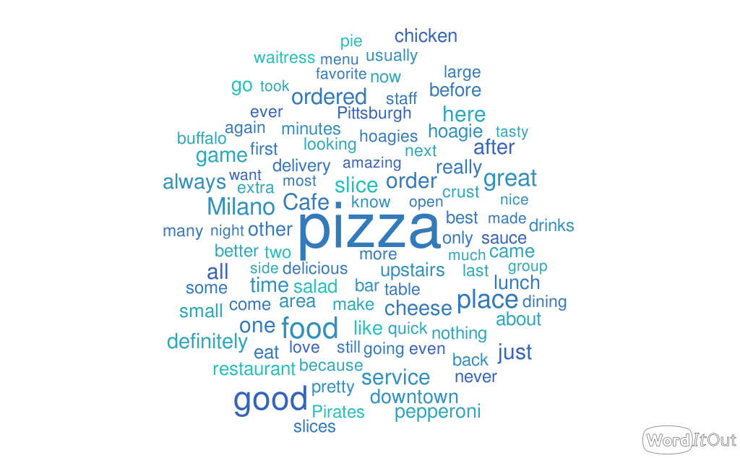
Sentiment Orientation of Words
Need a mechanism to get sentiment of object of interest across all Reviews
Attach Sentiment scores to words instead of Individual Reviews !

Slide 5
Random Walk
Approach for Sentiment Orientation of Words in Context
Semi Supervised Random walk with restarts
Build Positive and Negative graphs separately
Pos and Neg Labels Obtained using Sentiwordnet using words in Dataset
Sentiment of word = Sentiment of graph with higher score
Separately handled for R_{SIM} and R_{MIN}
Good
0.625
good
food
food
people
people
Terrible
0.625
answer
terrible
answer
POS Graph
NEG Graph
Edges : co-occuring words (same sentence words)
Edge Weights : Markov probabilities
Node Weights : Personalised for Labels

Slide 6

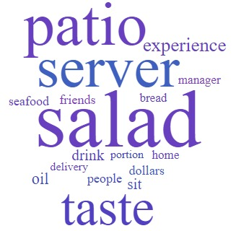
Improvements Selection
POSITIVE WORDS FROM R_{SIM}
NEGATIVE WORDS FROM R_{MIN}
Recommended Features for Montreal-Ville Marie-Pizza

Slide 7
Some Reviews...
Better Performing
“Great sit down pizza place on the Latin Quarter. Plenty of seating inside as well as in the outdoor patio.”
“My girlfriend and I came here and ordered some pizza. Service was great as was the food. Highly recommend. Nice area, quiet, and with a lovely patio.”
Inferior Performing
“There was only one server handling like the patio that had 4 tables filled with customers. By the time we got there all the other…”
“Tables were crowded, unkept and unorganized in the front patio. Was seated immediately by the staff. Given water menus and then told he'd return…”

Slide 8
Results
Used Accuracy Measure
Compared Sentiment score for a word with review star rating
Positive word -> rating >=3
Negative word -> rating <=3

Slide 9
Accuracy Measure
City-Neighborhood-Category | Accuracy
Montreal-Ville Marie-Pizza | 72.22
Cleveland-Goodrich Kirtland-Chinese | 71.84
Missisuaga-East Credit-Bars | 71.42
Pittsburg-Downtown-Italian | 65.59

Slide 10

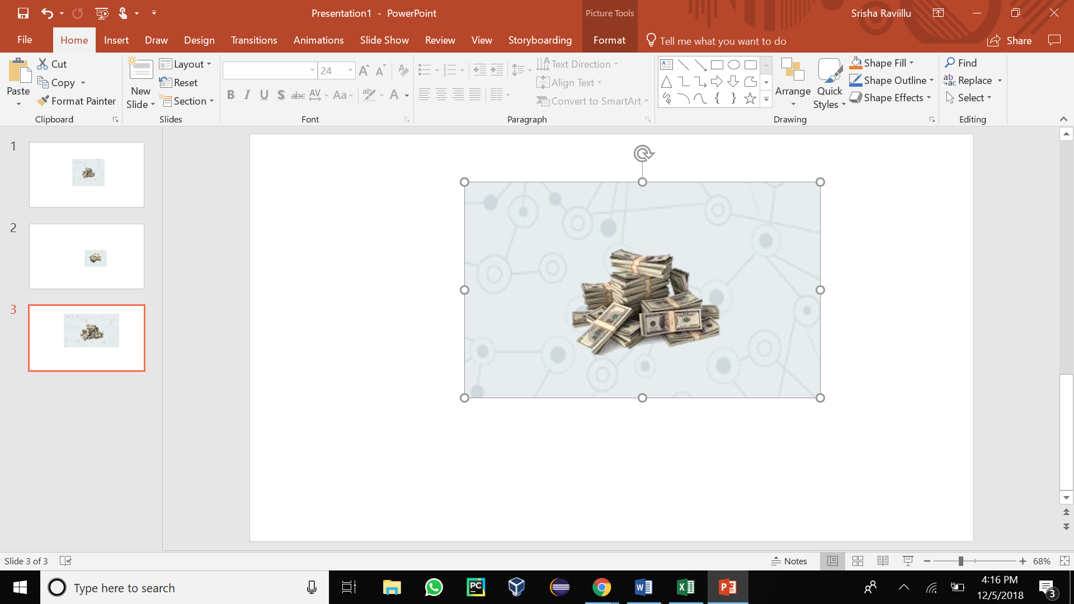

Conclusion and Future Work
Feature Recommendation
Better demarcation
Check accuracy with manually annotated reviews
Prioritize recent reviews, tips and ratings

Slide 11
References …
[1] Baccianella, Stefano, Andrea Esuli, and Fabrizio Sebastiani. ”Sentiwordnet 3.0: an enhanced lexical resource for sentiment analysis and opinion mining.” Lrec. Vol. 10. No. 2010. 2010.
[2] George A. Miller (1995). WordNet: A Lexical Database for English. Communications of the ACM Vol. 38, No. 11: 39-41.
[3] Mingzhi, Cheng, et al. ”A random walk method for sentiment classification.” Future Information Technology and Management Engineering, 2009. FITME’09. Second International Conference on. IEEE, 2009.
[4] Turney, Peter D., and Michael L. Littman. ”Unsupervised learning of semantic orientation from a hundred-billion-word corpus.” arXiv preprint cs/0212012 (2002).
[5] Hassan, Ahmed, et al. ”A random walk-based model for identifying semantic orientation.” Computational Linguistics 40.3 (2014): 539-562.
[6] Xu, Yunpeng, Xing Yi, and Changshui Zhang. ”A random walks method for text classification.” Proceedings of the 2006 SIAM International Conference on Data Mining. Society for Industrial and Applied Mathematics, 2006.

Slide 12
Thank You

