Slide 1
Computer vision Project
Facial Emotion Recognition
Problem Statement-> Develop a robust model to accurately classify facial expressions (e.g., happiness, sadness, anger etc.) in diverse real-world conditions. This system aims to enhance applications in mental health, human-computer interaction, and behavior analysis etc.
Shrey Srivastava
22303
About my Dataset->
1.) I have taken my dataset from Kaggle.
2.) My dataset has 35.9k files.
3.) My training data has 28821 images.
4.)My test data has 7066 images .
4.) Dataset has 7 classes (labels = {0 : 'angry', 1 : 'disgust', 2 : 'fear', 3 : 'happy', 4 : 'neutral', 5 : 'sad', 6 : 'surprise’}
5.) Each image I have converted in gray scale image with size of 48*48 .

Slide 2
MY approach towards this project->
Step1.) I have first prepared my dataset for applying different models like CNN and SVM etc. For example(encoding the target variable using Label Encoder).
Step2.) Then I have applied the CNN model (I will explain the working in next slides) . I have use Keras file to store the model info .
Step3.) Then I have found the Accuracy and Loss for CNN.
Step4.) Then I have applied the webcam using Haar Cascade to predict the expression of face in real time.
Step5.) Then I have applied HOG(to create the histogram of each feature vector) and SVM(to predict the class of pictures) . ( I have not applied webcam for SVM , QDA, LDA etc. because they are not performing well , I have used the individual photos to check the per.)
Step6.)I have found the performance and compare all the model over my dataset using confusion matrix , accuracy , precision and recall.
Lastly I found CNN doing best for my dataset.
Note-> In my CNN there are 19 layers.

Slide 3
How CNN is working in my code->
model.add(Input(shape=(48, 48, 1))) → Input shape: (48,48,1) means the input is a grayscale image (1 color channel) with a resolution of 48x48 pixels.
model.add(Conv2D(128, kernel_size=(3, 3), activation='relu’))→ Conv2D: Finds features in the image, like edges or corners. Activation(‘relu’): Helps the model learn complex patterns (if input < 0, it outputs 0; otherwise, keeps the value).
model.add(MaxPooling2D(pool_size=(2, 2)))-> Shrinks the image by taking the largest value in a 2x2 block. This makes the model faster and focuses on important features.
model.add(Dropout(0.4)) -> Drops 40% of the neurons randomly during training to prevent overfitting.
model.add(Dense(512, activation='relu’)) -> After flattening the image, these layers connect every neuron to every other neuron. Dense(512): Means 512 neurons to process all learned features.
model.add(Dense(7, activation='softmax’)) -> 7 neurons: The number of categories (e.g., 7 emotions if this is a facial emotion classifier). Softmax: Converts the output into probabilities. If the output is[0.2,0.7,0.1], it predicts the second category (70%).
Summary-> The CNN processes a grayscale image (48x48) through convolutional layers to extract features, pooling layers to reduce size, and fully connected layers for classification, resulting in 7 output categories. It has 4,232,199 trainable parameters, which are updated during training to learn patterns. The model uses dropout to prevent overfitting and ensures efficient learning of complex image data.

Slide 4
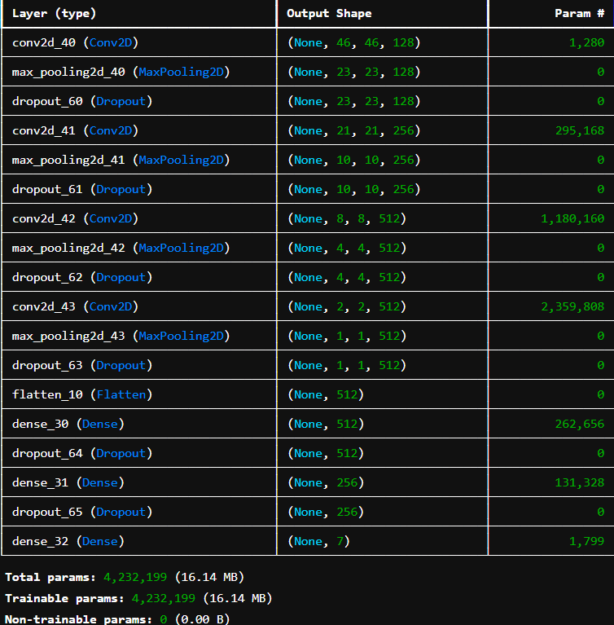
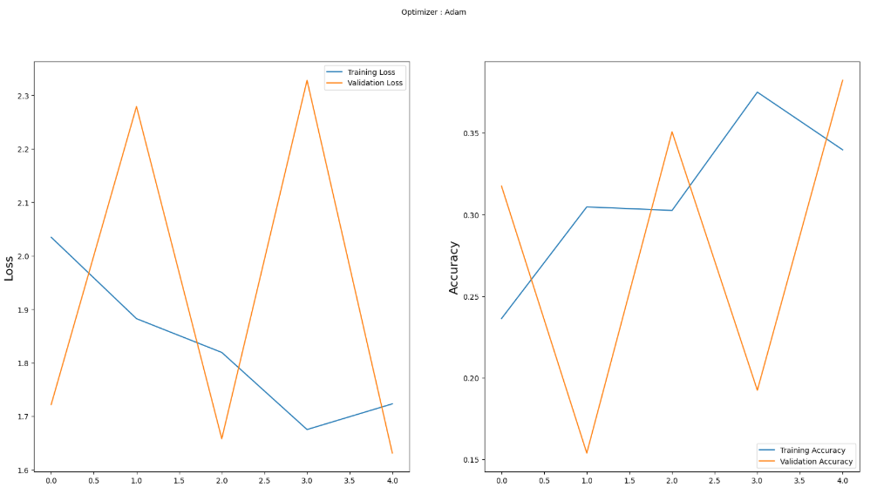
Plotting Accuracy and Loss for CNN , summary table for CNN and also output photos of webscam by applying CNN ->
The training curves suggest that my CNN is learning the training data well but struggling to generalize to the validation data. The sharp oscillations in validation metrics point to potential overfitting, unstable training, or data-related issues. Applying regularization techniques, fine-tuning the learning rate, and improving data preprocessing can help stabilize training and enhance performance on unseen data.

Slide 5
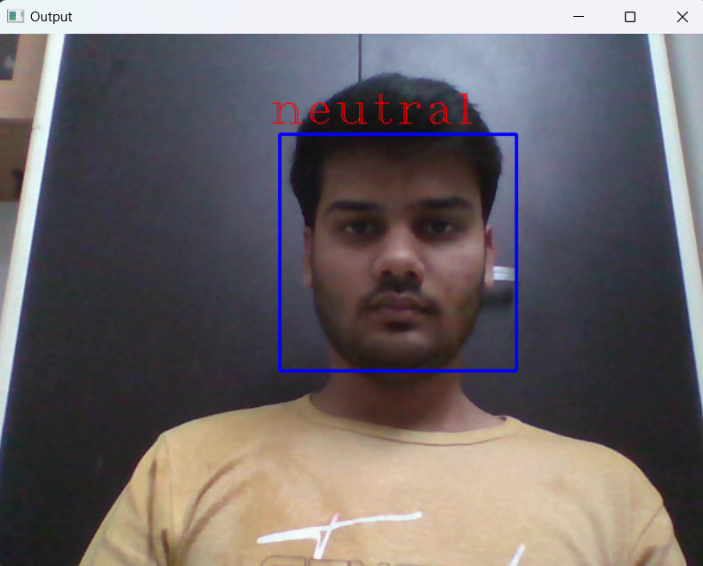
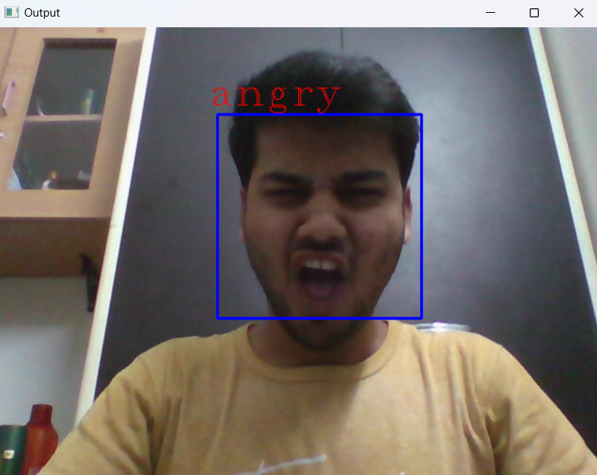
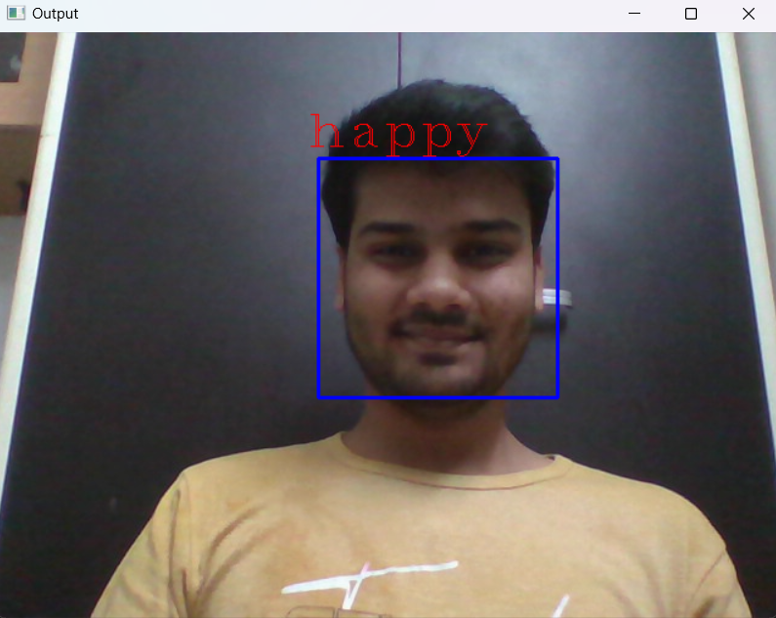
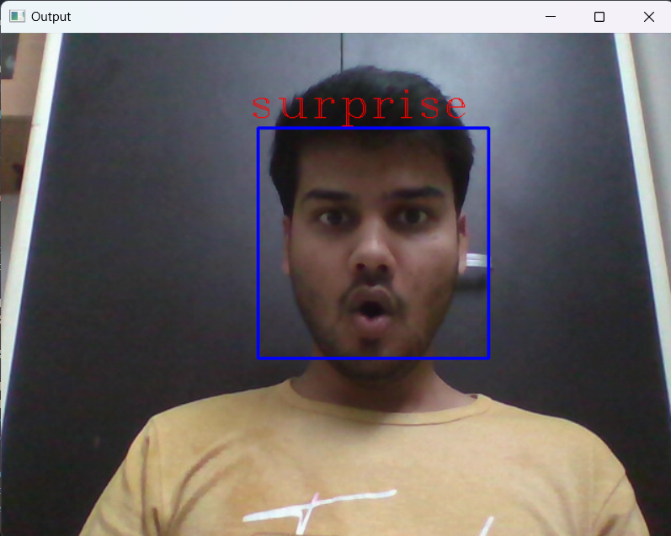
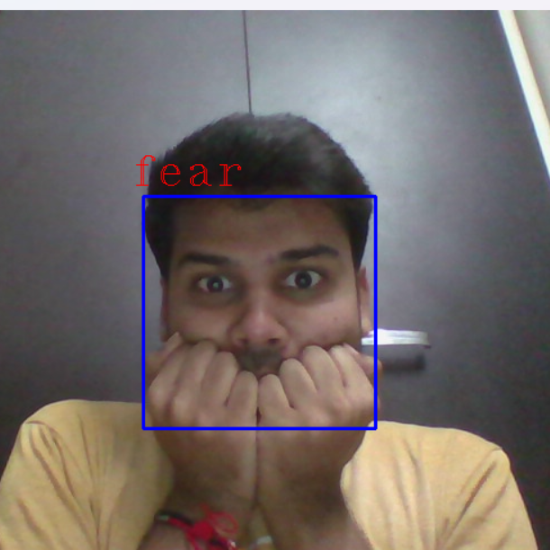
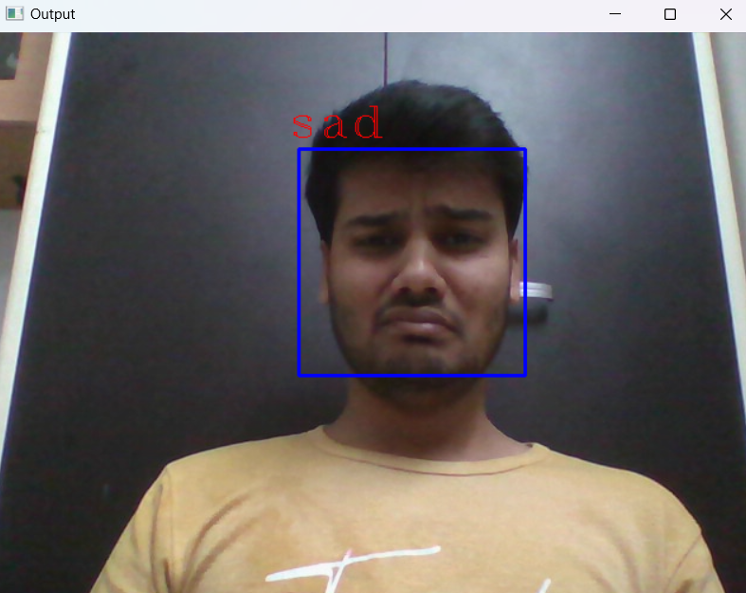
Outputs of Facial Expression Recognition using WebScam by CNN->
Angry
Happy←
→Neutral
Fear
Sad←
→Surprise

Slide 6
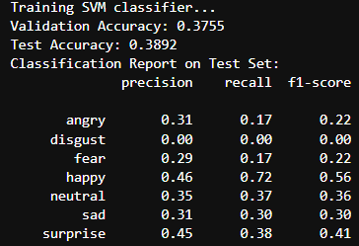
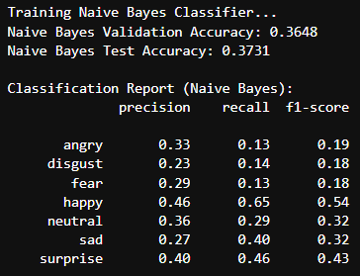
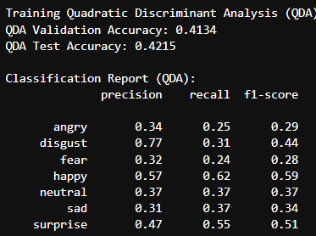
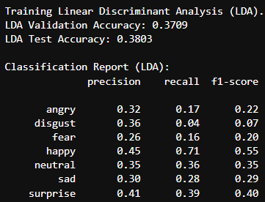
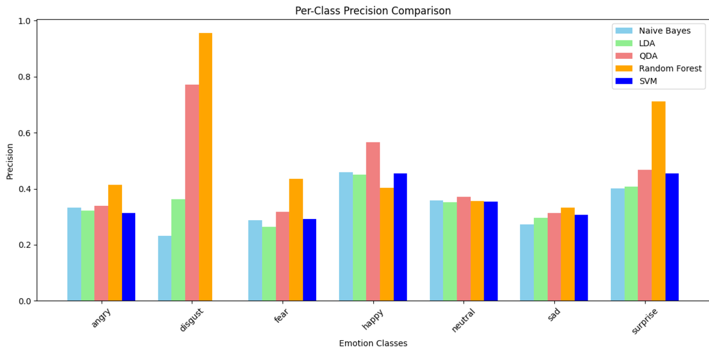
Other models other than CNN →
I have applied SVM, LDA, QDA, Naïve baye’s also
These are the performance chart all the other models I have tried to ensure that is there any model which is better than CNN , We can analyze from the given results of these classifier models that they are giving very low accuracy. Hence, I have not used any of these models to train my dataset and do the prediction of for the different image with respective of their clasess.

