Slide 1

Snake Game Presentation
CSB 101 Project
Guide:
Dr. Chandra Prakash
Subject Teacher
Presented By :
1. Vishal Singh (201210055)
2. Shrey Kumar Prajapati(201210041)
March 2020
NIT Delhi
*
Notes:
*
Chandra prakash
RAMAN LAB

Slide 2
Snake Game Project
Problem statement
Solution Proposed
  Advantages
About Program
  Environment setup/ used
  Functions used / created
Result / Outcome
My Learning / Problem Faced
Future Work
Demo
NIT Delhi

Slide 3
Problem statement
Develop a snake game using the concepts taught in the Problem Solving and Programming course in C language.
NIT Delhi
*

Slide 4
Solution Proposed
For creating any application It is important to identify the key features of that application and then write code for those key features.
In this project also we completed the project using following approach:
First made a rough approach to all steps involved in Game
Creating several small functions for that approach.
Integrating these functions to create the game as a whole.
NIT Delhi

Slide 5
ADVANTAGES OF OUR APPROACH
Easy and quick testing of individual functions
Easy debugging of the code
Easy to understand code
Created functions can be used to make new games!!
NIT Delhi

Slide 6
About Program
Our Snake Game Starts in a story line that our snake has lost, from his parents. Now in this game you are snake. You try to complete different stages. And finaly meet your family.
NIT Delhi
*

Slide 7
MAJOR CONCEPTS USED
FUNCTIONS
POINTERS
ARRAYS
MEMORY ALLOCATION TECHNIQUES
GRAPHICS
NIT Delhi

Slide 8
Environment USED
We had used Code Blocks IDE.
2. Graphics.h
NIT Delhi

Slide 9
FUNCTIONS USED
a. startSetup: This function welcome the player and set initials of Game.
b. setLevel: This function comes into play after player completed a level it increases the level when food condition full fill. And greets the player for completing the level.
c. theame: This function is created to set theme of game according to different levels . Different levels have different background and boundary theme in this game.
d. foodGenerate: This function generates new food when snake eats the food and increases score by one.
e. drawSnake: This function is created to draw the snake and inherit direction to all its parts.
NIT Delhi

Slide 10
FUNCTIONS USED
f. levelSpeed: It is a simple function created to set speed according to different levels.
g. input: This function allows user to give input for snake direction.
h. directionLogic: This function uses the input given by user and set snake direction.
i. diedCondition: This function checks whether player has died or not.
j. endFunc: This function gives the reason for losing the game and show score you got and the level you reached.
k. winFUNCTION: This function comes into play when the player clears all the 5 levels and hence completes the game. It displays congratulation message with a Smiley face.
NIT Delhi

Slide 11
ERRORS
Including Graphics.h :- In c language non of the idE’s provided this library by default. So, we got a error (graphics.h not found). We explored over google and downloaded codeblocks and downloaded graphics.h library to fix this issue.
Dereferencing: In the game there were lot of use of pointers and scanf statements. But sometimes the pointers store old values which caused some logical errors in game. So, we used fflush() to dereference the pointers which fixed this issue. Input stream from user was also stored and removed successfully using fflush().
Getch() :- On using this a popup window opens up stating that accessing drawing object when no current window opened. This problem was also sorted using fflush().
4. Error in declaring variables globally was solved by using pointers.
NIT Delhi

Slide 12
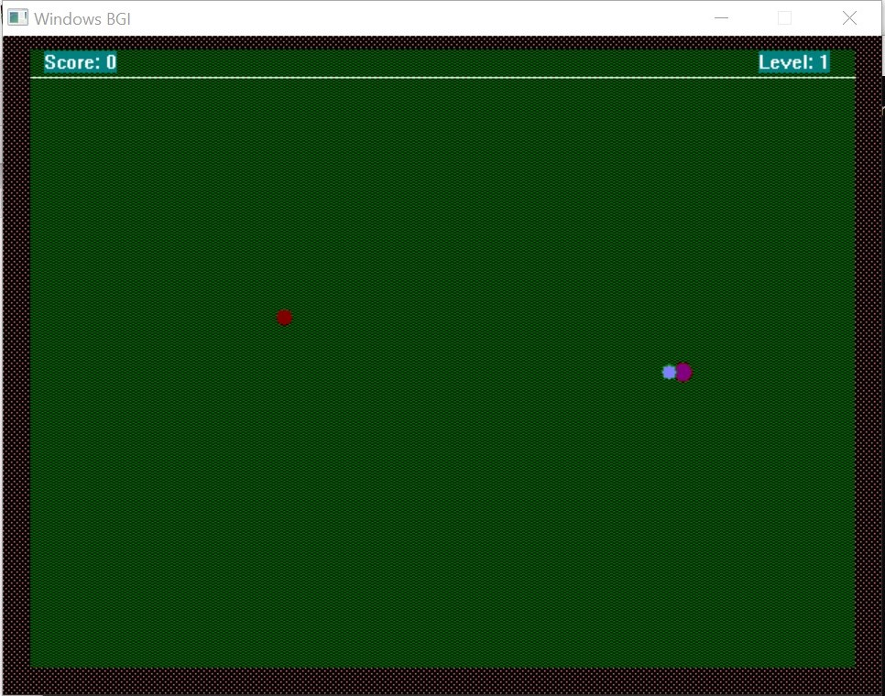
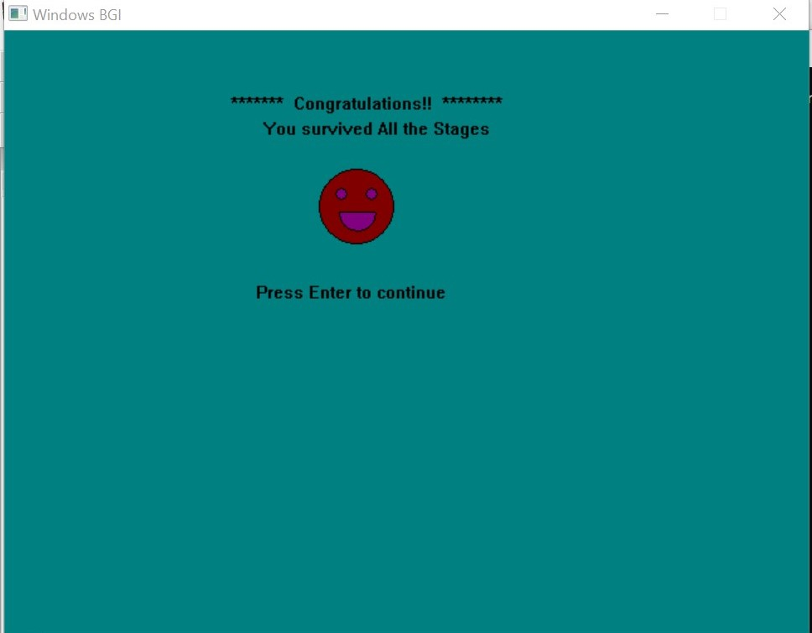
Resut/ Outcome
A well functioning game !!!
NIT Delhi
*

Slide 13
My Learning
LEARNED BASIC CONCEPTS OF GAMING.
LEARNED GRAPHICS.H
LEARNED DEBBUGING OF PROGRAMMES.
NIT Delhi

Slide 14
Future Work
GAME DEVELOPMENT WITH ADVANCED GRAPHICS
MORE USER FRIENDLY VERSION OF THIS GAME
UPDATING FEATURES LIKE MORE LEVELS AND LEVELS WISE AMOUNT OF FOOD EATING.
NIT Delhi
*

Slide 15
References
1. Youtube: https://www.youtube.com/watch?v=VEkAj-xVTKQ&t=14s
2. Google: For exploring several new functions in C like fflush and setfillstyle.
3. Geekforgeeks: For getting information and help to debug the code for game.
4. StackOverflow: Used this site for resolving many errors.
5. Concepts taught in this course
NIT Delhi
*

Slide 16
THANK YOU!!!!
NIT Delhi
*

