Slide 1
Signal and System (ECE210) Faculty – Prof. Ashok Ranade

Slide 2
LOSSY AUDIO COMPRESSION USING LPC (Linear Predictive Coding)
Roll No | Name of the student | Name of the program
AU1940110 | Shrey Patel | B-tech CSE
AU1940155 | Shubham Patel | B-tech CSE
AU1940137 | Tirth Patel | B-tech CSE
AU1940269 | Axay Ghoghari | B-tech CSE
 | GROUP 21

Slide 3
OBJECTIVE
Aim of this project is to compress speech signal.
To perform audio compression we used Linear Predictive coding.
Linear Predictive Coding is lossy compression technique that means if we want more compression then some data will be lost accordingly but the output audio will be understandable by human.

Slide 4
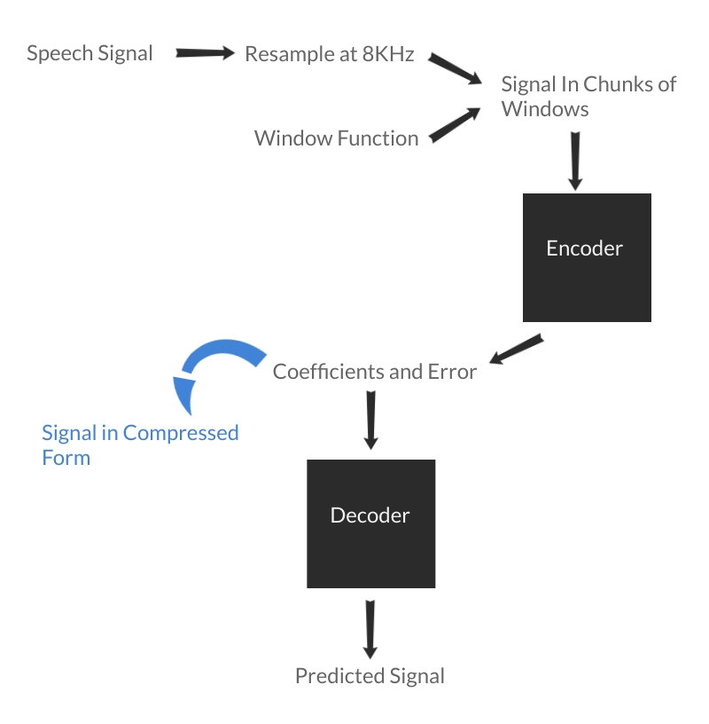
FLOWCHART

Slide 5
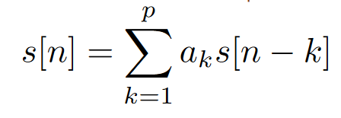
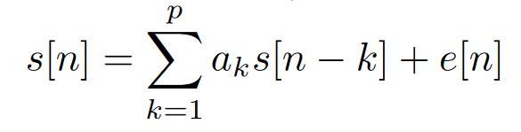
LPC Analysis
In LPC we try to find the current value of signal by linear combination of past values.
We know the signal values at all instant. We need to find the coefficients a_k (for 1 ≤ k ≤ p).
Since it is not necessary that very time it will be possible. There will be some error. We try to minimize that error and find coefficients.

Slide 6
LPC Synthesis
We are given coefficients a_k and error(e). We need to synthesize the signal.
The error is given excitation by random noise.
From the above equation we can easily find the s[n] for every value of n.

Slide 7
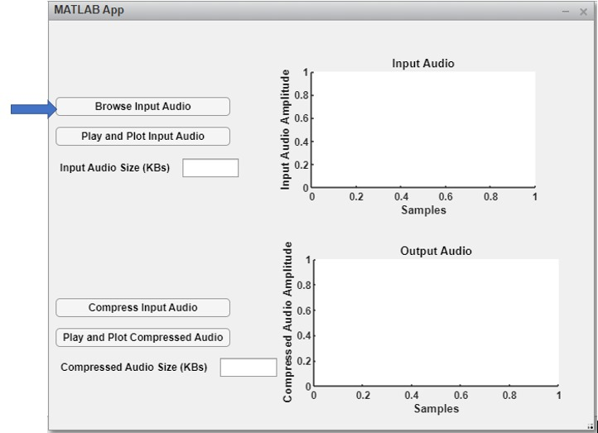
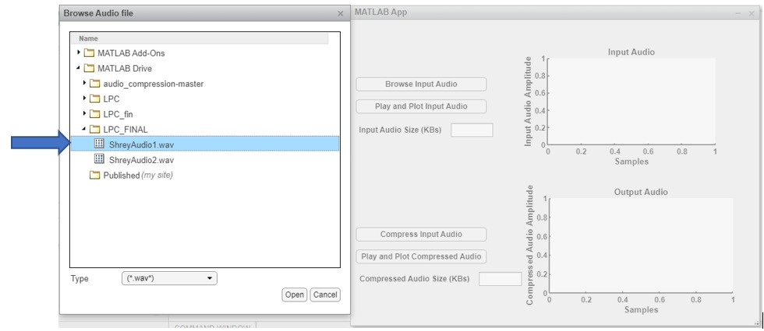
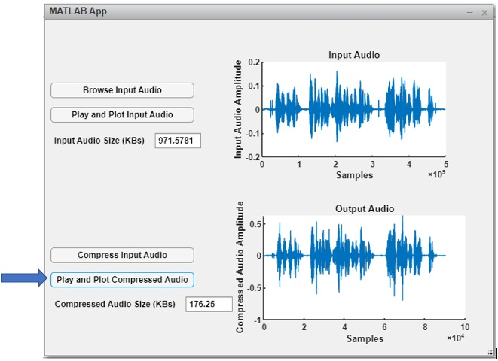
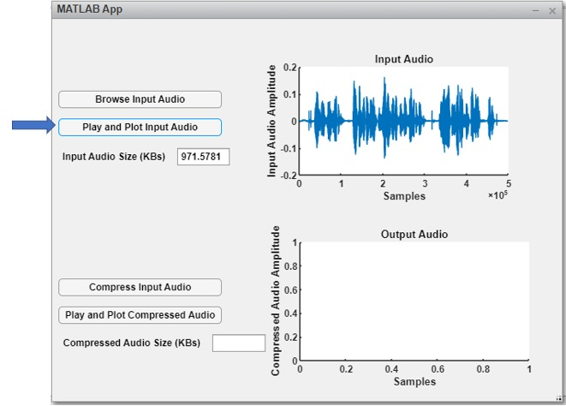
USER INTERFACE

Slide 8
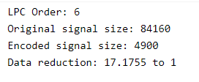
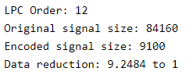
Compression
We got the following result when we compressed the signal with LPC order 6 and 12.

Slide 9
Linear Predictive Coding is an analysis/synthesis technique for lossy speech compression which models the speech instead of estimating it.
Generally, it achieves low bit rate from 1200 bits/second to 8000 bits/second which makes it ideal to use in telephone systems.
Telephone systems are more concerned about the content and meaning of speech being preserved, rather than the quality of speech.

Slide 10
CONCLUSION
From our results we saw that by decreasing the LPC order or the number of coefficients we can get very good compression ratios.
But the quality of the signal reduces and it becomes harder to understand the speech in it.
We tried different Order and at last selected order 12 which almost reduced the size to 1/10th of the input signal.
We learnt about the speech signals and how they are different from the normal audio signals.

