Slide 1
Real-Time Sign Language Recognition System Using LSTM and MediaPipe
Shreyas Shinde
FINX Institute
Academic Session: 2023-2026
Notes:
1

Slide 2
The Challenge
Sign language is a fundamental communication medium for individuals with hearing and speech impairments. Traditional sign language interpretation relies on human interpreters, which are scarce and expensive. This creates persistent accessibility barriers for millions of users worldwide. The need for real-time, automated sign language translation systems is critical for bridging communication gaps.
Notes:
2

Slide 3

Our Solution
This project presents a real-time sign language recognition system that integrates three core technologies:
MediaPipe
LSTM
OpenCV
01
02
03
MediaPipe Holistic
LSTM Neural Networks
OpenCV
for extracting 258-dimensional skeletal keypoint features from video frames
for capturing temporal dependencies in gesture sequences
for real-time video processing and inference
The system operates on standard CPU hardware without specialized peripherals, making it accessible for real-world deployment.
Notes:
3

Slide 4
Data Collection Pipeline
The system uses MediaPipe Holistic to extract pose and hand landmarks from webcam video. Facial landmarks are intentionally excluded to reduce dimensionality and focus on hand/arm movements.
Feature Vector Generation
Dataset Collection Scale
Incremental Expansion
60 sequences of 40 frames per gesture class.
Hierarchical directory structure supports incremental expansion - new gestures can be added without reprocessing existing data.
Each frame generates a 258-dimensional feature vector (132 pose values + 63 left hand + 63 right hand).
Notes:
4

Slide 5
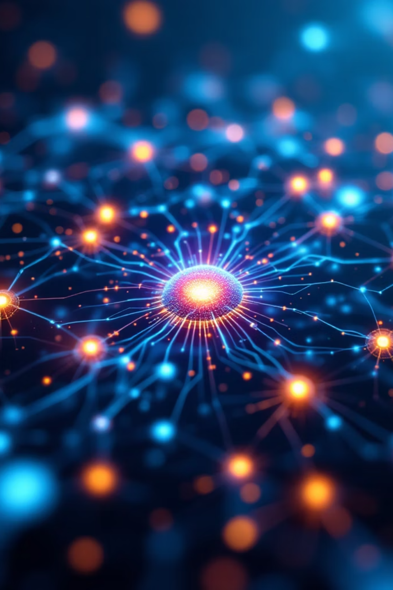
Neural Network Design
The gesture classification model uses a stacked LSTM architecture designed to capture temporal dependencies across gesture sequences.
01
02
Input layer
LSTM Layer 1
(40 frames × 258 features)
(64 units, returns sequences)
03
04
LSTM Layer 2
LSTM Layer 3
(128 units, returns sequences)
(64 units)
05
06
Dense Layer 1
Dense Layer 2
(ReLU activation)
(ReLU activation)
07
Output Layer
(Softmax, number of gesture classes)
Total trainable parameters: 237,383. Optimizer: Adam with categorical cross-entropy loss.
Notes:
5

Slide 6

Model Training & Performance
Training Configuration
Results
80/20 train-validation split.
EarlyStopping with patience of 30 epochs to prevent overfitting.
Maximum training duration: 200 epochs.
98.81%
Validation Accuracy
Training dynamics show consistent reduction in both training and validation loss across epochs. Close alignment between training and validation curves indicates minimal overfitting. The dimensionality reduction strategy (258 features vs. 1662 full MediaPipe) did not compromise model capacity to learn discriminative temporal patterns.
Notes:
6

Slide 7



Live Gesture Recognition
Real-time inference pipeline
Performance metrics
Rolling keypoint buffer
Frame processing rate
accumulates 40 consecutive frames. Once buffer reaches capacity, sequence is passed to LSTM model for prediction.
24-30 FPS on standard laptop CPU.
No-hands detection
Confidence threshold
When no hand landmarks are detected, prediction buffer resets automatically to prevent stale predictions from influencing output.
0.70 (reduced from 0.85 to accommodate expanded vocabulary).
Temporal consistency filter
Visual overlays
requires agreement across 10 consecutive frames to suppress noise.
display predicted gesture label and confidence score in real-time.
Notes:
7

Slide 8

Limitations & Future Work
Current Limitations
Recognition accuracy decreases
Gestures not in training dataset
System does not explicitly address signer independence
under poor lighting conditions due to reduced landmark detection reliability.
are mapped to closest learned class - no unknown gesture detection mechanism.
performance may vary across users with different hand shapes, motion styles, or gesture speeds.
Dataset size of 60 sequences per class is modest
Inter-class confusion observed
and may limit generalization in diverse real-world scenarios.
among gesturally similar signs.
Future Improvements
Larger datasets
Domain adaptation techniques
Transformer-based sequence models
Data augmentation strategies
Notes:
8

Slide 9
Project Contributions
This project makes several important contributions to sign language recognition research:
Dimensionality Reduction
1
Demonstrates that 258-dimensional feature vectors (pose + hand landmarks only) achieve comparable performance to 1662-dimensional full MediaPipe representation while reducing computational complexity.
Incremental Dataset Design
2
Modular data collection pipeline enables new gesture classes to be added without reprocessing existing data, supporting continuous system evolution.
Real-time Deployment
3
Achieves 24-30 FPS on consumer-grade CPU hardware without specialized peripherals, making the system accessible for practical deployment.
Accessibility Focus
4
Bridges communication gaps for deaf and hard-of-hearing communities through automated, affordable sign language translation.
Scalable Architecture
5
System design supports vocabulary expansion and model refinement as additional gestures are collected.
Notes:
9

Slide 10
Conclusion
This project successfully demonstrates a practical, real-time sign language recognition system that combines MediaPipe-based landmark extraction with stacked LSTM neural networks. Key achievements:
98.81% Validation Accuracy
24-30 FPS Real-time Performance
Modular Incremental Dataset Design
Accessibility-Focused Implementation
The system proves that robust gesture recognition can be achieved through careful integration of computer vision, temporal deep learning, and efficient system design. Impact: By eliminating dependence on specialized hardware and enabling real-time inference on consumer devices, this project advances practical deployment of accessible sign language translation technologies. Future work will focus on expanding gesture vocabulary, improving robustness across diverse signers, and exploring advanced architectures like transformers. This contributes to both assistive technology development and broader research in intelligent visual interaction systems.
Notes:
10

